Slide 1
On Hardness Assumptions Needed for “Extreme High-End” PRGs and Fast Derandomization
Ronen Shaltiel University of Haifa
Emanuele Viola Northeastern University

Slide 2
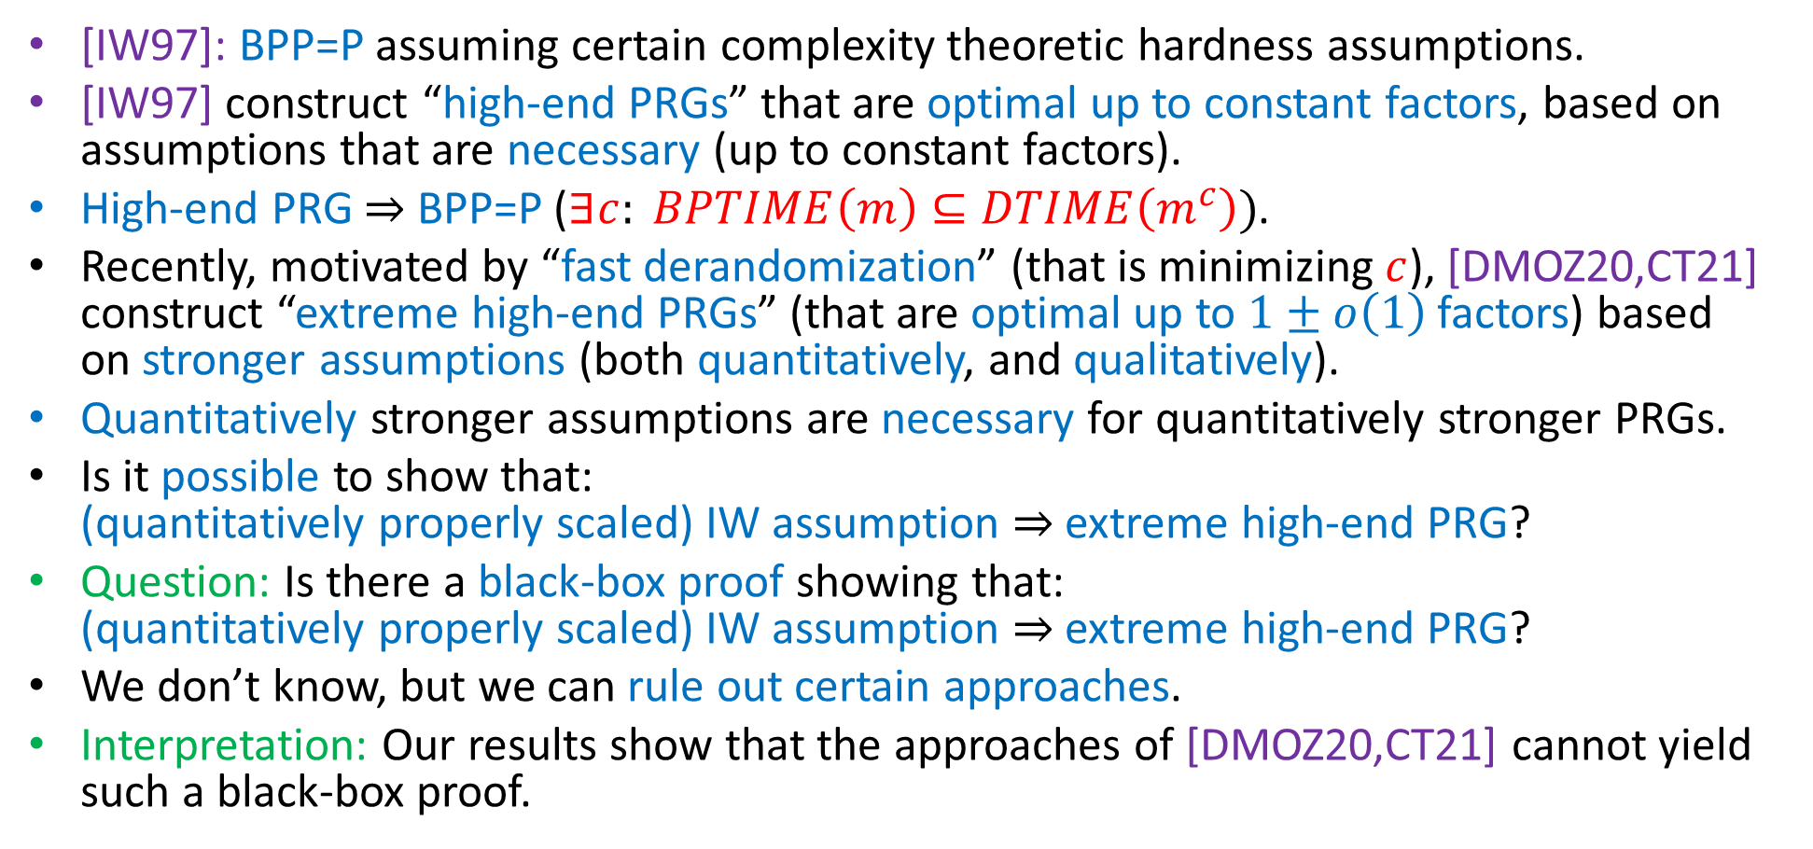
Summary and Outline
[IW97]: BPP=P assuming certain complexity theoretic hardness assumptions.
[IW97] construct “high-end PRGs” that are optimal up to constant factors, based on assumptions that are necessary (up to constant factors).
High-end PRG $⇒$ BPP=P ($∃c: BPTIME\left(m\right)⊆DTIME\left(m^{c}\right))$.
Recently, motivated by “fast derandomization” (that is minimizing $c$), [DMOZ20,CT21] construct “extreme high-end PRGs” (that are optimal up to $1±o\left(1\right)$factors) based on stronger assumptions (both quantitatively, and qualitatively).
Quantitatively stronger assumptions are necessary for quantitatively stronger PRGs.
Is it possible to show that: (quantitatively properly scaled) IW assumption $⇒$ extreme high-end PRG?
Question: Is there a black-box proof showing that: (quantitatively properly scaled) IW assumption $⇒$ extreme high-end PRG?
We don’t know, but we can rule out certain approaches.
Interpretation: Our results show that the approaches of [DMOZ20,CT21] cannot yield such a black-box proof.

Slide 3
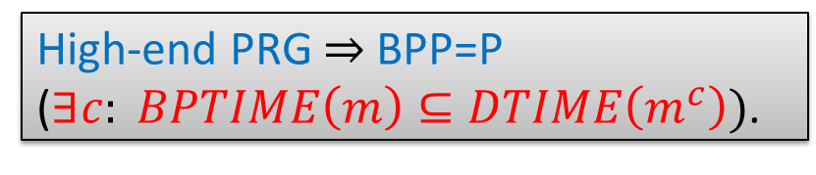
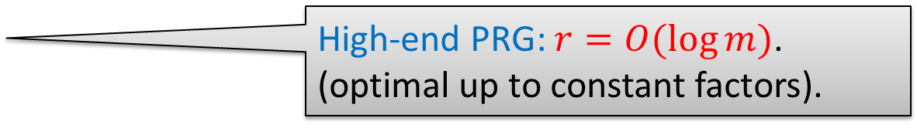
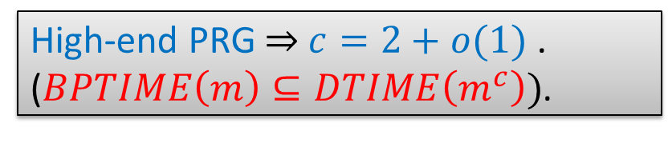

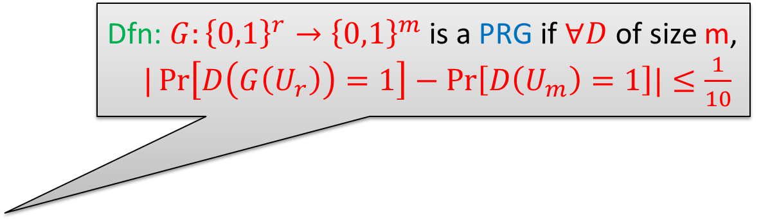
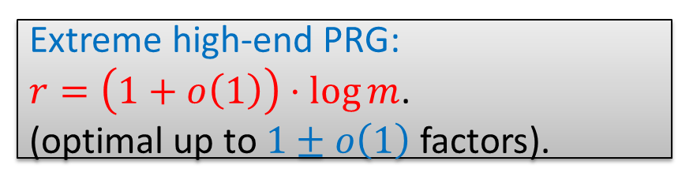
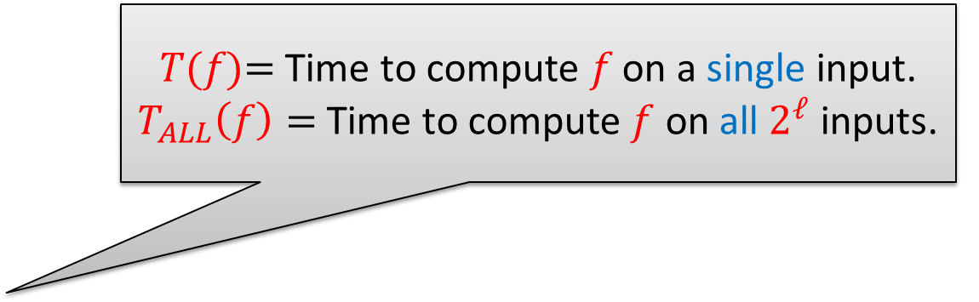
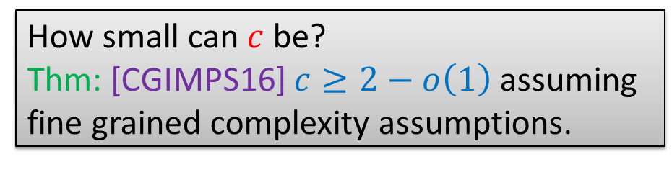
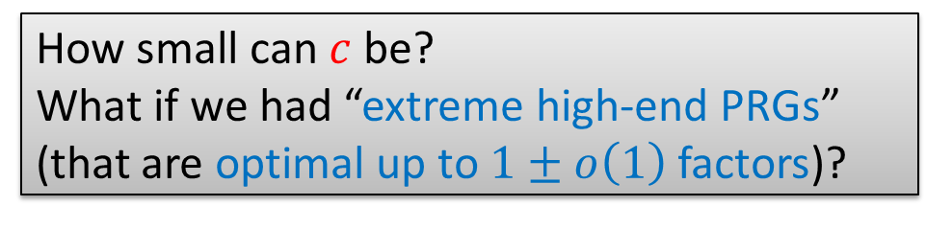
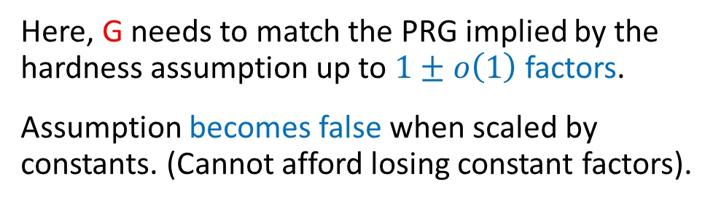

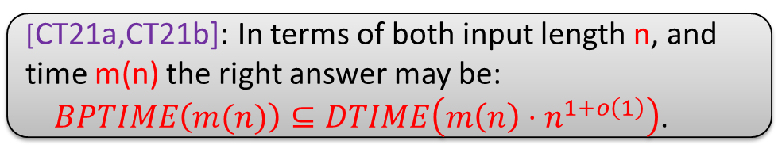
Hardness vs. Randomness (state of the art)
Extreme high-end PRG:
$r=\left(1+o\left(1\right)\right)⋅\log{m}$.
(optimal up to $1±o\left(1\right)$ factors).
High-end: Thm [IW97]:
𝑇(𝑓)= Time to compute 𝑓 on a single input.
$T_{ALL}\left(f\right)=$Time to compute $f$ on all $2^{ℓ}$ inputs.
Extreme high-end: Open problem, show that:
High-end IW hardness assumption:
Exists $f:{\left\{0,1\right\}}^{ℓ}→\left\{0,1\right\}$ s.t.
  $f$ not computable by size $2^{Ω(ℓ)}$ circuits.
  $T\left(f\right)=2^{O\left(ℓ\right)}{⇔T}_{ALL}\left(f\right)=2^{O\left(ℓ\right)}.$
Implies high-end PRG:
$G:{\left\{0,1\right\}}^{r=O(ℓ{) }}→{\left\{0,1\right\}}^{m=2^{Ω(ℓ)}}$
  with $T\left(G\right)=2^{O\left(ℓ\right)}{⇔T}_{ALL}\left(G\right)=2^{O\left(ℓ\right)}.$
Extreme high-end IW hardness assumption:
Exists $f:{\left\{0,1\right\}}^{ℓ}→\left\{0,1\right\}$ s.t.
  $f$ not computable by size $2^{\left(1−o\left(1\right)\right)⋅ℓ}$ circuits.
  $T_{ALL}\left(f\right)=2^{\left(2+o\left(1\right)\right)⋅ℓ}.$
Implies extreme high-end PRG:
$G:{\left\{0,1\right\}}^{r=\left(1+o\left(1\right)\right)⋅ℓ{ }}→{\left\{0,1\right\}}^{m=2^{\left(1−o\left(1\right)\right)⋅ℓ}}$
  with $T_{ALL}\left(G\right)=2^{\left(2+o\left(1\right)\right)⋅ℓ}$.
Dfn: $G:{\left\{0,1\right\}}^{r}→{\left\{0,1\right\}}^{m}$ is a PRG if $∀D$ of size m,
$|\operatorname{Pr}\left[D\left(G\left(U_{r}\right)\right)=1\right]−\operatorname{Pr}\left[D\left(U_{m}\right)=1\right]|≤\frac{1}{10}$
High-end PRG $⇒$ $c=2+o(1)$ .
($BPTIME\left(m\right)⊆DTIME\left(m^{c}\right))$.
High-end PRG: $r=O(\log{m)}$.
(optimal up to constant factors).
How small can $c$ be?
Thm: [CGIMPS16] $c≥2−o\left(1\right)$ assuming fine grained complexity assumptions.
High-end PRG $⇒$ BPP=P
($∃c: BPTIME\left(m\right)⊆DTIME\left(m^{c}\right))$.
[IW97] G matches the PRG implied by the hardness assumption up to constant factors.
Assumption remains plausible when scaled by constants. (Can afford losing constant factors).
Here, G needs to match the PRG implied by the hardness assumption up to $1±o\left(1\right)$factors.
Assumption becomes false when scaled by constants. (Cannot afford losing constant factors).
How small can $c$ be?
What if we had “extreme high-end PRGs” (that are optimal up to $1±o\left(1\right)$factors)?
[CT21a,CT21b]: In terms of both input length n, and time m(n) the right answer may be: $BPTIME\left(m(n)\right)⊆DTIME\left({m\left(n\right)⋅n}^{1+o\left(1\right)}\right)$.

Slide 4
The cost of the hybrid argument
High-end: Thm [IW97]:
Extreme high-end: Open problem, show that:
High-end IW hardness assumption:
Exists $f:{\left\{0,1\right\}}^{ℓ}→\left\{0,1\right\}$ s.t.
  $f$ not computable by size $2^{Ω(ℓ)}$ circuits.
  $T\left(f\right)=2^{O\left(ℓ\right)}{⇔T}_{ALL}\left(f\right)=2^{O\left(ℓ\right)}.$
Implies high-end PRG:
$G:{\left\{0,1\right\}}^{r=O(ℓ{) }}→{\left\{0,1\right\}}^{m=2^{Ω(ℓ)}}$
  with $T\left(G\right)=2^{O\left(ℓ\right)}{⇔T}_{ALL}\left(G\right)=2^{O\left(ℓ\right)}.$
Extreme high-end IW hardness assumption:
Exists $f:{\left\{0,1\right\}}^{ℓ}→\left\{0,1\right\}$ s.t.
  $f$ not computable by size $2^{\left(1−o\left(1\right)\right)⋅ℓ}$ circuits.
  $T_{ALL}\left(f\right)=2^{\left(2+o\left(1\right)\right)⋅ℓ}.$
Implies extreme high-end PRG:
$G:{\left\{0,1\right\}}^{r=\left(1+o\left(1\right)\right)⋅ℓ{ }}→{\left\{0,1\right\}}^{m=2^{\left(1−o\left(1\right)\right)⋅ℓ}}$
  with $T_{ALL}\left(G\right)=2^{\left(2+o\left(1\right)\right)⋅ℓ}$.
[IW97] and later proofs [STV99,SU01,U02] use “Hardness Amplification + Hybrid Argument”.
This (as well as other issues) results in losses of constant factors (that we can afford).
Here, we cannot afford the losses incurred by “Hardness Amplification + Hybrid Argument”.
[DMOZ20,CT21] bypass this barrier and give extreme high-end PRGs, albeit under qualitatively stronger assumptions (that we now survey).

Slide 5


The PRG of [DMOZ20]: Assume also that $f$ is hard for circuits equipped with nondeterminism and randomness
High-end: Thm [IW97]:
Extreme high-end: Open problem, show that:
Thm [DMOZ20]:
High-end IW hardness assumption:
Exists $f:{\left\{0,1\right\}}^{ℓ}→\left\{0,1\right\}$ s.t.
  $f$ not computable by size $2^{Ω(ℓ)}$ circuits.
  $T\left(f\right)=2^{O\left(ℓ\right)}{⇔T}_{ALL}\left(f\right)=2^{O\left(ℓ\right)}.$
Implies high-end PRG:
$G:{\left\{0,1\right\}}^{r=O(ℓ{) }}→{\left\{0,1\right\}}^{m=2^{Ω(ℓ)}}$
  with $T\left(G\right)=2^{O\left(ℓ\right)}{⇔T}_{ALL}\left(G\right)=2^{O\left(ℓ\right)}.$
Extreme high-end IW hardness assumption:
Exists $f:{\left\{0,1\right\}}^{ℓ}→\left\{0,1\right\}$ s.t.
  $f$ not computable by size $2^{\left(1−o\left(1\right)\right)⋅ℓ}$ circuits
  $T_{ALL}\left(f\right)=2^{\left(2+o\left(1\right)\right)⋅ℓ}.$
Implies extreme high-end PRG:
$G:{\left\{0,1\right\}}^{r=\left(1+o\left(1\right)\right)⋅ℓ{ }}→{\left\{0,1\right\}}^{m=2^{\left(1−o\left(1\right)\right)⋅ℓ}}$
  with $T_{ALL}\left(G\right)=2^{\left(2+o\left(1\right)\right)⋅ℓ}$.
that are also equipped with nondeterminism and randomness
[IW97] and later proofs [STV99,SU01,U02] use “Hardness Amplification + Hybrid Argument”.
This (as well as other issues) results in losses of constant factors (that we can afford).
Here, we cannot afford the losses incurred by “Hardness Amplification + Hybrid Argument”.
[DMOZ20,CT21] bypass this barrier and give extreme high-end PRGs, albeit under qualitatively stronger assumptions (that we now survey).

Slide 6
The PRG of [CT21]: Assume also that one-way functions exist
High-end: Thm [IW97]:
Extreme high-end: Open problem, show that:
Thm [CT21]:
High-end IW hardness assumption:
Exists $f:{\left\{0,1\right\}}^{ℓ}→\left\{0,1\right\}$ s.t.
  $f$ not computable by size $2^{Ω(ℓ)}$ circuits.
  $T\left(f\right)=2^{O\left(ℓ\right)}{⇔T}_{ALL}\left(f\right)=2^{O\left(ℓ\right)}.$
Implies high-end PRG:
$G:{\left\{0,1\right\}}^{r=O(ℓ{) }}→{\left\{0,1\right\}}^{m=2^{Ω(ℓ)}}$
  with $T\left(G\right)=2^{O\left(ℓ\right)}{⇔T}_{ALL}\left(G\right)=2^{O\left(ℓ\right)}.$
Extreme high-end IW hardness assumption:
Exists $f:{\left\{0,1\right\}}^{ℓ}→\left\{0,1\right\}$ s.t.
  $f$ not computable by size $2^{\left(1−o\left(1\right)\right)⋅ℓ}$ circuits.
  $T_{ALL}\left(f\right)=2^{\left(2+o\left(1\right)\right)⋅ℓ}.$
Implies extreme high-end PRG:
$G:{\left\{0,1\right\}}^{r=\left(1+o\left(1\right)\right)⋅ℓ{ }}→{\left\{0,1\right\}}^{m=2^{\left(1−o\left(1\right)\right)⋅ℓ}}$
  with $T_{ALL}\left(G\right)=2^{\left(2+o\left(1\right)\right)⋅ℓ}$.
and in addition that one-way functions exist.
[IW97] and later proofs [STV99,SU01,U02] use “Hardness Amplification + Hybrid Argument”.
This (as well as other issues) results in losses of constant factors (that we can afford).
Here, we cannot afford the losses incurred by “Hardness Amplification + Hybrid Argument”.
[DMOZ20,CT21] bypass this barrier and give extreme high-end PRGs, albeit under qualitatively stronger assumptions (that we now survey).

Slide 7
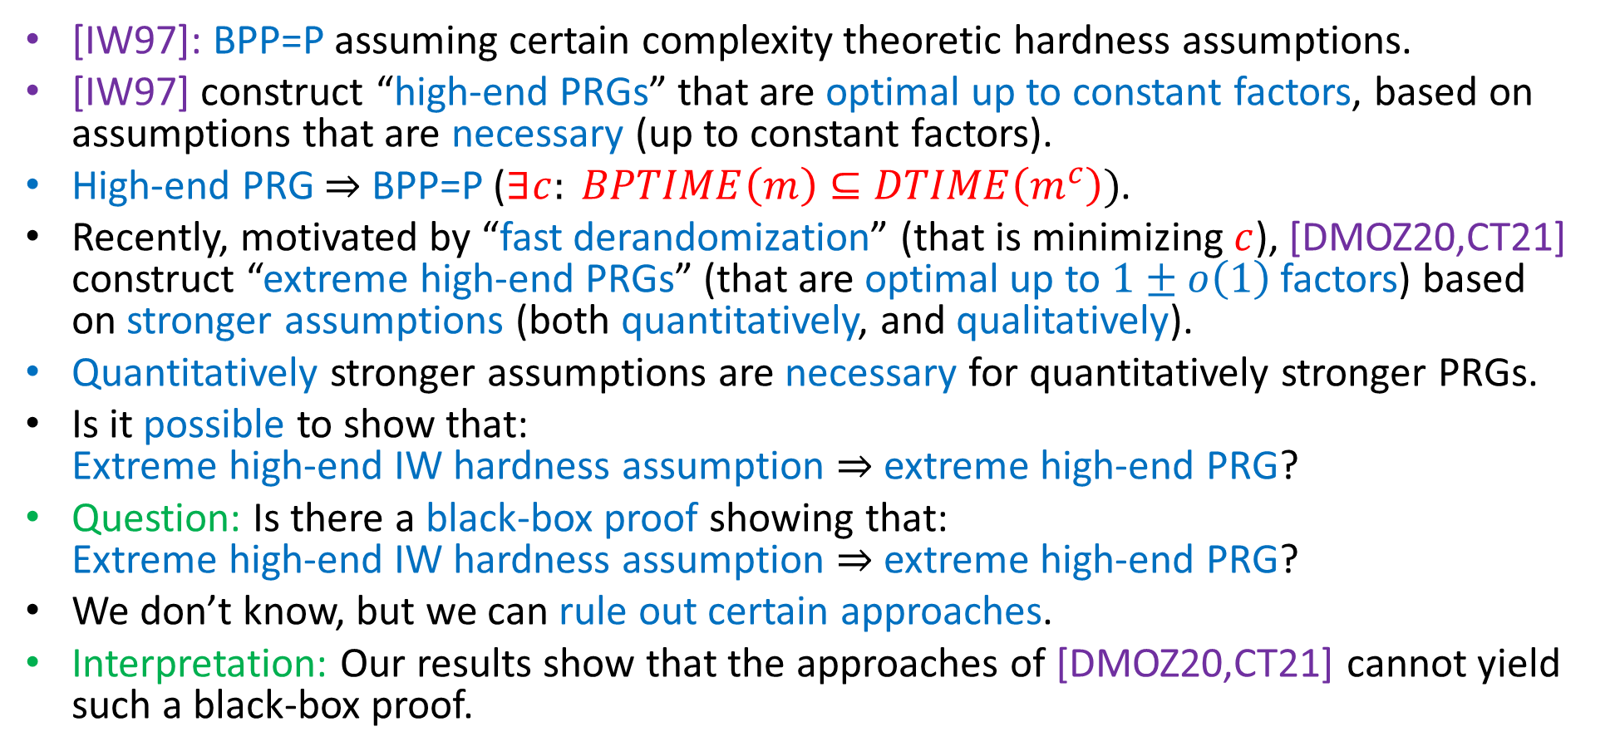
Summary and Outline
[IW97]: BPP=P assuming certain complexity theoretic hardness assumptions.
[IW97] construct “high-end PRGs” that are optimal up to constant factors, based on assumptions that are necessary (up to constant factors).
High-end PRG $⇒$ BPP=P ($∃c: BPTIME\left(m\right)⊆DTIME\left(m^{c}\right))$.
Recently, motivated by “fast derandomization” (that is minimizing $c$), [DMOZ20,CT21] construct “extreme high-end PRGs” (that are optimal up to $1±o\left(1\right)$factors) based on stronger assumptions (both quantitatively, and qualitatively).
Quantitatively stronger assumptions are necessary for quantitatively stronger PRGs.
Is it possible to show that: Extreme high-end IW hardness assumption $⇒$ extreme high-end PRG?
Question: Is there a black-box proof showing that: Extreme high-end IW hardness assumption $⇒$ extreme high-end PRG?
We don’t know, but we can rule out certain approaches.
Interpretation: Our results show that the approaches of [DMOZ20,CT21] cannot yield such a black-box proof.

Slide 8


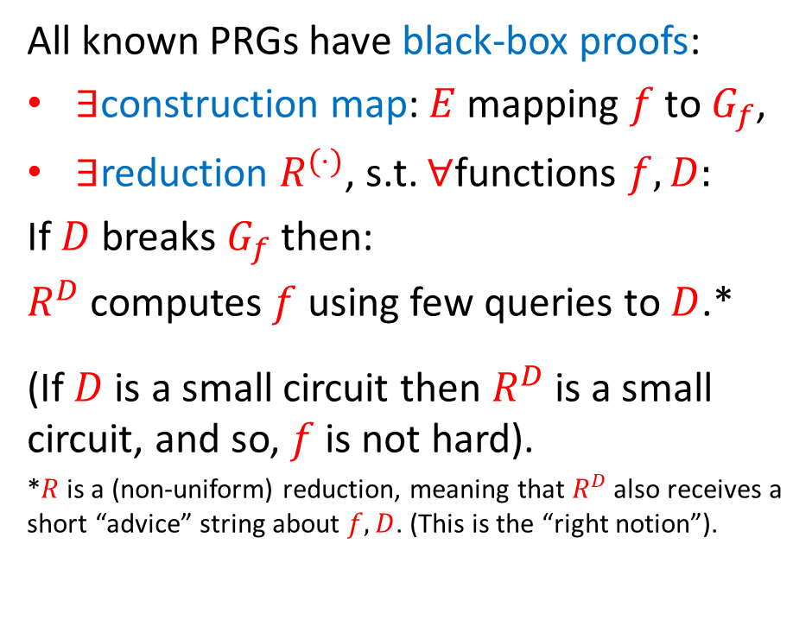
Black-box proofs for showing: extreme high-end IW hardness assumption $⇒$extreme high-end PRG
Extreme high-end: Open problem, show that:
All known PRGs have black-box proofs:
$∃$construction map: $E$ mapping $f$ to $G_{f}$,
$∃$reduction $R^{(⋅)}$, s.t. $∀$functions $f,D:$
If $D$ breaks $G_{f}$ then:
$R^{D}$ computes $f$ using few queries to $D$.*
(If $D$ is a small circuit then $R^{D}$ is a small circuit, and so, $f$ is not hard).
*$R$ is a (non-uniform) reduction, meaning that$R^{D}$also receives a short “advice” string about $f,D$. (This is the “right notion”).
Extreme high-end IW hardness assumption:
Exists $f:{\left\{0,1\right\}}^{ℓ}→\left\{0,1\right\}$ s.t.
  $f$ not computable by size $2^{\left(1−o\left(1\right)\right)⋅ℓ}$ circuits.
  $T_{ALL}\left(f\right)=2^{\left(2+o\left(1\right)\right)⋅ℓ}.$
Implies extreme high-end PRG:
$G:{\left\{0,1\right\}}^{r=\left(1+o\left(1\right)\right)⋅ℓ{ }}→{\left\{0,1\right\}}^{m=2^{\left(1−o\left(1\right)\right)⋅ℓ}}$
  with $T_{ALL}\left(G\right)=2^{\left(2+o\left(1\right)\right)⋅ℓ}$.
Question: Does there exist an “extreme black-box proof”? Namely, a bb-proof showing: extreme high-end IW hardness assumption $⇒$extreme high-end PRG.
Answer: We don’t know, but we can rule out certain approaches.

Slide 9
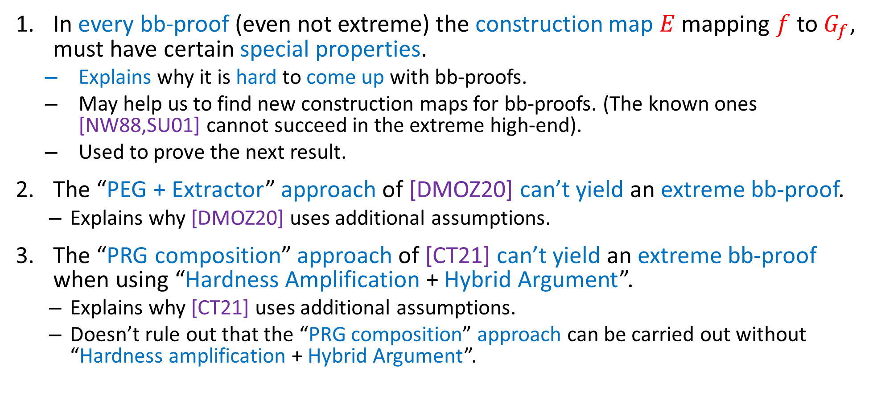
Our results: Limitations on some approaches for “extreme black-box proof”
In every bb-proof (even not extreme) the construction map $E$ mapping $f$ to $G_{f}$, must have certain special properties.
  Explains why it is hard to come up with bb-proofs.
  May help us to find new construction maps for bb-proofs. (The known ones [NW88,SU01] cannot succeed in the extreme high-end).
  Used to prove the next result.
The “PEG + Extractor” approach of [DMOZ20] can’t yield an extreme bb-proof.
  Explains why [DMOZ20] uses additional assumptions.
The “PRG composition” approach of [CT21] can’t yield an extreme bb-proof when using “Hardness Amplification + Hybrid Argument”.
  Explains why [CT21] uses additional assumptions.
  Doesn’t rule out that the “PRG composition” approach can be carried out without “Hardness amplification + Hybrid Argument”.

Slide 10
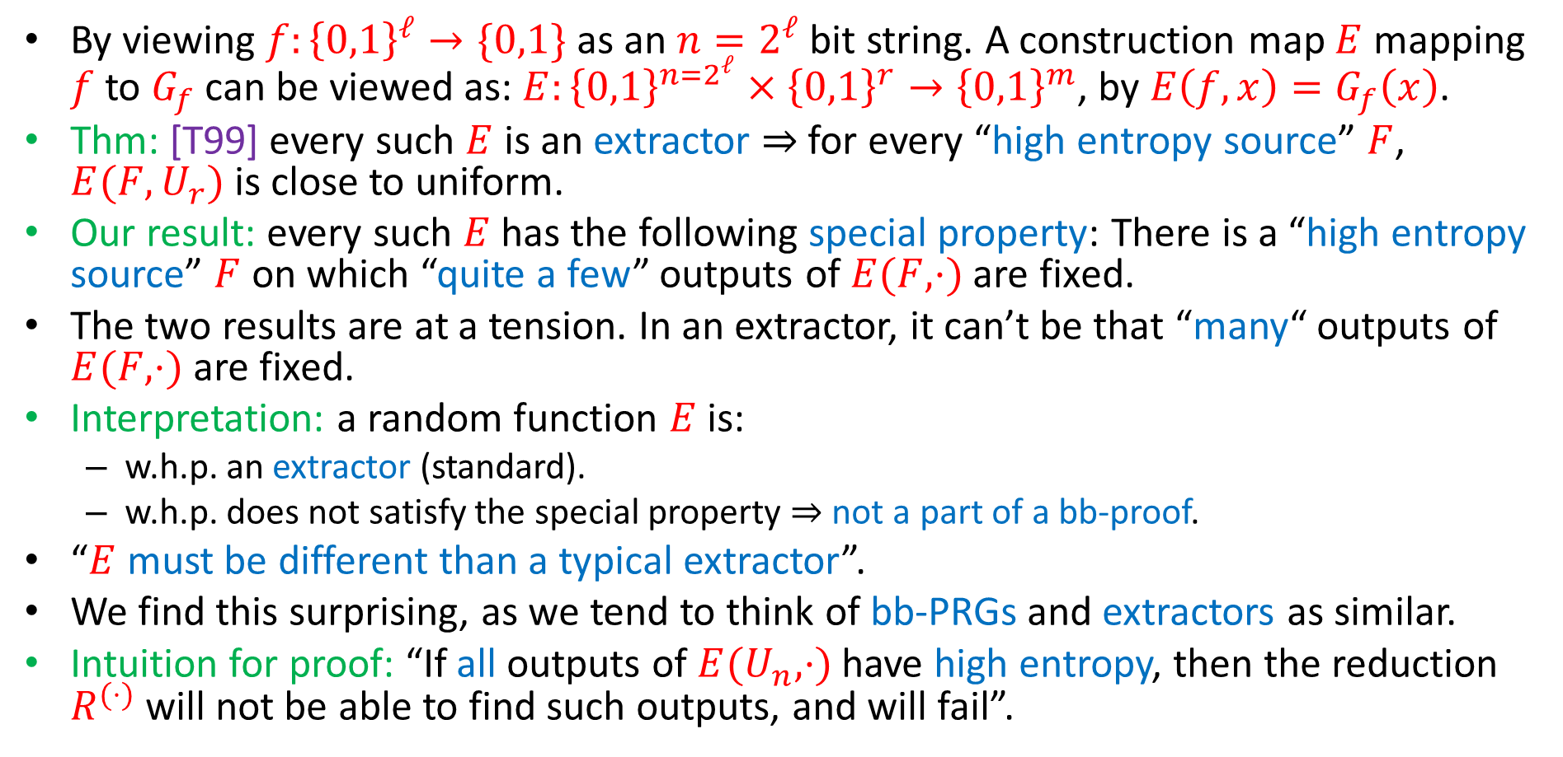
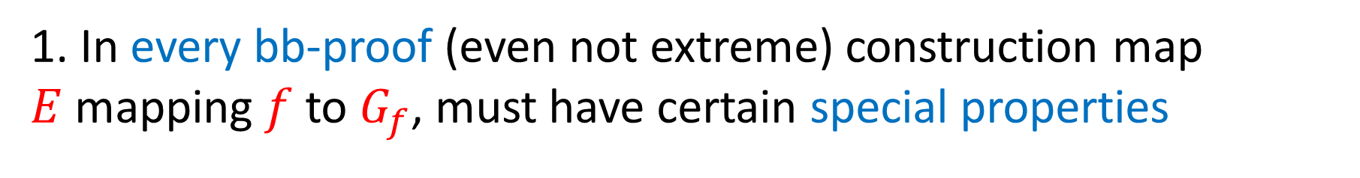
1. In every bb-proof (even not extreme) construction map $E$ mapping $f$ to $G_{f}$, must have certain special properties
By viewing $f:{\left\{0,1\right\}}^{ℓ}→\{0,1\}$ as an $n=2^{ℓ}$bit string. A construction map $E$ mapping $f$ to $G_{f}$ can be viewed as: $E:{\left\{0,1\right\}}^{{n=2}^{ℓ}}×{\left\{0,1\right\}}^{r}→{\left\{0,1\right\}}^{m}$, by $E\left(f,x\right)=G_{f}\left(x\right)$.
Thm: [T99] every such $E$ is an extractor $⇒$ for every “high entropy source” $F$, $E(F,U_{r})$ is close to uniform.
Our result: every such $E$has the following special property: There is a “high entropy source” $F$ on which “quite a few” outputs of $E(F,⋅)$ are fixed.
The two results are at a tension. In an extractor, it can’t be that “many“ outputs of $E(F,⋅)$ are fixed.
Interpretation: a random function $E$ is:
  w.h.p. an extractor (standard).
  w.h.p. does not satisfy the special property $⇒$ not a part of a bb-proof.
“$E$ must be different than a typical extractor”.
We find this surprising, as we tend to think of bb-PRGs and extractors as similar.
Intuition for proof: “If all outputs of $E(U_{n},⋅)$ have high entropy, then the reduction $R^{(⋅)}$ will not be able to find such outputs, and will fail”.

Slide 11
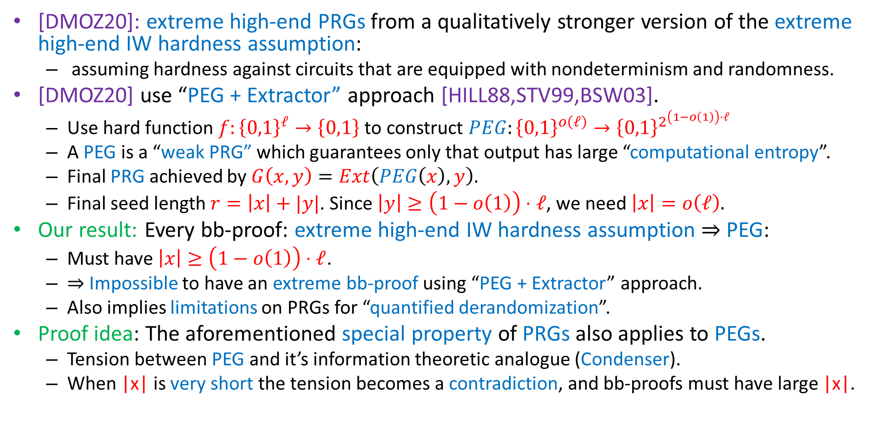
2. The “PEG + Extractor” approach of [DMOZ20] can’t yield an extreme bb-proof.
[DMOZ20]: extreme high-end PRGs from a qualitatively stronger version of the extreme high-end IW hardness assumption:
  assuming hardness against circuits that are equipped with nondeterminism and randomness.
[DMOZ20] use “PEG + Extractor” approach [HILL88,STV99,BSW03].
  Use hard function $f:{\left\{0,1\right\}}^{ℓ}→\left\{0,1\right\}$ to construct $PEG:{\left\{0,1\right\}}^{o\left(ℓ\right)}→{\left\{0,1\right\}}^{2^{\left(1−o\left(1\right)\right)⋅ℓ }}$
  A PEG is a “weak PRG” which guarantees only that output has large “computational entropy”.
  Final PRG achieved by $G\left(x,y\right)=Ext\left(PEG\left(x\right),y\right)$.
  Final seed length $r=\left|x\right|+|y|$. Since $\left|y\right|≥\left(1−o\left(1\right)\right)⋅ℓ$, we need $\left|x\right|=o\left(ℓ\right).$
Our result: Every bb-proof: extreme high-end IW hardness assumption $⇒$ PEG:
  Must have $\left|x\right|≥\left(1−o\left(1\right)\right)⋅ℓ$.
  $⇒$Impossible to have an extreme bb-proof using “PEG + Extractor” approach.
  Also implies limitations on PRGs for “quantified derandomization”.
Proof idea: The aforementioned special property of PRGs also applies to PEGs.
  Tension between PEG and it’s information theoretic analogue (Condenser).
  When |x| is very short the tension becomes a contradiction, and bb-proofs must have large |x|.

Slide 12
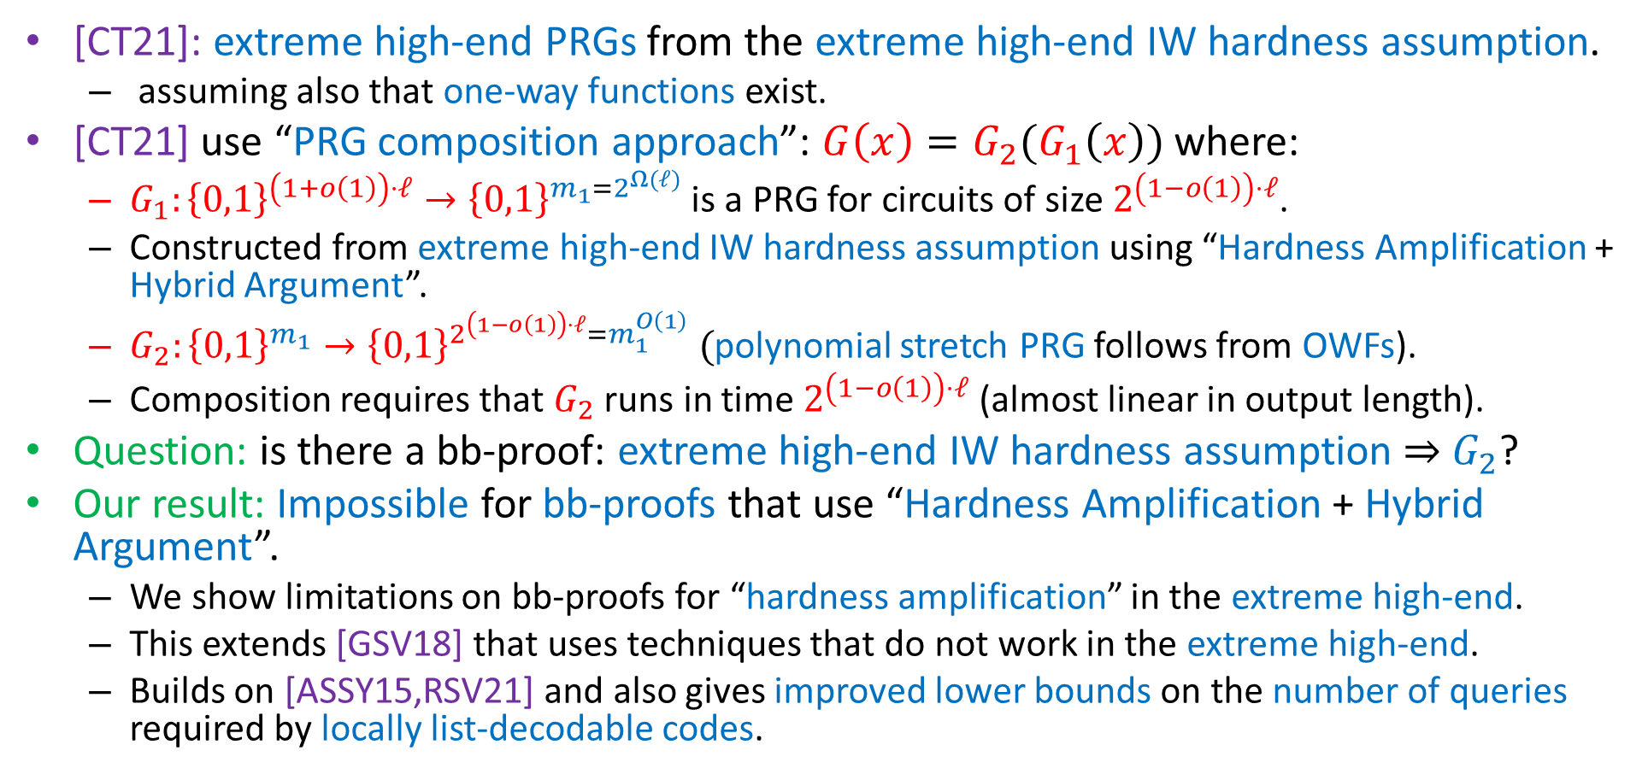
3. The “PRG composition” approach of [CT21] can’t give an extreme bb-proof using “Hardness Amplification + Hybrid Argument”.
[CT21]: extreme high-end PRGs from the extreme high-end IW hardness assumption.
  assuming also that one-way functions exist.
[CT21] use “PRG composition approach”: $G\left(x\right)=G_{2}(G_{1}\left(x\right))$ where:
  $G_{1}:{\left\{0,1\right\}}^{\left(1+o\left(1\right)\right)⋅ℓ}→{\left\{0,1\right\}}^{m_{1}=2^{Ω(ℓ)}}$ is a PRG for circuits of size $2^{\left(1−o\left(1\right)\right)⋅ℓ}$.
  Constructed from extreme high-end IW hardness assumption using “Hardness Amplification + Hybrid Argument”.
  $G_{2}:{\left\{0,1\right\}}^{m_{1}}→{\left\{0,1\right\}}^{2^{\left(1−o\left(1\right)\right)⋅ℓ}=m_{1}^{O\left(1\right)}} ($polynomial stretch PRG follows from OWFs).
  Composition requires that $G_{2}$ runs in time $2^{\left(1−o\left(1\right)\right)⋅ℓ}$ (almost linear in output length).
Question: is there a bb-proof: extreme high-end IW hardness assumption $⇒$ $G_{2}$?
Our result: Impossible for bb-proofs that use “Hardness Amplification + Hybrid Argument”.
  We show limitations on bb-proofs for “hardness amplification” in the extreme high-end.
  This extends [GSV18] that uses techniques that do not work in the extreme high-end.
  Builds on [ASSY15,RSV21] and also gives improved lower bounds on the number of queries required by locally list-decodable codes.

Slide 13
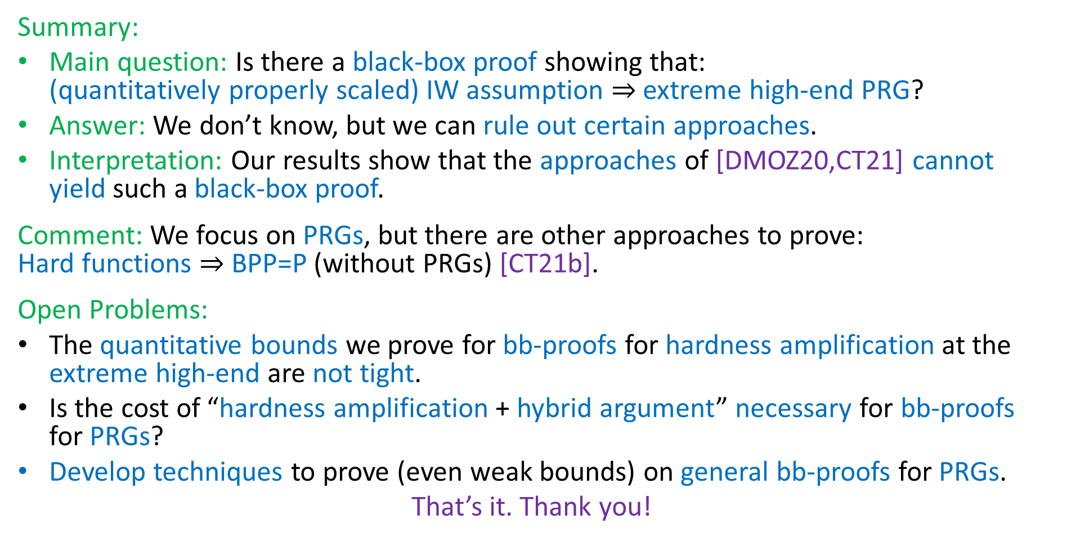
Conclusion and Open Problems
Summary:
Main question: Is there a black-box proof showing that: (quantitatively properly scaled) IW assumption $⇒$ extreme high-end PRG?
Answer: We don’t know, but we can rule out certain approaches.
Interpretation: Our results show that the approaches of [DMOZ20,CT21] cannot yield such a black-box proof.
Comment: We focus on PRGs, but there are other approaches to prove: Hard functions $⇒$ BPP=P (without PRGs) [CT21b].
Open Problems:
The quantitative bounds we prove for bb-proofs for hardness amplification at the extreme high-end are not tight.
Is the cost of “hardness amplification + hybrid argument” necessary for bb-proofs for PRGs?
Develop techniques to prove (even weak bounds) on general bb-proofs for PRGs.
That’s it. Thank you!

Slide 14
That’s it…
Thank you

