Slide 1
Quasilinear Time
List-Decodable Codes for Space Bounded Channels
Swastik Kopparty Rutgers University and IAS
Ronen Shaltiel University of Haifa
Jad Silbak Tel-Aviv University

Slide 2

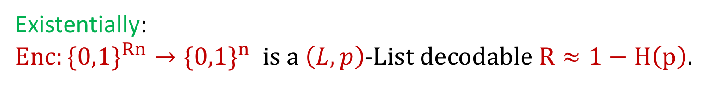


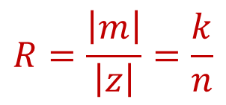


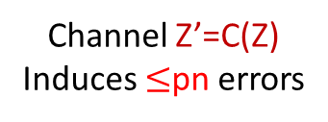
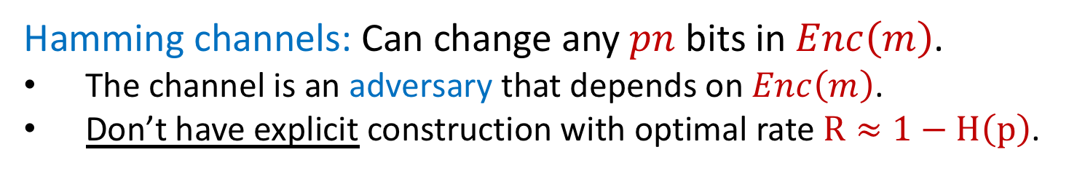



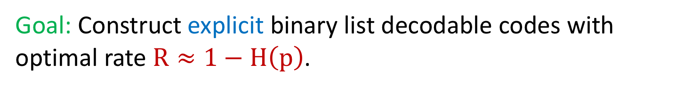
Binary List Decodable Codes
Short list
Channel Z’=C(Z)
Induces $≤$pn errors
$$m_{1}$$
$$Z=Enc(m)$$
$m_{2}$
$$m$$
$$Dec(Z′)$$
$$⋮$$
$$R=\frac{\left|m\right|}{\left|z\right|}=\frac{k}{n}$$
$m_{L}$
Unique decoding if L=1
$$∃ i:m=m_{i}$$
Hamming channels: Can change any $pn$ bits in $Enc\left(m\right)$.
The channel is an adversary that depends on $Enc\left(m\right)$.
Don’t have explicit construction with optimal rate $R≈1−H\left(p\right)$.
Goal: Construct explicit binary list decodable codes with optimal rate $R≈1−H\left(p\right)$.
Existentially:
${Enc:\{0,1\}}^{Rn}→{\{0,1\}}^{n} is a \left(L,p\right)$-$List decodable R≈1−H\left(p\right).$
Can we get an explicit code?
Major open problem.

Slide 3
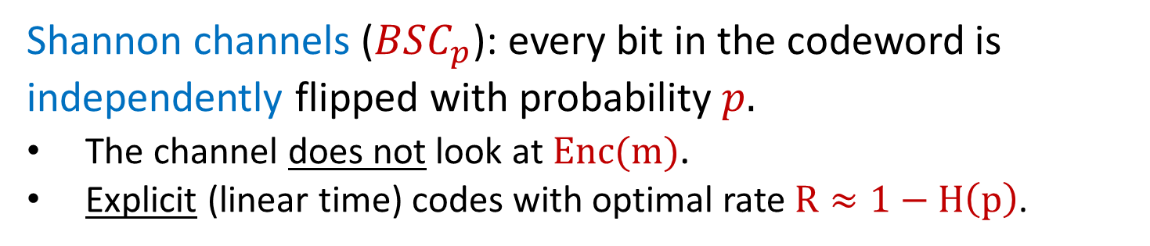
Binary List Decodable Codes
What about intermediate channel families?
Short list
Channel Z’=C(Z)
Induces $≤$pn errors
$$m_{1}$$
$$Z=Enc(m)$$
$m_{2}$
$$m$$
$$Dec(Z′)$$
$$⋮$$
$$R=\frac{\left|m\right|}{\left|z\right|}=\frac{k}{n}$$
$m_{L}$
Unique decoding if L=1
$$∃ i:m=m_{i}$$
Hamming channels: Can change any $pn$ bits in $Enc\left(m\right)$.
The channel is an adversary that depends on $Enc\left(m\right)$.
Don’t have explicit construction with optimal rate $R≈1−H\left(p\right)$.
Shannon channels (${BSC}_{p}$): every bit in the codeword is independently flipped with probability $p.$
The channel does not look at $Enc(m)$.
Explicit (linear time) codes with optimal rate $R≈1−H\left(p\right)$.

Slide 4
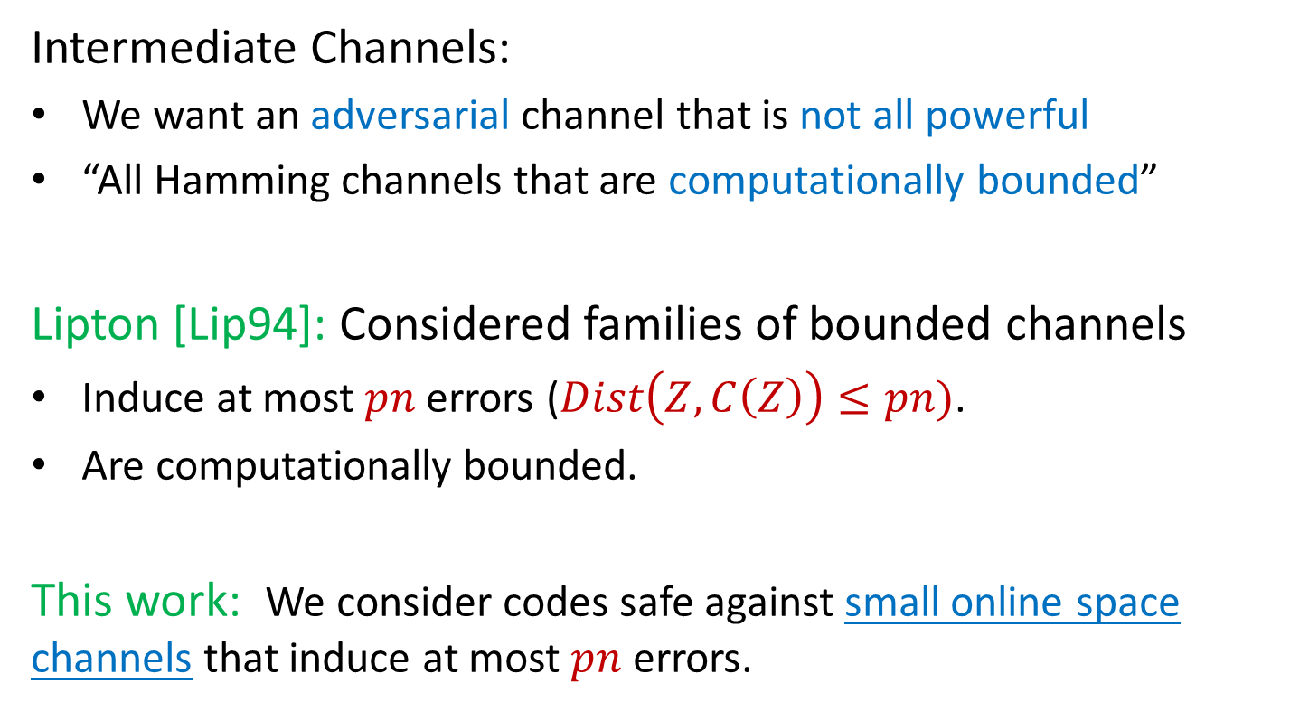
Intermediate Channels Between Hamming and Shannon
Intermediate Channels:
We want an adversarial channel that is not all powerful
“All Hamming channels that are computationally bounded”
Lipton [Lip94]: Considered families of bounded channels
Induce at most $pn$ errors ($Dist\left(Z,C\left(Z\right)\right)≤pn)$.
Are computationally bounded.
This work: We consider codes safe against small online space channels that induce at most $pn$ errors.

Slide 5
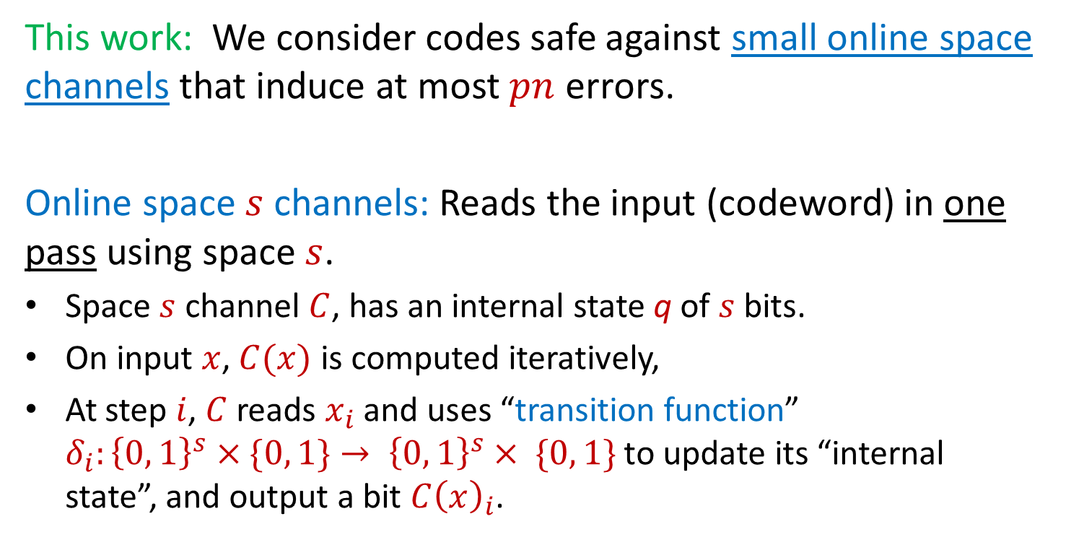
Intermediate Channels Between Hamming and Shannon
This work: We consider codes safe against small online space channels that induce at most $pn$ errors.
Online space $s$ channels: Reads the input (codeword) in one pass using space $s$.
Space $s$ channel $C$, has an internal state q of $s$ bits.
On input $x$, $C(x)$ is computed iteratively,
At step $i$, $C$ reads $x_{i}$ and uses “transition function”
$δ_{i}:{\left\{0, 1\right\}}^{s}×\{0, 1\}→ {\left\{0, 1\right\}}^{s}× \{0, 1\}$ to update its “internal state”, and output a bit $C{\left(x\right)}_{i}$.

Slide 6
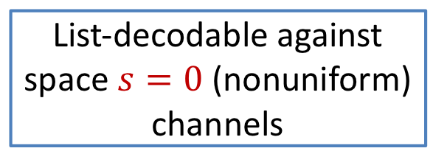
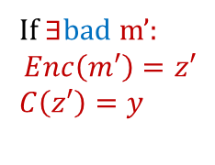



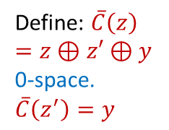


Intermediate Channels Between Hamming and Shannon
This work: We consider codes safe against small online space channels that induce at most $pn$ errors.
List-decodable against space $s=0$(nonuniform) channels
List-decodable against Hamming channel
$$\underset{⇔}{unfortunately}$$
Solution: Stochastic codes
Encoding is randomized
Decoding succeeds only with high probability.
If $∃$bad m’:
$$Enc\left(m′\right)=z′$$
$$C\left(z′\right)=y$$
Define: $\overline{C}\left(z\right)=z⊕z′⊕y$
0-space.
$$\overline{C}\left(z^{′}\right)=y$$
$$pn$$
$$y$$
$$z′$$

Slide 7

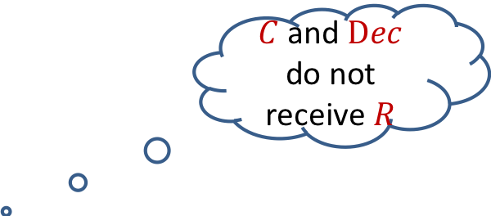


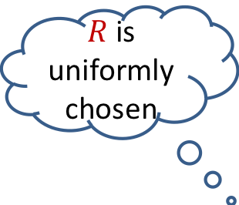

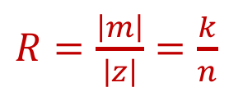


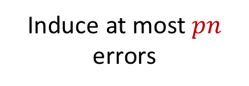

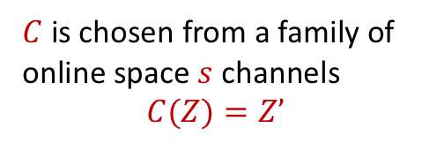

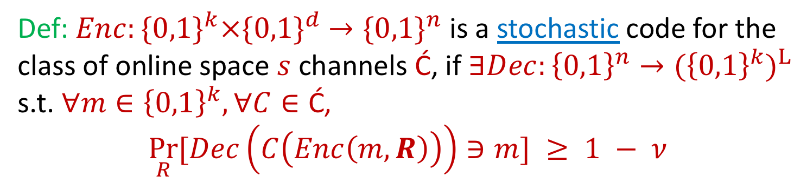
Guruswami and Smith [GS16]
Stochastic Codes
$R$ is uniformly chosen
$C$ and $Dec$ do not receive $R$
$C$ is chosen from a family of online space $s$ channels
$$C(Z)=Z’$$
$$m_{1}$$
$$Z=Enc(m,R)$$
$$Dec(Z′)$$
$m_{2}$
$$m$$
$$⋮$$
Induce at most $pn$ errors
$m_{L}$
$R=\frac{\left|m\right|}{\left|z\right|}=\frac{k}{n}$
$$\underset{R}{Pr}[∃i:m=m_{i}]≥1 − ν$$
Def: ${Enc:\{0,1\}}^{k}×{\{0,1\}}^{d} →{\{0,1\}}^{n}$ is a stochastic code for the class of online space $s$ channels Ć, if $∃Dec:{\left\{0,1\right\}}^{n}→{{(\left\{0,1\right\}}^{k})}^{L}$ s.t. $∀m∈{\left\{0,1\right\}}^{k}, ∀C∈\text{Ć}\text{,}$
$$\underset{R}{Pr}[Dec\left(C\left(Enc\left(m,R\right)\right)\right)∋m] ≥ 1 − ν$$
A code is explicit if $(Enc,Dec)$ are polynomial.

Slide 8
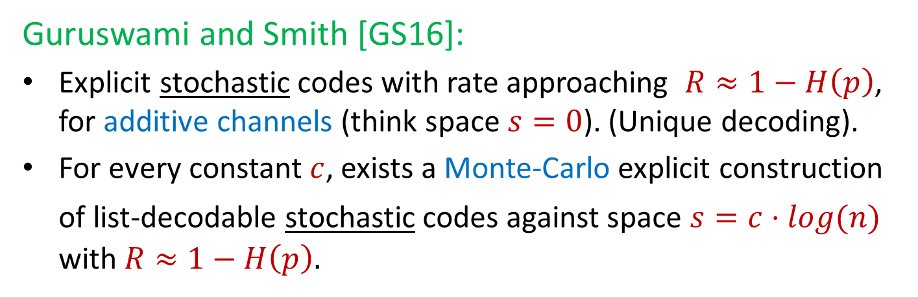
Previous Results: Binary Stochastic
List-Decodable Codes for Online Space
Guruswami and Smith [GS16]:
Explicit stochastic codes with rate approaching $R≈1−H\left(p\right)$, for additive channels (think space $s=0$). (Unique decoding).
For every constant $c$, exists a Monte-Carlo explicit construction
of list-decodable stochastic codes against space $s=c⋅log(n)$ with $R≈1−H\left(p\right).$
Preprocessing stage: (Enc,Dec) toss a shared randomness of poly length that is used for Encoding/Decoding (and is revealed to the channel)

Slide 9
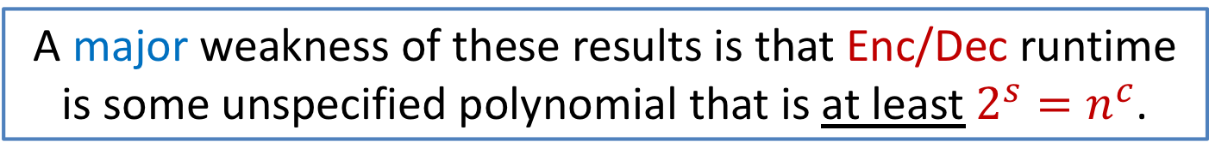
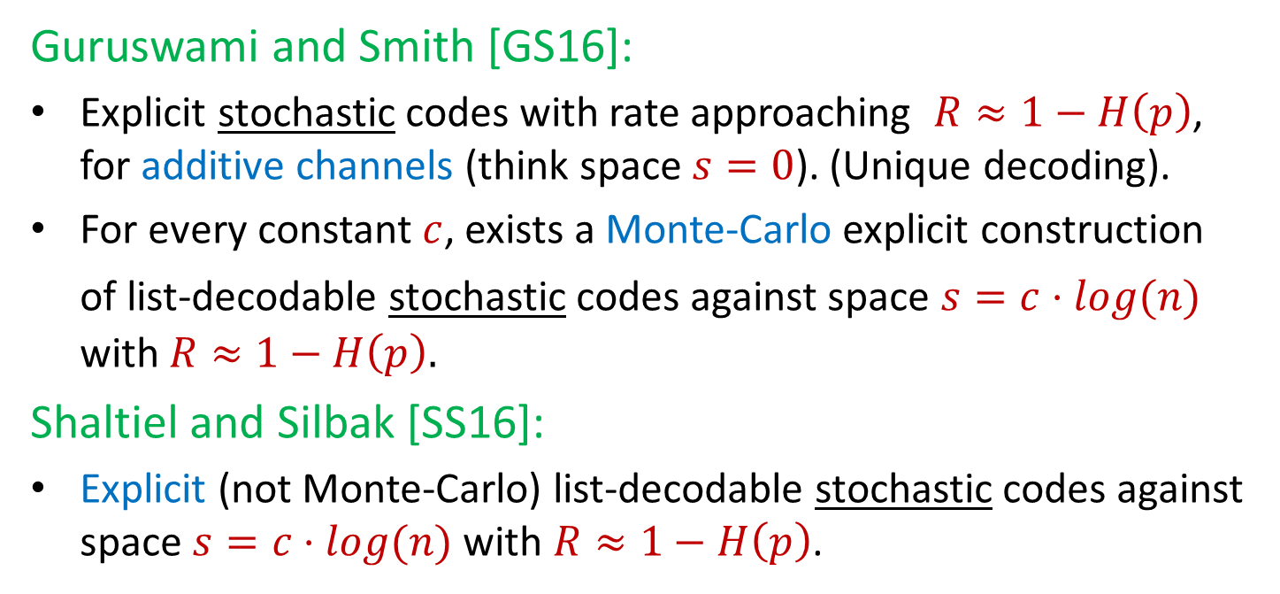
Previous Results: Binary Stochastic
List-Decodable Codes for Online Space
Guruswami and Smith [GS16]:
Explicit stochastic codes with rate approaching $R≈1−H\left(p\right)$, for additive channels (think space $s=0$). (Unique decoding).
For every constant $c$, exists a Monte-Carlo explicit construction
of list-decodable stochastic codes against space $s=c⋅log(n)$ with $R≈1−H\left(p\right).$
Shaltiel and Silbak [SS16]:
Explicit (not Monte-Carlo) list-decodable stochastic codes against space $s=c⋅log(n)$ with $R≈1−H\left(p\right)$.
A major weakness of these results is that Enc/Dec runtime is some unspecified polynomial that is at least $2^{s}=n^{c}$.

Slide 10
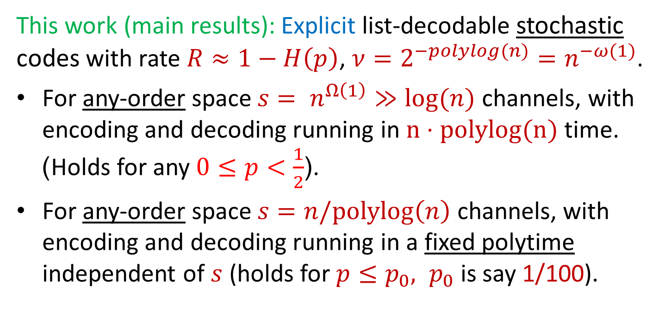
List-Decodable Codes for Larger Space
This work (main results): Explicit list-decodable stochastic codes with rate $R≈1−H\left(p\right)$, $ν=2^{−polylog(n)}=n^{−ω(1)}$.
For any-order space $s= n^{Ω\left(1\right)}≫log⁡(n)$ channels, with encoding and decoding running in $n⋅polylog(n)$ time. )Holds for any $0≤p<\frac{1}{2}$(.
For any-order space $s=n/polylog\left(n\right)$ channels, with encoding and decoding running in a fixed polytime independent of $s$ (holds for $p≤p_{0}, p_{0}$ is say 1/100).
“Essentially” all randomized channels studied in info-theory (e.g. BSC, Burst,…) are implementable in small space channels
Notes:
(we have space $O(logn)$and are allowed to read the input in one pass).

Slide 11
Outline of construction
Component: Raw Reed-Solomon codes.
  Explicit linear (standard) codes with large distance, dual distance and explicit list-decoding from ½ errors.
  New point of view on good old Reed-Solomon codes.
Gives: Pseudorandom “control” codes.
  Stochastoc codes (against Hamming channels) with pseudorandom properties.
Stochastic codes for space bounded channels.
  Use new pseudorandom codes in framework of [GS16,SS16] (with some additional ideas).

Slide 12


Component: Raw Reed-Solomon Codes
We will need a (standard) linear code which:
Has explicit list-decoding from $(\frac{1}{2}−o\left(1\right))$ errors
Has Dual distance $≥n^{Ω\left(1\right)}$. (implies $k≥n^{Ω\left(1\right)}).$
Usual suspects:
Dual-BCH Codes
Have $(\frac{1}{2}−o\left(1\right))$ distance.
Are linear with with dual distance $n^{Ω\left(1\right)}$.
Unfortunately, we don’t have explicit list-decoding algorithm.
Reed-Solomon concatenated with an inner code
Has explicit list-decoding
Concatenation with nontrivial code destroys the dual distance.
An inner component in our construction. We will see later why it’s useful

Slide 13

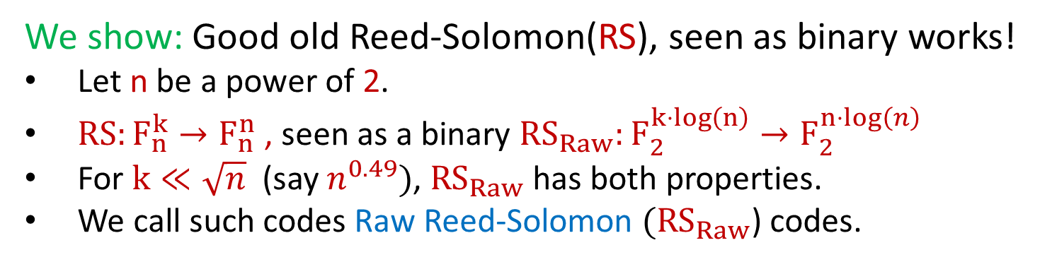
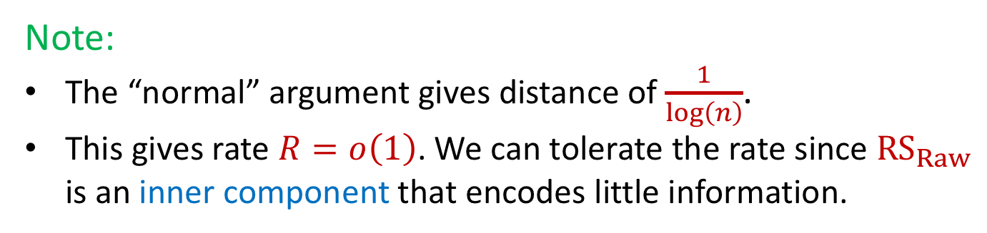
Raw Reed-Solomon Codes
We will need a (standard) linear code which:
Has explicit list-decoding from $(\frac{1}{2}−o\left(1\right))$ errors
Has Dual distance $≥n^{Ω\left(1\right)}$. (implies $k≥n^{Ω\left(1\right)}).$
We show: Good old Reed-Solomon(RS), seen as binary works!
Let n be a power of 2.
$RS:F_{n}^{k}→F_{n}^{n}$ , seen as a binary ${RS}_{Raw}:F_{2}^{k⋅log\left(n\right)}→F_{2}^{n⋅log\left(n\right) }$
For $k≪\sqrt{n}$ (say $n^{0.49})$, ${RS}_{Raw}$ has both properties.
We call such codes Raw Reed-Solomon $({RS}_{Raw}$) codes.
Note:
The “normal” argument gives distance of $\frac{1}{\log\left(n\right)}$.
This gives rate $R=o\left(1\right)$. We can tolerate the rate since ${RS}_{Raw}$ is an inner component that encodes little information.

Slide 14


Raw Reed-Solomon Codes:
Correlated Dual-BCH Codes
Standard interpretation:
$${RS}_{Raw}=RS∘Identity$$
m
RS
$$Id$$

Slide 15
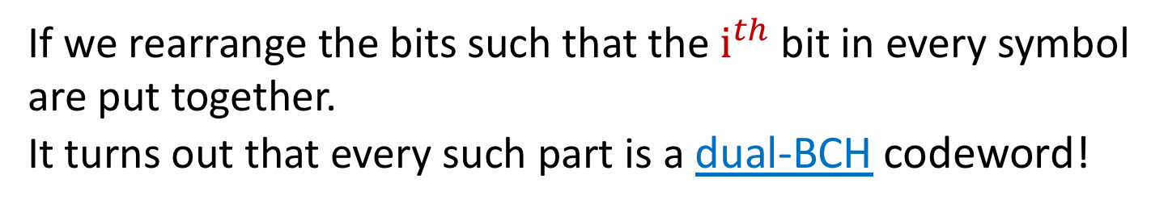
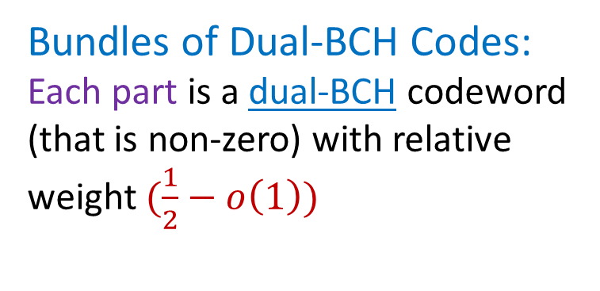
Raw Reed-Solomon Codes:
Correlated Dual-BCH Codes
Standard interpretation:
$${RS}_{Raw}=RS∘Identity$$
Bundles of Dual-BCH Codes:
Each part is a dual-BCH codeword (that is non-zero) with relative weight $(\frac{1}{2}−o\left(1\right))$
m
RS
Dual-BCH
$$Id$$
If we rearrange the bits such that the $i^{th}$ bit in every symbol are put together.
It turns out that every such part is a dual-BCH codeword!

Slide 16
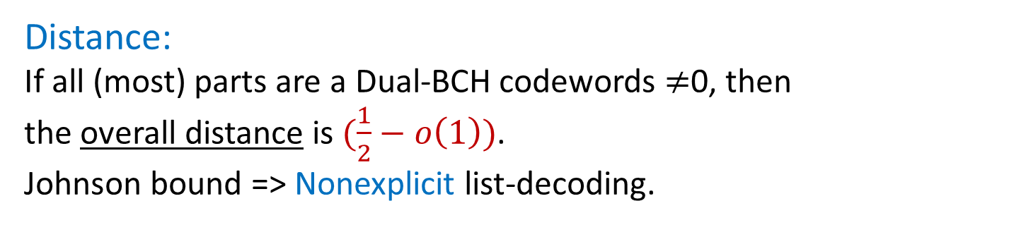
Raw Reed-Solomon Codes:
Correlated Dual-BCH Codes
Standard interpretation:
$${RS}_{Raw}=RS∘Identity$$
Bundles of Dual-BCH Codes:
Each part is a dual-BCH codeword (that is non-zero) with relative weight $(\frac{1}{2}−o\left(1\right))$
m
RS
Dual-BCH
$$Id$$
Distance:
If all (most) parts are a Dual-BCH codewords $≠$0, then the overall distance is $(\frac{1}{2}−o\left(1\right))$.
Johnson bound => Nonexplicit list-decoding.

Slide 17
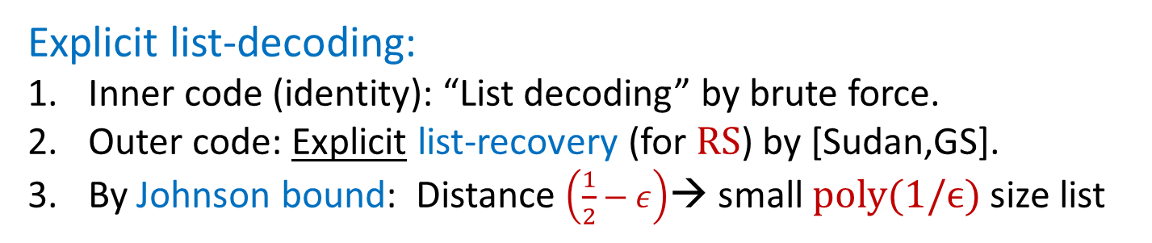
Raw Reed-Solomon Codes:
Correlated Dual-BCH Codes
Standard interpretation:
$${RS}_{Raw}=RS∘Identity$$
Bundles of Dual-BCH Codes:
Each part is a dual-BCH codeword (that is non-zero) with relative weight $(\frac{1}{2}−o\left(1\right))$
m
RS
$$Id$$
Explicit list-decoding:
Inner code (identity): “List decoding” by brute force.
Outer code: Explicit list-recovery (for $RS$) by [Sudan,GS].
By Johnson bound: Distance $\left(\frac{1}{2}−ε\right)$→ small $poly(1/ϵ)$ size list

Slide 18
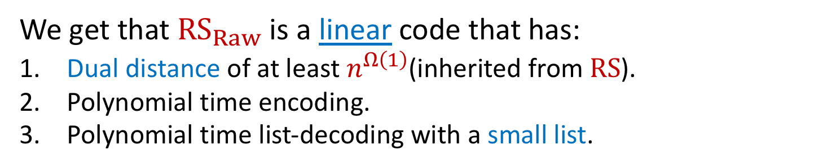
Raw Reed-Solomon Codes:
Correlated Dual-BCH Codes
Standard interpretation:
$${RS}_{Raw}=RS∘Identity$$
Bundles of Dual-BCH Codes:
Each part is a dual-BCH codeword (that is non-zero) with relative weight $(\frac{1}{2}−o\left(1\right))$
m
RS
$$Id$$
We get that ${RS}_{Raw}$ is a linear code that has:
Dual distance of at least $n^{Ω\left(1\right)}$(inherited from $RS$).
Polynomial time encoding.
Polynomial time list-decoding with a small list.

Slide 19
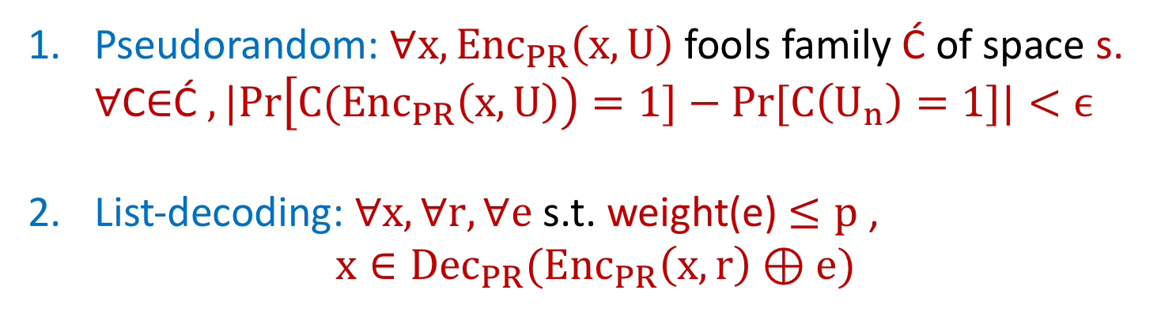
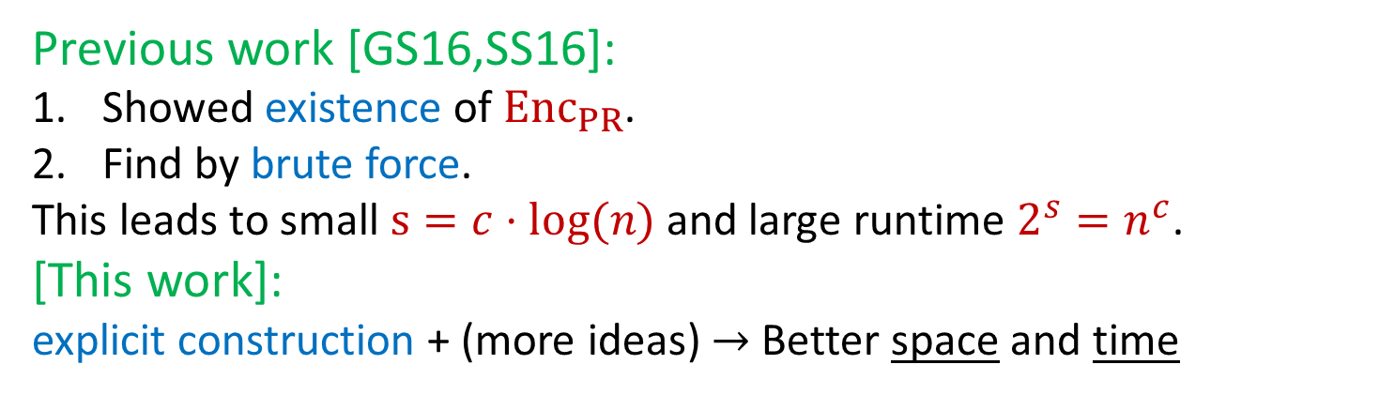
Stochastic Pseudorandom codes
(inner component in [GS16,SS16])
Pseudorandom: $∀x, Enc_{PR}\left(x,U\right)$ fools family $\text{Ć}$ of space s.
$∀$C∈$\text{Ć}$ $,|Pr\left[C(Enc_{PR}\left(x,U\right)\right)=1]−Pr⁡[C\left(U_{n}\right)=1]|<ϵ$
List-decoding: $∀x,∀r, ∀e$ s.t. weight(e) $≤p$ ,
$$x∈{Dec}_{PR}(Enc_{PR}\left(x,r\right)⊕e)$$
Previous work [GS16,SS16]:
Showed existence of $Enc_{PR}$.
Find by brute force.
This leads to small $s=c⋅log(n)$ and large runtime $2^{s}=n^{c}$.
[This work]:
explicit construction + (more ideas) $→$ Better space and time

Slide 20
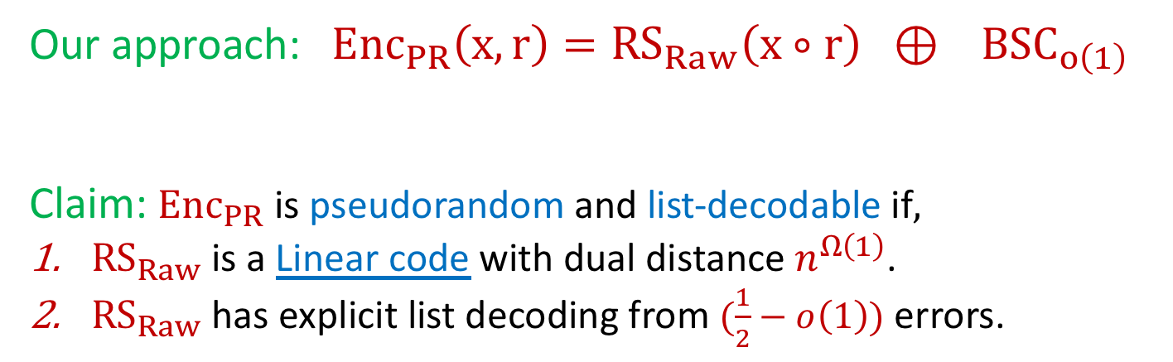
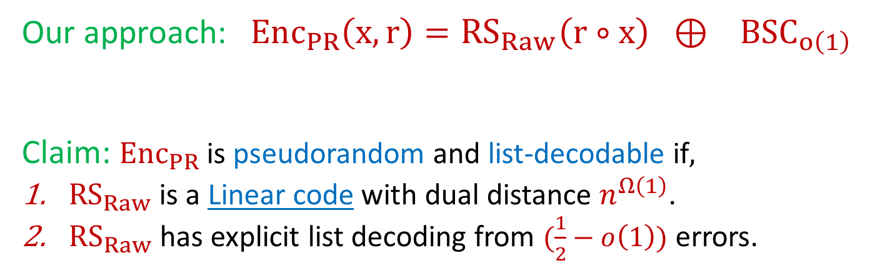
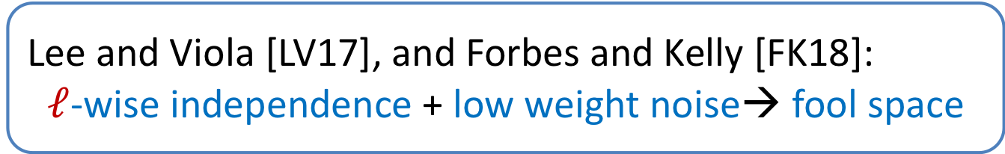
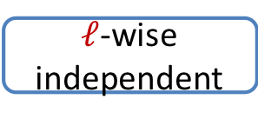
Stochastic Pseudorandom
(inner component in [GS16,SS16])
Lee and Viola [LV17], and Forbes and Kelly [FK18]:
$ℓ$-wise independence + low weight noise→ fool space
Pseudorandom: $∀x, Enc_{PR}\left(x,U\right)$ fools family $\text{Ć}$ of space s.
$∀$C∈$\text{Ć}$ $,|Pr\left[C(Enc_{PR}\left(x,U\right)\right)=1]−Pr⁡[C\left(U_{n}\right)=1]|<ϵ$
List-decoding: $∀x,∀r, ∀e$ s.t. weight(e) $≤p$ ,
$$x∈{Dec}_{PR}(Enc_{PR}\left(x,r\right)⊕e)$$
Our approach: $Enc_{PR}\left(x,r\right)={RS}_{Raw}\left(r∘x\right) ⊕ { BSC}_{o\left(1\right)}$
Claim: $Enc_{PR}$ is pseudorandom and list-decodable if$,$
${RS}_{Raw}$ is a Linear code with dual distance $n^{Ω\left(1\right)}$.
${RS}_{Raw}$ has explicit list decoding from $(\frac{1}{2}−o\left(1\right))$ errors.
$ℓ$-wise independent
Low weight noise

Slide 21
Stochastic Pseudorandom
(inner component in [GS16,SS16])
Pseudorandom: $∀x, Enc_{PR}\left(x,U\right)$ fools family $\text{Ć}$ of space s.
$∀$C∈$\text{Ć}$ $,|Pr\left[C(Enc_{PR}\left(x,U\right)\right)=1]−Pr⁡[C\left(U_{n}\right)=1]|<ϵ$
List-decoding: $∀x,∀r, ∀e$ s.t. weight(e) $≤p$ ,
$$x∈{Dec}_{PR}(Enc_{PR}\left(x,r\right)⊕e)$$
Our approach: $Enc_{PR}\left(x,r\right)={RS}_{Raw}\left(r∘x\right) ⊕ { BSC}_{o\left(1\right)}$
Claim: $Enc_{PR}$ is pseudorandom and list-decodable if$,$
${RS}_{Raw}$ is a Linear code with dual distance $n^{Ω\left(1\right)}$.
${RS}_{Raw}$ has explicit list decoding from $(\frac{1}{2}−o\left(1\right))$ errors.
Codeword
Low weight noise

Slide 22
Stochastic codes for space bounded channels: Outline
  Use new pseudorandom codes in framework of [GS16,SS16] (with some additional ideas).
Warmup: additive channels and shared randomness.
Generalize to space bounded channels using our new pseudorandom code.

Slide 23



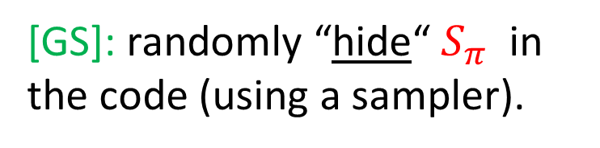
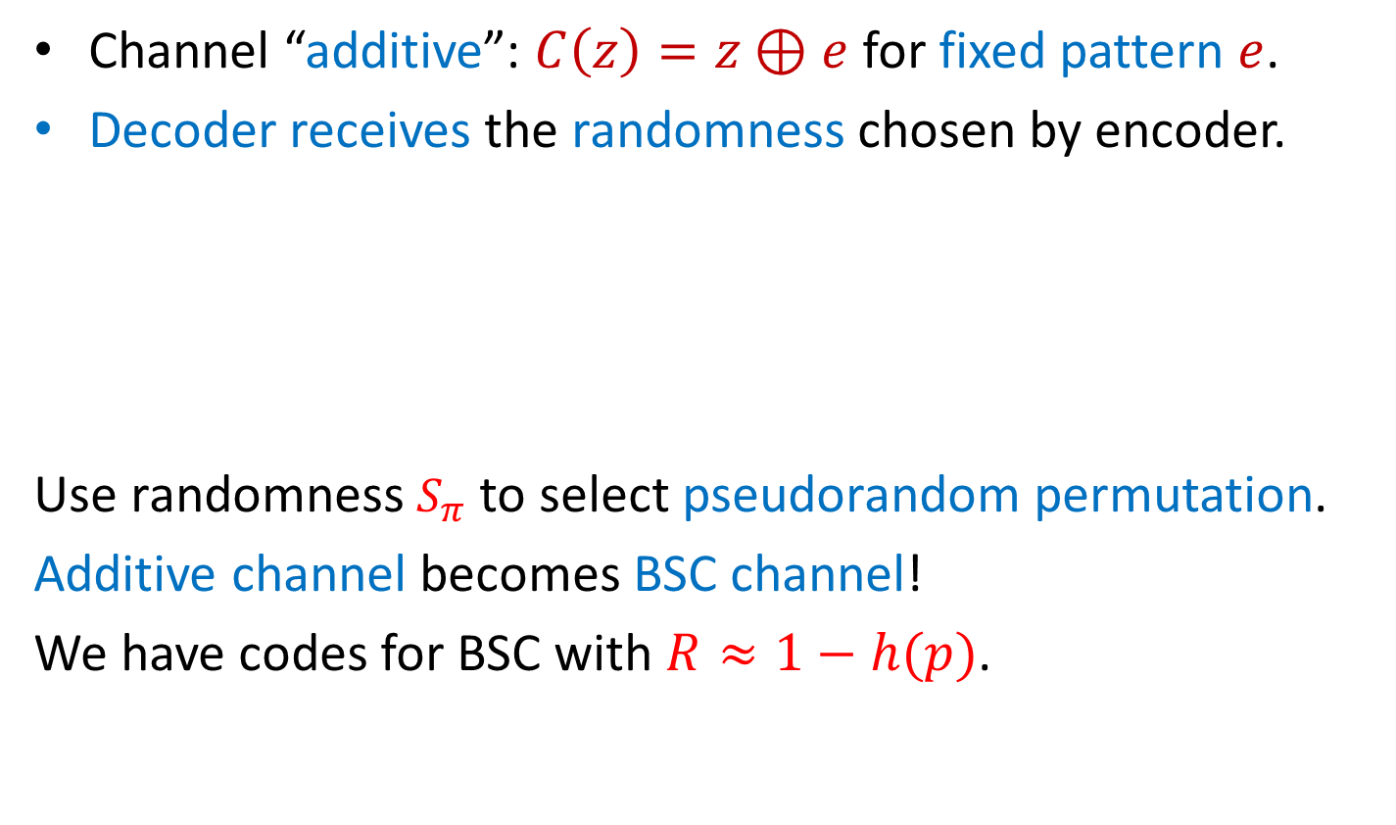

Warmup: codes for additive channels using shared private randomness
Channel “additive”: $C\left(z\right)=z⊕e$ for fixed pattern $e$.
Decoder receives the randomness chosen by encoder.
Use randomness $S_{π}$ to select pseudorandom permutation.
Additive channel becomes BSC channel!
We have codes for BSC with $R≈1−h(p)$.
1
2
3
4
5
6
$$S_{π}$$
1
2
3
4
5
6
Code for BSC
$$⊕$$
Enc
Message
m
m
m
m
Fixed error
1
0
0
1
0
0
But how do we send $S_{π}$
[GS]: randomly “hide“ $S_{π}$ in the code (using a sampler).

Slide 24








Codes against additive channels: (rough sketch)
1
Enc
1
2
2
3
3
4
4
5
5
6
6
7
7
8
8
9
9
10
10
11
11
12
12
13
13
14
14
15
15
Message
Permutation generator
$$S_{π}$$
11
6
10
$$S_{samp}$$
11
6
10
14
14
9
9
15
15
5
5
7
7
8
8
4
4
12
12
$$S_{π}$$
2
3
2
3
13
13
1
1
Additive channels fix the error pattern in advance => Can’t wipe out the control information.
Sampler
$$S_{samp}$$
$$S_{π}$$
$$S_{samp}$$
Need to worry how the decoder finds the control information.
$$S_{samp}$$
$$S_{π}$$
Codes for BSC channels
permuting & sampling
Codes against additive channels

Slide 25





Codes against bounded channels: (rough sketch)
1
Enc
1
2
2
3
3
4
4
5
5
6
6
7
7
8
8
9
9
10
10
11
11
12
12
13
13
14
14
15
15
Message
List decoding: Decode PR code on every block.
For each candidate, decode message.
Permutation generator
$$S_{π}$$
~
~
~
~
~
~
~
~
~
~
~
~
~
~
~
PRG
$$⊕$$
11
6
10
$$S_{samp}$$
14
9
15
5
7
8
4
12
$$S_{π}$$
2
3
13
1
What if the channel targets the control information?
The channel can inspect the data and find weaknesses
$$S_{PRG}$$
GS10: Let’s make the control info pseudorandom.
Sampler
Channel can’t distinguish the data part from control part!
$$S_{PRG}$$
$$S_{samp}$$
$$S_{samp}$$
$$S_{π}$$
$$S_{PRG}$$
$ctrl={Enc}_{PR}(S_{samp},S_{π},S_{PRG})$
Codes for BSC channels
permuting & sampling
Codes against additive channels
pseudo randomness
Codes against bounded channels

Slide 26
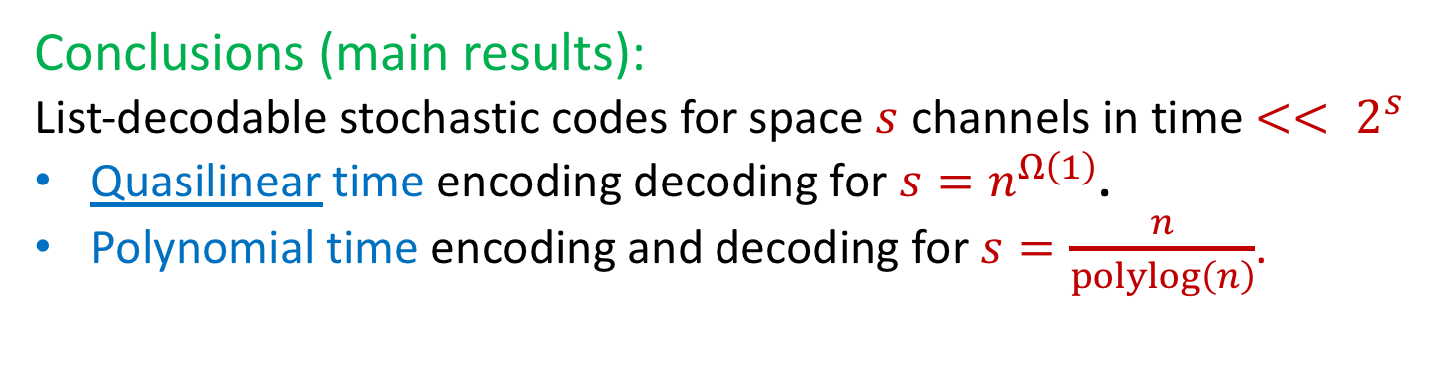
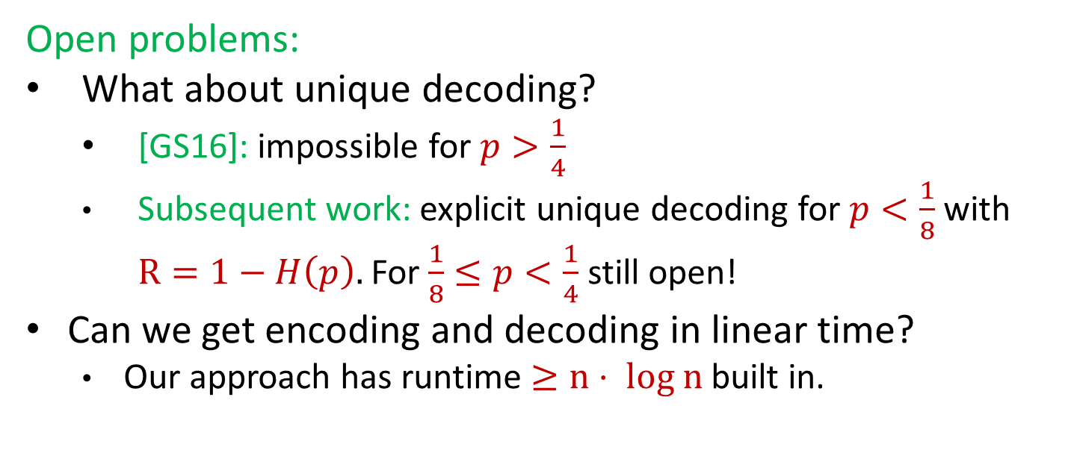
Conclusions and open problems
Conclusions (main results):
List-decodable stochastic codes for space $s$ channels in time $<< 2^{s}$
Quasilinear time encoding decoding for $s=n^{Ω\left(1\right)}$.
Polynomial time encoding and decoding for $s=\frac{n}{polylog\left(n\right)}$.
Open problems:
What about unique decoding?
  [GS16]: impossible for $p>\frac{1}{4}$
  Subsequent work: explicit unique decoding for $p<\frac{1}{8}$ with
  $R=1−H\left(p\right).$ For $\frac{1}{8}≤p<\frac{1}{4}$ still open!
Can we get encoding and decoding in linear time?
  Our approach has runtime $≥n⋅ log n$ built in.
Thank you

Slide 27
That’s it…

Slide 28
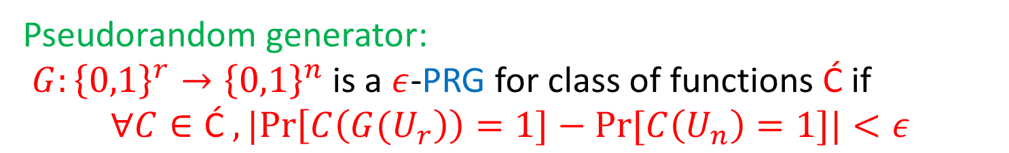
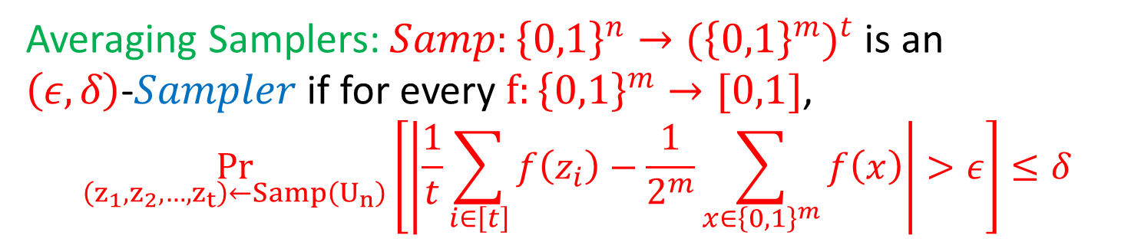
Stochastic codes for space bounded channels Ingredients:
Pseudorandom generator:
$G:{\left\{0,1\right\}}^{r}→{\left\{0,1\right\}}^{n}$ is a $ε$-PRG for class of functions $\text{Ć}$if
$$∀C∈\text{Ć} ,|Pr\left[C\left(G(U_{r}\right)\right)=1]−Pr⁡[C\left(U_{n}\right)=1]|<ε$$
Intuition: functions in $\text{Ć}$cannot distinguish $G\left(U_{r}\right)$ from $U_{n}$.
Averaging Samplers: $Samp:{\left\{0,1\right\}}^{n}{→{(\left\{0,1\right\}}^{m})}^{t}$ is an $\left(ε,δ\right)$-$Sampler$ if for every $f:{\left\{0,1\right\}}^{m}→[0,1]$,
$$\underset{\left(z_{1},z_{2},…,z_{t}\right)←Samp\left(U_{n}\right)}{Pr}\left[\left|\frac{1}{t}\sum_{i∈\left[t\right]}{f\left(z_{i}\right)}−\frac{1}{2^{m}}\sum_{x∈{\left\{0,1\right\}}^{m}}{f\left(x\right)}\right|>ε\right]≤δ$$
Intuition: samplers use few random bits and select a subset that has properties similar to uniform subset.

