Slide 1

Some New Results on
Extractors for Samplable Distributions
In memory of Luca Trevisan (1971-2024).
Ronen Shaltiel, University of Haifa.
Based on:
Multiplicative extractors for samplable distributions.
Extractors for samplable distributions with low min-entropy. Joint work with Marshall Ball and Jad Silbak.

Slide 2
Randomness extractors (motivation)
Daddy, how do computers get random bits?
Do we have to tell that same old story again.
Notes:
This is the original joke.
I would say something like: “Any talk on extractors must start with a motivation on how computers get random bits”.
Flash the slide and move on (don’t explain it as it may ruin the joke)…

Slide 3


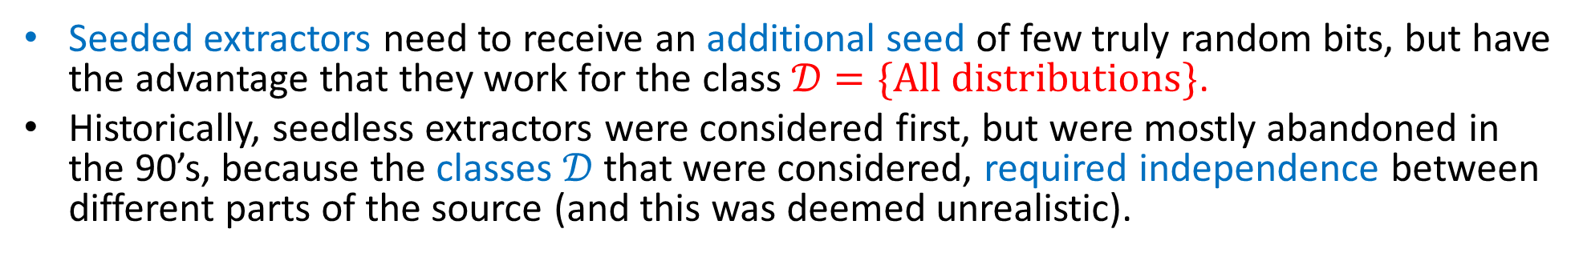
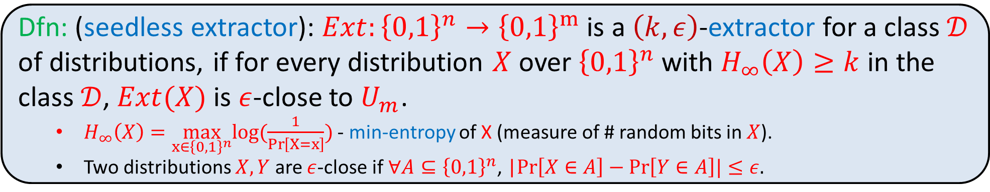
Seedless (Deterministic) Extractors
Dfn: (seedless extractor): $Ext:{\left\{0,1\right\}}^{n}→{\left\{0,1\right\}}^{m}$ is a $\left(k,ε\right)$-extractor for a class $𝒟$ of distributions, if for every distribution $X$ over ${\left\{0,1\right\}}^{n}$ with $H_{∞}\left(X\right)≥k$ in the class $𝒟$, $Ext(X)$ is $ε$-close to $U_{m}$.
  $H_{∞}\left(X\right)=\max_{x∈{\left\{0,1\right\}}^{n}}log(\frac{1}{\operatorname{Pr}\left[X=x\right]})$ - min-entropy of X (measure of # random bits in $X$).
  Two distributions $X,Y$ are $ε$-close if $∀A⊆{\left\{0,1\right\}}^{n}$, |$Pr\left[X∈A\right]−Pr\left[Y∈A\right]|≤ε.$
“weak source of randomness”
“weak source of randomness”
seedless
extractor
seeded
extractor
seed
“close to uniform output”
“close to uniform output”
Seeded extractors need to receive an additional seed of few truly random bits, but have the advantage that they work for the class $𝒟=\{All distributions\}$.
Historically, seedless extractors were considered first, but were mostly abandoned in the 90’s, because the classes $𝒟$ that were considered, required independence between different parts of the source (and this was deemed unrealistic).

Slide 4
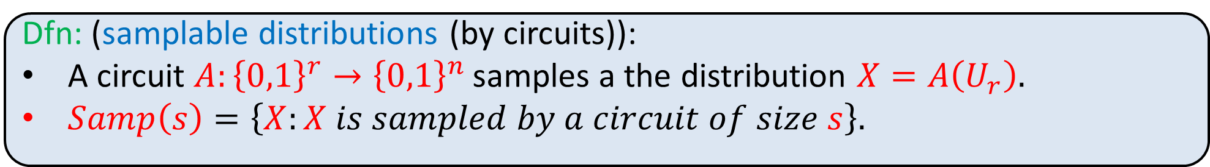
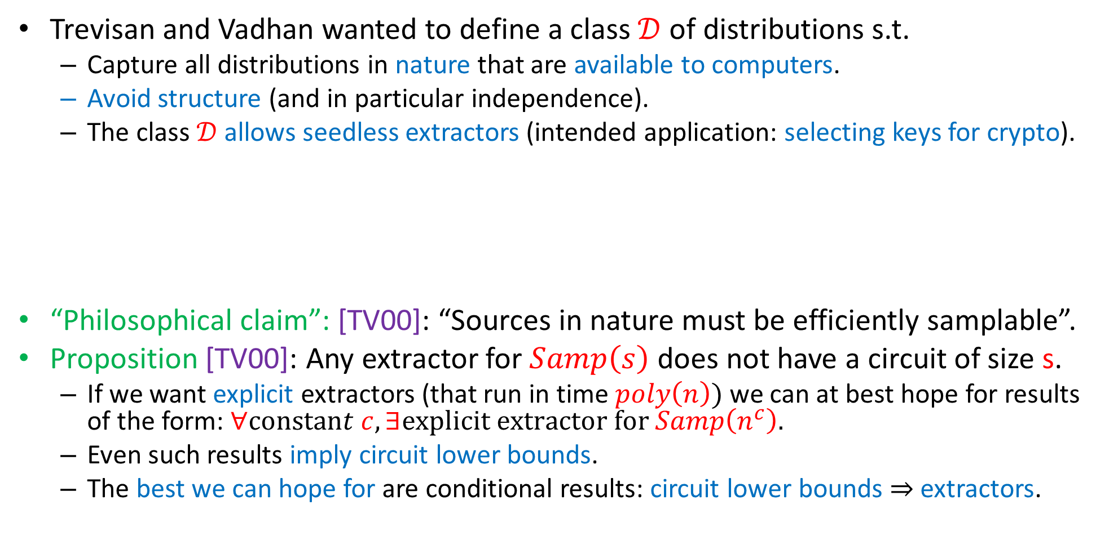
Extractors for Samplable Distributions [TV00]
Trevisan and Vadhan wanted to define a class $𝒟$ of distributions s.t.
  Capture all distributions in nature that are available to computers.
  Avoid structure (and in particular independence).
  The class $𝒟$ allows seedless extractors (intended application: selecting keys for crypto).
“Philosophical claim”: [TV00]: “Sources in nature must be efficiently samplable”.
Proposition [TV00]: Any extractor for $Samp\left(s\right)$ does not have a circuit of size s.
  If we want explicit extractors (that run in time $poly\left(n\right))$ we can at best hope for results of the form: $∀constant c, ∃explicit extractor for Samp\left(n^{c}\right).$
  Even such results imply circuit lower bounds.
  The best we can hope for are conditional results: circuit lower bounds $⇒$extractors.
Dfn: (samplable distributions (by circuits)):
A circuit $A:{\left\{0,1\right\}}^{r}→{\left\{0,1\right\}}^{n}$ samples a the distribution $X=A\left(U_{r}\right).$
$Samp\left(s\right)=\left\{X:X is sampled by a circuit of size s\right\}.$

Slide 5
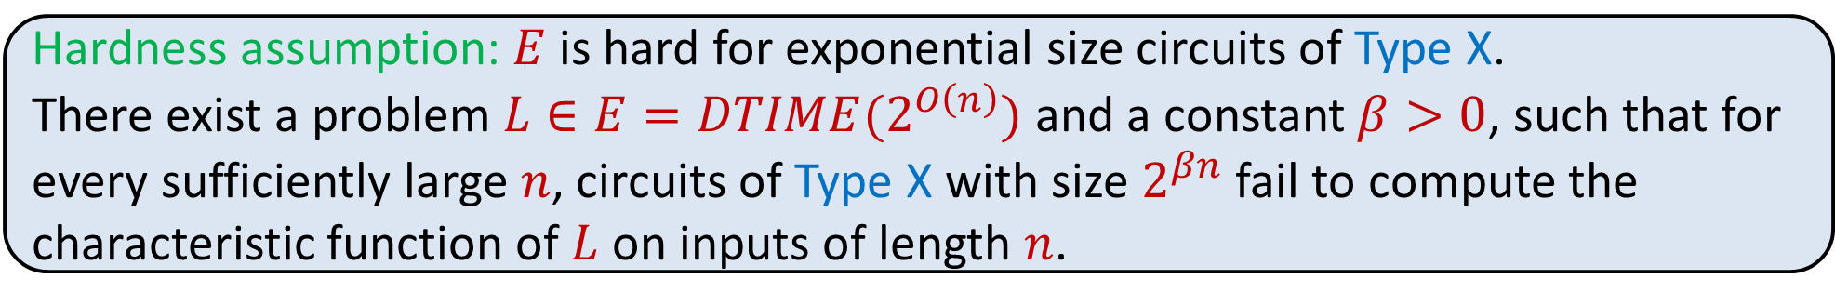
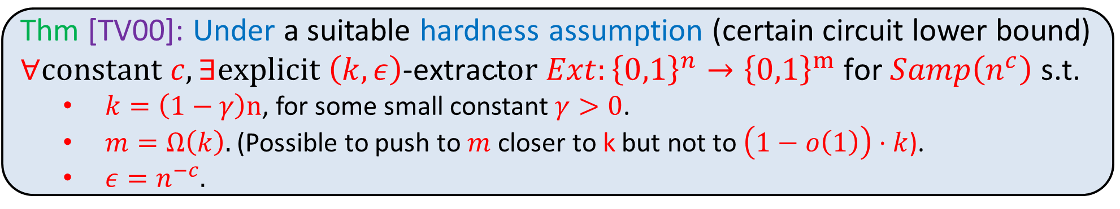
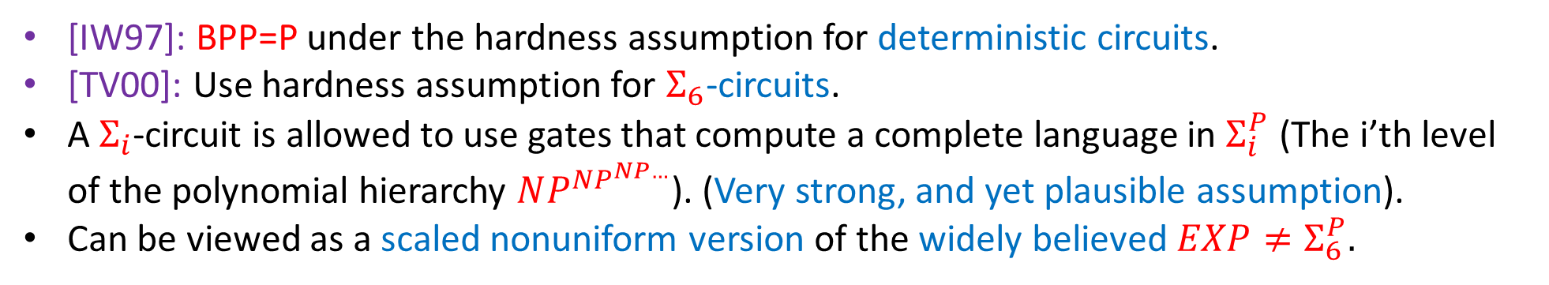
Extractors for Samplable Distributions [TV00]
Thm [TV00]: Under a suitable hardness assumption (certain circuit lower bound) $∀constant c, ∃explicit \left(k,ε\right)\text{−}\text{extract}or Ext:{\left\{0,1\right\}}^{n}→{\left\{0,1\right\}}^{m} \text{for} Samp\left(n^{c}\right)$ s.t.
  $k=\left(1−γ\right)n$, for some small constant $γ>0$.
  $m=Ω\left(k\right).$(Possible to push to $m$ closer to k but not to $\left(1−o\left(1\right)\right)⋅k$).
  $ε=n^{−c}.$
Hardness assumption: $E$ is hard for exponential size circuits of Type X.
There exist a problem $L∈E=DTIME(2^{O\left(n\right)})$ and a constant $β>0$, such that for every sufficiently large $n$, circuits of Type X with size $2^{βn}$ fail to compute the characteristic function of $L$ on inputs of length $n$.
[IW97]: BPP=P under the hardness assumption for deterministic circuits.
[TV00]: Use hardness assumption for $Σ_{6}$-circuits.
A $Σ_{i}$-circuit is allowed to use gates that compute a complete language in $Σ_{i}^{P}$ (The i’th level of the polynomial hierarchy $NP^{NP^{NP…}}$). (Very strong, and yet plausible assumption).
Can be viewed as a scaled nonuniform version of the widely believed $EXP≠Σ_{6}^{P}.$

Slide 6

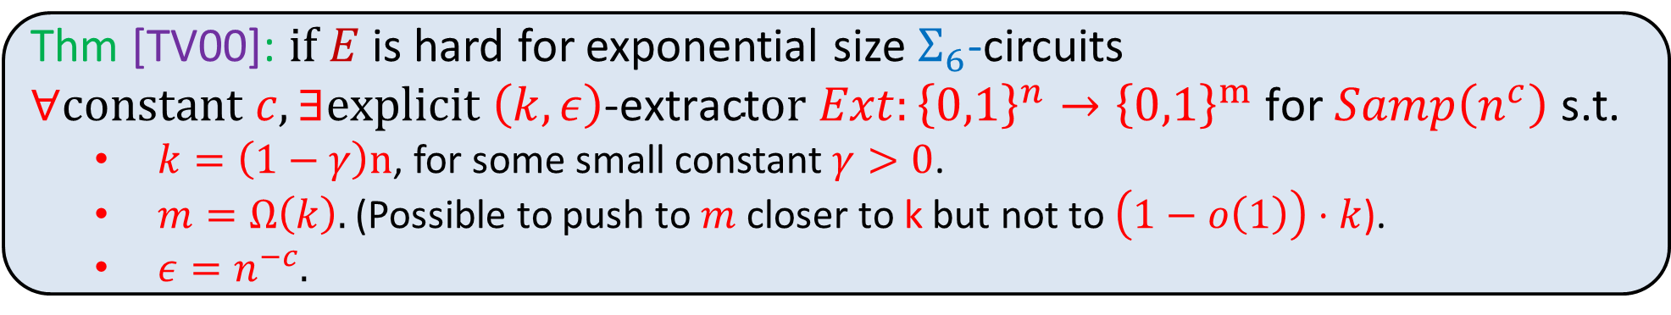
Multiplicative extractors for samplable distributions
Thm [TV00]: $if E$ is hard for exponential size $Σ_{6}$-circuits $∀constant c, ∃explicit \left(k,ε\right)\text{−}\text{extract}or Ext:{\left\{0,1\right\}}^{n}→{\left\{0,1\right\}}^{m} \text{for} Samp\left(n^{c}\right)$ s.t.
  $k=\left(1−γ\right)n$, for some small constant $γ>0$.
  $m=Ω\left(k\right).$(Possible to push to $m$ closer to k but not to $\left(1−o\left(1\right)\right)⋅k$).
  $ε=n^{−c}.$
[BGDM23]: Same result, with assumption against nondeterministic circuits $⊆Σ_{1}$-circuits.
Same construction as [TV00], significantly more complicated proof.
Our Results [S24]: Same as [BGDM23], much simpler proof (arguably simpler than [TV00]).
Our Results [S24]: Partial justification for necessity of hardness assumption.
[TV00] motivation is “selecting keys for cryptographic protocols”. This requires $ε=n^{−ω(1)}.$
[AASY15]: “Black-box proofs” cannot achieve explicit extractors with $ε=n^{−ω(1)}.$
[AASY15]: Introduced “multiplicative extractors” to bypass this problem.
Dfn [AASY15]: $Ext$ is multiplicative if output distribution $Z=Ext\left(X\right)$ satisfies $∀z∈{\left\{0,1\right\}}^{m}$, $\operatorname{Pr}\left[Z=z\right]≤\left(1+ε\right)⋅2^{−m} ⇒∀A⊆{\left\{0,1\right\}}^{m}$, $\operatorname{Pr}\left[Z∈A\right]≤\left(1+ε\right)⋅\operatorname{Pr}\left[U_{m}∈A\right].$
Sufficient for app: $\operatorname{Pr}\left[U_{m}∈A\right]=n^{−ω\left(1\right)}⇒\operatorname{Pr}\left[Z∈A\right]=n^{−ω\left(1\right)}, where A=${Adversary wins}.
Our results [S24]: The simpler proof in fact gives a multiplicative extractor.
This hardness assumption was introduced in the framework of derandomizing AM, and is by now standard [AK02, KvM02, MV05, SU05, BOV07, GW02, GST03, SU06, SU09, Dru13, AASY15, BV17, AIKS16, HNY17, DMOZ22, BDL22, CT22, BGDM23, BSS24, SS24].

Slide 7
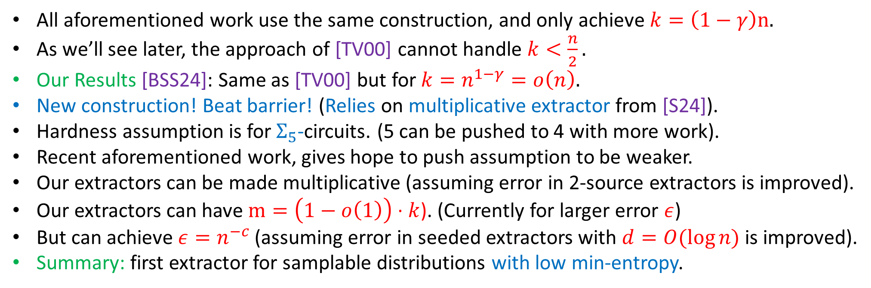
Extractors for samplable distributions with low min-entropy
Thm [TV00]: $if E$ is hard for exponential size $Σ_{6}$-circuits $∀constant c, ∃explicit \left(k,ε\right)\text{−}\text{extract}or Ext:{\left\{0,1\right\}}^{n}→{\left\{0,1\right\}}^{m} \text{for} Samp\left(n^{c}\right)$ s.t.
  $k=\left(1−γ\right)n$, for some small constant $γ>0$.
  $m=Ω\left(k\right).$(Possible to push to $m$ closer to k but not to $\left(1−o\left(1\right)\right)⋅k$).
  $ε=n^{−c}.$
All aforementioned work use the same construction, and only achieve $k=\left(1−γ\right)n.$
As we’ll see later, the approach of [TV00] cannot handle $k<\frac{n}{2}.$
Our Results [BSS24]: Same as [TV00] but for$k=n^{1−γ}=o\left(n\right).$
New construction! Beat barrier! (Relies on multiplicative extractor from [S24]).
Hardness assumption is for${ Σ}_{5}$-circuits. (5 can be pushed to 4 with more work).
Recent aforementioned work, gives hope to push assumption to be weaker.
Our extractors can be made multiplicative (assuming error in 2-source extractors is improved).
Our extractors can have $m=\left(1−o\left(1\right)\right)⋅k$). (Currently for larger error $ε$)
But can achieve$ε=n^{−c}$ (assuming error in seeded extractors with $d=O(\log{n) }$is improved).
Summary: first extractor for samplable distributions with low min-entropy.

Slide 8
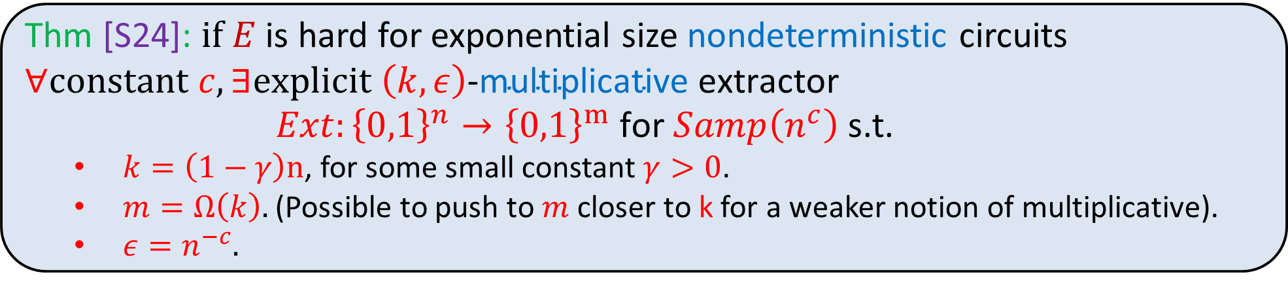
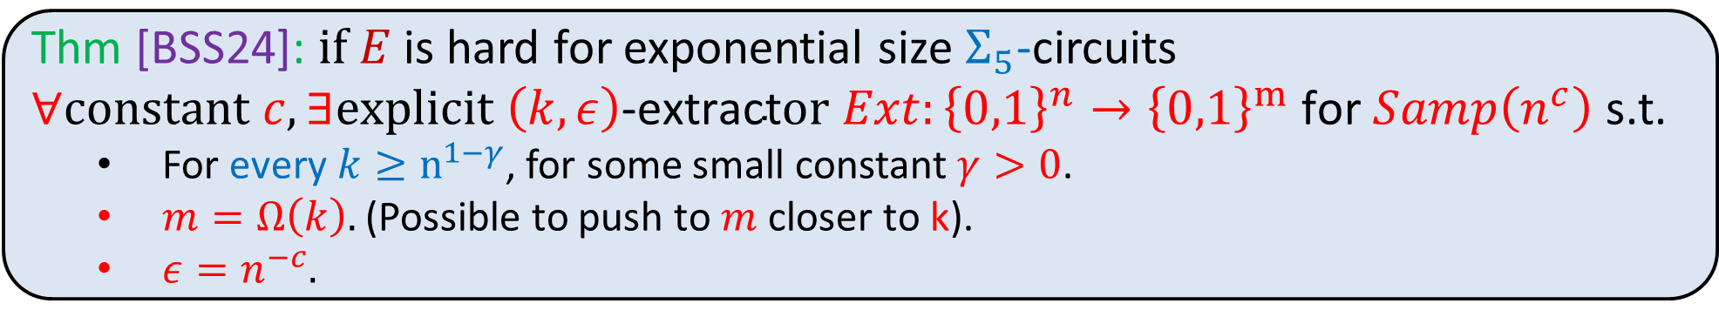
Formal statements of new theorems
Dfn [AASY15]: $Ext$ is multiplicative if output distribution $Z=Ext\left(X\right)$ satisfies $∀z∈{\left\{0,1\right\}}^{m}$, $\operatorname{Pr}\left[Z=z\right]≤\left(1+ε\right)⋅2^{−m} ⇒∀A⊆{\left\{0,1\right\}}^{m}$, $\operatorname{Pr}\left[Z∈A\right]≤\left(1+ε\right)⋅\operatorname{Pr}\left[U_{m}∈A\right].$
Thm [S24]: $if E$ is hard for exponential size nondeterministic circuits $∀constant c, ∃explicit \left(k,ε\right)\text{−}\text{multiplicative} \text{extractor} Ext:{\left\{0,1\right\}}^{n}→{\left\{0,1\right\}}^{m} \text{for} Samp\left(n^{c}\right)$ s.t.
  $k=\left(1−γ\right)n$, for some small constant $γ>0$.
  $m=Ω\left(k\right).$(Possible to push to $m$ closer to k for a weaker notion of multiplicative).
  $ε=n^{−c}.$
Thm [BSS24]: $if E$ is hard for exponential size $Σ_{5}$-circuits $∀constant c, ∃explicit \left(k,ε\right)\text{−}\text{extract}or Ext:{\left\{0,1\right\}}^{n}→{\left\{0,1\right\}}^{m} \text{for} Samp\left(n^{c}\right)$ s.t.
  For every $k≥n^{1−γ}$, for some small constant $γ>0$.
  $m=Ω\left(k\right).$(Possible to push to $m$ closer to k).
  $ε=n^{−c}.$
Open problem: combine benefits of both theorems$.$

Slide 9
Remainder of talk: High level overview
  Multiplicative extractor for samplable distributions
  Extractor for samplable distributions with low min-entropy.

Slide 10
Multiplicative extractor [S24] (high level overview)
  Approach of previous work [TV00,BDGM23]:
Hardness Assumption
Extractor for samplable distributions

Slide 11

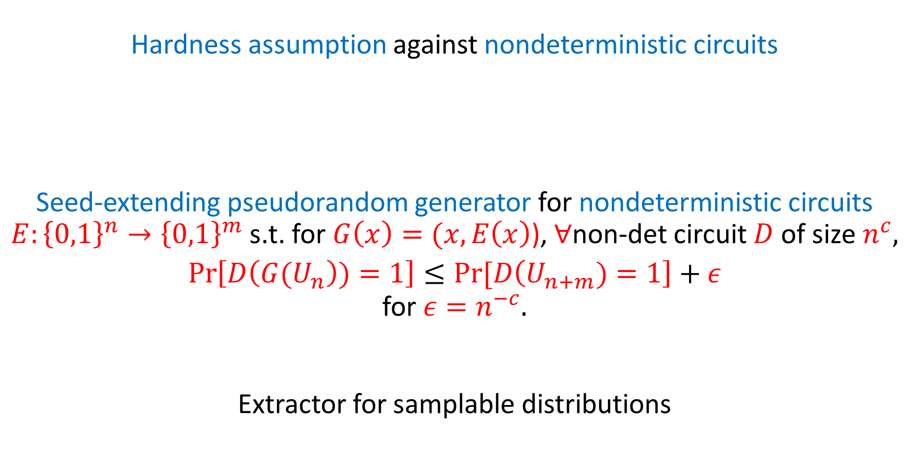
Multiplicative extractor [S24] (high level overview)
  New approach [S24]:
Hardness assumption against nondeterministic circuits
Seed-extending pseudorandom generator for nondeterministic circuits
$E:{\left\{0,1\right\}}^{n}→{\left\{0,1\right\}}^{m}$ s.t. for $G\left(x\right)=(x,E\left(x\right)$), $∀$non-det circuit $D$ of size $n^{c},$
$$\operatorname{Pr}\left[D\left({G(U}_{n}\right))=1\right]≤Pr⁡[D\left(U_{n+m})=1\right]+ε$$
for $ε=n^{−c}.$
Extractor for samplable distributions
Using the same construction as [TV00], [BDGM23].
This turns out to be much easier because we only need to analyze on the uniform distribution, rather than on any samplable source with high min-entropy.
Multiplicative [AIKS16]
$$⋅\left(1+ε\right)+2^{−Ω\left(n\right)}$$
Very easy.
Multiplicative

Slide 12
Remainder of talk: High level overview
  Multiplicative extractor for samplable distributions
  Extractor for samplable distributions with low min-entropy.

Slide 13
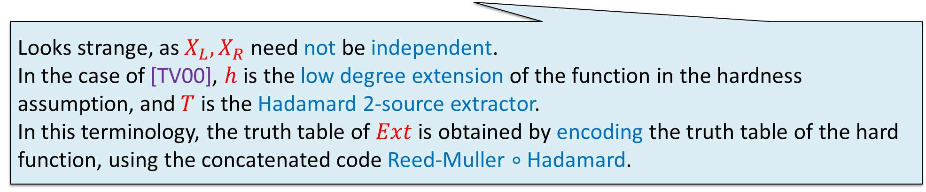


Overview of the construction of [TV00]
  Goal: Construct $Ext:{\left\{0,1\right\}}^{n}→${0,1} assuming hardness assumption.
  Ingredients:
  Hard on average function: $h:{\left\{0,1\right\}}^{n}→{\left\{0,1\right\}}^{n}$ s.t. $∀Σ_{2}$-circuit $C$ of size $n^{c}$, $\underset{Y←U_{n}}{Pr}\left[C\left(Y\right)=h\left(Y\right)\right]≤2^{−Ω\left(n\right)}$. (Constructed from assumption by [TV00]).
  2-source extractor $T:{\left\{0,1\right\}}^{n}×{\left\{0,1\right\}}^{n}→\left\{0,1\right\}.$
  Construction: Given $X∈{\left\{0,1\right\}}^{n}$, split it to two halves $X=(X_{L},X_{R})$ and set:
  $Ext\left(X\right)=T\left(h\left(X_{L}\right),X_{R}\right)$.
$$X$$
Looks strange, as $X_{L},X_{R}$ need not be independent.
In the case of [TV00], $h$ is the low degree extension of the function in the hardness assumption, and $T$ is the Hadamard 2-source extractor.
In this terminology, the truth table of $Ext$ is obtained by encoding the truth table of the hard function, using the concatenated code Reed-Muller $∘$ Hadamard.

Slide 14
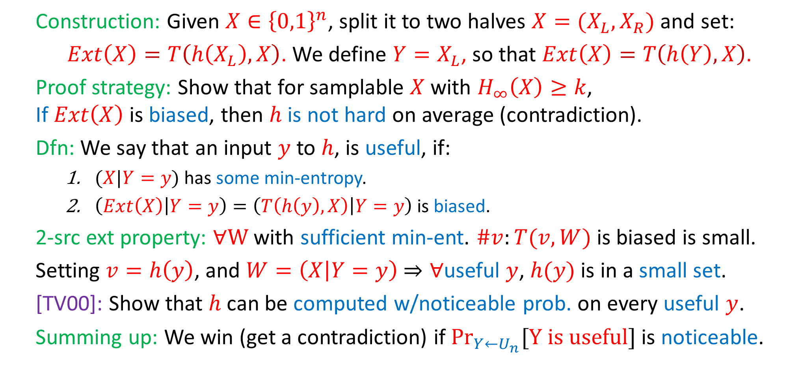
Analysis of [TV00] at a high level
  Construction: Given $X∈{\left\{0,1\right\}}^{n}$, split it to two halves $X=(X_{L},X_{R})$ and set:
  $Ext\left(X\right)=T\left(h\left(X_{L}\right),X\right)$. We define $Y=X_{L}$, so that $Ext\left(X\right)=T\left(h\left(Y\right),X\right)$.
  Proof strategy: Show that for samplable $X$with $H_{∞}\left(X\right)≥k$, If $Ext\left(X\right)$ is biased, then $h$ is not hard on average (contradiction).
  Dfn: We say that an input $y$ to $h$, is useful, if:
    $(X|Y=y)$ has some min-entropy.
    $\left(Ext\left(X\right) | Y=y\right)=\left(T\left(h\left(y\right),X\right) | Y=y\right)$ is biased.
  2-src ext property: $∀W$ with sufficient min-ent. $\#v:T(v,W)$ is biased is small.
  Setting $v=h\left(y\right)$, and $W=\left(X | Y=y\right)$ $⇒∀$useful $y$, $h(y)$ is in a small set.
  [TV00]: Show that $h$ can be computed w/noticeable prob. on every useful $y$.
  Summing up: We win (get a contradiction) if $\underset{Y←U_{n}}{Pr}{[Y is useful]}$ is noticeable.

Slide 15
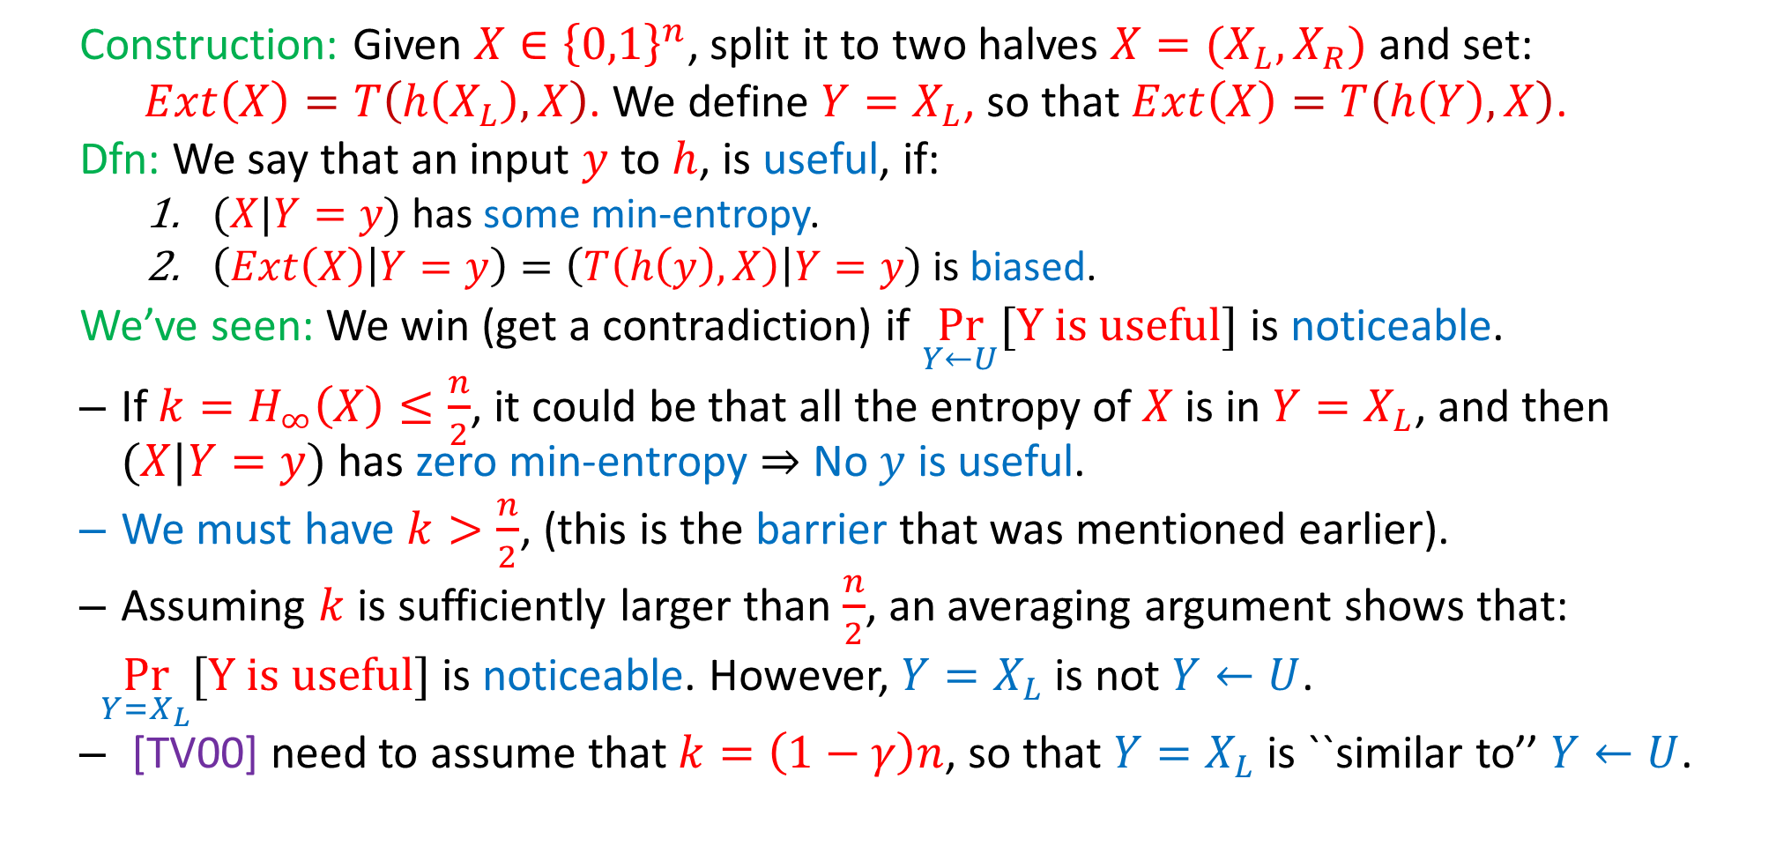
Analysis of [TV00]: barrier to low entropy
  Construction: Given $X∈{\left\{0,1\right\}}^{n}$, split it to two halves $X=(X_{L},X_{R})$ and set:
  $Ext\left(X\right)=T\left(h\left(X_{L}\right),X\right)$. We define $Y=X_{L}$, so that $Ext\left(X\right)=T\left(h\left(Y\right),X\right)$.
  Dfn: We say that an input $y$ to $h$, is useful, if:
    $(X|Y=y)$ has some min-entropy.
    $\left(Ext\left(X\right) | Y=y\right)=\left(T\left(h\left(y\right),X\right) | Y=y\right)$ is biased.
  We’ve seen: We win (get a contradiction) if $\underset{Y←U}{Pr}{[Y is useful]}$ is noticeable.
  If $k=H_{∞}\left(X\right)≤\frac{n}{2}$, it could be that all the entropy of $X$is in $Y=X_{L}$, and then $(X|Y=y)$ has zero min-entropy $⇒$ No $y$ is useful.
  We must have $k>\frac{n}{2}$, (this is the barrier that was mentioned earlier).
  Assuming $k$ is sufficiently larger than $\frac{n}{2}$, an averaging argument shows that:
  $\underset{Y=X_{L}}{Pr}{[Y is useful]}$ is noticeable. However, $Y=X_{L}$ is not $Y←U$.
  [TV00] need to assume that $k=\left(1−γ\right)n$, so that $Y=X_{L}$ is ``similar to’’ $Y←U$.

Slide 16



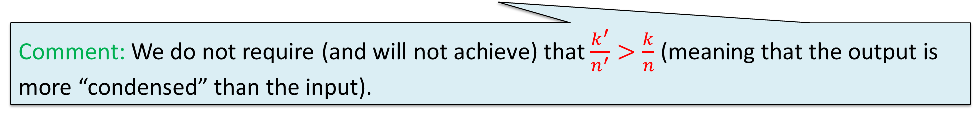
How to avoid the first barrier
  Construction: Given $X∈{\left\{0,1\right\}}^{n}$, split it to two halves $X=(X_{L},X_{R})$ and set:
  $Ext\left(X\right)=T\left(h\left( Cnd\left(X\right) \right),X\right)$. We define $Y=Cnd(X)$, so that $Ext\left(X\right)=T\left(h\left(Y\right),X\right)$.
  We’ve seen: If $k=H_{∞}\left(X\right)≤\frac{n}{2}$, it could be that all the entropy of $X$is in $Y=X_{L}$ and then $(X|Y=y)$ has zero min-entropy $⇒$ No $y$ is useful.
  We introduce a new object: “errorless condenser for samplable distributions”.
  We replace $X_{L}$ with $Cnd(X)$ for a condenser with $n′≤\frac{k}{2}$, and say $k^{′}=n^{0.9}$. (We give an explicit conditional construction of such $Cnd$ for $k=n^{1−γ}$).
  Now, we have that $\left(Y,X\right)$ is a (close to) a “block-wise source”, meaning that: $H_{∞}\left(Y\right)≥k′$, and $H_{∞}\left(X\right)≥\frac{k}{2}$, (even conditioned on $\{Y=y\}).$
  Sufficient for the previous argument. We get that: if $Ext(X)$ is biased, then: $\underset{Y=Cnd(X)}{Pr}{[Y is useful]}$ is noticeable.
$$X_{L}$$
$$X_{L}$$
Dfn: (errorless condenser): $Cnd:{\left\{0,1\right\}}^{n}→{\left\{0,1\right\}}^{n^{′}}$ is a $\left(k,k′\right)$-errorless condenser for $Samp(n^{c})$, if $∀X∈Samp(n^{c})$ over ${\left\{0,1\right\}}^{n}$ with $H_{∞}\left(X\right)≥k$, $H_{∞}\left(Cnd\left(X\right)\right)≥k′$.
Comment: We do not require (and will not achieve) that $\frac{k^{′}}{n^{′}}>\frac{k}{n}$ (meaning that the output is more “condensed” than the input).

Slide 17
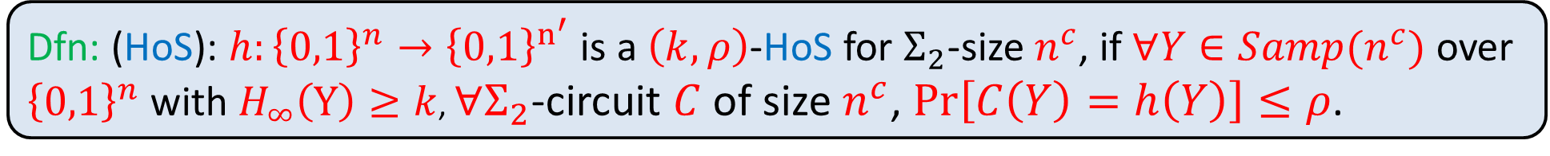
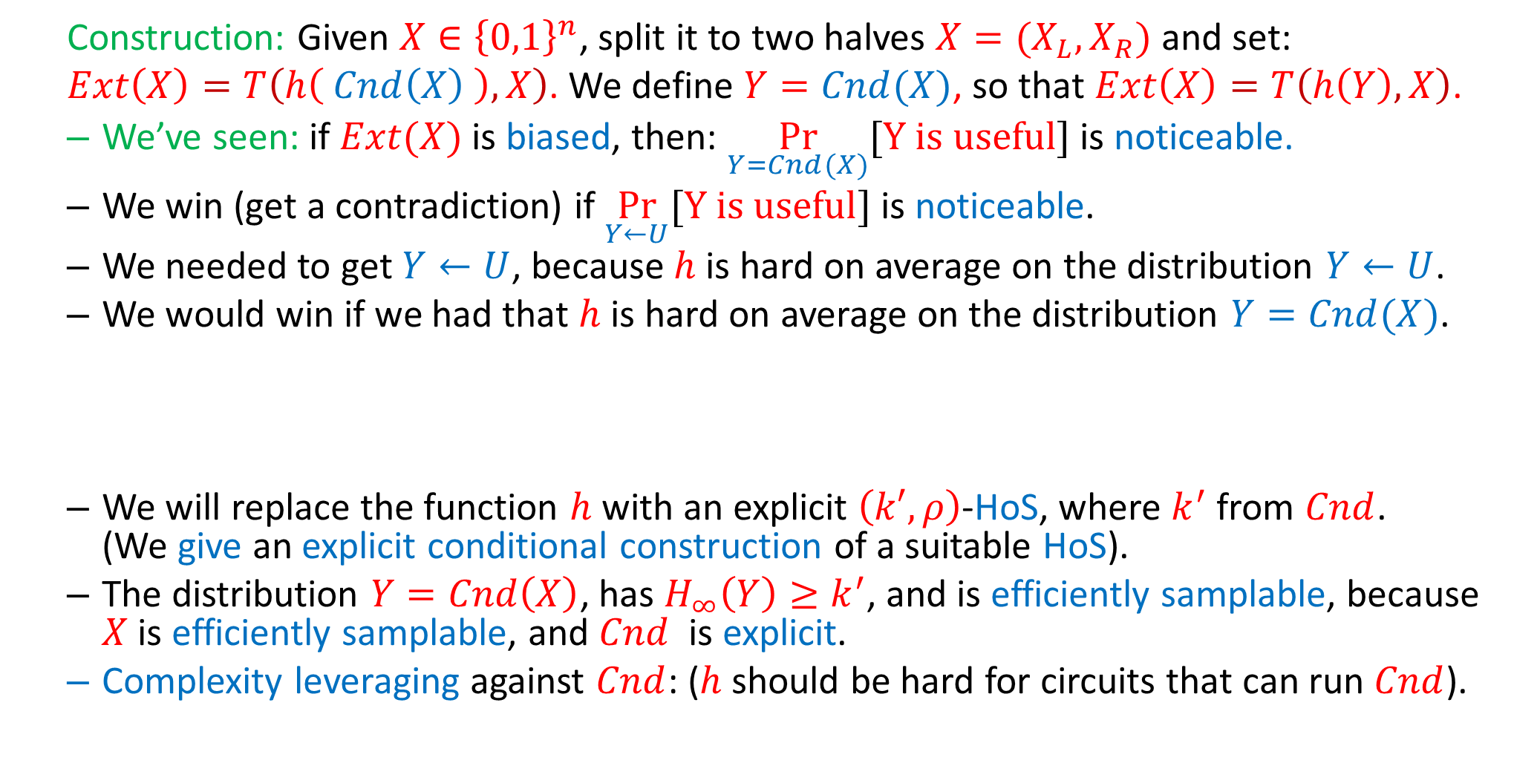
How to avoid the second barrier
  Construction: Given $X∈{\left\{0,1\right\}}^{n}$, split it to two halves $X=(X_{L},X_{R})$ and set:
  $Ext\left(X\right)=T\left(h\left( Cnd\left(X\right) \right),X\right)$. We define $Y=Cnd(X)$, so that $Ext\left(X\right)=T\left(h\left(Y\right),X\right)$.
  We’ve seen: if $Ext(X)$ is biased, then: $\underset{Y=Cnd(X)}{Pr}{[Y is useful]}$ is noticeable.
  We win (get a contradiction) if $\underset{Y←U}{Pr}{[Y is useful]}$ is noticeable.
  We needed to get $Y←U$, because $h$ is hard on average on the distribution $Y←U$.
  We would win if we had that $h$ is hard on average on the distribution $Y=Cnd(X)$.
  We will replace the function $h$ with an explicit $\left(k′,ρ\right)$-HoS, where $k^{′}$ from $Cnd$. (We give an explicit conditional construction of a suitable HoS).
  The distribution $Y=Cnd\left(X\right)$, has $H_{∞}\left(Y\right)≥k^{′}$, and is efficiently samplable, because $X$ is efficiently samplable, and $Cnd$ is explicit.
  Complexity leveraging against $Cnd$: ($h$ should be hard for circuits that can run $Cnd$).
Dfn: (HoS): $h:{\left\{0,1\right\}}^{n}→{\left\{0,1\right\}}^{n^{′}}$ is a $\left(k,ρ\right)$-HoS for $Σ_{2}$-size $n^{c}$, if $∀Y∈Samp(n^{c})$ over ${\left\{0,1\right\}}^{n}$ with $H_{∞}\left(Y\right)≥k$, $∀Σ_{2}$-circuit $C$ of size $n^{c}$, $\operatorname{Pr}\left[C\left(Y\right)=h\left(Y\right)\right]≤ρ$.

Slide 18
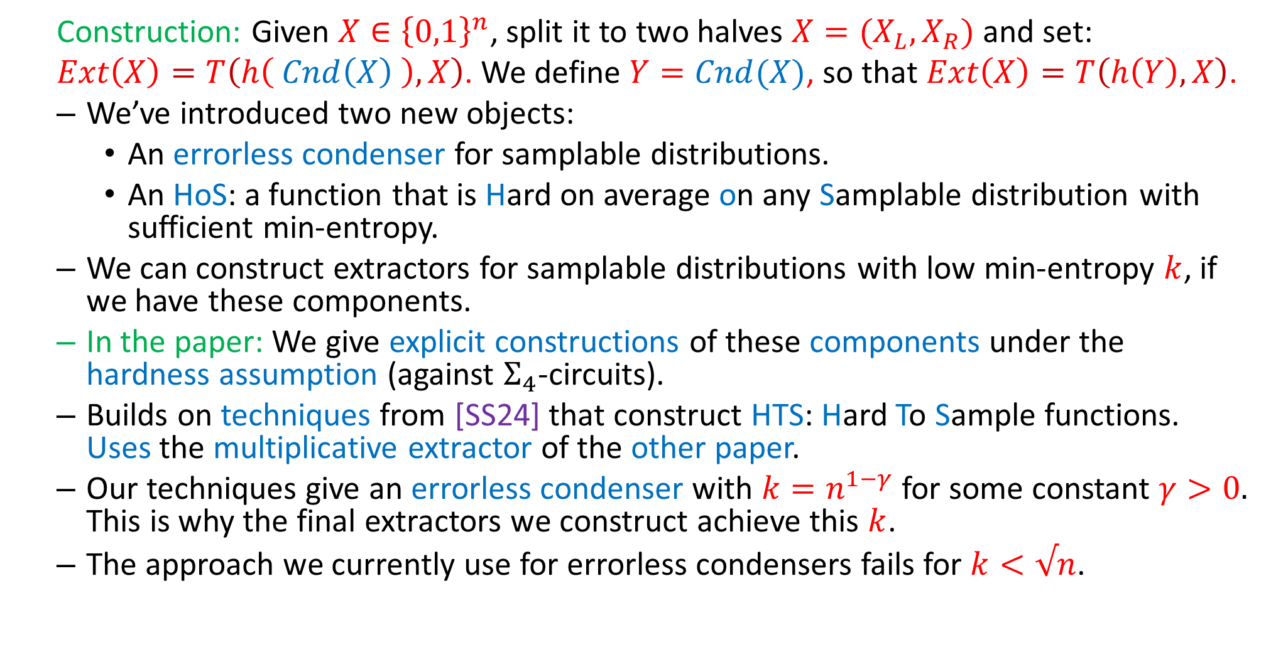
Summing up
  Construction: Given $X∈{\left\{0,1\right\}}^{n}$, split it to two halves $X=(X_{L},X_{R})$ and set:
  $Ext\left(X\right)=T\left(h\left( Cnd\left(X\right) \right),X\right)$. We define $Y=Cnd(X)$, so that $Ext\left(X\right)=T\left(h\left(Y\right),X\right)$.
  We’ve introduced two new objects:
    An errorless condenser for samplable distributions.
    An HoS: a function that is Hard on average on any Samplable distribution with sufficient min-entropy.
  We can construct extractors for samplable distributions with low min-entropy $k$, if we have these components.
  In the paper: We give explicit constructions of these components under the hardness assumption (against $Σ_{4}$-circuits).
  Builds on techniques from [SS24] that construct HTS: Hard To Sample functions. Uses the multiplicative extractor of the other paper.
  Our techniques give an errorless condenser with $k=n^{1−γ}$ for some constant $γ>0.$ This is why the final extractors we construct achieve this $k$.
  The approach we currently use for errorless condensers fails for $k<√n$.

Slide 19
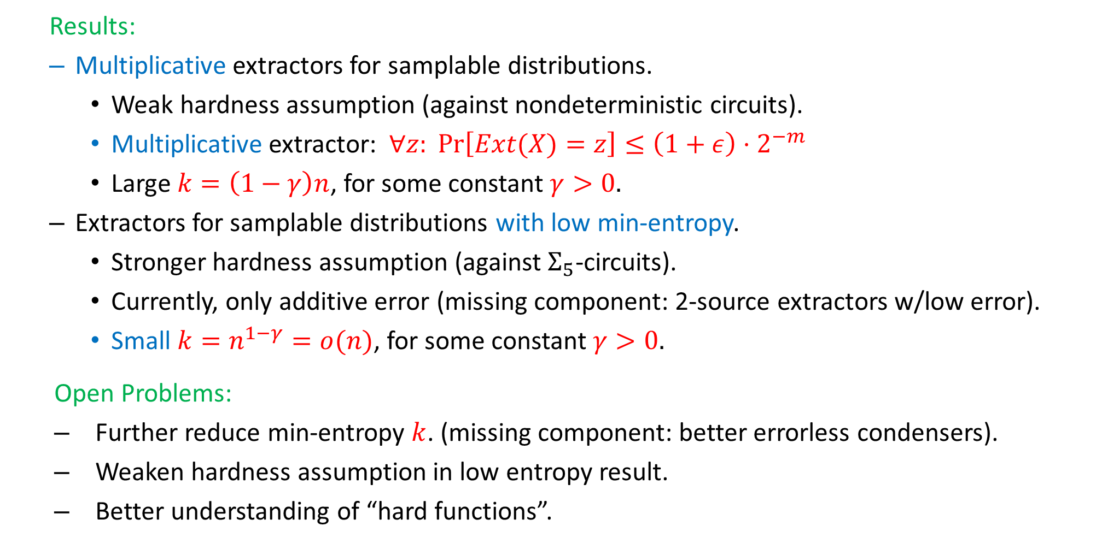
Conclusion and Open Problems
  Results:
  Multiplicative extractors for samplable distributions.
    Weak hardness assumption (against nondeterministic circuits).
    Multiplicative extractor: $∀z: \operatorname{Pr}\left[Ext(X)=z\right]≤\left(1+ε\right)⋅2^{−m}$
    Large $k=\left(1−γ\right)n$, for some constant $γ>0.$
  Extractors for samplable distributions with low min-entropy.
    Stronger hardness assumption (against $Σ_{5}$-circuits).
    Currently, only additive error (missing component: 2-source extractors w/low error).
    Small $k=n^{1−γ}=o(n)$, for some constant $γ>0.$
  Open Problems:
  Further reduce min-entropy $k$. (missing component: better errorless condensers).
  Weaken hardness assumption in low entropy result.
  Better understanding of “hard functions”.

Slide 20

That’s it…
Thank You…

