Slide 1
Computational Two Party Correlation
Iftach Haitner, TAU
Eran Omri, Ariel
Kobbi Nissim, Georgetown
Ronen Shaltiel, U. Haifa
Jad Silbak, U. Haifa

Slide 2
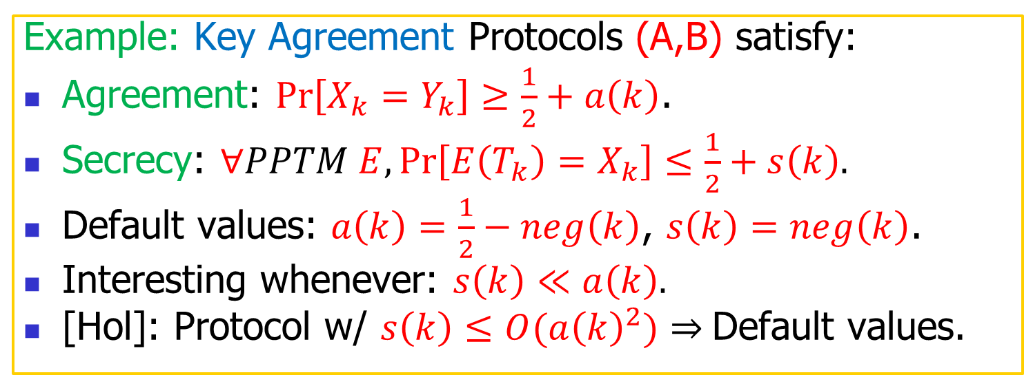
Poly-time 2-party protocols
security parameter
Two rand. poly-time parties: A,B.
Common input: security parameter k.
Parties interact.
Each party outputs one bit.
A
k
B
X_{k}
T_{k}
Y_{k}
output
transript
output
Example: Key Agreement Protocols (A,B) satisfy:
Agreement: $\operatorname{Pr}\left[X_{k}=Y_{k}\right]≥\frac{1}{2}+a\left(k\right)$.
Secrecy: $∀PPTM E,\operatorname{Pr}\left[E\left(T_{k}\right)=X_{k}\right]≤\frac{1}{2}+s\left(k\right).$
Default values: $a\left(k\right)=\frac{1}{2}−neg\left(k\right)$, $s\left(k\right)=neg\left(k\right)$.
Interesting whenever: $s\left(k\right)≪a\left(k\right).$
[Hol]: Protocol w/ $s\left(k\right)≤O({a\left(k\right)}^{2})⇒$Default values.

Slide 3
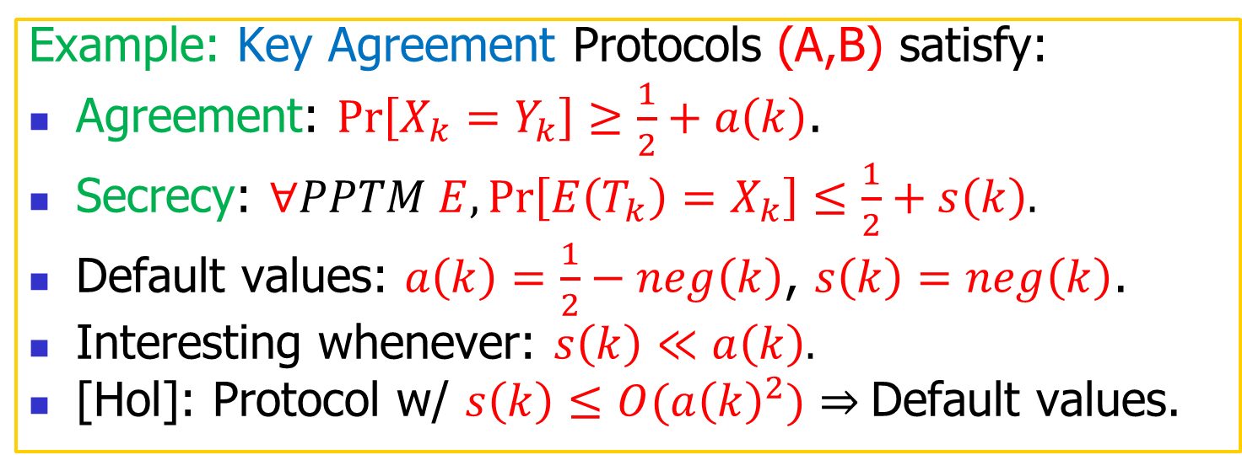
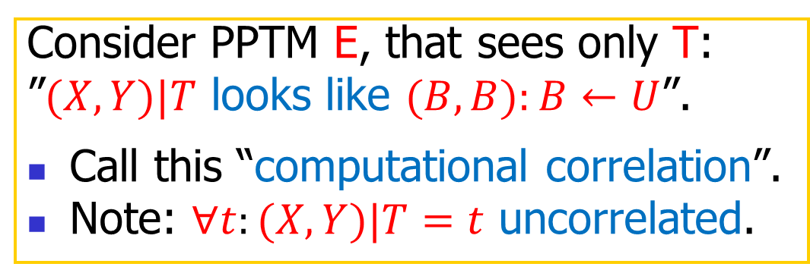
Key Agreement protocols and “Computational Correlation”
security parameter
Consider PPTM E, that sees only T:
”$(X,Y)|T$ looks like $(B,B):B←U$”.
Call this “computational correlation”.
$\text{Note}\text{: }∀t:(X,Y)|T=t$ uncorrelated.
A
k
B
X_{k}
T_{k}
Y_{k}
output
transript
output
Example: Key Agreement Protocols (A,B) satisfy:
Agreement: $\operatorname{Pr}\left[X_{k}=Y_{k}\right]≥\frac{1}{2}+a\left(k\right)$.
Secrecy: $∀PPTM E,\operatorname{Pr}\left[E\left(T_{k}\right)=X_{k}\right]≤\frac{1}{2}+s\left(k\right).$
Default values: $a\left(k\right)=\frac{1}{2}−neg\left(k\right)$, $s\left(k\right)=neg\left(k\right)$.
Interesting whenever: $s\left(k\right)≪a\left(k\right).$
[Hol]: Protocol w/ $s\left(k\right)≤O({a\left(k\right)}^{2})⇒$Default values.

Slide 4
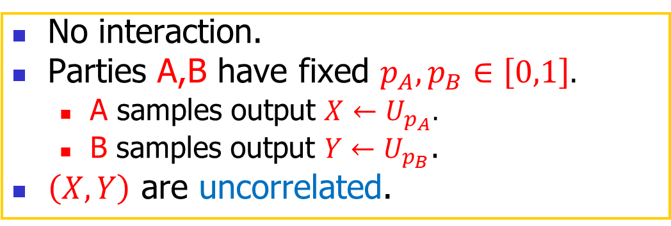
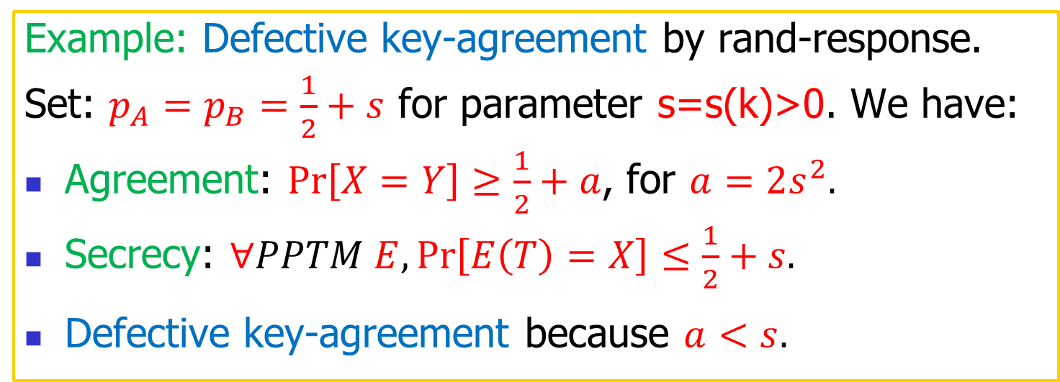
Uninteresting protocol:
Non-interactive randomized response
security parameter
No interaction.
Parties A,B have fixed $p_{A},p_{B}∈\left[0,1\right].$
  A samples output $X←U_{p_{A}}.$
  B samples output $Y←U_{p_{B}}$.
$\left(X,Y\right)$ are uncorrelated.
A
k
B
X_{k}
T_{k}
Y_{k}
output
transript
output
Example: Defective key-agreement by rand-response.
Set: $p_{A}=p_{B}=\frac{1}{2}+s$ for parameter s=s(k)>0. We have:
Agreement: $\operatorname{Pr}\left[X=Y\right]≥\frac{1}{2}+a$, for $a=2s^{2}.$
Secrecy: $∀PPTM E,\operatorname{Pr}\left[E\left(T\right)=X\right]≤\frac{1}{2}+s.$
Defective key-agreement because $a<s.$

Slide 5
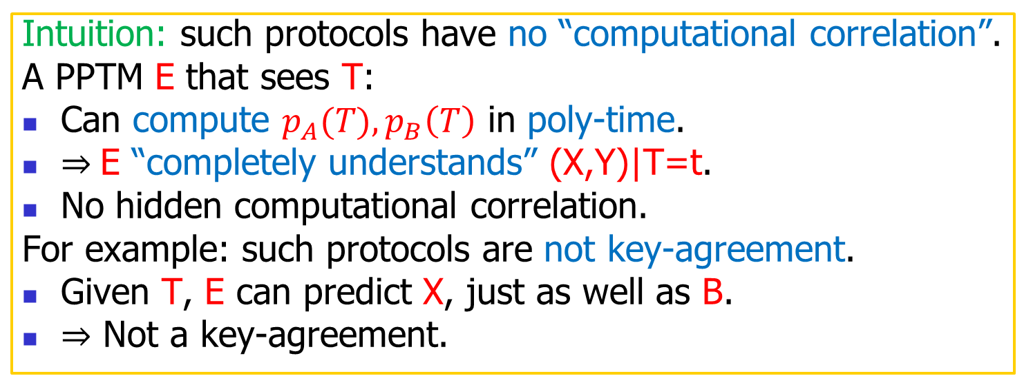
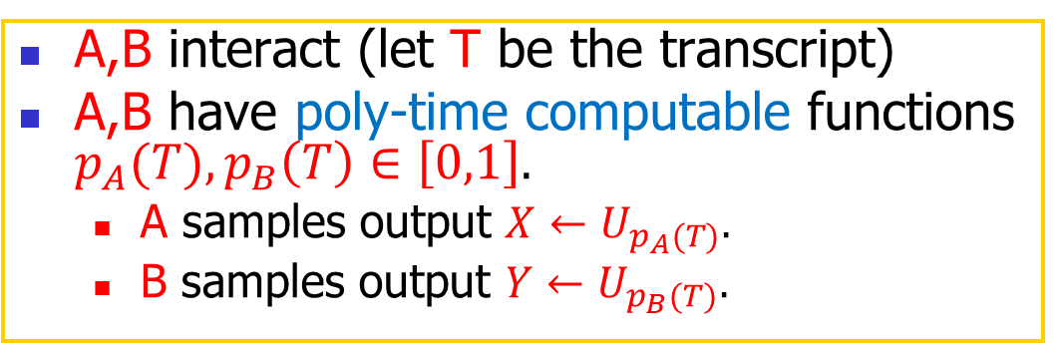
Slightly more interesting protocol:
Interactive randomized response
security parameter
A,B interact (let T be the transcript)
A,B have poly-time computable functions $p_{A}(T),p_{B}\left(T\right)∈\left[0,1\right].$
  A samples output $X←U_{p_{A}(T)}.$
  B samples output $Y←U_{p_{B}(T)}.$
A
k
B
X_{k}
T_{k}
Y_{k}
output
transript
output
Intuition: such protocols have no “computational correlation”.
A PPTM E that sees T:
Can compute $p_{A}(T),p_{B}\left(T\right)$ in poly-time.
$⇒$E “completely understands” (X,Y)|T=t.
No hidden computational correlation.
For example: such protocols are not key-agreement.
Given T, E can predict X, just as well as B.
$⇒$ Not a key-agreement.

Slide 6



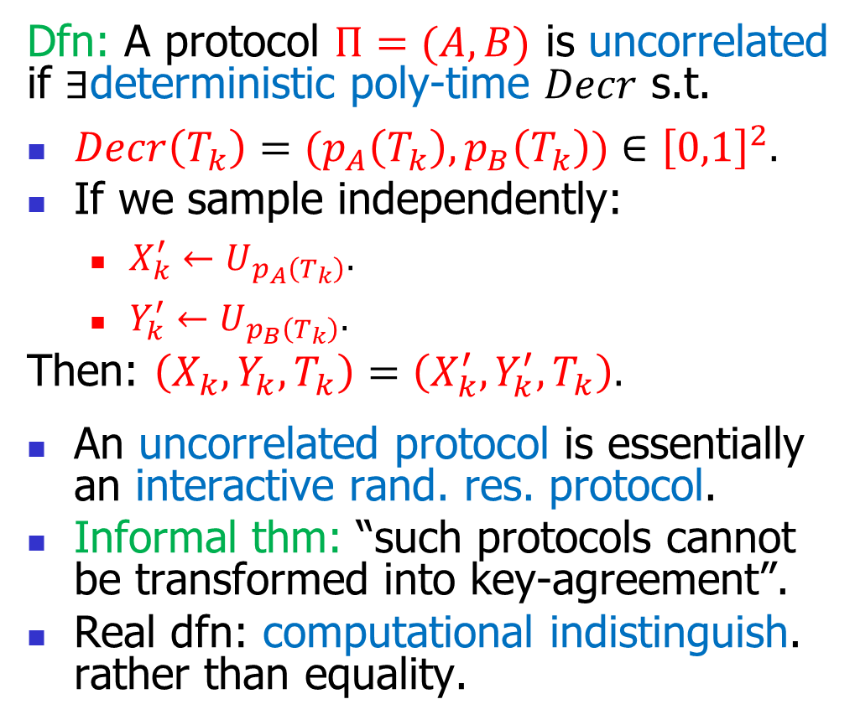



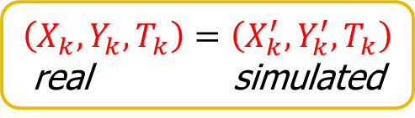
Uncorrelated protocols (informal)
security parameter
Dfn: A protocol $Π=(A,B)$ is uncorrelated if $∃$deterministic poly-time $Decr$ s.t.
$Decr\left(T_{k}\right)={(p}_{A}\left(T_{k}\right),p_{B}\left(T_{k}\right))∈{\left[0,1\right]}^{2}.$
If we sample independently:
  $X_{k}^{′}←U_{p_{A}\left(T_{k}\right)}.$
  $Y_{k}^{′}←U_{p_{B}\left(T_{k}\right)}.$
Then: $\left(X_{k},Y_{k},T_{k}\right)=\left(X_{k}^{′},Y_{k}^{′},T_{k}\right).$
An uncorrelated protocol is essentially an interactive rand. res. protocol.
Informal thm: “such protocols cannot be transformed into key-agreement”.
Real dfn: computational indistinguish. rather than equality.
A
k
B
$$X_{k}$$
$$T_{k}$$
$$Y_{k}$$
output
transript
output
Decr
$$p_{A},p_{B}$$
numbers
Sample independently:
$$X_{k}^{′}←U_{p_{A}}$$
$$Y_{k}^{′}←U_{p_{B}}$$
$\left(X_{k},Y_{k},T_{k}\right)=\left(X_{k}^{′},Y_{k}^{′},T_{k}\right)$ real simulated

Slide 7
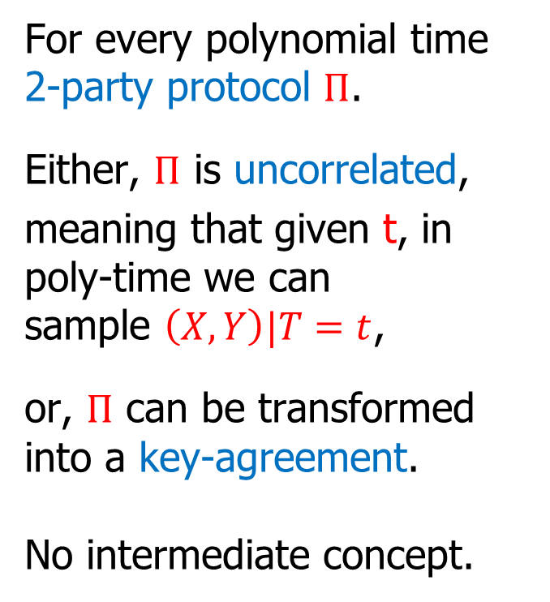
Main theorem (informal): A dichotomy
security parameter
Modulu some caveats and technicalities (explained soon)
A
k
B
For every polynomial time 2-party protocol $Π$.
Either, $Π$ is uncorrelated,
meaning that given t, in poly-time we can sample $\left(X,Y\right)|T=t$,
or, $Π$ can be transformed into a key-agreement.
No intermediate concept.
$$X_{k}$$
$$T_{k}$$
$$Y_{k}$$
output
transript
output
Decr
$$p_{A},p_{B}$$
numbers
Sample independently:
$$X_{k}^{′}←U_{p_{A}}$$
$$Y_{k}^{′}←U_{p_{B}}$$
$\left(X_{k},Y_{k},T_{k}\right)=\left(X_{k}^{′},Y_{k}^{′},T_{k}\right)$ real simulated

Slide 8

Main theorem (informal): A dichotomy
security parameter
Candidae intermediate concept: Defective key agreement: a<s.
In general, DKA doesn’t imply KA.
DKA can be “interesting”.
Examples:
Randomized response whp, and KA with small prob.
Stronger form of secrecy: $Pr⁡[X=1|E(T)=1]=\frac{1}{2}±s$
$∀$ppt E, which answers one with noticeable probability.
Agreement $a>2s^{2}$.
Modulu some caveats and technicalities (explained soon)
A
k
B
For every polynomial time 2-party protocol $Π$.
Either, $Π$ is uncorrelated,
meaning that given t, in poly-time we can sample $\left(X,Y\right)|T=t$,
or, $Π$ can be transformed into a key-agreement.
No intermediate concept.
$$X_{k}$$
$$T_{k}$$
$$Y_{k}$$
output
transript
output
Decr
$$p_{A},p_{B}$$
numbers
Sample independently:
$$X_{k}^{′}←U_{p_{A}}$$
$$Y_{k}^{′}←U_{p_{B}}$$
$\left(X_{k},Y_{k},T_{k}\right)=\left(X_{k}^{′},Y_{k}^{′},T_{k}\right)$ real simulated

Slide 9
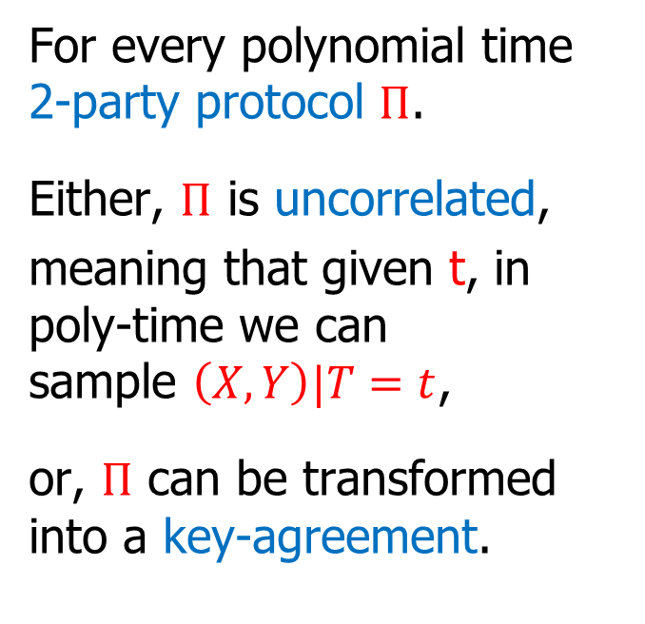
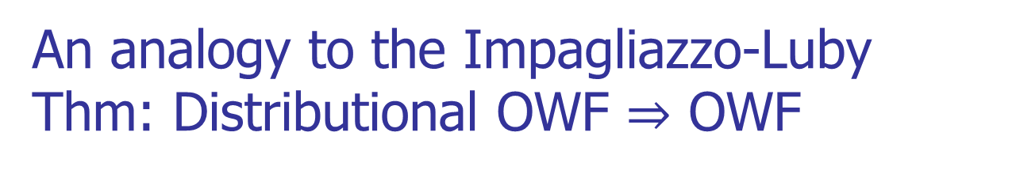
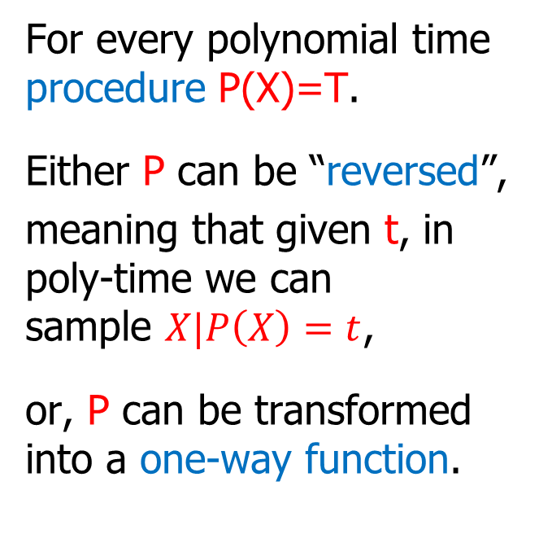
An analogy to the Impagliazzo-Luby Thm: Distributional OWF $⇒$ OWF
Our Theorem (Informal)
Impagliazzo-Luby (informal)
For every polynomial time 2-party protocol $Π$.
Either, $Π$ is uncorrelated,
meaning that given t, in poly-time we can sample $\left(X,Y\right)|T=t$,
or, $Π$ can be transformed into a key-agreement.
For every polynomial time procedure P(X)=T.
Either P can be “reversed”,
meaning that given t, in poly-time we can sample $X|P\left(X\right)=t$,
or, P can be transformed into a one-way function.
To show that a primitive implies OWF/KA, sufficient to show that it cannot be reversed/not uncorrelated.

Slide 10





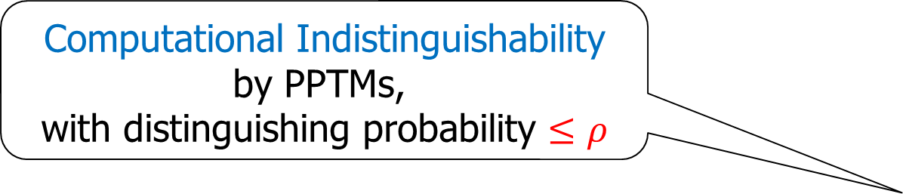
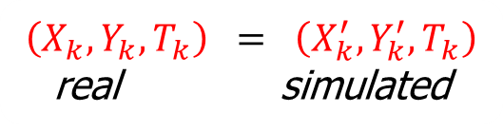
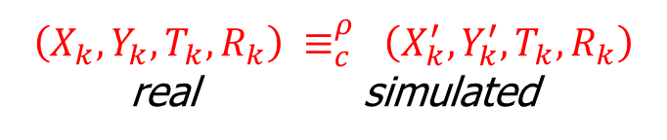
Main theorem: with caveats
security parameter
A
k
B
For every polynomial time 2-party protocol $Π$.
Either,
$Π$ is uncorrelated
or, $Π$ can be transformed into
a key-agreement
*Decr is allowed to be randomized.
for every constant $ρ>0$,
$$X_{k}$$
$$T_{k}$$
$$Y_{k}$$
$$ρ−$$
(on infinitely many k’s).
output
transript
output
$$R_{k}$$
Decr
(on infinitely many k’s).
$$p_{A},p_{B}$$
numbers
Computational Indistinguishability
by PPTMs,
with distinguishing probability $≤ρ$
Sample independently:
$$X_{k}^{′}←U_{p_{A}}$$
$$Y_{k}^{′}←U_{p_{B}}$$
$$≡_{c}^{ρ}$$
$\left(X_{k},Y_{k},T_{k}\right) = \left(X_{k}^{′},Y_{k}^{′},T_{k}\right)$ real simulated
$\left(X_{k},Y_{k},T_{k},R_{k}\right) ≡_{c}^{ρ} \left(X_{k}^{′},Y_{k}^{′},T_{k},R_{k}\right)$ real simulated

Slide 11
Applications:
Goal: Show that a primitive implies key-agreement.
Method: Show that primitive yields a correlated protocol.
This work:
Nontrivial differentially private protocol for XOR, implies (io) key agreement.
[Haitner,Makriyannis,Omri ‘18]:
Nontrivial coin-flipping protocol, implies (io) key agreement.

Slide 12
Proof of main theorem: Rigorous treatment of computational correlation.

Slide 13
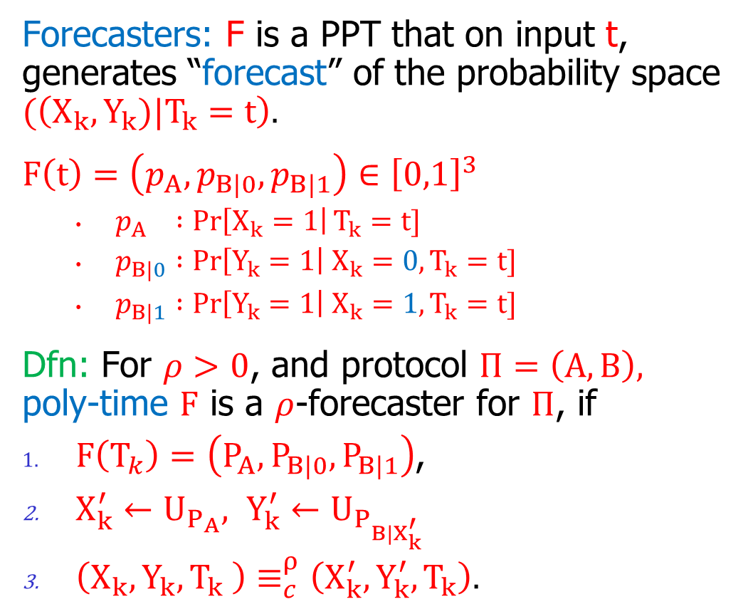
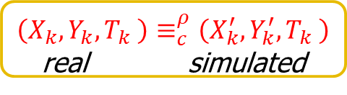
Forecasters: rigorous treatment of computational correlation
security parameter
Forecasters: F is a PPT that on input t, generates “forecast” of the probability space $(\left(X_{k},Y_{k})|T_{k}=t\right).$
$$F\left(t\right)=\left(p_{A},p_{B|0},p_{B|1}\right)∈{\left[0,1\right]}^{3}$$
  $p_{A} :\operatorname{Pr}\left[X_{k}=1\right|T_{k}=t]$
  $p_{B|0} :\operatorname{Pr}\left[Y_{k}=1\right| X_{k}=0,T_{k}=t]$
  $p_{B|1} :\operatorname{Pr}\left[Y_{k}=1\right| X_{k}=1,T_{k}=t]$
Dfn: For $ρ>0$, and protocol $Π=\left(A,B\right),$ poly-time $F$ is a $ρ$-forecaster for $Π$, if
$F\left(T_{k}\right)=\left(P_{A},P_{B|0},P_{B|1}\right)$,
$X_{k}^{′}←U_{P_{A}}, Y_{k}^{′}←U_{P_{B|X_{k}^{′}}}$
$\left(X_{k},Y_{k},T_{k} \right)≡_{c}^{ρ}\left(X_{k}^{′},Y_{k}^{′},T_{k}\right).$
A
k
B
$$X_{k}$$
$$T_{k}$$
$$Y_{k}$$
output
transript
output
$$F$$
$$p_{A},p_{B|0},p_{B|1}$$
numbers
Sample
$$X_{k}^{′}←U_{p_{A}}$$
$$Y_{k}^{′}←U_{p_{B|X_{k}^{′}}}$$
$\left(X_{k},Y_{k},T_{k} \right)≡_{c}^{ρ}\left(X_{k}^{′},Y_{k}^{′},T_{k} \right)$ real simulated

Slide 14
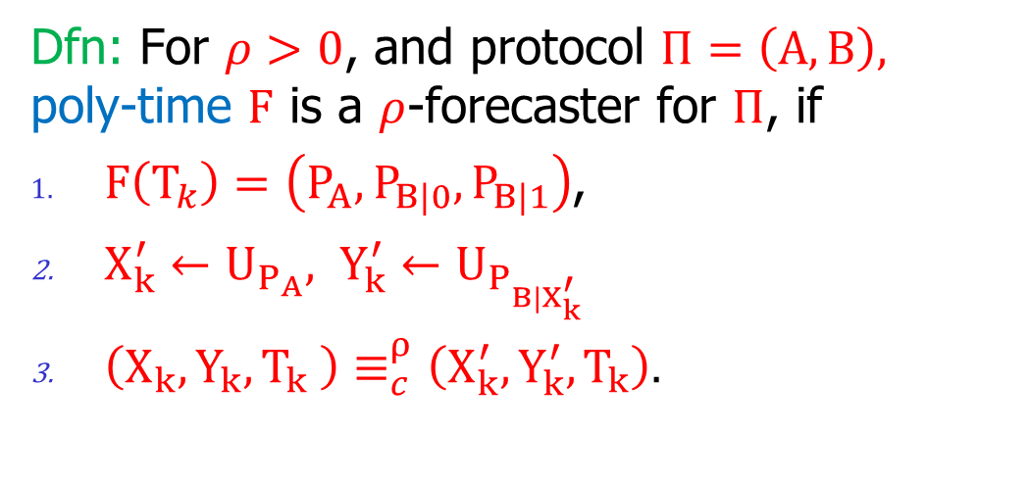
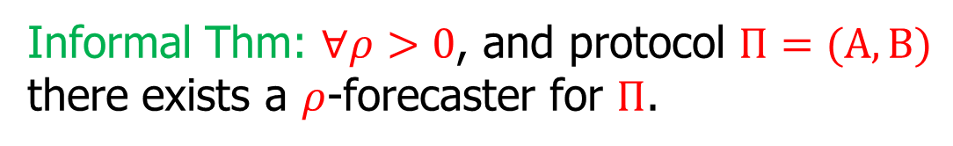
Forecasters: rigorous treatment of computational correlation
security parameter
Dfn: For $ρ>0$, and protocol $Π=\left(A,B\right),$ poly-time $F$ is a $ρ$-forecaster for $Π$, if
$F\left(T_{k}\right)=\left(P_{A},P_{B|0},P_{B|1}\right)$,
$X_{k}^{′}←U_{P_{A}}, Y_{k}^{′}←U_{P_{B|X_{k}^{′}}}$
$\left(X_{k},Y_{k},T_{k} \right)≡_{c}^{ρ}\left(X_{k}^{′},Y_{k}^{′},T_{k}\right).$
A
k
B
$$X_{k}$$
$$T_{k}$$
$$Y_{k}$$
output
transript
output
$$F$$
Informal Thm: $∀ρ>0$, and protocol $Π=(A,B)$ there exists a $ρ$-forecaster for $Π$.
$$p_{A},p_{B|0},p_{B|1}$$
numbers
Sample
Two caveats:
computational indistinguish for $ρ=o\left(1\right)$, not negligible.
$\left(X_{k},Y_{k},T_{k} \right) ≡_{c}^{ρ} \left(X_{k}^{′},Y_{k}^{′},T_{k}\right)$, only holds for an infinite subset of $k$’s.
$$X_{k}^{′}←U_{p_{A}}$$
$$Y_{k}^{′}←U_{p_{B|X_{k}^{′}}}$$
$\left(X_{k},Y_{k},T_{k} \right)≡_{c}^{ρ}\left(X_{k}^{′},Y_{k}^{′},T_{k} \right)$ real simulated

Slide 15
Forecasters give dichotomy
security parameter
Uncorrelated protocol: If except for very few $t$: $p_{B|0}=p_{B|1}$use $F$as Decr. $Decr\left(t\right)=(F{\left(t\right)}_{1},F{\left(t\right)}_{2})=(p_{A},p_{B|0}).$
A
k
B
$$X_{k}$$
$$T_{k}$$
$$Y_{k}$$
output
transript
output
$$F$$
If $p_{B|0}{=p}_{B|1}$
$X_{k}^{′},$ $Y_{k}^{′}$ are independent
$$p_{A},p_{B|0},p_{B|1}$$
numbers
Sample
$$X_{k}^{′}←U_{p_{A}}$$
$$Y_{k}^{′}←U_{p_{B|X_{k}^{′}}}$$
$\left(X_{k},Y_{k},T_{k} \right)≈_{c}^{ρ}\left(X_{k}^{′},Y_{k}^{′},T_{k} \right)$ real simulated

Slide 16
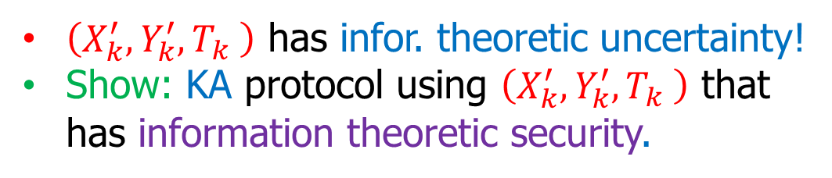
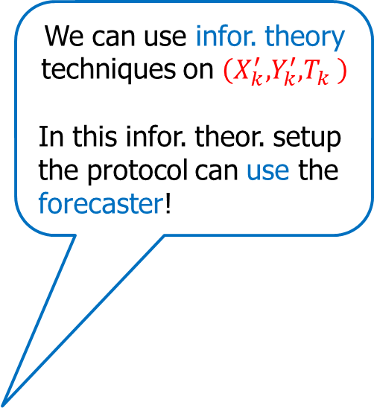
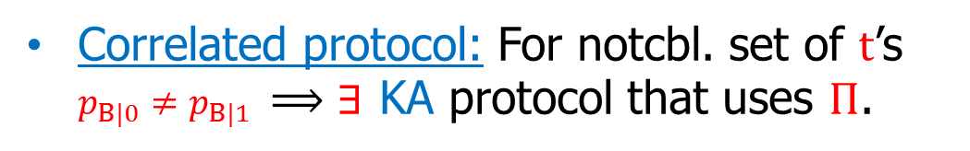
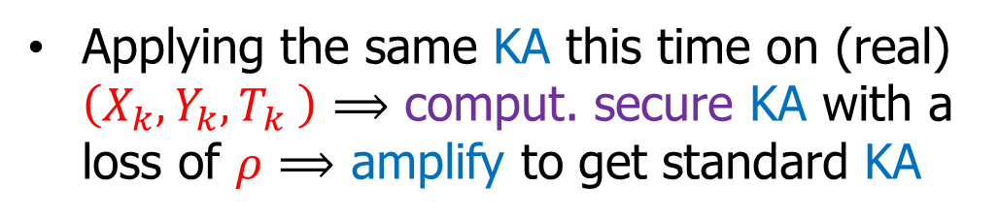
Forecasters give dichotomy
security parameter
We can use infor. theory techniques on $\left(X_{k}^{′},Y_{k}^{′},T_{k} \right)$
In this infor. theor. setup the protocol can use the forecaster!
Uncorrelated protocol: If except for very few $t$: $p_{B|0}=p_{B|1}$use $F$as Decr. $Decr\left(t\right)=(F{\left(t\right)}_{1},F{\left(t\right)}_{2})=(p_{A},p_{B|0}).$
A
k
B
$$X_{k}$$
$$T_{k}$$
$$Y_{k}$$
Correlated protocol: For notcbl. set of $t$’s $p_{B|0}≠p_{B|1} ⟹∃$ KA protocol that uses $Π$.
output
transript
output
$$F$$
$\left(X_{k}^{′},Y_{k}^{′},T_{k} \right)$ has infor. theoretic uncertainty!
Show: KA protocol using $\left(X_{k}^{′},Y_{k}^{′},T_{k} \right)$ that has information theoretic security.
$$p_{A},p_{B|0},p_{B|1}$$
numbers
Sample
$$\left(X_{k},Y_{k},T_{k} \right)≈_{c}^{ρ}\left(X_{k}^{′},Y_{k}^{′},T_{k} \right)$$
$$X_{k}^{′}←U_{p_{A}}$$
$$Y_{k}^{′}←U_{p_{B|X_{k}^{′}}}$$
Applying the same KA this time on (real) $\left(X_{k},Y_{k},T_{k} \right)$ $⟹$ comput. secure KA with a loss of $ρ$ $⟹$ amplify to get standard KA
$\left(X_{k},Y_{k},T_{k} \right)≈_{c}^{ρ}\left(X_{k}^{′},Y_{k}^{′},T_{k} \right)$ real simulated

Slide 17




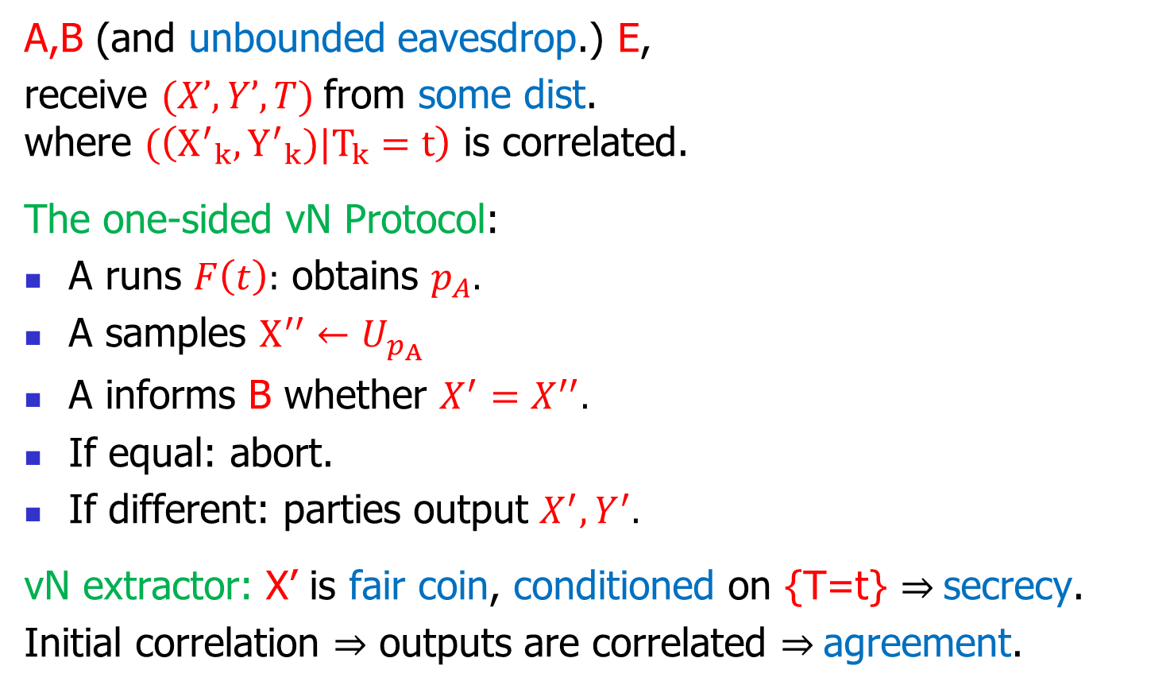



From correlated protocol to KA (in the simulated infor. theor. world)
A,B (and unbounded eavesdrop.) E,
receive $(X’,Y’,T)$from some dist. where $(\left({X^{′}}_{k},{Y^{′}}_{k})|T_{k}=t\right)$ is correlated.
The one-sided vN Protocol:
A runs $F\left(t\right):$ obtains $p_{A}.$
A samples $X^{′′}←U_{p_{A}}$
A informs B whether $X^{′}=X^{′′}.$
If equal: abort.
If different: parties output $X^{′},Y^{′}.$
vN extractor: X’ is fair coin, conditioned on {T=t} $⇒$secrecy.
Initial correlation $⇒$ outputs are correlated $⇒$agreement.
A
B
$$X′$$
$$T$$
$$Y′$$
output
“transcript”
output
If $X^{′}=X′′:$
If $X^{′}≠X′′:$
abort
continue
$$X′$$
$$Y′$$
final
output
final
output

Slide 18
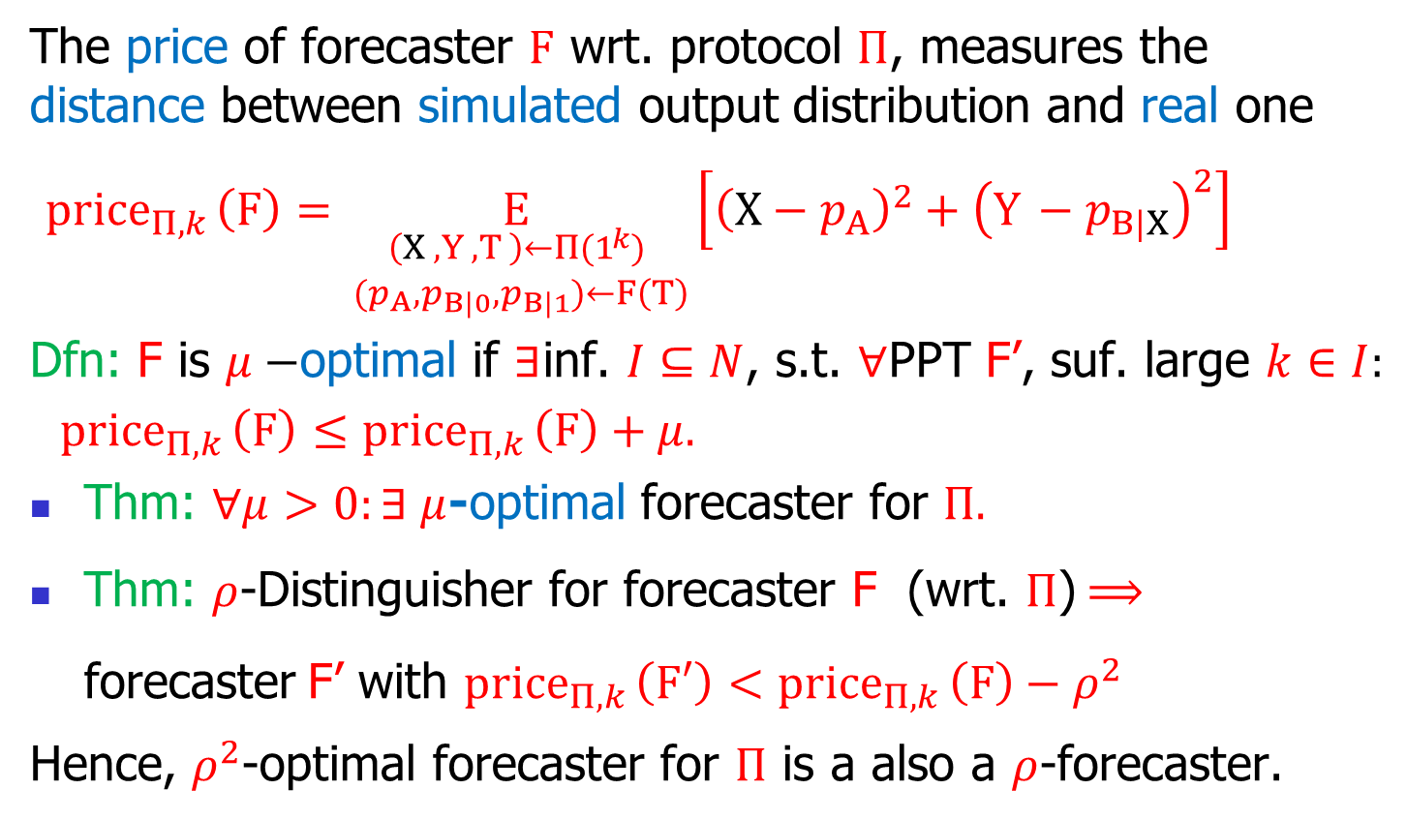
Existence of forecasters: A competition
The price of forecaster $F$ wrt. protocol $Π$, measures the distance between simulated output distribution and real one
${price}_{Π,k }\left(F\right)=\underset{\begin{aligned}\left(X_{ },Y_{ },T_{ }\right)←Π(1^{k}) \\ { (p}_{A},p_{B|0},p_{B|1})←F\left(T\right)\end{aligned}}{E}\left[{\left(X−{ p}_{A}\right)}^{2}+{\left(Y_{ }−p_{B|X}\right)}^{2}\right]$
Dfn: F is $μ−$optimal if $∃\text{inf}\text{. }I⊆N$, s.t. $∀$PPT F’, suf. large $k∈I:$
${price}_{Π,k }\left(F\right)$ $≤{price}_{Π,k }\left(F\right)+μ.$
Thm: $∀μ>0:∃ μ$-optimal forecaster for $Π.$
Thm: $ρ$-Distinguisher for forecaster F (wrt. $Π$)$⟹$ $\text{forecaster}$F’ with ${price}_{Π,k }\left(F′\right)<{price}_{Π,k }\left(F\right)−ρ^{2}$
Hence, $ρ^{2}$-optimal forecaster for $Π$ is a also a $ρ$-forecaster.

Slide 19
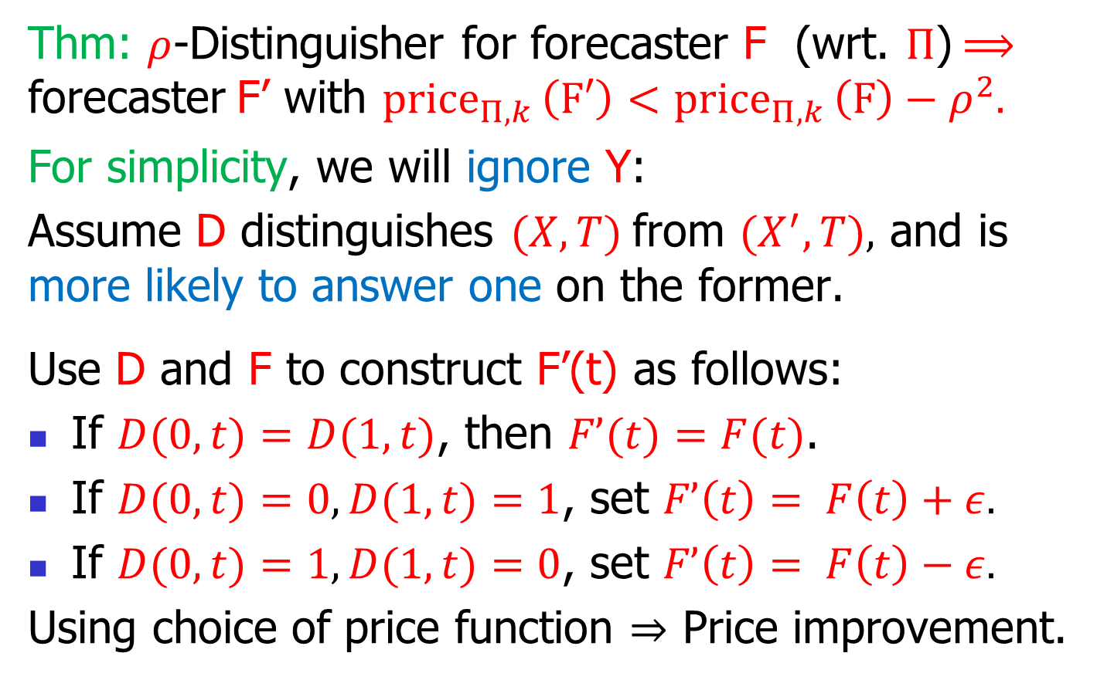
Distinguishing to price improvement
Thm: $ρ$-Distinguisher for forecaster F (wrt. $Π$)$⟹$ $\text{forecaster}$F’ with ${price}_{Π,k }\left(F′\right)<{price}_{Π,k }\left(F\right)−ρ^{2}.$
For simplicity, we will ignore Y:
Assume D distinguishes $(X,T)$from $(X^{′},T),$ and is more likely to answer one on the former.
Use D and F to construct F’(t) as follows:
If $D(0,t)=D(1,t)$, then $F’(t)=F(t)$.
If $D(0,t)=0, D(1,t)=1$, set $F’\left(t\right)= F\left(t\right)+ε.$
If $D(0,t)=1, D(1,t)=0$, set $F’\left(t\right)= F\left(t\right)−ε.$
Using choice of price function $⇒$ Price improvement.

Slide 20
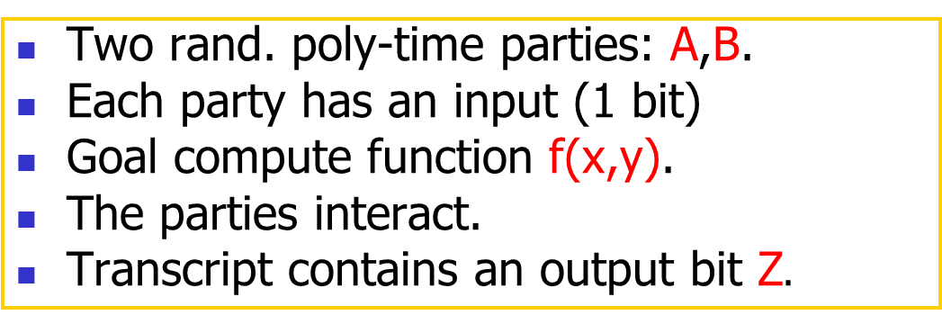

Application: Nontrivial Differential Privacy for XOR implies Key-Agreement
Two rand. poly-time parties: A,B.
Each party has an input (1 bit)
Goal compute function f(x,y).
The parties interact.
Transcript contains an output bit Z$.$
A
B
Actually, this is a weaker notion of DP against an external observer
x
y
Z
T
Z
Studied in:
[McGregor,Mironov,Pitassi,Reingold,Talwar,Vadhan10]
[Goyal,Mironov, Pandey,Sahai13]
[Khurana,Maji,Sahai14]
[Goyal,Khurana,Mironov,Pandey,Sahai16].
output
transript
output
Dfn: an $α$-correct, $(ε,δ)$-differentially private protocol:
Correctness: $∀x,y,$ $\operatorname{Pr}\left[Z=f(x,y)\right]≥\frac{1}{2}+α$.
Privacy of A: $∀PPTM D, \frac{\operatorname{Pr}\left[D\left(T\right)=1 | x=0\right]}{\operatorname{Pr}\left[D\left(T\right)=1 | x=1\right]}=e^{±ε}±δ.$
Do such protocols imply KA? For what parameters?
For $f\left(x,y\right)=x⊕y, α=2ε^{2}$ follows info-theoretically.
Thm: For f, constant $ε$,$α=Ω\left(ε^{2}\right)$, DP $⇒$ KA.

Slide 21

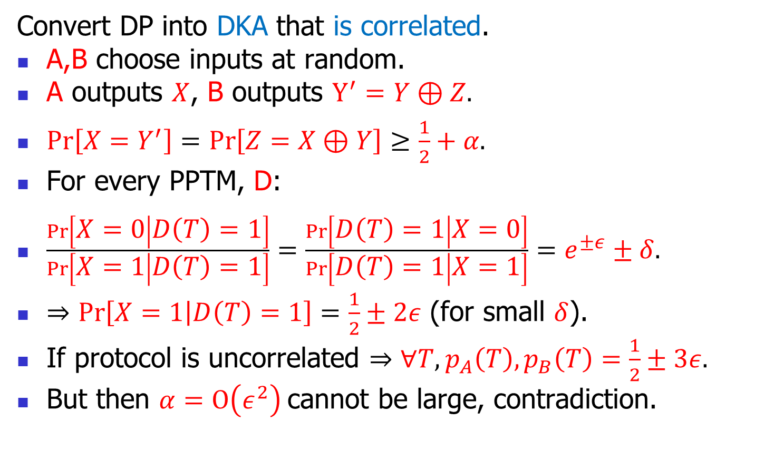

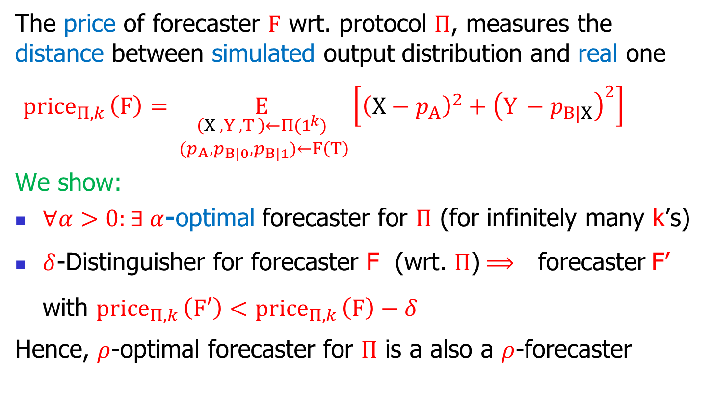



Proof: DP $⇒$ not uncorrelated $⇒$KA
Convert DP into DKA that is correlated.
A,B choose inputs at random.
A outputs $X$, B outputs $Y^{′}=Y⊕Z.$
$\operatorname{Pr}\left[X=Y^{′}\right]=\operatorname{Pr}\left[Z=X⊕Y\right]≥\frac{1}{2}+α.$
For every PPTM, D:
$\frac{\operatorname{Pr}\left[X=0 | D\left(T\right)=1\right]}{\operatorname{Pr}\left[X=1 | D\left(T\right)=1\right]}=\frac{\operatorname{Pr}\left[D\left(T\right)=1 | X=0\right]}{\operatorname{Pr}\left[D\left(T\right)=1 | X=1\right]}=e^{±ε}±δ.$
$⇒Pr\left[X=1 | D\left(T\right)=1\right]=\frac{1}{2}±2ε$ (for small $δ$).
If protocol is uncorrelated $⇒∀T, p_{A}\left(T\right),p_{B}\left(T\right)=\frac{1}{2}±3ε.$
But then $α=O\left(ε^{2}\right)$cannot be large, contradiction.
A
B
$$X$$
$$Y$$
$$X$$
$$Z,T$$
$$Y⊕Z$$

Slide 22
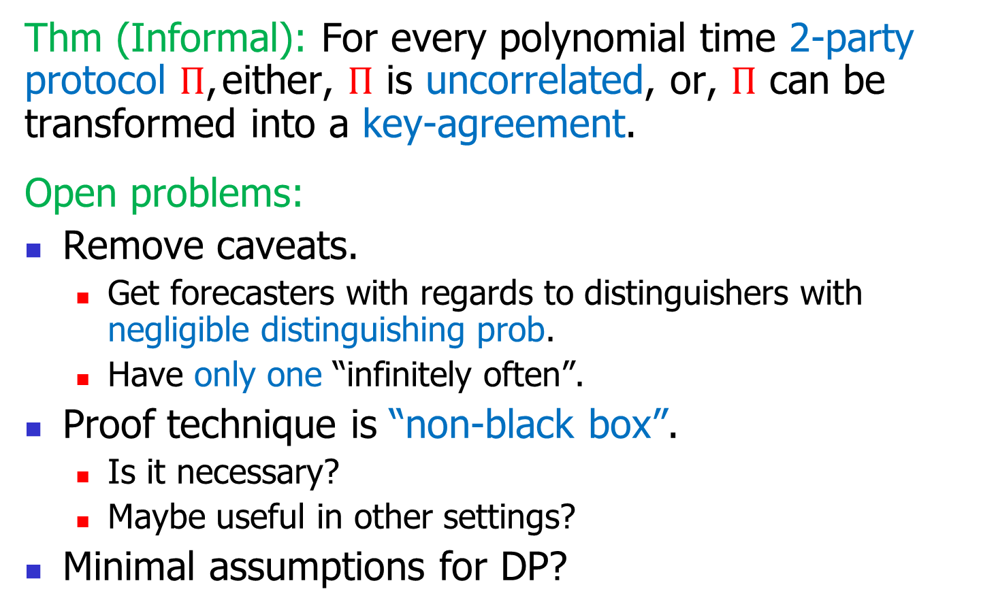
Conclusion and open problems
Thm (Informal): For every polynomial time 2-party protocol $Π$, either, $Π$ is uncorrelated, or, $Π$ can be transformed into a key-agreement.
Open problems:
Remove caveats.
  Get forecasters with regards to distinguishers with negligible distinguishing prob.
  Have only one “infinitely often”.
Proof technique is “non-black box”.
  Is it necessary?
  Maybe useful in other settings?
Minimal assumptions for DP?

Slide 23
That’s it…

Slide 24

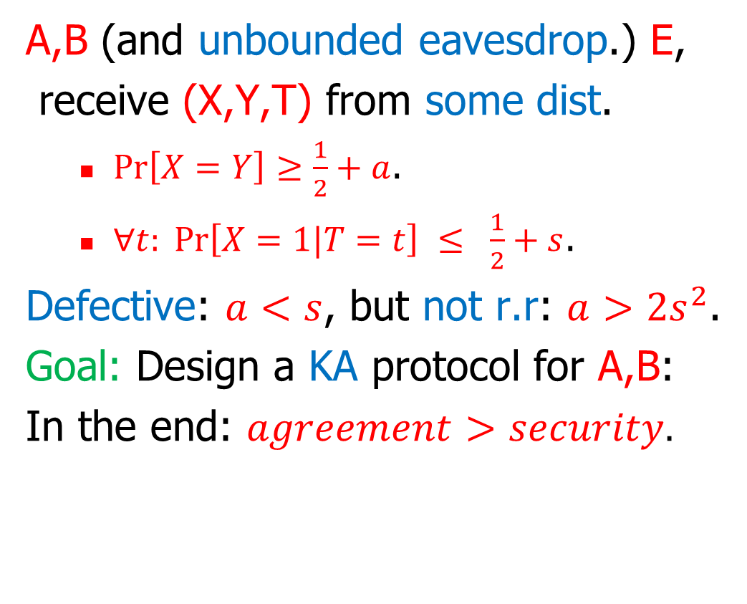

Transforming DKA to KA: Practice in info-theoretic setu
p
A,B (and unbounded eavesdrop.) E,
receive (X,Y,T) from some dist.
  $\operatorname{Pr}\left[X=Y\right]≥\frac{1}{2}+a$.
  $∀t: \operatorname{Pr}\left[X=1|T=t\right] ≤ \frac{1}{2}+s$.
Defective: $a<s$, but not r.r: $a>{2s}^{2}$.
Goal: Design a KA protocol for A,B:
In the end: $agreement>security.$
A
B
$$X$$
$$T$$
$$Y$$
output
“transcript”
output

Slide 25




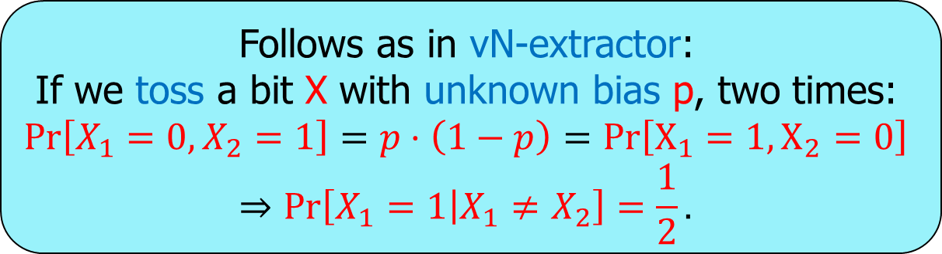


The one-sided vN-Protocol:
Follows as in vN-extractor:
If we toss a bit X with unknown bias p, two times:
$$\operatorname{Pr}\left[X_{1}=0,X_{2}=1\right]=p⋅\left(1−p\right)=Pr\left[X_{1}=1,X_{2}=0\right]$$
$$⇒\operatorname{Pr}\left[X_{1}=1 | X_{1}≠X_{2}\right]=\frac{1}{2}.$$
“Pull lever twice”
A,B (and unbounded eavesdrop.) E,
receive (X,Y,T) from some dist.
  $\operatorname{Pr}\left[X=Y\right]≥\frac{1}{2}+a$.
  $∀t: \operatorname{Pr}\left[X=1|T=t\right] ≤ \frac{1}{2}+s$.
Defective: $a<s$, but not r.r: $a>{2s}^{2}$.
Goal: Design a KA protocol for A,B:
In the end: $agreement>security.$
  $\operatorname{Pr}\left[X_{1}=Y_{1}|X_{1}≠X_{2}\right]≥\frac{1}{2}+a−2s^{2}$.
  $∀t_{1},t_{2}: \operatorname{Pr}\left[X_{1}=1\left|{(T}_{1},T_{2}\right)={(t}_{1},t_{2}),X_{1}≠X_{2} \right]=\frac{1}{2}$.
A
B
unjustified simplifying assumption
$$X_{1},X_{2}$$
$$T_{1},T_{2}$$
$$Y_{1},Y_{2}$$
output
“transcript”
output
$$=$$
If $X_{1}=X_{2}:$
If $X_{1}≠X_{2}:$
abort
continue
$$X_{1}$$
$$Y_{1}$$
final
output
final
output

Slide 26
The one-sided vN-Protocol:
“Pull lever twice”
A,B (and unbounded eavesdrop.) E,
receive (X,Y,T) from some dist.
  $\operatorname{Pr}\left[X=Y\right]≥\frac{1}{2}+a$.
  $∀t: \operatorname{Pr}\left[X=1|T=t\right] ≤ \frac{1}{2}+s$.
Given t, parties can approximate:
$p_{t}= \operatorname{Pr}\left[X=1|T=t\right].$ (within $±γ).$
Prot. vN⁺: Pull lever until we get $t_{1},t_{2}$ with ${|p}_{t_{1}}−p_{t_{2}}|≤γ$.
Cost: $poly\left(\frac{1}{γ}\right)$ invocations (affordable).
A
B
unjustified simplifying assumption
$$X_{1},X_{2}$$
$$T_{1},T_{2}$$
$$Y_{1},Y_{2}$$
output
“transcript”
output
$$=$$
If $X_{1}=X_{2}:$
If $X_{1}≠X_{2}:$
abort
continue
$$X_{1}$$
$$Y_{1}$$
final
output
final
output

Slide 27
Roadmap of proof for computational case: A competition of forecasters
security parameter
k
Players: poly-time $F\left(t\right)=(p_{A},p_{B}^{0},p_{B}^{1})$.
Set: $Price\left(F\right)$ to incentivize $F$ to output:
  $p_{A}(t)=$ $Pr⁡[X=1|T=t]$.
  $p_{B}^{0}(t)=$ $Pr⁡[Y=1|T=t,X=0]$.
  $p_{B}^{1}(t)=Pr⁡[Y=1|T=t,X=1]\text{.}$
Show: $∃$winner $\hat{F}\left(t\right)=(\hat{p_{A}} \left(t\right),\hat{p_{B}^{0}}\left(t\right),\hat{p_{B}^{1}}\left(t\right))\text{.}$
If except for very few $t$: $\hat{p_{B}^{0}}(t)$=$\hat{p_{B}^{1}}(t)$, use $\hat{F}$ as Decr. $Decr\left(t\right)=(\hat{p_{A}} (t),\hat{p_{B}^{0}}(t)).$
O.w. for notcbl. $G$ of $t$’s: $\hat{p_{B}^{0}}(t)$≠$\hat{p_{B}^{1}}(t)$. Run vN⁺ on $G$. Use $\hat{p_{A}} (t)$ as estimate for $\operatorname{Pr}\left[X=1 | T=t\right]$. Get KA.
A
B
$$X_{k}$$
$$T_{k}$$
$$Y_{k}$$
output
transript
output
Decr
$$p_{A},p_{B}$$
numbers

Slide 28

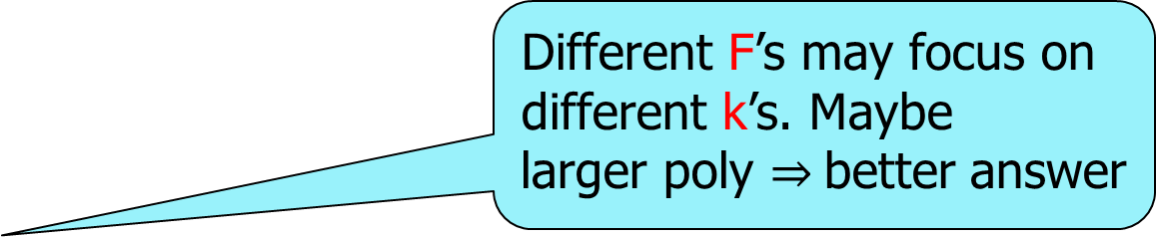
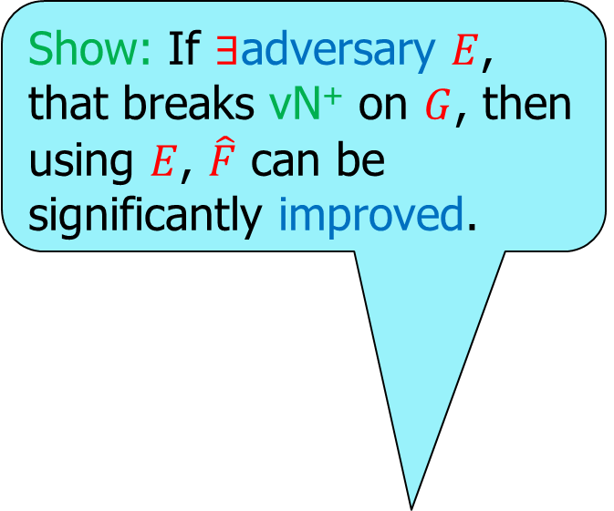
Roadmap of proof for computational case: A competition of forecasters
security parameter
k
Players: poly-time $F\left(t\right)=(p_{A},p_{B}^{0},p_{B}^{1})$.
Set: $Price\left(F\right)$ to incentivize $F$ to output:
  $p_{A}(t)=$ $Pr⁡[X=1|T=t]$.
  $p_{B}^{0}(t)=$ $Pr⁡[Y=1|T=t,X=0]$.
  $p_{B}^{1}(t)=Pr⁡[Y=1|T=t,X=1]\text{.}$
Show: $∃$winner $\hat{F}\left(t\right)=(\hat{p_{A}} \left(t\right),\hat{p_{B}^{0}}\left(t\right),\hat{p_{B}^{1}}\left(t\right))\text{.}$
If except for very few $t$: $\hat{p_{B}^{0}}(t)$=$\hat{p_{B}^{1}}(t)$, use $\hat{F}$ as Decr. $Decr\left(t\right)=(\hat{p_{A}} (t),\hat{p_{B}^{0}}(t)).$
O.w. for notcbl. $G$ of $t$’s: $\hat{p_{B}^{0}}(t)$≠$\hat{p_{B}^{1}}(t)$. Run vN⁺ on $G$. Use $\hat{p_{A}} (t)$ as estimate for $\operatorname{Pr}\left[X=1 | T=t\right]$. Get KA.
A
B
Show: If $∃$distinguisher $D$, that breaks the simulation,
then using $D$, $\hat{F}$ can be significantly improved.
Show: If $∃$adversary $E$, that breaks vN⁺ on $G$, then using $E$, $\hat{F}$ can be significantly improved.
It can be the case that no poly-time machine can compute these quantitites
$$X_{k}$$
$$T_{k}$$
$$Y_{k}$$
Different F’s may focus on different k’s. Maybe
larger poly $⇒$better answer
output
transript
output

Slide 29

Conclusion and open problems
Thm (Informal): For every polynomial time 2-party protocol $Π$, either, $Π$ is uncorrelated, or, $Π$ can be transformed into a key-agreement.
Open problems:
Remove caveats.
  Get uncorrelated with reagrds to distinguishers with negligible distinguishing prob.
  Have only one “infinitely often”.
Proof technique is “non-black box”.
  Is it necessary?
  Maybe useful in other settings?
Minimal assumptions for DP?

Slide 30
That’s it…

Slide 31
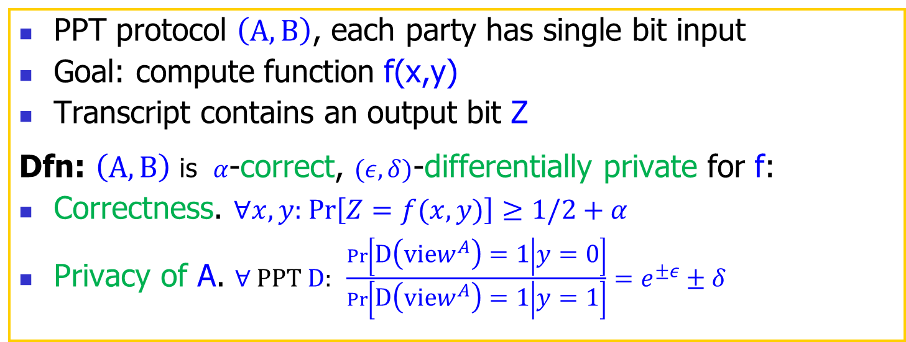
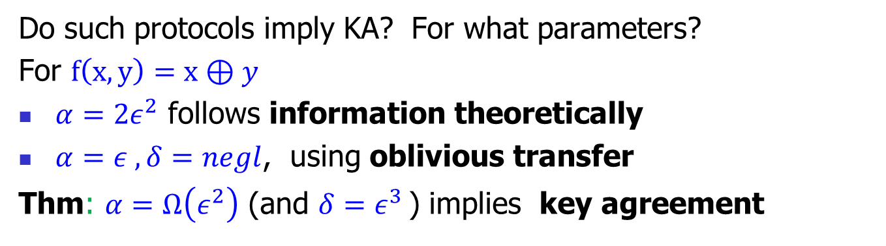
Application: Nontrivial DP for XOR implies KA
PPT protocol $\left(A,B\right)$, each party has single bit input
Goal: compute function f(x,y)
Transcript contains an output bit Z
Dfn: $\left(A,B\right)$ is $α$-correct, $(ε,δ)$-differentially private for f:
Correctness. $∀x,y:$ $\operatorname{Pr}\left[Z=f(x,y)\right]≥1/2+α$
Privacy of A. $∀ PPT D: \frac{\operatorname{Pr}\left[D\left({view}^{A}\right)=1 | y=0\right]}{\operatorname{Pr}\left[D\left({view}^{A}\right)=1 | y=1\right]}=e^{±ε}±δ$
A
B
x
y
Z
Z
Do such protocols imply KA? For what parameters?
For $f\left(x,y\right)=x⊕y$
$α=2ε^{2}$ follows information theoretically
$α=ε^{ }, δ=negl$, using oblivious transfer
Thm: $α=Ω\left(ε^{2}\right)$ (and $δ=ε^{3 }$) implies key agreement
Holds for privacy against external observer (for which key agreement is a sufficient condition)
Only for constant $ε$

Slide 32
Application: Nontrivial Fair Coin Flip implies KA
PPT protocol $\left(A,B\right)$
Goal: output a common uniform bit
Dfn: $\left(A,B\right)$ is$ε$-fair coin flip, if
$∀$PPT $A^{∗}$ and $c∈\{0,1\}$: $Pr\left[\left(A^{∗},B\right)=\left(⋅,c\right)≤\frac{1}{2}+ε\right]$
A
B
c
c
Do such protocols imply KA? For what parameters?
For r-round protocols
$\left(1/{\sqrt{r}}\right)$-fair using one-way functions [Awerbuch et al ‘86]
$\left(1/r\right)$-fair using oblivious transfer [Moran-Naor-Segev ‘09]
Thm [H-Makriyannis,Omri ‘18] : $o\left(1/{\sqrt{r}}\right)\text{−}\text{fair}$ implies key agreement
Holds for constant r

