Slide 1
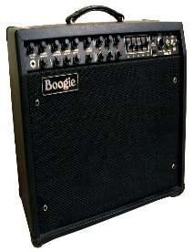

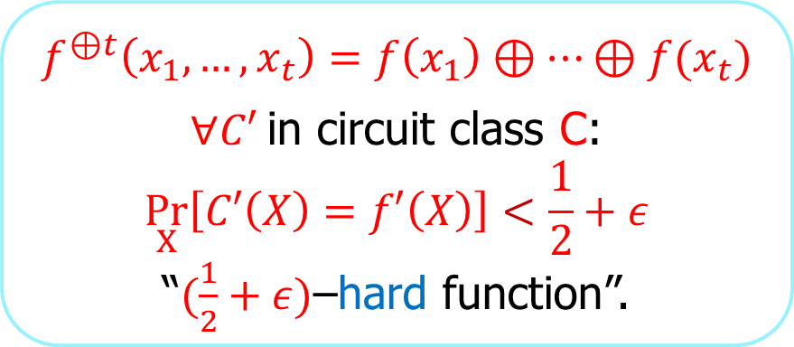
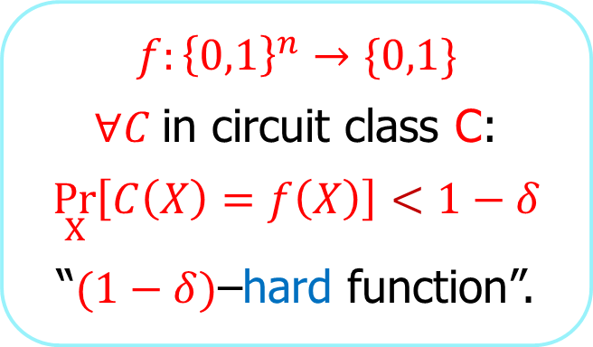
Is it possible to improve Yao’s XOR lemma using reductions that exploit the efficiency of their oracle?
Ronen Shaltiel, University of Haifa
$$f:{\left\{0,1\right\}}^{n}→\{0,1\}$$
$∀C$in circuit class C:
$$\underset{X}{Pr}\left[C\left(X\right)=f\left(X\right)\right]<1−δ$$
“$(1−δ)$–hard function”.
Yao’s
XOR Lemma
$$f^{⊕t}\left(x_{1},…,x_{t}\right)=f\left(x_{1}\right)⊕…⊕f(x_{t})$$
$∀C′$in circuit class C:
$$\underset{X}{Pr}\left[C′\left(X\right)=f′\left(X\right)\right]<\frac{1}{2}+ε$$
“$(\frac{1}{2}+ε)$–hard function”.

Slide 2
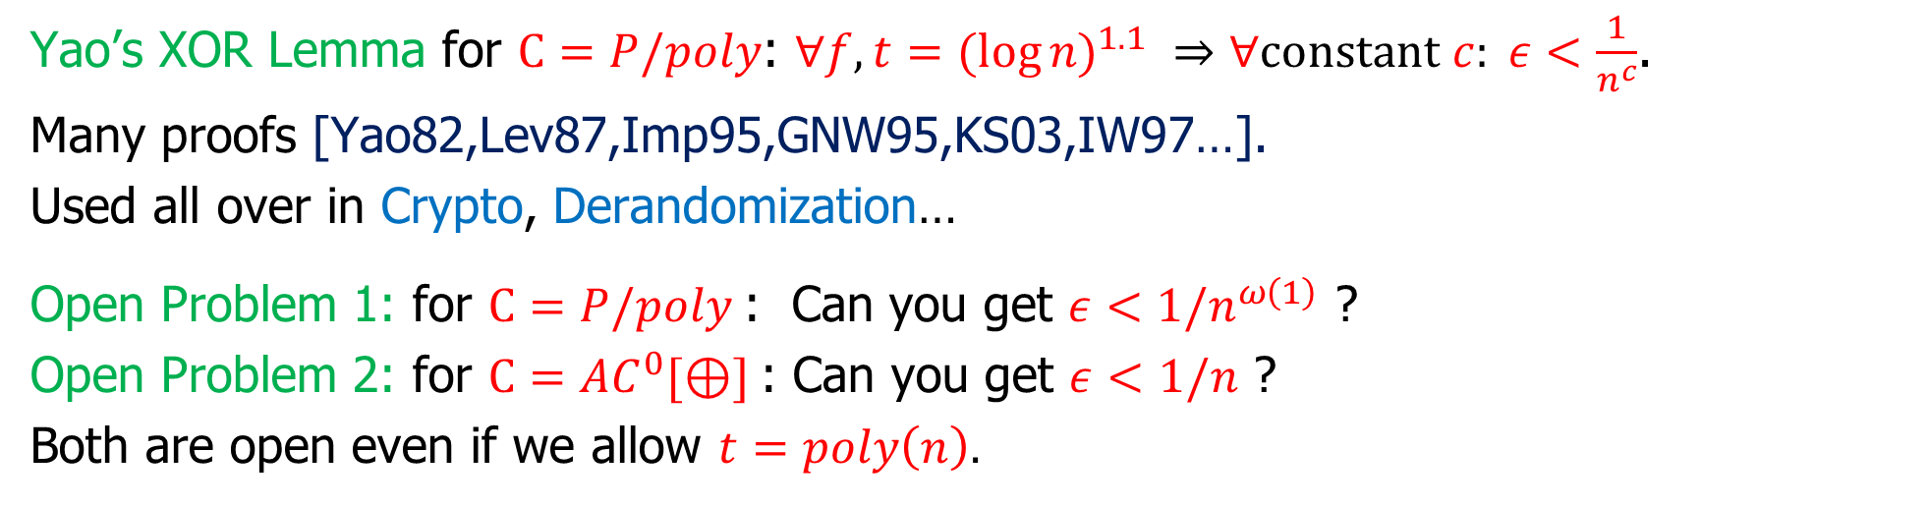


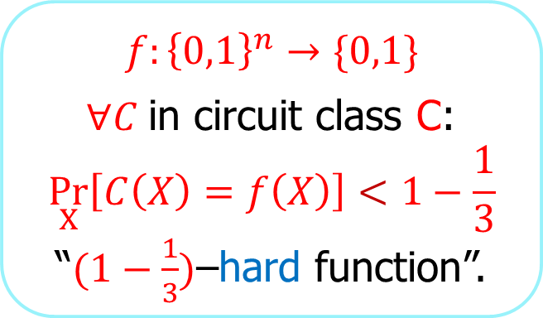
Yao’s XOR Lemma: Hardness amplification mildly hard functions $⇒$ very hard functions
$$f:{\left\{0,1\right\}}^{n}→\{0,1\}$$
$∀C$in circuit class C:
$$\underset{X}{Pr}\left[C\left(X\right)=f\left(X\right)\right]<1−\frac{1}{3}$$
“$(1−\frac{1}{3})$–hard function”.
Yao’s
XOR Lemma
$$f^{⊕t}\left(x_{1},…,x_{t}\right)=f\left(x_{1}\right)⊕…⊕f(x_{t})$$
$∀C′$in circuit class C:
$$\underset{X}{Pr}\left[C′\left(X\right)=f^{⊕t}\left(X\right)\right]<\frac{1}{2}+ε$$
“$(\frac{1}{2}+ε)$–hard function”.
Yao’s XOR Lemma for $C=P/poly$: $∀f, t={(log{n)}}^{1.1} ⇒∀constant c: ε<\frac{1}{n^{c}}$.
Many proofs [Yao82,Lev87,Imp95,GNW95,KS03,IW97…].
Used all over in Crypto, Derandomization…
Open Problem 1: for $C=P/poly$: Can you get $ε<1/n^{ω\left(1\right)}$ ?
Open Problem 2: for $C=AC^{0}[⊕]$: Can you get $ε<1/n$ ?
Both are open even if we allow $t=poly\left(n\right).$

Slide 3
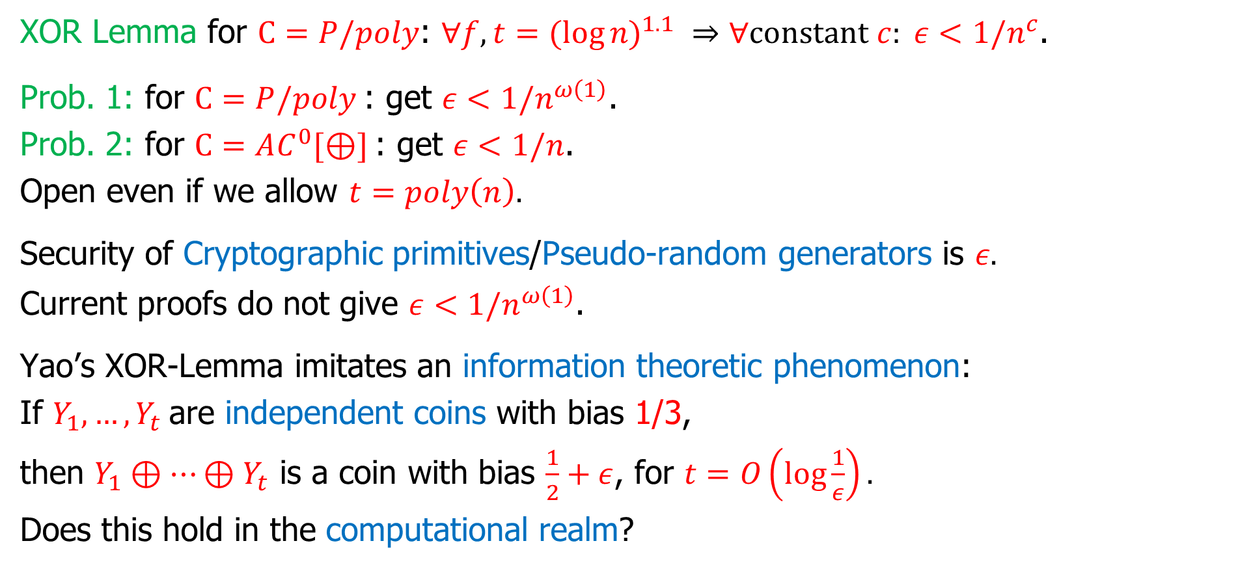

Motivation for: improved XOR-Lemma for $P/poly$
XOR Lemma for $C=P/poly$: $∀f, t={(log{n)}}^{1.1} ⇒∀constant c: ε<1/n^{c}$.
Prob. 1: for $C=P/poly$: get $ε<1/n^{ω\left(1\right)}$.
Prob. 2: for $C=AC^{0}[⊕]$: get $ε<1/n$.
Open even if we allow $t=poly\left(n\right).$
Security of Cryptographic primitives/Pseudo-random generators is $ε.$
Current proofs do not give $ε<1/n^{ω\left(1\right)}$.
Yao’s XOR-Lemma imitates an information theoretic phenomenon:
If $Y_{1},…,Y_{t}$are independent coins with bias 1/3,
then $Y_{1}⊕…⊕Y_{t}$ is a coin with bias $\frac{1}{2}+ε$, for $t=O\left(log\frac{1}{ε}\right).$
Does this hold in the computational realm?

Slide 4

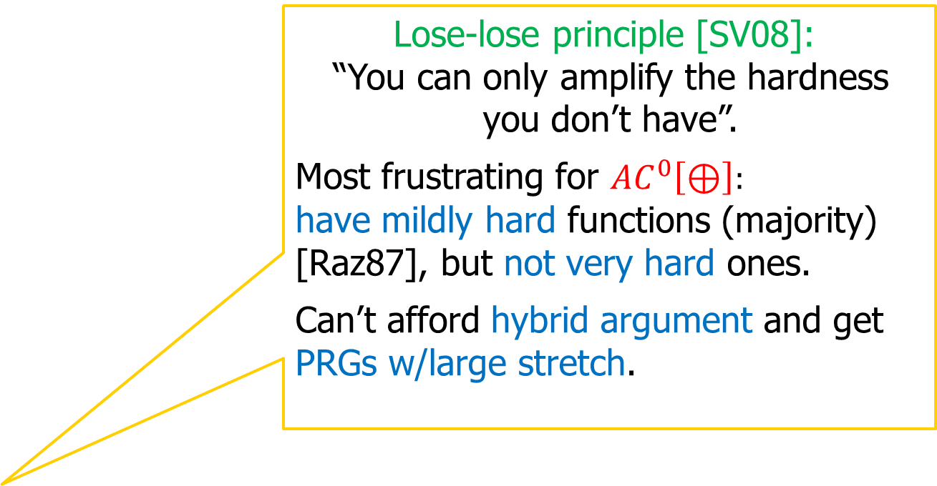
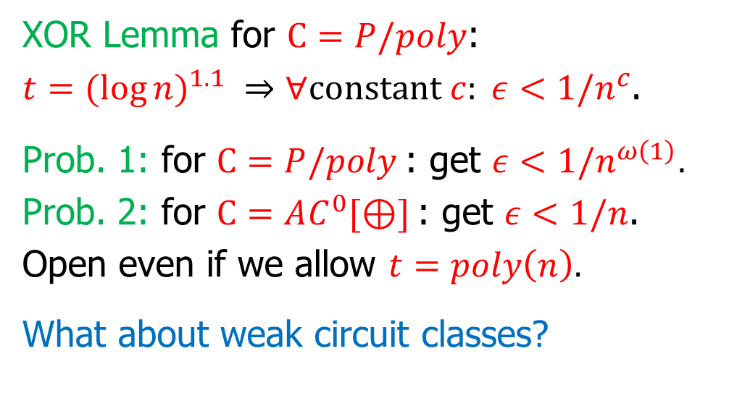
Motivation for: improved XOR-Lemma for $AC^{0}[⊕]$
XOR Lemma for $C=P/poly$:
$t={(log{n)}}^{1.1} ⇒∀constant c: ε<1/n^{c}$.
Prob. 1: for $C=P/poly$: get $ε<1/n^{ω\left(1\right)}$.
Prob. 2: for $C=AC^{0}[⊕]$: get $ε<1/n$.
Open even if we allow $t=poly\left(n\right).$
What about weak circuit classes?
Lose-lose principle [SV08]:
“You can only amplify the hardness you don’t have”.
Most frustrating for $AC^{0}\left[⊕\right]:$
have mildly hard functions (majority) [Raz87], but not very hard ones.
Can’t afford hybrid argument and get PRGs w/large stretch.
Majority
$AC^{0}$ $AC^{0}[⊕]$ $TC^{0}=AC^{0}\left[maj\right]$ $NC P/poly$
Power of C
Have lower bounds!
Don’t know Yao’s XOR lemma ☹
Can do Yao’s XOR lemma!
Hard to prove lower bounds [RR,NR] ☹

Slide 5
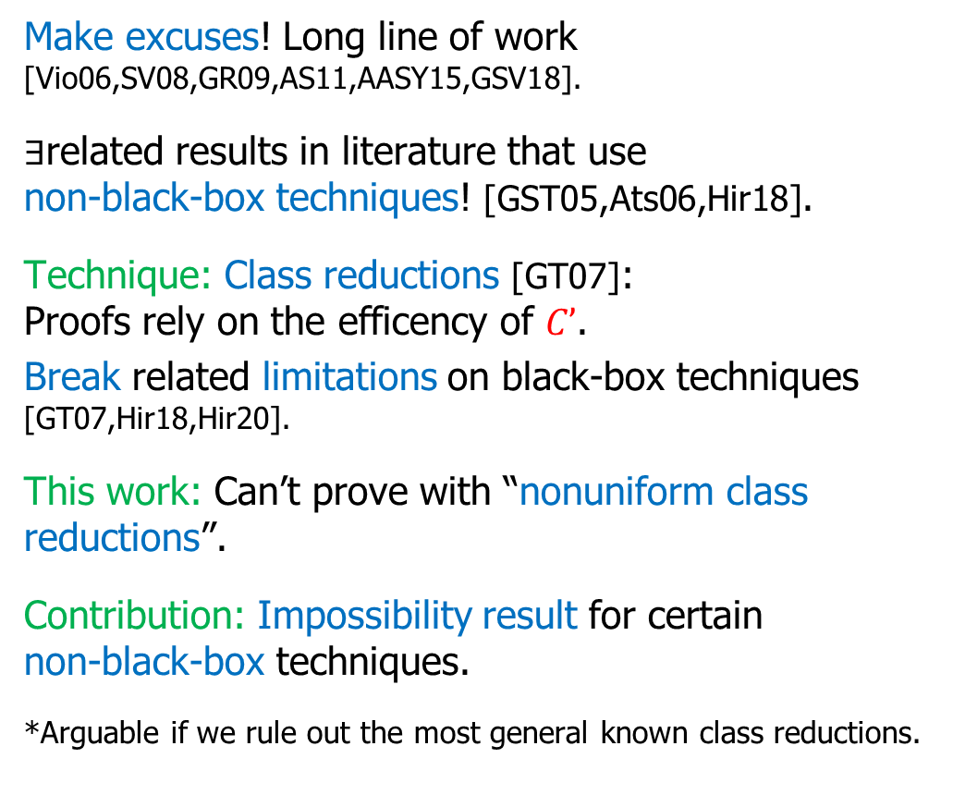
What do complexity theorists do when we can’t prove something?
Make excuses! Long line of work [Vio06,SV08,GR09,AS11,AASY15,GSV18].
$∃$related results in literature that use non-black-box techniques! [GST05,Ats06,Hir18].
Technique: Class reductions [GT07]: Proofs rely on the efficency of $C’$.
Break related limitations on black-box techniques [GT07,Hir18,Hir20].
This work: Can’t prove with “nonuniform class reductions”.
Contribution: Impossibility result for certain non-black-box techniques.
*Arguable if we rule out the most general known class reductions.
“The dog ate the proof”.
Adaptive/non-adaptive
Uniform/non-uniform
“Can’t prove with black-box techniques”.
Class reductions - Non-black box.
“Can’t prove with all existing techniques”.
adaptive nonuniform
We are here
[GSV18]

Slide 6

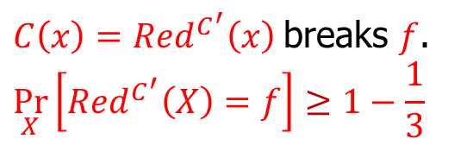
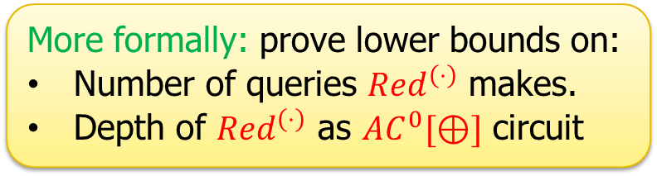

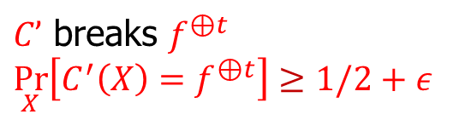


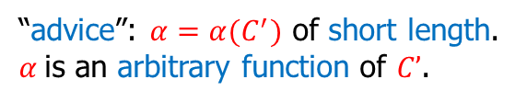
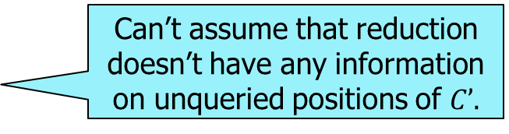



Proofs of Yao’s XOR lemma by reduction black-box, nonuniform and class reductions
Need to show: $f$ is $(1−\frac{1}{3}$)-hard $⇒$ $f^{⊕t}$ is $\left(\frac{1}{2}+ε\right)$-hard.
Proof: reduction $Red^{\left(⋅\right)}\left(x\right)$ showing that:
Black-box reduction:
$Red$ interacts with $C’$ only by queries.
$∀C’$ (even inefficient) that breaks $f^{⊕t}$, $Red^{C^{′}}\left(x\right)$breaks $f$.
Our result: impossible to solve open problems 1,2 even using nonuniform class reductions.
$C’$ breaks $f^{⊕t}$
$$\underset{X}{Pr}\left[C^{′}\left(X\right)=f^{⊕t}\right]≥1/2+ε$$
$C\left(x\right)=Red^{C^{′}}\left(x\right)$breaks $f$.
$$\underset{X}{Pr}\left[Red^{C^{′}}\left(X\right)=f\right]≥1−\frac{1}{3}$$
More formally: prove lower bounds on:
Number of queries $Red^{\left(⋅\right)}$ makes.
Depth of $Red^{\left(⋅\right)}$ as $AC^{0}[⊕]$ circuit
black box
query
$${C′}_{1},{C′}_{2},…………………,{C′}_{N}$$
answer
Can’t assume that reduction doesn’t have any information on unqueried positions of $C’.$
$$Red^{\left(⋅\right)}\left(x\right)$$
“advice”: $α=α(C^{′})$ of short length.
$α$is an arbitrary function of $C’$.
nonuniform
class
All known proofs use nonuniform reductions. nonuniform : uniform $⇔$ list decoding : unique decoding
, after receiving advice $α=α\left(C^{′}\right).$
from some class of “efficient functions”
Can’t prove limitation by designing inefficient oracle $C’.$

Slide 7
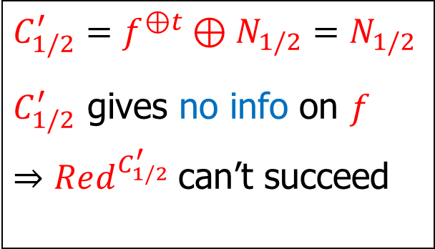
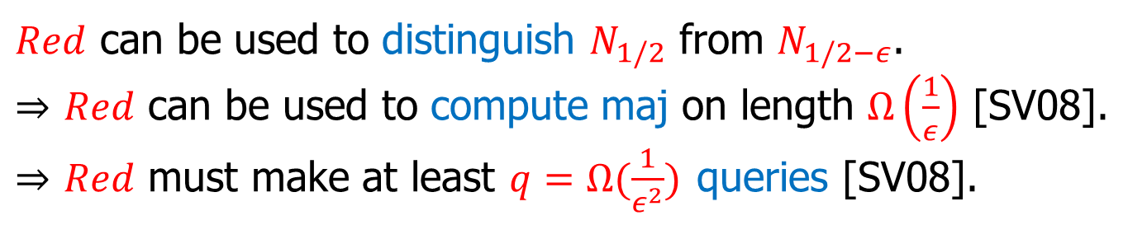
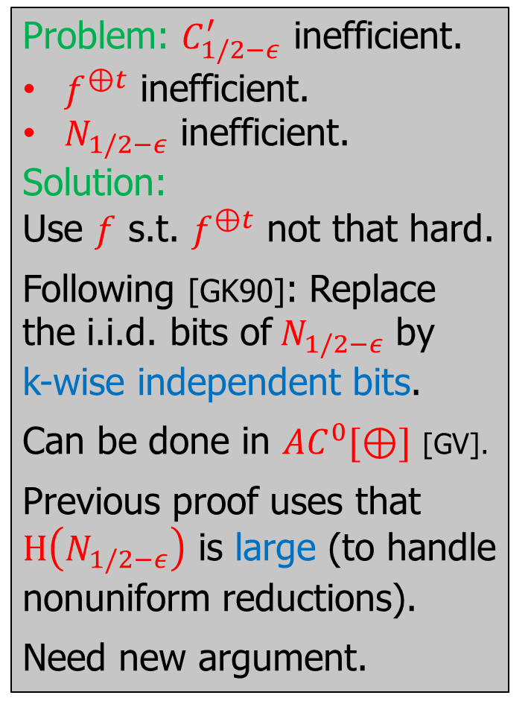
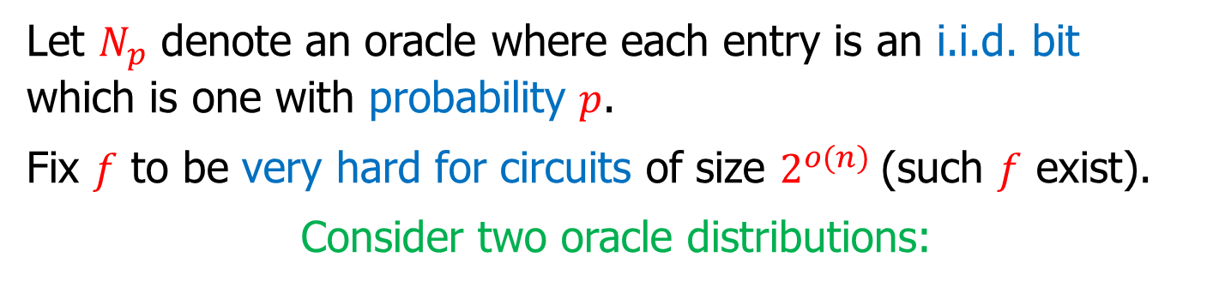
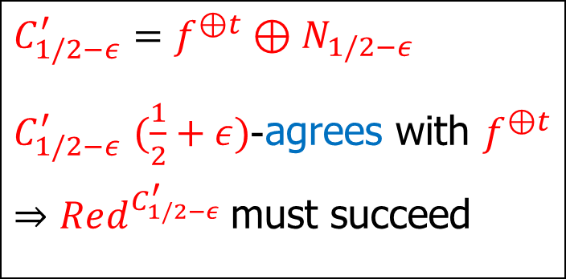
Something about the proof: Proof strategy [Vio06,SV08,GR09,GSV18]
Problem: $C_{1/2−ε}^{′}$ inefficient.
$f^{⊕t}$ inefficient.
$N_{1/2−ε}$ inefficient.
Solution:
Use $f$ s.t. $f^{⊕t}$ not that hard.
Following [GK90]: Replace the i.i.d. bits of$N_{1/2−ε}$ by k-wise independent bits.
Can be done in $AC^{0}[⊕]$ [GV].
Previous proof uses that $H\left(N_{1/2−ε}\right)$ is large (to handle nonuniform reductions).
Need new argument.
Let $N_{p}$ denote an oracle where each entry is an i.i.d. bit which is one with probability $p$.
Fix $f$ to be very hard for circuits of size $2^{o(n)}$(such $f$ exist).
Consider two oracle distributions:
$$C_{1/2−ε}^{′}={f^{⊕t}⊕N}_{1/2−ε}$$
$C_{1/2−ε}^{′}$ $(\frac{1}{2}+ε)$-agrees with $f^{⊕t}$
$⇒Red^{C_{1/2−ε}^{′}}$must succeed
$$C_{1/2}^{′}={f^{⊕t}⊕N}_{1/2}=N_{1/2}$$
$C_{1/2}^{′}$ gives no info on $f$
$⇒Red^{C_{1/2}^{′}}$can’t succeed
$Red$ can be used to distinguish $N_{1/2}$ from $N_{1/2−ε}$.
$⇒$ $Red$ can be used to compute maj on length $Ω\left(\frac{1}{ε}\right)$ [SV08].
$⇒$ $Red$ must make at least $q=Ω(\frac{1}{ε^{2}})$ queries [SV08].

Slide 8
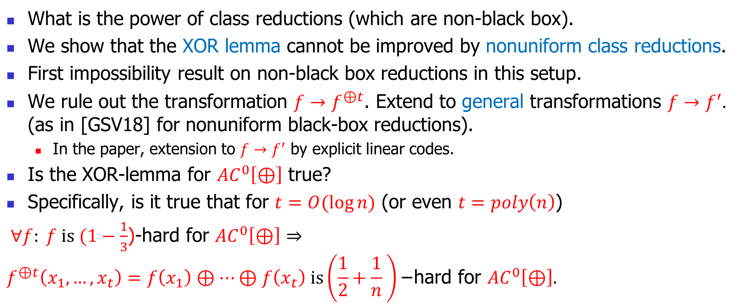
Conclusion and open problems
What is the power of class reductions (which are non-black box).
We show that the XOR lemma cannot be improved by nonuniform class reductions.
First impossibility result on non-black box reductions in this setup.
We rule out the transformation $f→f^{⊕t}$. Extend to general transformations $f→f^{′}.$ (as in [GSV18] for nonuniform black-box reductions).
  In the paper, extension to $f→f^{′}$ by explicit linear codes.
Is the XOR-lemma for $AC^{0}\left[⊕\right]$ true?
Specifically, is it true that for $t=O(\log{n)}$ (or even $t=poly\left(n\right)$)
$∀f: f is (1−\frac{1}{3}$)-hard for $AC^{0}\left[⊕\right]⇒$
$$f^{⊕t}\left(x_{1},…,x_{t}\right)=f\left(x_{1}\right)⊕…⊕f\left(x_{t}\right) is\left(\frac{1}{2}+\frac{1}{n} \right)\text{−}\text{hard} \text{for} AC^{0}\left[⊕\right].$$

Slide 9
That’s it…

Slide 10
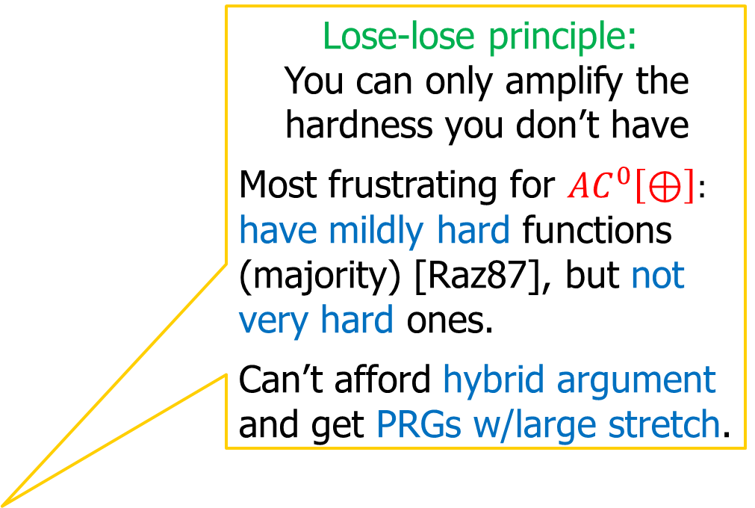
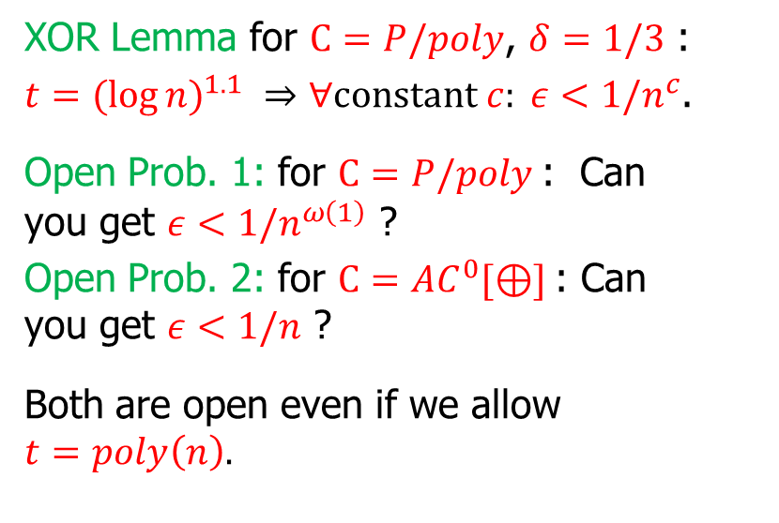
Our results: Limitations on “powerful” black-box techniques for hardness amplification
XOR Lemma for $C=P/poly$, $δ=1/3$ :
$t={(log{n)}}^{1.1} ⇒∀constant c: ε<1/n^{c}$.
Open Prob. 1: for $C=P/poly$: Can you get $ε<1/n^{ω\left(1\right)}$ ?
Open Prob. 2: for $C=AC^{0}[⊕]$: Can you get $ε<1/n$ ?
Both are open even if we allow $t=poly\left(n\right).$
Lose-lose principle:
You can only amplify the hardness you don’t have
Most frustrating for $AC^{0}\left[⊕\right]:$
have mildly hard functions (majority) [Raz87], but not very hard ones.
Can’t afford hybrid argument and get PRGs w/large stretch.
Majority
$AC^{0}$ $AC^{0}[⊕]$ $TC^{0}=AC^{0}\left[maj\right]$ $NC P/poly$
Power of C
Have lower bounds!
No amplification ☹
Can do hardness amplification!
Cannot prove lower bounds [RR,NR] ☹

Slide 11

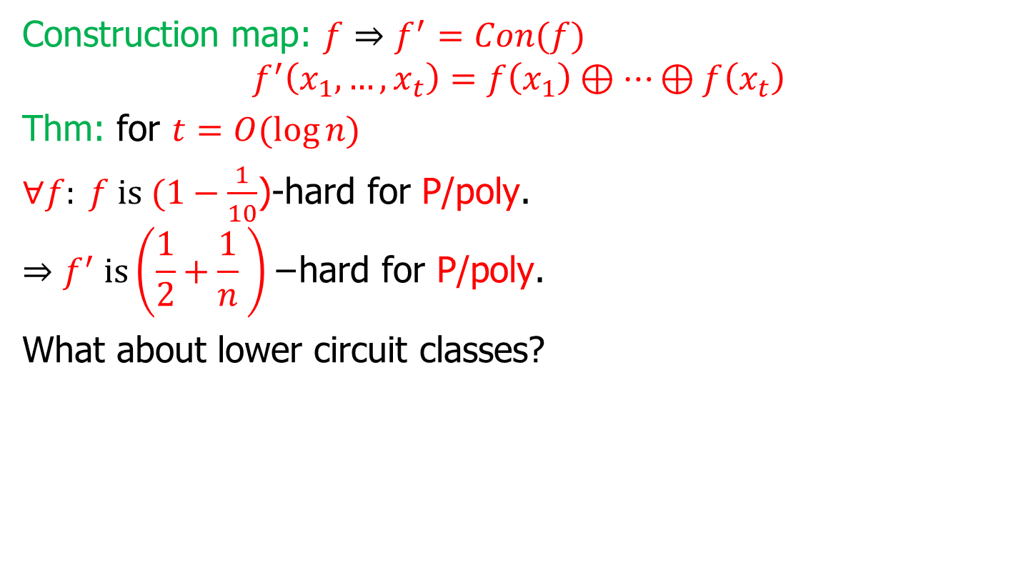
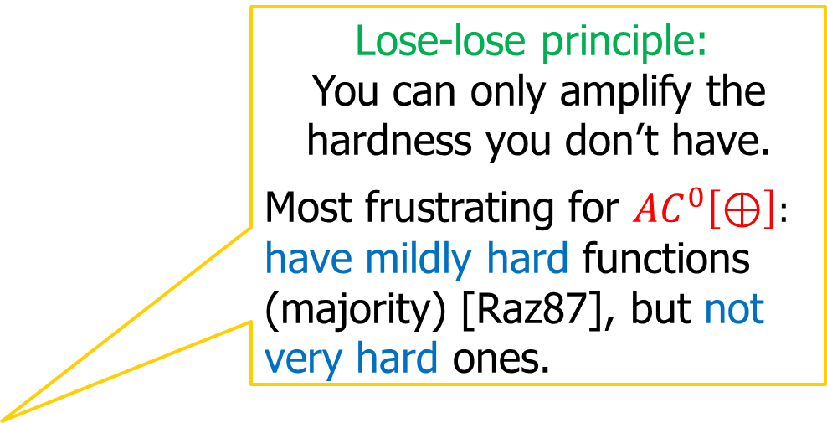
Example: Yao’s XOR-Lemma [Yao82,Lev87,Imp95,GNW95,KS03]
Construction map: $f⇒f^{′}=Con(f)$
$$f^{′}\left(x_{1},…,x_{t}\right)=f\left(x_{1}\right)⊕…⊕f\left(x_{t}\right)$$
Thm: for $t=O(\log{n)}$
$∀f: f is (1−\frac{1}{10}$)-hard for P/poly.
$$⇒f^{′} is\left(\frac{1}{2}+\frac{1}{n} \right)\text{−}\text{hard} \text{for} \text{P}\text{/}\text{poly}\text{.}$$
What about lower circuit classes?
Lose-lose principle:
You can only amplify the hardness you don’t have.
Most frustrating for $AC^{0}\left[⊕\right]:$
have mildly hard functions (majority) [Raz87], but not very hard ones.
Majority
$AC^{0}$ $AC^{0}[⊕]$ $TC^{0}=AC^{0}\left[maj\right]$ $NC P/poly$
Power of C
Have lower bounds!
No amplification ☹
Can do hardness amplification!
Cannot prove lower bounds [RR,NR] ☹

Slide 12
Our results: Limitations on “powerful” black-box techniques for hardness amplification
Previous work [SV08,GR09]: Barrier cannot be bypassed by certain black-box techniques.
This work:
Barrier cannot be bypassed by general black-box techniques.
Lose-lose principle:
You can only amplify the hardness you don’t have
Most frustrating for $AC^{0}\left[⊕\right]:$
have mildly hard functions (majority) [Raz87], but not very hard ones.
Can’t afford hybrid argument and get PRGs w/large stretch.
Majority
$AC^{0}$ $AC^{0}[⊕]$ $TC^{0}=AC^{0}\left[maj\right]$ $NC P/poly$
Power of C
Have lower bounds!
No amplification ☹
Can do hardness amplification!
Cannot prove lower bounds [RR,NR] ☹

Slide 13

Example: Yao’s XOR-Lemma [Yao82,Lev87,Imp95,GNW95,KS03]
Construction map: $f⇒f^{′}=Con(f)$
$$f^{′}\left(x_{1},…,x_{t}\right)=f\left(x_{1}\right)⊕…⊕f\left(x_{t}\right)$$
Thm: for $t=O(log(1/ε)/δ)$
$∀f: f is (1−δ$)-hard for size $s$ circuits.
$$⇒f^{′} is\left(\frac{1}{2}+ε\right)\text{−}\text{hard} \text{for} \text{size} s^{′}=\frac{s}{q} \text{circuits}\text{, }q=O(\frac{log⁡(1/δ)}{ε^{2}})$$
Circuit for $f’$ is q times smaller?! $⇒$ $ε≥\frac{1}{s},$disappointing!
This work: a loss of $q=O(\frac{log⁡(1/δ)}{ε^{2}})$ is necessary for general black-box techniques for hardness amplification.
Improves upon [SV08,AS11].
The case $δ=2^{−n},$ captures worst-case hardness.
Closely related to locally-decoadable list-decodable codes [STV99].

Slide 14





Reductions proving hardness amplification: nonuniform advice and adaptivity
(black-box) hardness amplification theorems consist of:
Construction map: $f⇒f^{′}=Con(f)$.
Proof: reduction $Red^{\left(⋅\right)}\left(x\right)$ showing that: $C’$ breaks $f’$ $⇒$ $C\left(x\right)=Red^{C^{′}}\left(x\right)$breaks $f$.
nonuniform : uniform $≡$ list decoding : unique decoding.
Our results: lower bounds on circuit depth and # of queries for general reductions $Red^{\left(⋅\right)}$ that take advice and are adaptive.
General reductions:
Can be adaptive.
Receive poly-size “nonuniform” advice string.
black box
query
$${C′}_{1},{C′}_{2},…………………,{C′}_{N}$$
answer
$$Red^{\left(⋅\right)}\left(x\right)$$
“advice”: $α=α(C^{′})$ of short length.
$α$is an arbitrary function of $C’$.

Slide 15
Indistinguishability by adaptive procedures that take advice
(A component in the proof)
Unrelated to black-box issues!
Potentially useful in other settings?

Slide 16


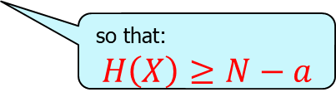




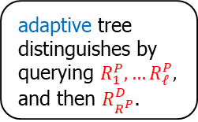


Indistinguishability by adaptive procedures with advice
say $q,a=polylog(N)$
Setup: Let $R=\left(R_{1},…,R_{N}\right)$ be uniform i.i.d. bits.
Let A be an event s.t. $\operatorname{Pr}\left[R∈A\right]≥2^{−a}$. Let $X=(R|A)$.
Can depth q decision trees distinguish R from X?
Advice is helpful!
Bad bits: $A=\{R_{1}=1\}$.
Pointer: $N=ℓ+2^{ℓ}$
$$R=\left(R^{P},R^{D}\right), A=\left\{R_{R^{P}}^{D}=1\right\}$$
Forbidden set lemma: $∃B⊆\left[N\right]$, small, s.t. depth q trees that don’t query in B cannot distinguish $R \text{from} X$.
Fixed set lemma: $∃B⊆\left[N\right]$, small, $∃$value $v$ for $X_{B}$, s.t. depth q trees cannot distinguish $(R|R_{B}=v)$ from $(X|X_{B}=v)$.
so that:
$$H\left(X\right)≥N−a$$
fixed
Nonadaptive tree distinguishes by querying $R_{1}.$
$$R_{1},R_{2},……………….…,R_{N}$$
fixed
$$R^{P}$$
$$R_{1}^{D},R_{2}^{D},…R_{R^{P}}^{D}…,R_{2^{ℓ}}^{D}$$
adaptive tree distinguishes by querying $R_{1}^{P},…R_{ℓ}^{P},$
and then $R_{R^{P}}^{D}$.
$$ℓ≈logN$$
$$2^{ℓ}$$

Slide 17
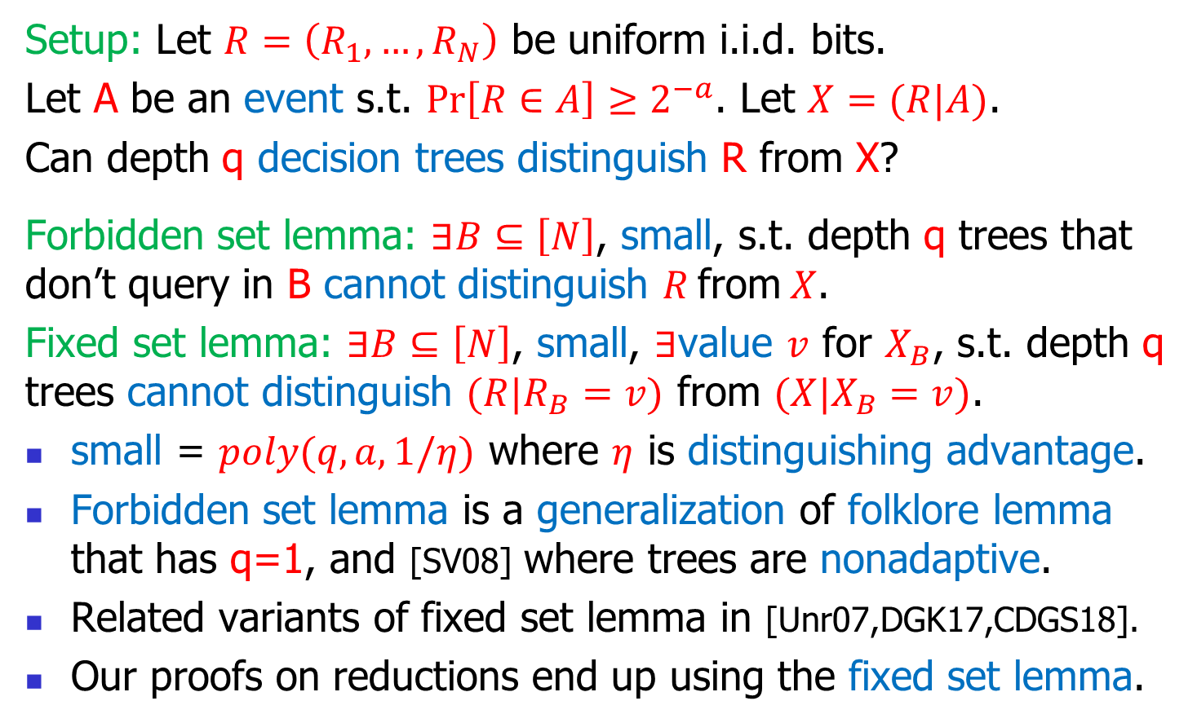
Indistinguishability by adaptive procedures with advice
say $q,a=polylog(N)$
Setup: Let $R=\left(R_{1},…,R_{N}\right)$ be uniform i.i.d. bits.
Let A be an event s.t. $\operatorname{Pr}\left[R∈A\right]≥2^{−a}$. Let $X=(R|A)$.
Can depth q decision trees distinguish R from X?
Forbidden set lemma: $∃B⊆\left[N\right]$, small, s.t. depth q trees that don’t query in B cannot distinguish $R \text{from} X$.
Fixed set lemma: $∃B⊆\left[N\right]$, small, $∃$value $v$ for $X_{B}$, s.t. depth q trees cannot distinguish $(R|R_{B}=v)$ from $(X|X_{B}=v)$.
small = $poly(q,a,1/η)$ where $η$ is distinguishing advantage.
Forbidden set lemma is a generalization of folklore lemma that has q=1, and [SV08] where trees are nonadaptive.
Related variants of fixed set lemma in [Unr07,DGK17,CDGS18].
Our proofs on reductions end up using the fixed set lemma.
so that:
$$H\left(X\right)≥N−a$$

Slide 18
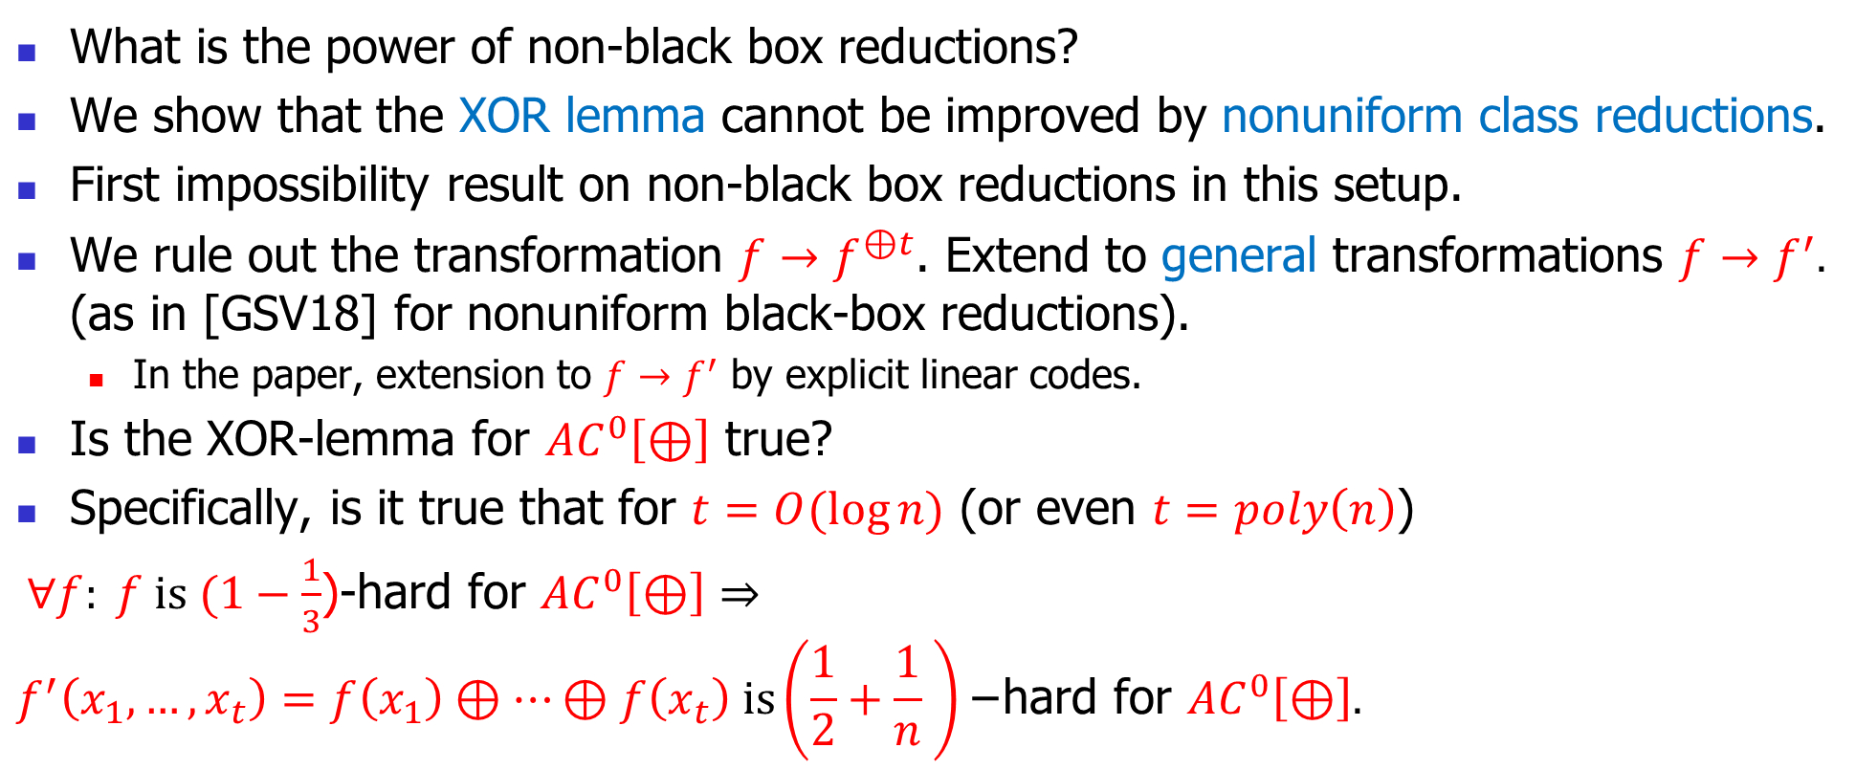
Conclusion and open problems
What is the power of non-black box reductions?
We show that the XOR lemma cannot be improved by nonuniform class reductions.
First impossibility result on non-black box reductions in this setup.
We rule out the transformation $f→f^{⊕t}$. Extend to general transformations $f→f^{′}.$ (as in [GSV18] for nonuniform black-box reductions).
  In the paper, extension to $f→f^{′}$ by explicit linear codes.
Is the XOR-lemma for $AC^{0}\left[⊕\right]$ true?
Specifically, is it true that for $t=O(\log{n)}$ (or even $t=poly\left(n\right)$)
$∀f: f is (1−\frac{1}{3}$)-hard for $AC^{0}\left[⊕\right]⇒$
$$f^{′}\left(x_{1},…,x_{t}\right)=f\left(x_{1}\right)⊕…⊕f\left(x_{t}\right) is\left(\frac{1}{2}+\frac{1}{n} \right)\text{−}\text{hard} \text{for} AC^{0}\left[⊕\right].$$

Slide 19
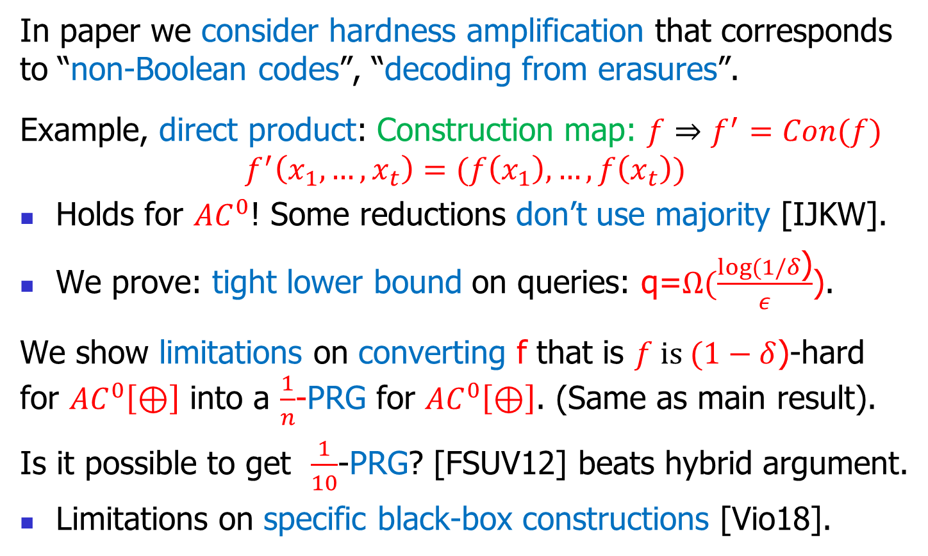
More conclusions and open problems
In paper we consider hardness amplification that corresponds to “non-Boolean codes”, “decoding from erasures”.
Example, direct product: Construction map: $f⇒f^{′}=Con(f)$
$$f^{′}\left(x_{1},…,x_{t}\right)=(f\left(x_{1}\right),…,f\left(x_{t}\right))$$
Holds for $AC^{0}$! Some reductions don’t use majority [IJKW].
We prove: tight lower bound on queries: q=$Ω(\frac{log⁡(1/δ\text{)}}{ε}$).
We show limitations on converting f that is $f is (1−δ$)-hard for $AC^{0}\left[⊕\right]$ into a $\frac{1}{n}$-PRG for $AC^{0}\left[⊕\right]$. (Same as main result).
Is it possible to get $\frac{1}{10}$-PRG? [FSUV12] beats hybrid argument.
Limitations on specific black-box constructions [Vio18].

Slide 20
That’s it…

Slide 21
Old Slides

Slide 22
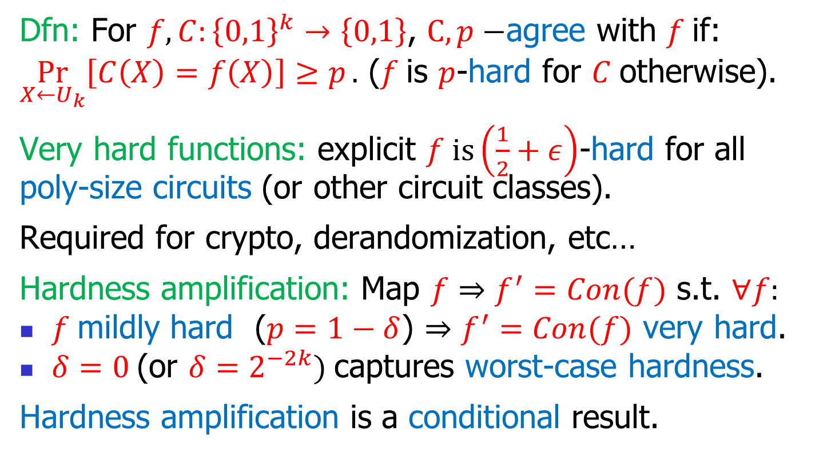

Hardness amplification theorems: hard functions $⇒$ harder functions
Dfn: For $f,C:{\left\{0,1\right\}}^{k}→\left\{0,1\right\}$, $C, p−$agree with $f$if:
$\underset{X←U_{k}}{Pr}\left[C\left(X\right)=f\left(X\right)\right]≥p.$ ($f$is $p$-hard for $C$otherwise).
Very hard functions: explicit $f is\left(\frac{1}{2}+ε\right)$-hard for all poly-size circuits (or other circuit classes).
Required for crypto, derandomization, etc…
Hardness amplification: Map $f⇒f^{′}=Con(f)$ s.t. $∀f:$
$f$mildly hard ($p=1−δ$) $⇒f^{′}=Con(f)$ very hard.
$δ=0$(or $δ=2^{−2k})$captures worst-case hardness.
Hardness amplification is a conditional result.

Slide 23


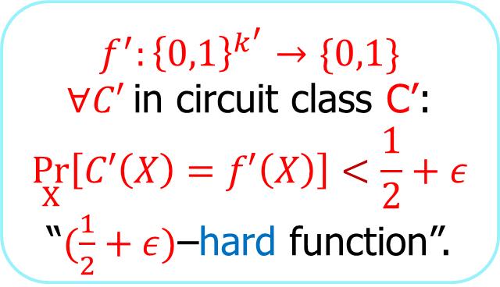
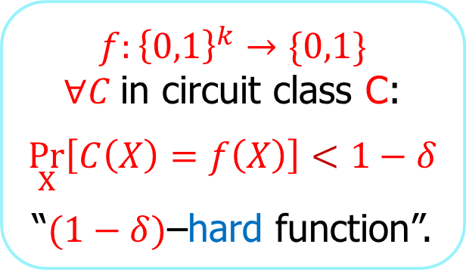
Hardness amplification theorems: mildly hard functions $⇒$ very hard functions
$$f:{\left\{0,1\right\}}^{k}→\{0,1\}$$
$∀C$in circuit class C:
$$\underset{X}{Pr}\left[C\left(X\right)=f\left(X\right)\right]<1−δ$$
“$(1−δ)$–hard function”.
$$f^{′}:{\left\{0,1\right\}}^{k^{′}}→\{0,1\}$$
$∀C′$in circuit class C’:
$$\underset{X}{Pr}\left[C′\left(X\right)=f′\left(X\right)\right]<\frac{1}{2}+ε$$
“$(\frac{1}{2}+ε)$–hard function”.
(black-box) hardness amplification theorems consist of:
Construction map: $f⇒f^{′}=Con(f)$.
Proof: reduction $Red^{\left(⋅\right)}\left(x\right)$ showing that: $C’$ breaks $f’$ $⇒$ $C\left(x\right)=Red^{C^{′}}\left(x\right)$breaks $f$.
Used all over in Crypto, Derandomization…
Special case: $δ=0≈2^{−k},$captures worst case hardness.

Slide 24

Proof of fixed set lemma
Setup: Let $R=\left(R_{1},…,R_{N}\right)$ be uniform i.i.d. bits.
Let A be an event s.t. $\operatorname{Pr}\left[R∈A\right]≥2^{−a}$. Let $X=(R|A)$.
Can depth q decision trees distinguish R from X?
Fixed set lemma: $∃B⊆\left[N\right]$, small, $∃$value $v$ for $X_{B}$, s.t. depth q trees cannot distinguish $(R|R_{B}=v)$ from $(X|X_{B}=v)$.
Let $HD\left(X\right)=\left|X\right|−H\left(X\right)≥0$be the “entropy deficiency” of X.
Claim: If depth q tree $η$-distinguishes X from R, then $∃Q⊆\left[N\right]$, of size q, $∃v∈{\left\{0,1\right\}}^{q}$, s.t $HD\left(X|X_{Q}=v\right)≤HD\left(X\right)−η^{2}$.
Fixed lemma follows as initially, $HD\left(X\right)≤a$, and so after at most $a/η^{2}$ steps, no tree can distinguish.
We fix at most $qa/η^{2}$ bits.

Slide 25
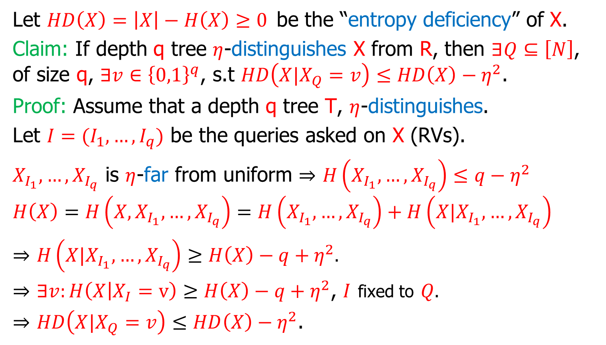
Proof of fixed set lemma: Proof of claim
Let $HD\left(X\right)=\left|X\right|−H\left(X\right)≥0$be the “entropy deficiency” of X.
Claim: If depth q tree $η$-distinguishes X from R, then $∃Q⊆\left[N\right]$, of size q, $∃v∈{\left\{0,1\right\}}^{q}$, s.t $HD\left(X|X_{Q}=v\right)≤HD\left(X\right)−η^{2}$.
Proof: Assume that a depth q tree T, $η$-distinguishes.
Let $I=(I_{1},…,I_{q})$ be the queries asked on X (RVs).
$X_{I_{1}},…,X_{I_{q}}$ is $η$-far from uniform $⇒$ $H\left(X_{I_{1}},…,X_{I_{q}}\right)≤q−η^{2}$
$$H\left(X\right)=H\left(X,X_{I_{1}},…,X_{I_{q}}\right)=H\left(X_{I_{1}},…,X_{I_{q}}\right)+H\left(X|X_{I_{1}},…,X_{I_{q}}\right)$$
$⇒$ $H\left(X|X_{I_{1}},…,X_{I_{q}}\right)≥H\left(X\right)−q+η^{2}.$
$⇒$ $∃v:H\left(X | X_{I}=v\right)≥H\left(X\right)−q+η^{2}$, $I$ fixed to $Q.$
$⇒$ $HD\left(X|X_{Q}=v\right)≤HD\left(X\right)−η^{2}$.
Pinsker’s lemma
I is a function of X
Entropy chain rule

