Slide 1

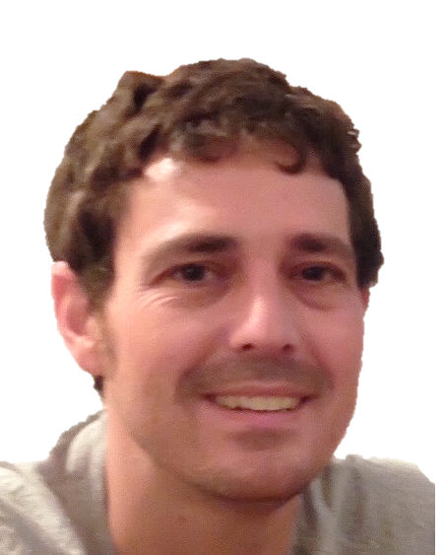
A Simple Distributed Deterministic Planar Separator
Yaseen Abd-Elhaleem,
Michal Dory, and Oren Weimann
University of Haifa

Slide 2
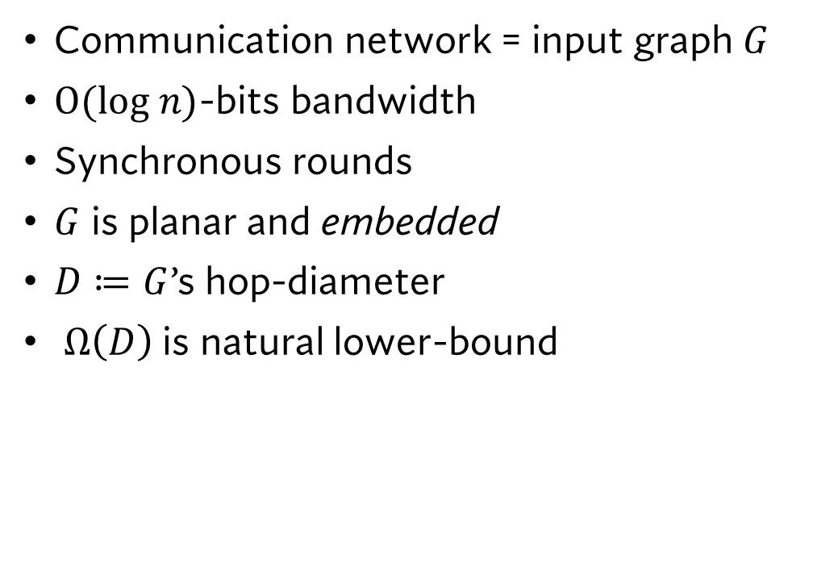
CONGEST
11
n
n-2
4
1
Communication network = input graph $G$
$O(log n)$-bits bandwidth
Synchronous rounds
$G$ is planar and embedded
$D≔G$’s hop-diameter
$Ω\left(D\right)$ is natural lower-bound
…
…
7
6
…
…
5
14
…
…
3
2
…
…
…
n-1
n-12

Slide 3

Balanced separators
Small set of vertices $S$
$G∖S$ is disconnected
Components’ sizes $≤$ ½ $|G|$
Divide-and-conquer on graphs!

Slide 4
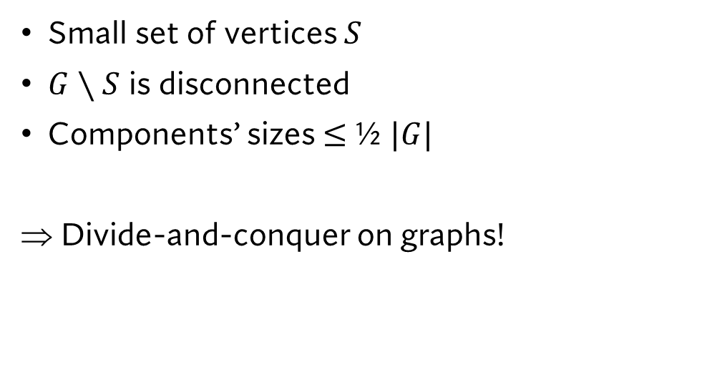
Balanced separators
Small set of vertices $S$
$G∖S$ is disconnected
Components’ sizes $≤$ ½ $|G|$
Divide-and-conquer on graphs!

Slide 5

Prior work
Simple O(n) time deterministic sequential algorithm [Lipton-Tarjan ‘79]
….
CONGEST:
  Simple $\tilde{O}(D)$ round randomized algorithm [Ghaffari-Parter ’17, Li-Parter ‘19]
  Complex $\tilde{O}(D)$ round deterministic algorithm [Jauregui-Montealegre-Rapaport ‘25]
Simple $\tilde{O}(D)$ deterministic distributed algorithm?

Slide 6

Prior work
Simple O(n) time deterministic sequential algorithm [Lipton-Tarjan ‘79]
….
CONGEST:
  Simple $\tilde{O}(D)$ round randomized algorithm [Ghaffari-Parter ’17, Li-Parter ‘19]
  Complex $\tilde{O}(D)$ round deterministic algorithm [Jauregui-Montealegre-Rapaport ‘25]
Simple $\tilde{O}(D)$ deterministic distributed algorithm?

Slide 7
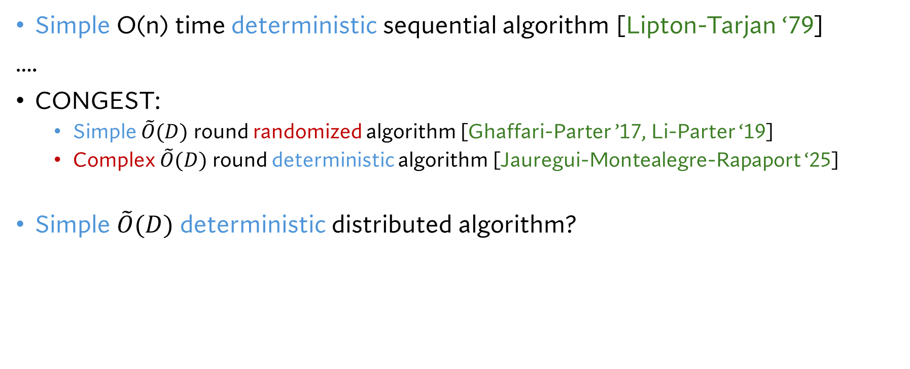
Prior work
Simple O(n) time deterministic sequential algorithm [Lipton-Tarjan ‘79]
….
CONGEST:
  Simple $\tilde{O}(D)$ round randomized algorithm [Ghaffari-Parter ’17, Li-Parter ‘19]
  Complex $\tilde{O}(D)$ round deterministic algorithm [Jauregui-Montealegre-Rapaport ‘25]
Simple $\tilde{O}(D)$ deterministic distributed algorithm?

Slide 8
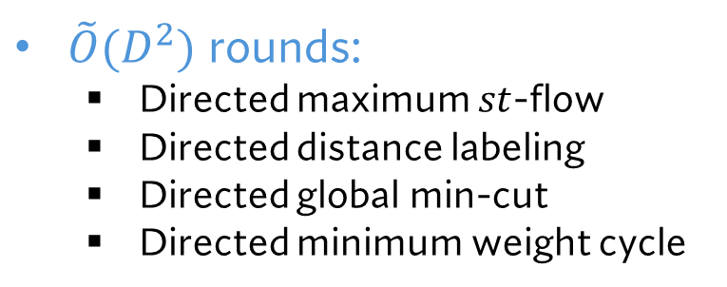
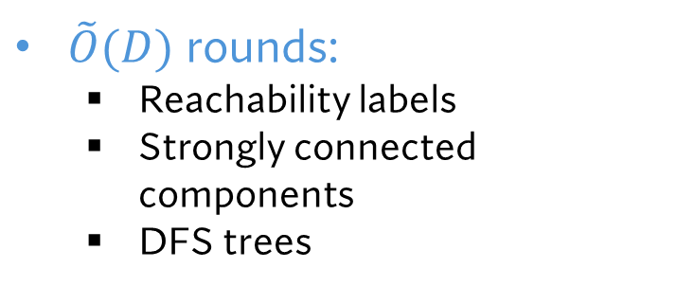
Applications
Derandomization for:
$\tilde{O}(D^{2})$ rounds:
  Directed maximum $st$-flow
  Directed distance labeling
  Directed global min-cut
  Directed minimum weight cycle
$\tilde{O}(D)$ rounds:
  Reachability labels
  Strongly connected components
  DFS trees

Slide 9



Planar separators [Lipton-Tarjan ’79]
$$T$$
$S$ has $O\left(min\left\{\sqrt{n}, D\right\}\right)$ vertices
$S$ = two paths of $T$ and edge $e∉T$
$$e$$

Slide 10

Planar separators [Lipton-Tarjan ’79]
$$T$$
$S$ has $O\left(min\left\{\sqrt{n}, D\right\}\right)$ vertices
$S$ = two paths of $T$ and edge $e∉T$
$$S$$
$$e$$

Slide 11
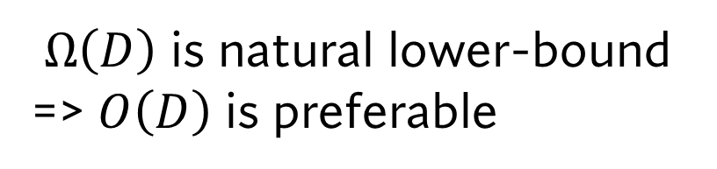
Planar separators [Lipton-Tarjan ’79]
$$T$$
$Ω\left(D\right)$ is natural lower-bound => $O\left(D\right)$ is preferable
$$S$$
$$e$$

Slide 12

Planar separators [Lipton-Tarjan ’79]
$$T$$
$Ω\left(D\right)$ is natural lower-bound => $O\left(D\right)$ is preferable
Set $T$ to BFS tree
$$S$$
$$e$$

Slide 13
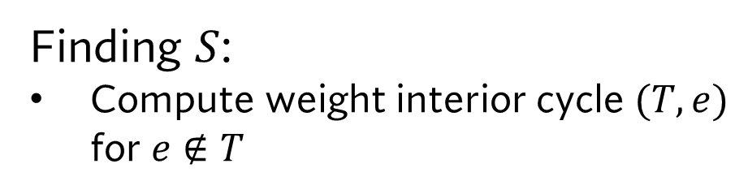
Planar separators [Lipton-Tarjan ’79]
$$T$$
Finding $S$:
Compute weight interior cycle $(T,e)$ for $e∉T$

Slide 14

Planar separators [Lipton-Tarjan ’79]
$$T$$
Finding $S$:
Compute weight interior cycle $(T,e)$ for $e∉T$
$$e$$

Slide 15

Planar separators [Lipton-Tarjan ’79]
$$T$$
Finding $S$:
Compute weight interior cycle $(T,e)$ for $e∉T$
$$e$$

Slide 16
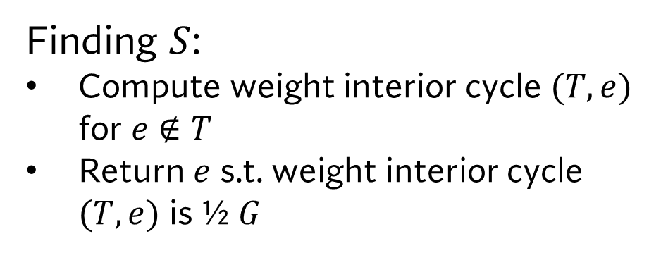
Planar separators [Lipton-Tarjan ’79]
$$T$$
Finding $S$:
Compute weight interior cycle $(T,e)$ for $e∉T$
Return $e$ s.t. weight interior cycle $(T,e)$ is ½ $G$
$$S$$
$$e$$

Slide 17
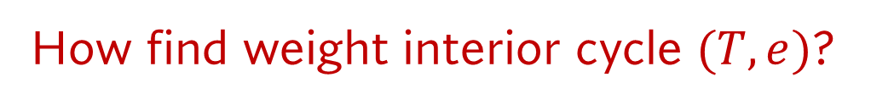
Planar separators [Lipton-Tarjan ’79]
$$T$$
How find weight interior cycle $(T,e)$?
$$e$$

Slide 18
Planar separators [Lipton-Tarjan ’79]
$$T$$
How find weight interior cycle $(T,e)$?
Reduce to simpler problem on another tree!
$$e$$

Slide 19


The dual graph $G^{∗}$
Faces of $G$ are nodes in $G^{∗}$
Adjacent faces of $G$ are connected in $G^{∗}$

Slide 20
The dual graph $G^{∗}$
Faces of $G$ are nodes in $G^{∗}$
Adjacent faces of $G$ are connected in $G^{∗}$

Slide 21
The dual graph $G^{∗}$
Faces of $G$ are nodes in $G^{∗}$
Adjacent faces of $G$ are connected in $G^{∗}$

Slide 22
The dual graph $G^{∗}$
Faces of $G$ are nodes in $G^{∗}$
Adjacent faces of $G$ are connected in $G^{∗}$

Slide 23

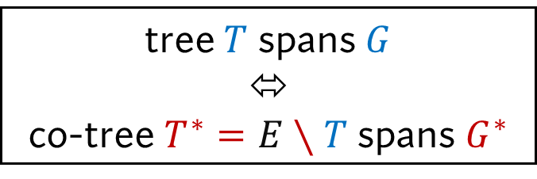
Tree co-tree duality
$$T$$
tree $T$ spans $G$
⬄
co-tree $T^{∗}=E∖T$ spans $G^{∗}$
$$T^{∗}$$

Slide 24
Tree co-tree duality
$$T$$
tree $T$ spans $G$
⬄
co-tree $T^{∗}=E∖T$ spans $G^{∗}$
$$T^{∗}$$

Slide 25

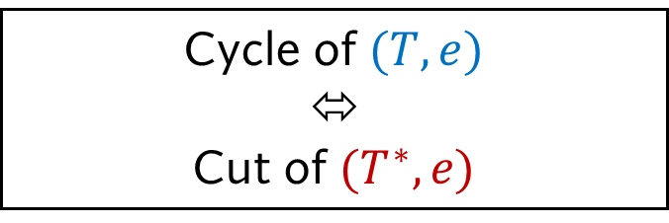
Cut-cycle Duality
$$T$$
Cycle of $(T,e)$
⬄
Cut of $(T^{∗},e)$
$$e$$
$$T^{∗}$$

Slide 26

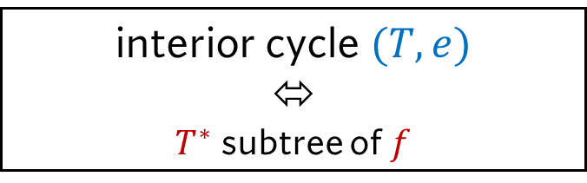
Cut-cycle Duality
interior cycle $(T,e)$
⬄
$T^{∗}$ subtree of $f$
$$f$$

Slide 27

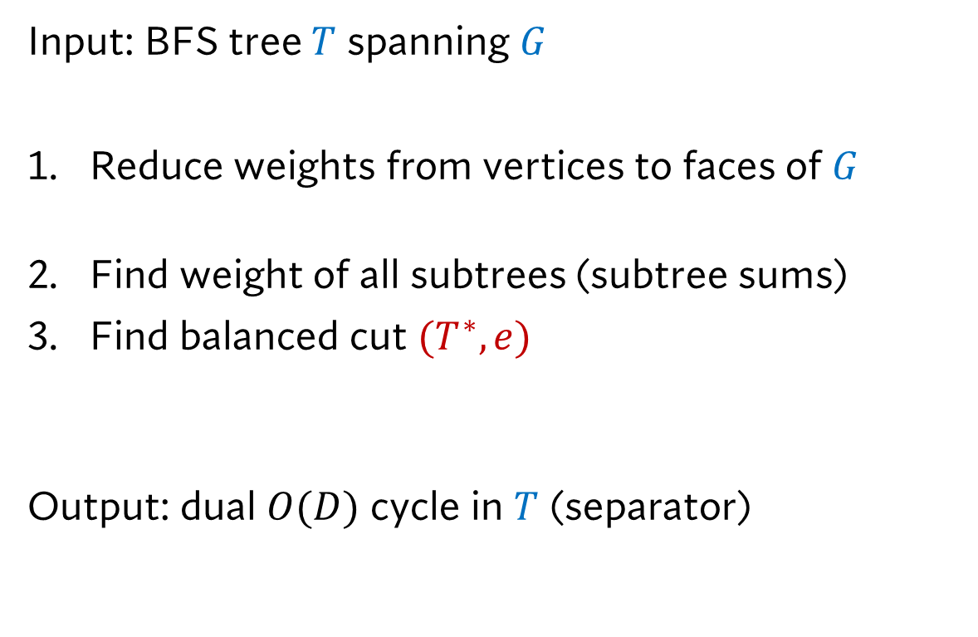
Planar separators [Lipton-Tarjan ’79]
Input: BFS tree $T$ spanning $G$
Reduce weights from vertices to faces of $G$
  Need balanced cut in $T^{∗}$ iff balanced sep in $T$
Find weight of all subtrees (subtree sums)
Find balanced cut $(T^{∗},e)$
  Need $T^{∗}$ of constant degree
Output: dual $O(D)$ cycle in $T$ (separator)
$$f$$

Slide 28
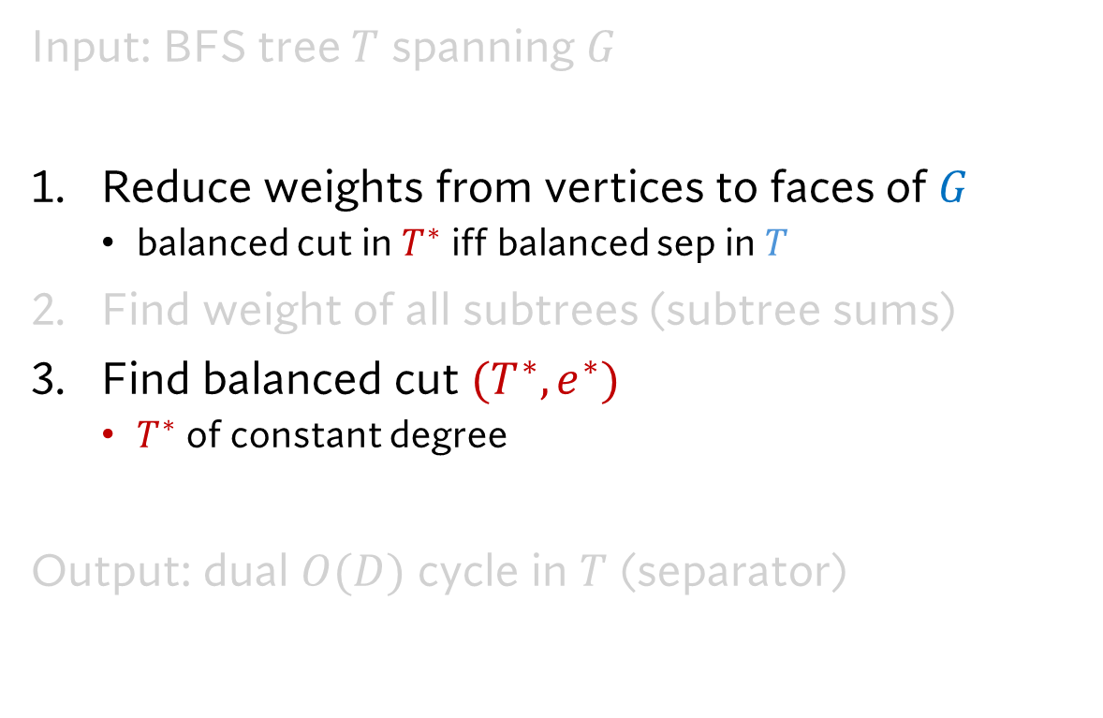
Planar separators [Lipton-Tarjan ’79]
Input: BFS tree $T$ spanning $G$
Reduce weights from vertices to faces of $G$
  balanced cut in $T^{∗}$ iff balanced sep in $T$
Find weight of all subtrees (subtree sums)
Find balanced cut $(T^{∗},e^{∗})$
  $T^{∗}$ of constant degree
Output: dual $O(D)$ cycle in $T$ (separator)
$$f$$

Slide 29

Planar separators [Lipton-Tarjan ’79]
Input: BFS tree $T$ spanning $G$
Reduce weights from vertices to faces of $G$
  balanced cut in $T^{∗}$ iff balanced sep in $T$
Find weight of all subtrees (subtree sums)
Find balanced cut $(T^{∗},e^{∗})$
  $T^{∗}$ of constant degree
Output: dual $O(D)$ cycle in $T$ (separator)

Slide 30

Planar separators [Lipton-Tarjan ’79]
Input: BFS tree $T$ spanning $G$
Reduce weights from vertices to faces of $G$
  balanced cut in $T^{∗}$ iff balanced sep in $T$
Find weight of all subtrees (subtree sums)
Find balanced cut $(T^{∗},e^{∗})$
  $T^{∗}$ of constant degree
Output: dual $O(D)$ cycle in $T$ (separator)
Ensured by triangulating $G$

Slide 31
Planar separators [Lipton-Tarjan ’79]
Input: BFS tree $T$ spanning $G$
Reduce weights from vertices to faces of $G$
  balanced cut in $T^{∗}$ iff balanced sep in $T$
Find weight of all subtrees (subtree sums)
Find balanced cut $(T^{∗},e^{∗})$
  $T^{∗}$ of constant degree
Output: dual $O(D)$ cycle in $T$ (separator)
Ensured by triangulating $G$
Not feasible in CONGEST

Slide 32

Ghaffari-Parter ’17, Li-Parter ‘19
$$T$$
Assigning weights to faces :
  Random sampling of vertices
  Compute subtree OR in $T^{∗}$
  => Approx. interior of cycle $\left(T,e\right)$
$$T^{∗}$$

Slide 33
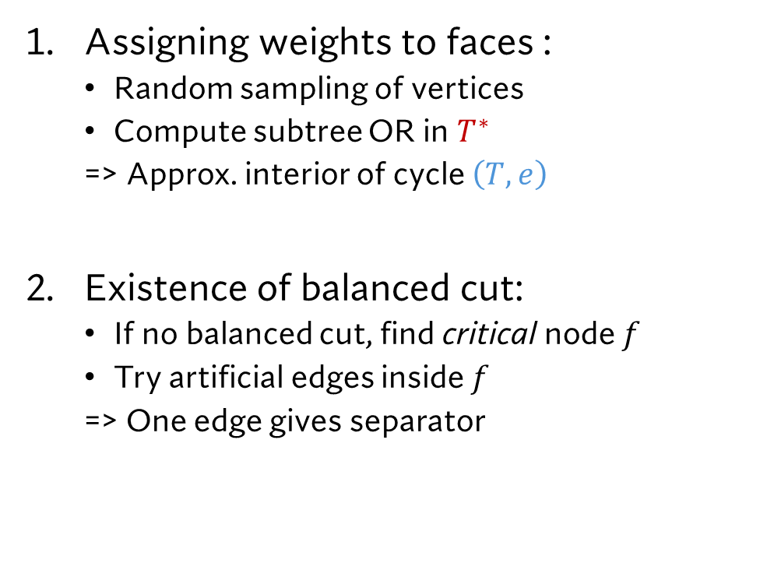
Ghaffari-Parter ’17, Li-Parter ‘19
$$T$$
Assigning weights to faces :
  Random sampling of vertices
  Compute subtree OR in $T^{∗}$
  => Approx. interior of cycle $\left(T,e\right)$
Existence of balanced cut:
  If no balanced cut, find critical node $f$
  Try artificial edges inside $f$
  => One edge gives separator
$$T^{∗}$$

Slide 34
Ghaffari-Parter ’17, Li-Parter ‘19
$$T$$
Assigning weights to faces :
  Random sampling of vertices
  Compute subtree OR in $T^{∗}$
  => Approx. interior of cycle $\left(T,e\right)$
Existence of balanced cut:
  If no balanced cut, find critical node $f$
  Try artificial edges inside $f$
  => One edge gives separator
$$T^{∗}$$

Slide 35

Jauregui, Montealegre, and Rapaport ‘25
$$T$$
Assigning weights to faces:
  Observations on $T$ (edges $∉T$, LCAs, ..)
  => Formula approx. interior $(T,e)$

Slide 36
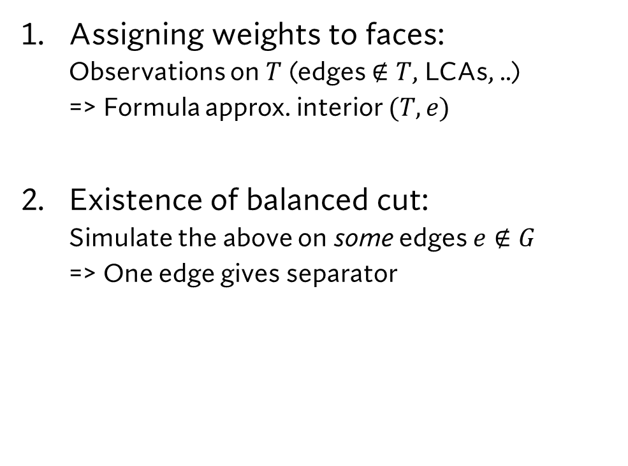
Jauregui, Montealegre, and Rapaport ‘25
$$T$$
Assigning weights to faces:
  Observations on $T$ (edges $∉T$, LCAs, ..)
  => Formula approx. interior $(T,e)$
Existence of balanced cut:
  Simulate the above on some edges $e∉G$
  => One edge gives separator

Slide 37

Our work
$$T$$
Assigning weights to faces:
  Vertex transfers weight to arbitrary face
  $f$ weight = sum of vertices choose $f$
  => Compute subtree sums in $T^{∗}$
$$T^{∗}$$

Slide 38
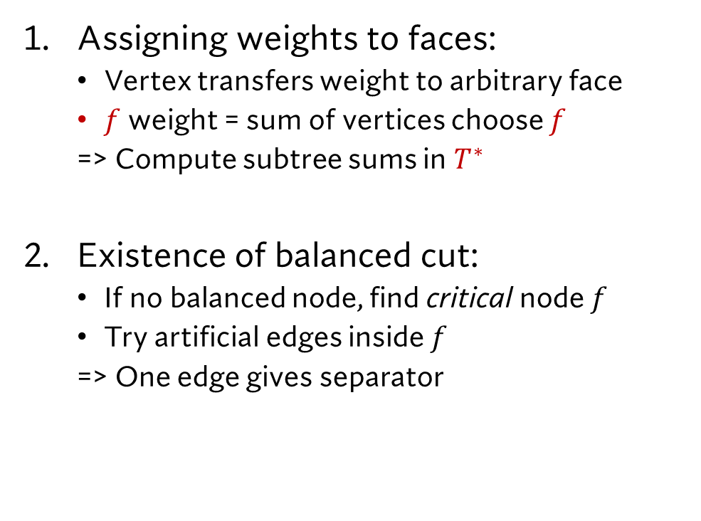
Our work
$$T$$
Assigning weights to faces:
  Vertex transfers weight to arbitrary face
  $f$ weight = sum of vertices choose $f$
  => Compute subtree sums in $T^{∗}$
Existence of balanced cut:
  If no balanced node, find critical node $f$
  Try artificial edges inside $f$
  => One edge gives separator

Slide 39
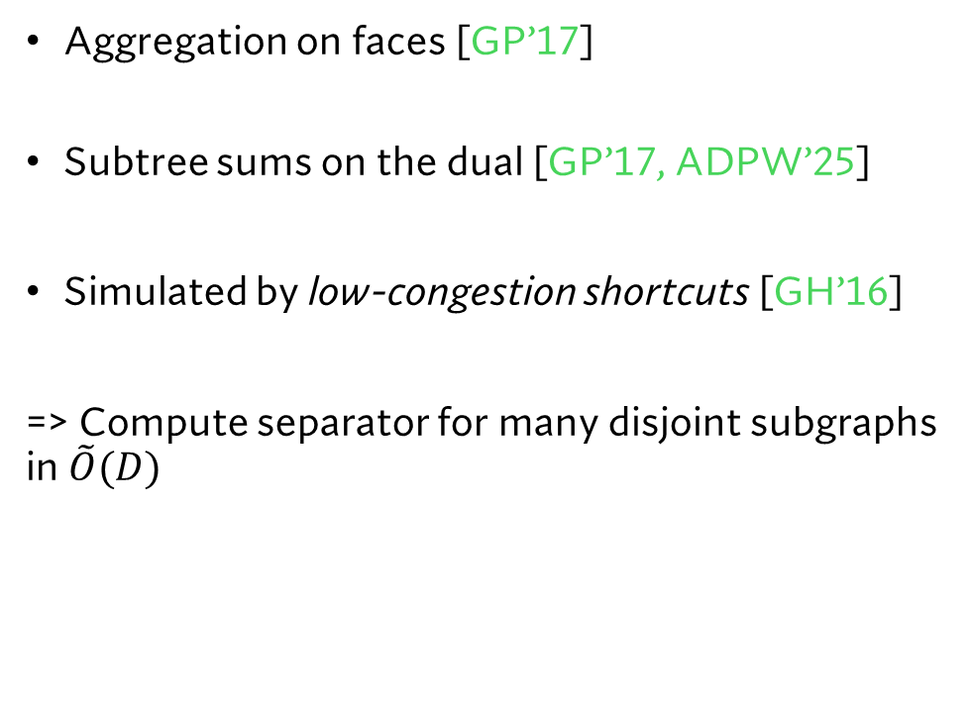
Implementation
$$T$$
Aggregation on faces [GP’17]
Subtree sums on the dual [GP’17, ADPW’25]
Simulated by low-congestion shortcuts [GH’16]
=> Compute separator for many disjoint subgraphs in $\tilde{O}(D)$
$$T^{∗}$$

Slide 40
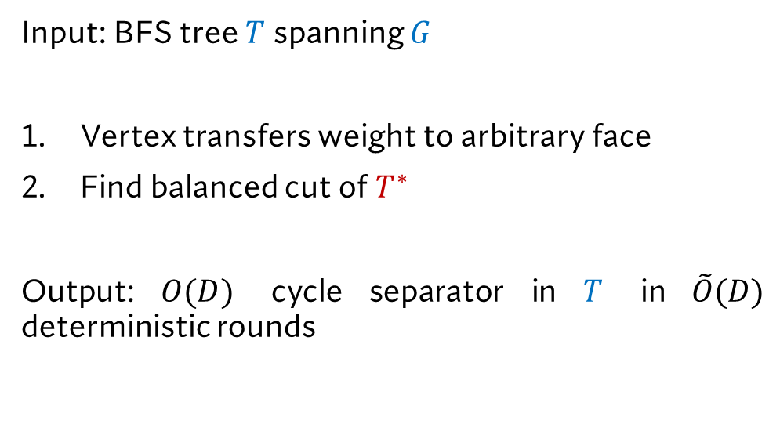
Simple Distributed Deterministic Planar Separator
$$T$$
Input: BFS tree $T$ spanning $G$
Vertex transfers weight to arbitrary face
Find balanced cut of $T^{∗}$
Output: $O(D)$ cycle separator in $T$ in $\tilde{O}(D)$ deterministic rounds
Thanks!
Questions?

