Slide 1


Faster Construction of a Planar Distance Oracle with Õ(1) Query Time
Itai Boneh, Shay Golan, Shay Mozes, Daniel Prigan and Oren Weimann
ICALP 2025 – Aarhus, Denmark

Slide 2
Distance Oracle
Data Structure
  Preprocess the graph G=(V,E)
Construction
Distance Oracle

Slide 3




Distance Oracle
We focus on
Planar Undirctded graphs
Data Structure
  Preprocess the graph G=(V,E)
  Query(u,v) – returns $dist(u,v)$
  Measure: Construction time, Query time and Space.
Distance Oracle
$$dist_{G}(u,v)$$
$$u$$
$$v$$

Slide 4


Distance Oracle
We focus on
Planar Undirctded graphs
Data Structure
  Preprocess the graph G=(V,E)
  Query(u,v) – returns $dist(u,v)$
  Measure: Construction time, Query time and Space.
$$\tilde{O}(1)$$
Distance Oracle
$$dist_{G}(u,v)$$
$$u$$
$$v$$

Slide 5


Oracles with $\tilde{O}(1)$ query time
Construction time | Reference
$$n^{2}$$ | Naive
$$n^{11/6}$$ | FOCS’17 Cohen-Addad, Dahlgaard, Wulff-Nilsen
$$n^{3/2}$$ | SODA’18 Gawrychowski, Mozes, Weimann, Wulff-Nilsen

Slide 6

Oracles with $\tilde{O}(1)$ query time
Construction time | Reference
$$n^{2}$$ | Naive
$$n^{11/6}$$ | FOCS’17 Cohen-Addad, Dahlgaard, Wulff-Nilsen
$$n^{3/2}$$ | SODA’18 Gawrychowski, Mozes, Weimann, Wulff-Nilsen
$$n^{4/3}$$ | New

Slide 7








$r$-Division
Partition of G into pieces:
$O\left(n/r\right)$ pieces.
$O\left(r\right)$ vertices in every piece.
Each piece has $O( \sqrt{r})$ boundary
vertices (vertices incident to
edges in other pieces).
$$G$$
$$∂P_{3}$$
$P_{2}$
$P_{3}$
$P_{1}$
$P_{O\left(n/r\right)}$

Slide 8





Distance oracle using $r$-Division
The shortest path between $u$ and $v$ must go through some (last) boundary vertex.
One can consider for all $s∈∂P$ $dist\left(u,s\right)+dist(s,v)$ and take the minimum
$$dist\left(u,v\right)=\min_{s∈∂P}(dist\left(u,s\right)+dist\left(s,v\right))$$
$$s$$
$$u$$
$$v$$

Slide 9

Distance oracle using $r$-Division
The shortest path between $u$ and $v$ must go through some (last) boundary vertex.
One can consider for all $s∈∂P$ $dist\left(u,s\right)+dist(s,v)$ and take the minimum
$$dist\left(u,v\right)=\min_{s∈∂P}(dist\left(u,s\right)+dist\left(s,v\right))$$
$$u$$
$$v$$

Slide 10
Distance oracle using $r$-Division
The shortest path between $u$ and $v$ must go through some (last) boundary vertex.
One can consider for all $s∈∂P$ $dist\left(u,s\right)+dist(s,v)$ and take the minimum
$$dist\left(u,v\right)=\min_{s∈∂P}(dist\left(u,s\right)+dist\left(s,v\right))$$
$$u$$
$$v$$

Slide 11









Distance oracle using $r$-Division
The shortest path between $u$ and $v$ must go through some (last) boundary vertex.
One can consider for all $s∈∂P$ $dist\left(u,s\right)+dist(s,v)$ and take the minimum
$$dist\left(u,v\right)=\min_{s∈∂P}(dist\left(u,s\right)+dist\left(s,v\right))$$
$$11$$
$$6$$
$$s$$
$$86$$
$$37$$
$$u$$
$$74$$
$$7$$
$$18$$
$$48$$
$$v$$

Slide 12
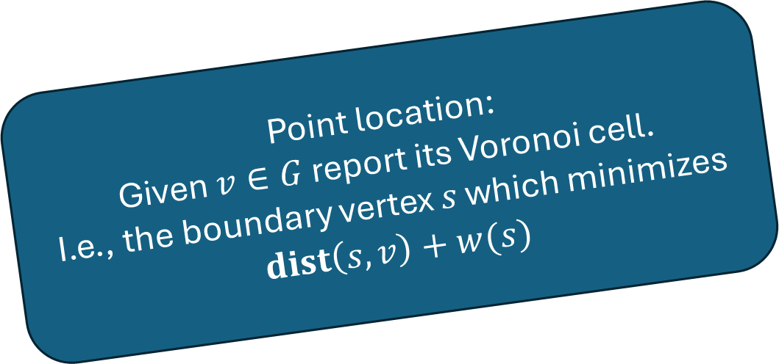
Additively weighted Voronoi diagrams
Point location:
Given $v∈G$ report its Voronoi cell.
I.e., the boundary vertex $s$ which minimizes
$$dist\left(s,v\right)+w(s)$$
The shortest path between $u$ and $v$ must go through some (last) boundary vertex.
One can consider for all $s∈∂P$ $dist\left(u,s\right)+dist(s,v)$ and take the minimum
$$dist\left(u,v\right)=\min_{s∈∂P}(dist\left(u,s\right)+dist\left(s,v\right))$$
$$11$$
$$6$$
$$s$$
$$86$$
$$37$$
$$u$$
$$74$$
$$7$$
$$18$$
$$48$$
$$v$$

Slide 13
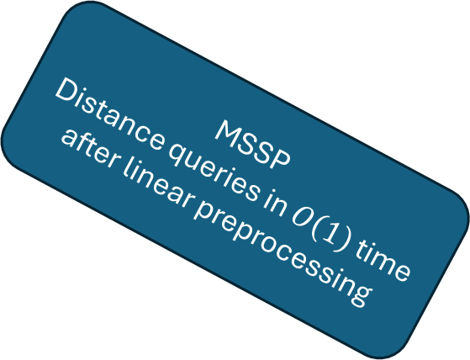
Additively weighted Voronoi diagrams
MSSP
Distance queries in $O\left(1\right)$ time after linear preprocessing
The shortest path between $u$ and $v$ must go through some (last) boundary vertex.
One can consider for all $s∈∂P$ $dist\left(u,s\right)+dist(s,v)$ and take the minimum
$$dist\left(u,v\right)=\min_{s∈∂P}(dist\left(u,s\right)+dist\left(s,v\right))$$
$$11$$
$$6$$
$$86$$
$$37$$
$$u$$
$$74$$
$$7$$
$$18$$
$$48$$
$$v$$

Slide 14

Additively weighted Voronoi diagrams
Previous Algorithms:
Additive Voronoi diagram construction in $\tilde{O}\left(\left|f\right|\sqrt{n}\right)$ time
The shortest path between $u$ and $v$ must go through some (last) boundary vertex.
One can consider for all $s∈∂P$ $dist\left(u,s\right)+dist(s,v)$ and take the minimum
$$dist\left(u,v\right)=\min_{s∈∂P}(dist\left(u,s\right)+dist\left(s,v\right))$$
$$11$$
$$6$$
$$86$$
$$37$$
$$74$$
$$7$$
$$18$$
$$48$$
$$v$$

Slide 15

Additively weighted Voronoi diagrams
Main technical innovation:
Additive Voronoi diagram construction in $\tilde{O}\left(\left|f\right|\right)$ time
The shortest path between $u$ and $v$ must go through some (last) boundary vertex.
One can consider for all $s∈∂P$ $dist\left(u,s\right)+dist(s,v)$ and take the minimum
$$dist\left(u,v\right)=\min_{s∈∂P}(dist\left(u,s\right)+dist\left(s,v\right))$$
$$11$$
$$6$$
$$86$$
$$37$$
$$74$$
$$7$$
$$18$$
$$48$$
$$v$$

Slide 16



Reduce to Voronoi diagram on a path
Previous results (on grid graphs) find a Voronoi diagram of some shortest path –each vertex has a color of the corresponding site.
Problem:
Could be hard to represent
$$x$$
$$P$$
$$y$$

Slide 17

Reduce to Voronoi diagram on a path
Define left and right partitions of $P$
  Find explicitly the sites of $x$ and $y$
Left partition considers only paths entering $P$ from the left
In the left partition each site has (at most) one subpath.
$$x$$
$$P$$
$$y$$

Slide 18

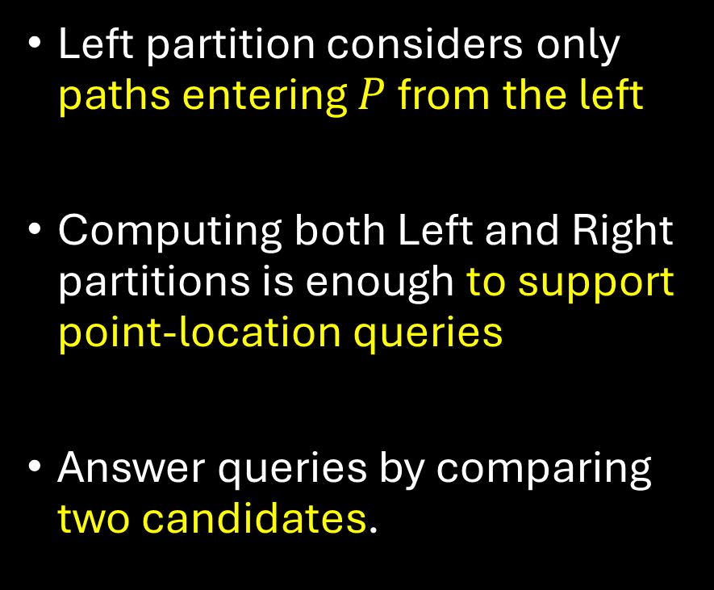
Reduce to Voronoi diagram on a path
MSSP
Distance queries in $O\left(1\right)$ time after linear preprocessing
Left partition considers only paths entering $P$ from the left
Computing both Left and Right partitions is enough to support point-location queries
Answer queries by comparing two candidates.
$$x$$
$$P$$
$$u$$
$$y$$

Slide 19
Computing Left-partition
Problem: How to compute?
We know how to find the direction of the shortest path, but we cannot restrict the paths to go from a specific direction
$$x$$
$$P$$
$$y$$

Slide 20


Computing Left-partition
Problem: How to compute?
We know how to find the direction of the shortest path, but we cannot restrict the paths to go from a specific direction
Relaxation:
We insist on colors only for nodes whose correct site enters $P$ from the left
$$x$$
$$P$$
Don’t care
?
$$y$$

Slide 21



Computing Left-partition of two colors
Goal: find some “middle” node that is in strictly in one of the colors.
Then, it remains to solve recursively on “half of $P$”
$$x$$
$$s_{1}$$
$$P$$
$$y$$
$$s_{2}$$

Slide 22



Computing Left-partition of two colors
If $s_{2}$ reaches $u$ from the left:
Find the color of $u$ and continue with one side of $P$.
$$x$$
$$s_{1}$$
$$P$$
Median of vertices $s_{1}$
reaches from the left
$$u$$
$$y$$
$$s_{2}$$

Slide 23



Computing Left-partition of two colors
If $s_{2}$ reaches $u$ from the left:
Find the color of $u$ and continue with one side of $P$.
If $u$ is closer to $s_{1}$ - continue with the bottom of $P$
$$x$$
$$s_{1}$$
$$P$$
Median of vertices $s_{1}$
reaches from the left
$$u$$
If $s_{2}$ is closer and reaches from the right – every node in $s_{2}−u$ is closer to $s_{2}$ than to $s_{1}$.
Use the median of $s_{2}$ left vertices - 𝑣
$$y$$
$$s_{2}$$

Slide 24




Computing Left-partition of two colors
If $s_{2}$ is closer and reaches from the right – every node in $s_{2}−u$ is closer to $s_{2}$ than to $s_{1}$.
Use the median of $s_{2}$ left vertices - 𝑣
$$x$$
$$s_{1}$$
$$P$$
$$u$$
If $s_{1}$ reaches $v$ from the left – continue with one half of $P$
$$v$$
Median of vertices $s_{2}$
reaches from the left
$$y$$
$$s_{2}$$

Slide 25



Computing Left-partition of two colors
If $s_{2}$ is closer and reaches from the right – every node in $s_{2}−u$ is closer to $s_{2}$ than to $s_{1}$.
Use the median of $s_{2}$ left vertices - 𝑣
$$x$$
$$s_{1}$$
$$P$$
$$u$$
If $s_{1}$ reaches $v$ from the left – continue with one half of $P$
Otherwise, $s_{2}$ is closer to $v$ – due to the intesection.
$$v$$
Median of vertices $s_{2}$
reaches from the left
$$y$$
$$s_{2}$$

Slide 26

Computing Left-partition of two colors
There are more cases to consider – details in the paper
If $s_{2}$ is closer and reaches from the right – every node in $s_{2}−u$ is closer to $s_{2}$ than to $s_{1}$.
Use the median of 𝑠_2 left vertices - 𝑣
$$x$$
$$s_{1}$$
$$P$$
$$u$$
If $s_{1}$ reaches $v$ from the left – continue with one half of $P$
Otherwise, $s_{2}$ is closer to $v$ – due to the intesection.
$$v$$
Median of vertices $s_{2}$
reaches from the left
$$y$$
$$s_{2}$$

Slide 27

Further implications
Dynamic distance oracle for undirected graphs with:
$\tilde{O}(1)$ query time – when the source does not change
$\tilde{O}(n^{2/3})$ update time:
  Edge insertion/deletion
  Changing source
Following the algorithm of Charalampopoulos and Karczmarz -improving from $\tilde{O}(n^{4/5})$

Slide 28
Thank you!
Tak!

