Slide 1


Near-Optimal
Dynamic Time Warping on
Run Length Encoded Strings
Itai Boneh, Shay Golan, Shay Mozes, Oren Weimann

Slide 2
Dynamic Time Warping
Free operation: duplicate a symbol
A
B
A
A
B
B
A
A

Slide 3
Dynamic Time Warping
Free operation: duplicate a symbol
A
B
A
A
B
B
B
A
A

Slide 4



Dynamic Time Warping
$DTW(S,T)=$ the minimal number of mismatches after applying duplications to $S$ and $T$
$$S$$
A
B
A
C
B
B
B
B
A
A
B
A
C
B
B
B
B
A
$$T$$
A
B
B
B
B
B
B
A
A
A
B
B
B
B
B
B
A
A

Slide 5
Dynamic Time Warping
$DTW(S,T)=$ the minimal number of mismatches after applying duplications to $S$ and $T$
$$S$$
A
B
A
C
B
B
B
B
A
A
B
A
C
B
B
B
B
A
A
A
B
B
B
B
B
B
A
A
$$T$$
A
B
B
B
B
B
B
A
A

Slide 6


Dynamic Time Warping
$DTW(S,T)=$ the minimal number of mismatches after applying duplications to $S$ and $T$
$$S$$
A
B
A
C
B
B
B
B
A
A
B
A
C
B
B
B
B
A
A
$$≠$$
$$≠$$
2 mismatches
A
B
B
B
B
B
B
B
A
A
$$T$$
A
B
B
B
B
B
B
A
A

Slide 7



Dynamic Time Warping
total cost
$DTW(S,T)=$ the minimal number of mismatches after applying duplications to $S$ and $T$
$$S$$
A
B
A
C
B
B
B
B
A
A
B
A
C
B
B
B
B
A
A
$$c(A,B)$$
$$≠$$
$$≠$$
$$c(C,B)$$
2 mismatches
A
B
B
B
B
B
B
B
A
A
$$T$$
A
B
B
B
B
B
B
A
A

Slide 8
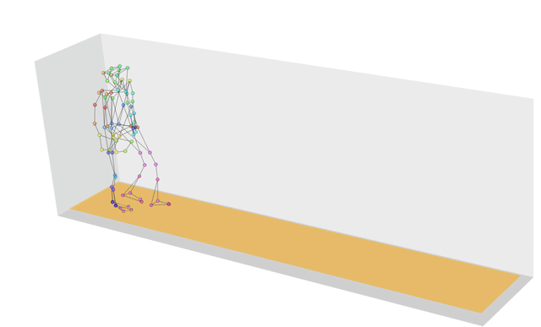
Dynamic Time Warping
Captures ‘Structural’ Similarity, ignoring delays.

Slide 9

Run Length Encoding
$$T$$
A
A
B
B
B
B
B
B
B
A
A
A

Slide 10



Run Length Encoding
$$T$$
A
B
B
B
B
B
B
A
A
$$N=9$$
1
6
2
$$RLE\left(T\right)=$$
A
B
A
$n$=3

Slide 11
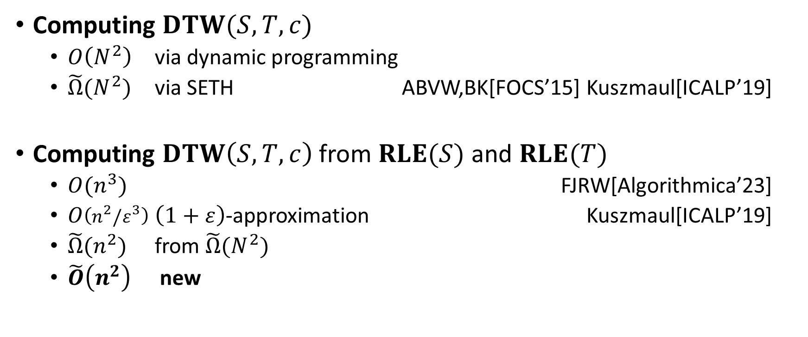
Dynamic Time Warping
Computing $DTW(S,T,c)$
  $O\left(N^{2}\right)$ via dynamic programming
  $\tilde{Ω}(N^{2})$ via SETH ABVW,BK[FOCS’15] Kuszmaul[ICALP’19]
Computing $DTW\left(S,T,c\right)$ from $RLE(S)$ and $RLE(T)$
  $O(n^{3})$ FJRW[Algorithmica’23]
  $O\left(n^{2}/ε^{3}\right)$ $\left(1+ε\right)$-approximation Kuszmaul[ICALP’19]
  $\tilde{Ω}(n^{2})$ from $\tilde{Ω}(N^{2})$
  $\tilde{O}\left(n^{2}\right)$ new

Slide 12



Dynamic Programming
$D\left[i,j\right]≝DTW\left(S\left[1..i\right],T\left[1..j\right]\right)$
$$i$$
$$j$$

Slide 13

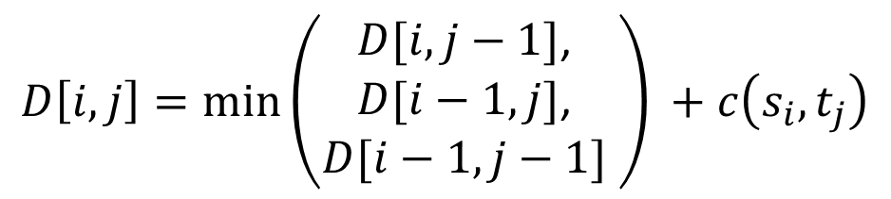
Dynamic Programming
$D\left[i,j\right]≝DTW\left(S\left[1..i\right],T\left[1..j\right]\right)$
$$i$$
$$D\left[i,j\right]=\min\left(\begin{matrix}D[i,j−1]\text{,} \\ D[i−1,j]\text{,} \\ D[i−1,j−1] \end{matrix}\right) +c\left(s_{i},t_{j}\right)$$
$$j$$
$$+c(s_{i},t_{j})$$

Slide 14
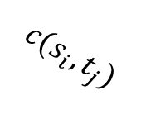


Alignment grid and blocks
$$D\left[i,j\right]=\min\left(\begin{matrix}D[i,j−1]\text{,} \\ D[i−1,j]\text{,} \\ D[i−1,j−1] \end{matrix}\right) +c\left(s_{i},t_{j}\right)$$
$$c(s_{i},t_{j})$$
$$c(s_{i},t_{j})$$
$$c(s_{i},t_{j})$$

Slide 15

Alignment grid and blocks
$RLE$ partition the grid into $n^{2}$ blocks
A
A
A
B
B
B
B
A
A
A
B
B
A
A
B
B
A

Slide 16
Processed Blocks and the Frontier
At every point, we have a set of processed blocks.
A
A
A
B
B
B
B
A
A
A
B
B
A
A
B
B
A

Slide 17


Processed Blocks and the Frontier
Idea: Maintain an array $F$ storing distances to the frontier.
A
A
A
B
B
B
B
A
A
A
B
B
A
A
B
B
A
$$F$$

Slide 18

Processed Blocks and the Frontier
Idea: When a block is processed, update $F$ accordingly.
A
A
A
B
B
B
B
A
A
A
B
B
A
A
B
B
A
$$F$$

Slide 19
Processed Blocks and the Frontier
Idea: When a block is processed, update $F$ accordingly.
A
A
A
B
B
B
B
A
A
A
B
B
A
A
B
B
A
$$F$$
Update!

Slide 20
Processed Blocks and the Frontier
Idea: When a block is processed, update $F$ accordingly.
A
A
A
B
B
B
B
A
A
A
B
B
A
A
B
B
A
$$F$$

Slide 21
Processed Blocks and the Frontier
Idea: When a block is processed, update $F$ accordingly.
A
A
A
B
B
B
B
A
A
A
B
B
A
A
B
B
A
$$F$$

Slide 22
Processed Blocks and the Frontier
Idea: When a block is processed, update $F$ accordingly.
A
A
A
B
B
B
B
A
A
A
B
B
A
A
B
B
A
$$F$$

Slide 23
Processed Blocks and the Frontier
Idea: When a block is processed, update $F$ accordingly.
A
A
A
B
B
B
B
A
A
A
B
B
A
A
B
B
A
$$F$$

Slide 24

Processed Blocks and the Frontier
Idea: When a block is processed, update $F$ accordingly.
A
A
A
B
B
B
B
A
A
A
B
B
A
A
B
B
$$DTW(S,T)$$
A
$$F$$

Slide 25

Processed Blocks and the Frontier
Question: What is happening in $F$?
A
A
A
B
B
B
B
A
A
A
B
B
A
A
B
B
A
$$F$$
Update!

Slide 26



Range Operations
AddConst($c$)
AddGrdient($g$)
LinearWave($α$)

Slide 27

Range Operations
$$c$$
AddConst($c$)
AddGrdient($g$)
LinearWave($α$)

Slide 28
Range Operations
$$c$$
AddConst($c$)
AddGrdient($g$)
LinearWave($α$)

Slide 29

Range Operations
$$c$$
$$g$$
AddConst($c$)
AddGrdient($g$)
LinearWave($α$)

Slide 30

Range Operations
$$c$$
$$g$$
$$α$$
AddConst($c$)
AddGrdient($g$)
LinearWave($α$)

Slide 31

Range Operations
$$c$$
$$α$$
$$g$$
$$α$$
AddConst($c$)
AddGrdient($g$)
LinearWave($α$)

Slide 32
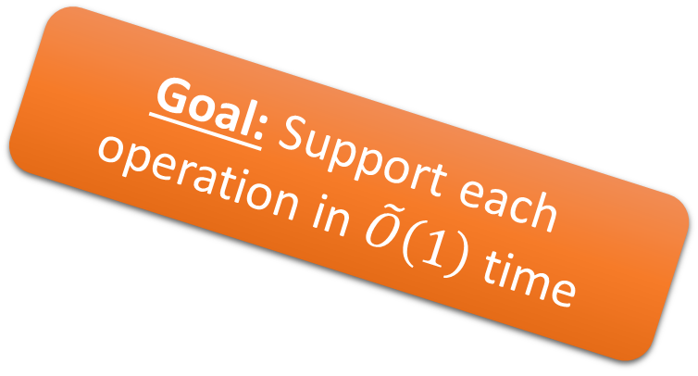
Range Operations
Goal: Support each operation in $\tilde{O}\left(1\right)$ time
$$c$$
$$α$$
$$g$$
$$α$$
AddConst($c$)
AddGrdient($g$)
LinearWave($α$)

Slide 33


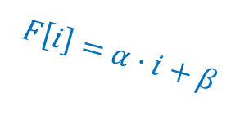
Piecewise Linear Representation
$F$ is represented using linear pieces
$$F\left[i\right]=α⋅i+β$$
$$F$$

Slide 34
Add Const
Split pieces that are partially within the update
$$F$$
$Add(c)$

Slide 35
Add Const
Split pieces that are partially within the update
$$F$$
$Add(c)$

Slide 36



Add Const
Increase $β$ for every piece in the interval.
$$c$$
$$c$$
$$F$$
$Add(c)$

Slide 37
Add Const
Add linear pieces to close the gaps.
$$F$$
$Add(c)$

Slide 38

Add Const
Adding $c$ to an interval- can be implemented in $O(\log\left(n\right))$.
$$F$$
$Add(c)$

Slide 39

Add Gradient
Similar to $AddConst$ – increase $α$ instead of $β$.
$$F$$
$Gradient(g)$

Slide 40

Add Gradient
Similar to $AddConst$ – increase $α$ instead of $β$.
$$F$$
$Gradient(g)$

Slide 41
Add Gradient
Similar to $AddConst$ – increase $α$ instead of $β$.
$$F$$
$Gradient(g)$

Slide 42
Main Challenge – Linear Wave
First Attempt: Left to Right iteration
$$F$$
$LinearWave(α)$

Slide 43


Main Challenge – Linear Wave
First Attempt: Left to Right iteration
Slope $>α$?
Start ray shooting!
$$α$$
$$F$$
$LinearWave(α)$

Slide 44
Main Challenge – Linear Wave
First Attempt: Left to Right iteration
Above the ray-
Delete!
$$F$$
$LinearWave(α)$

Slide 45
Main Challenge – Linear Wave
First Attempt: Left to Right iteration
$$F$$
$LinearWave(α)$

Slide 46
Main Challenge – Linear Wave
First Attempt: Left to Right iteration
Below the ray-
Stop ray shooting
$$F$$
$LinearWave(α)$

Slide 47
Main Challenge – Linear Wave
First Attempt: Left to Right iteration
Below the ray-
Stop ray shooting
$$F$$
$LinearWave(α)$

Slide 48

Main Challenge – Linear Wave
First Attempt: Left to Right iteration
Slope $>α$?
Start ray shooting!
$$F$$
$LinearWave(α)$

Slide 49


Main Challenge – Linear Wave
First Attempt: Left to Right iteration
Slope $>α$?
Start ray shooting!
$$<α$$
$$F$$
$LinearWave(α)$

Slide 50

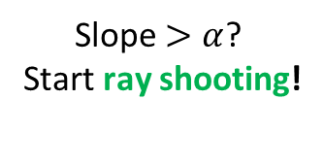
Main Challenge – Linear Wave
First Attempt: Left to Right iteration
Slope $>α$?
Start ray shooting!
$$<α$$
$$<α$$
$$F$$
$LinearWave(α)$

Slide 51
Main Challenge – Linear Wave
First Attempt: Left to Right iteration
$$<α$$
$$<α$$
$$F$$
$LinearWave(α)$

Slide 52
Main Challenge – Linear Wave
First Attempt: Left to Right iteration
$$<α$$
$$<α$$
$$F$$
$LinearWave(α)$

Slide 53
Main Challenge – Linear Wave
First Attempt: Left to Right iteration
$$<α$$
$$<α$$
$$F$$
$LinearWave(α)$

Slide 54
Main Challenge – Linear Wave
First Attempt: Left to Right iteration
$$<α$$
$$<α$$
$$F$$
$LinearWave(α)$

Slide 55
Main Challenge – Linear Wave
First Attempt: Left to Right iteration
$$<α$$
$$<α$$
$$F$$
$LinearWave(α)$

Slide 56

Main Challenge – Linear Wave
Time Complexity: Number of internal Linear Pieces – Can be $Ω(n)$!
$$<α$$
$$<α$$
$$F$$
$LinearWave(α)$

Slide 57
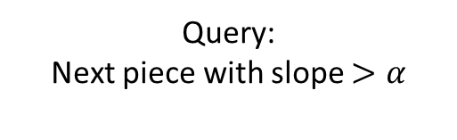
Main Challenge – Linear Wave
Improvement: ‘Jump’ to the next ray shooting
Query:
Next piece with slope $>α$
$$<α$$
$$<α$$
$$F$$
$LinearWave(α)$

Slide 58
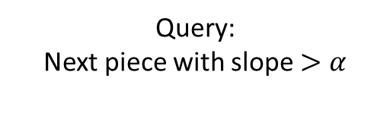
Main Challenge – Linear Wave
Improvement: ‘Jump’ to the next ray shooting
Query:
Next piece with slope $>α$
$$<α$$
$$<α$$
Skipped!
$$F$$
$LinearWave(α)$

Slide 59
Main Challenge – Linear Wave
Improvement: That way, Every visited point ‘deletes’ at least one other point
Query:
Next piece with slope $>α$
$$<α$$
$$<α$$
Skipped!
$$F$$
$LinearWave(α)$

Slide 60
Main Challenge – Linear Wave
Improvement: That way, Every visited point ‘deletes’ at least one other point
$$<α$$
$$<α$$
Skipped!
$$F$$
$LinearWave(α)$

Slide 61

Main Challenge – Linear Wave
Would be Great: For every iterated point, a point is deleted –
‘charge’ iteration on deleted point – Amortized $polylog(n)$ time!
$$<α$$
$$<α$$
Skipped!
$$F$$
$LinearWave(α)$

Slide 62




Main Challenge – Linear Wave
Sadly… We may create a lot of new points as well.
$$α$$
$$α$$
$$α$$
$$α$$
$$α$$
$$F$$
$LinearWave(α)$

Slide 63
Main Challenge – Linear Wave
Sadly… We may create a lot of new points as well.
New Points!
$$F$$
$LinearWave(α)$

Slide 64
Main Challenge – Linear Wave
Solution: Focus on Maximal Concave Segments!
$$F$$
$LinearWave(α)$

Slide 65
Main Challenge – Linear Wave
Useful Fact: Ray Only start on the endpoint of Concave Segments
$$F$$
$LinearWave(α)$

Slide 66
Main Challenge – Linear Wave
How Ray Interacts with Concave Segments?

Slide 67

Main Challenge – Linear Wave
How Ray Interacts with Concave Segments?
Case 1: $α<$ segment slope

Slide 68

Main Challenge – Linear Wave
How Ray Interacts with Concave Segments?
Case 1: $α<$ segment slope
In this case, at least two points are deleted!

Slide 69

Main Challenge – Linear Wave
How Ray Interacts with Concave Segments?
Case 2: $α≥$ segment slope
In this case, we apply the update Implicitly

Slide 70

Main Challenge – Linear Wave
Case 2: $α≥$ segment slope
A segment keeps a slope $ρ$ of a pending ray

Slide 71

Main Challenge – Linear Wave
Case 2: $α≥$ segment slope
If the Pending ray has slope larger than $α$, we need to assign $ρ←α$

Slide 72
Main Challenge – Linear Wave
Case 2: $α≥$ segment slope
If the Pending ray has slope larger than $α$, we need to assign $ρ←α$

Slide 73

Main Challenge – Linear Wave
Case 2: $α≥$ segment slope
If the slope of the Pending Ray is smaller than $α$, we can ignore the ray

Slide 74

Main Challenge – Linear Wave
Case 2: $α≥$ segment slope
In conclusion, we need to set $ρ←min(α,ρ)$

Slide 75

Main Challenge – Linear Wave
We apply Case 2 by implicitly setting $ρ←min(α,ρ)$ for every segment.
$$α$$
$$α$$
$$α$$
$$α$$
$$α$$
$$F$$
$LinearWave(α)$

Slide 76
Main Challenge – Linear Wave
We apply Case 2 by implicitly setting $ρ←min(α,ρ)$ for every segment.
$$α$$
$$α$$
$$α$$
$$α$$
$$α$$
$$F$$
$LinearWave(α)$

Slide 77
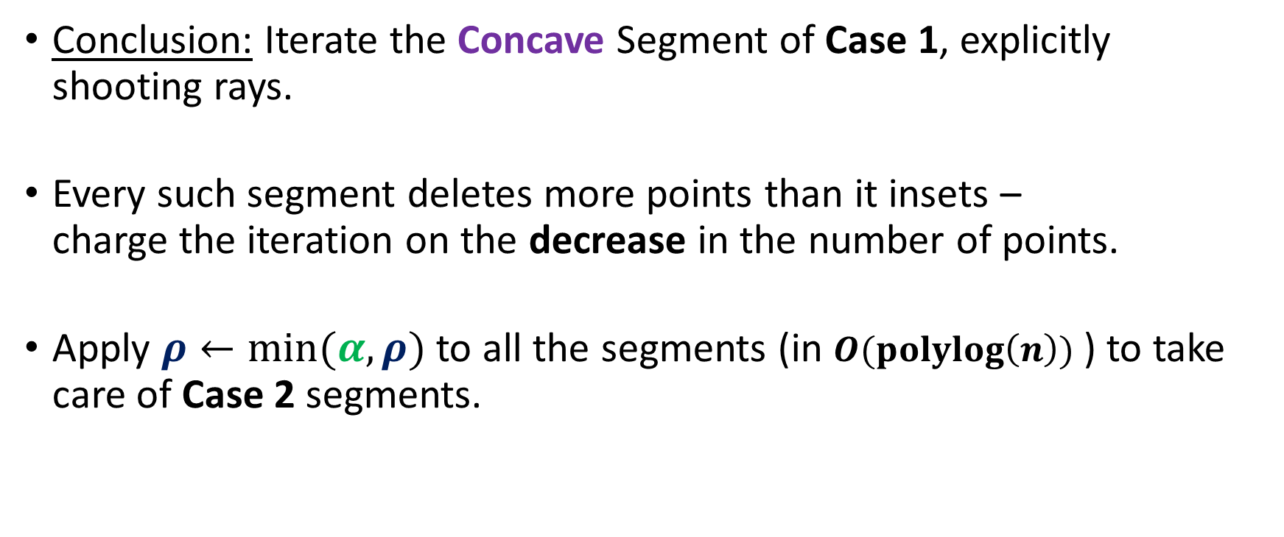
Main Challenge – Linear Wave
Conclusion: Iterate the Concave Segment of Case 1, explicitly shooting rays.
Every such segment deletes more points than it insets –
charge the iteration on the decrease in the number of points.
Apply $ρ←min(α,ρ)$ to all the segments (in $O(polylog\left(n\right))$ ) to take care of Case 2 segments.

Slide 78

Range Operations
Amorzied $\tilde{O}\left(1\right)$ time per operation
$$c$$
$$α$$
$$g$$
$$α$$
AddConst($c$)
AddGrdient($g$)
LinearWave($α$)

Slide 79


Processed Blocks and the Frontier
Question: What is happening in $F$?
A
A
A
B
B
B
B
A
A
A
B
B
A
A
B
B
A
Amortized $polylog(n)$ time
$$F$$
Update!

Slide 80
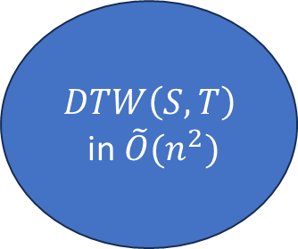
Processed Blocks and the Frontier
Idea: When a block is processed, update $F$ accordingly.
A
A
A
B
B
B
B
A
A
A
B
B
A
A
$$DTW\left(S,T\right)$$
in $\tilde{O}(n^{2})$
B
B
A
$$F$$

Slide 81
Thank You!

