Slide 1
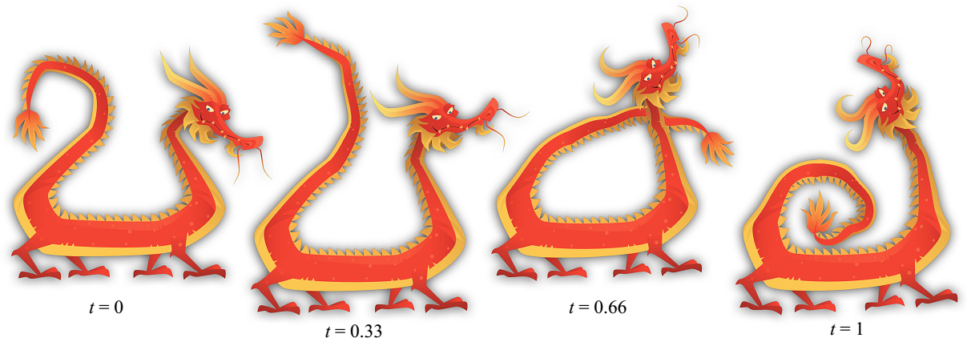
Planar Shape Interpolation with Bounded Distortion
¹Renjie Chen ²Ofir Weber ²Danny Keren ¹Mirela Ben-Chen
¹Technion – Israel Institute of Technology
²University of Haifa
Notes:
Good afternoon, thanks Ilya for the kind introduction. And thank you all for coming to the talk.
So the title of my talk is planar shape interpolation with bounded distortion
And let’s go straight to the motivation of our work

Slide 2
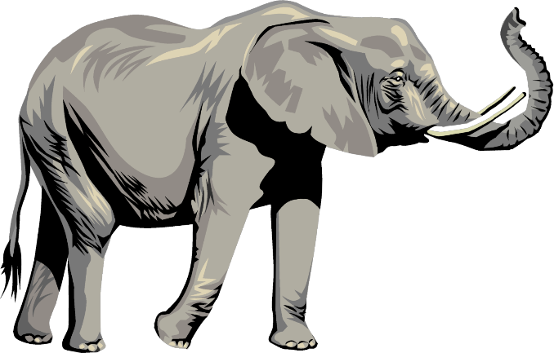
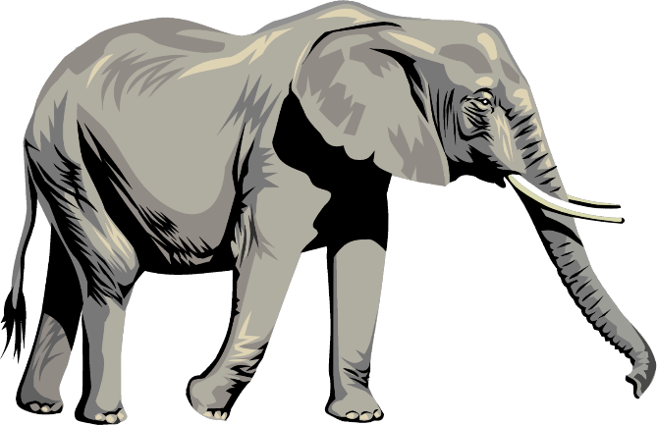
Motivation
Notes:
Oftentimes, we get two or more planar shapes as input, which can be keyframes of hand drawn animations, or just pictures of the same object that undergoes some interesting deformation
And we want to generate a continuous animation sequence that evolves from one shape to the other

Slide 3
Shape interpolation - the problem
Input:
$$(1−t) ( )+t( )$$
$$= ?$$
Output:
Notes:
So for each intermediate frame, we need to solve the same problem, that is the shape interpolation problem
Here is a more formal definition of the problem, as input we are given 2 shapes,
[CLICK] as output we need to generate some in-between shape as some combination of the 2 input shapes
For this particular example, most of us would intercept the input as an animation that the elephant is swing its trunk,
So we expect the result should be something like this [CLICK]
We use a parameter t to control how much the result should resemble either input shape
The bigger t is, the more that the elephant should be similar to the second input shape
For the interpolation problem, t is always between 0 and 1
t is usually known as the time variable
This framework can be generalized to support more than 2 shapes as input
Not that in this work, we are solving the shape interpolation in the plane.

Slide 4
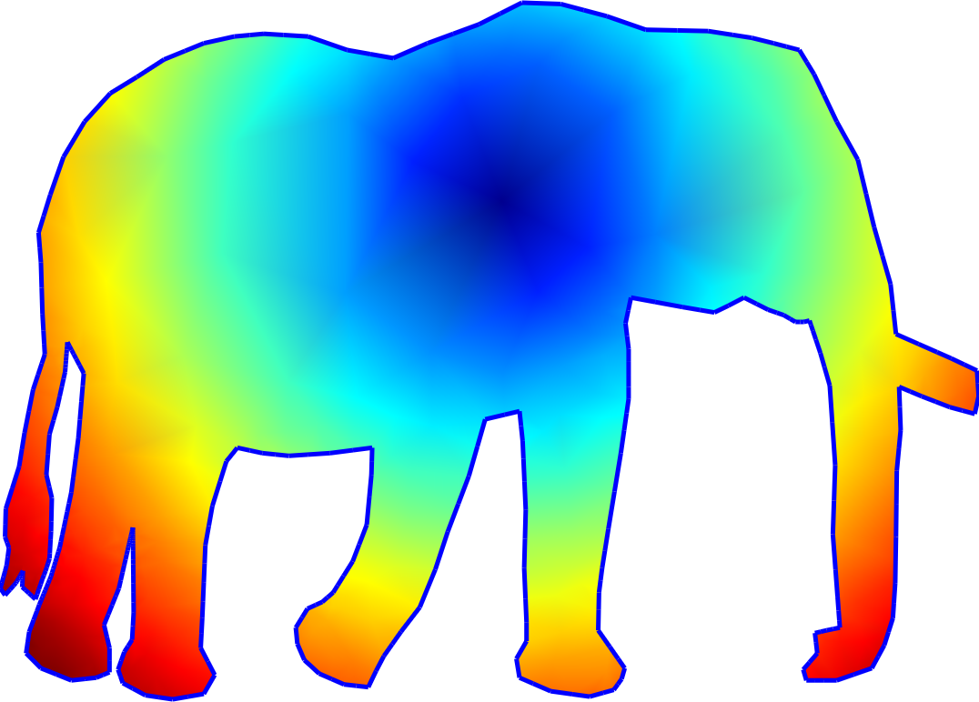
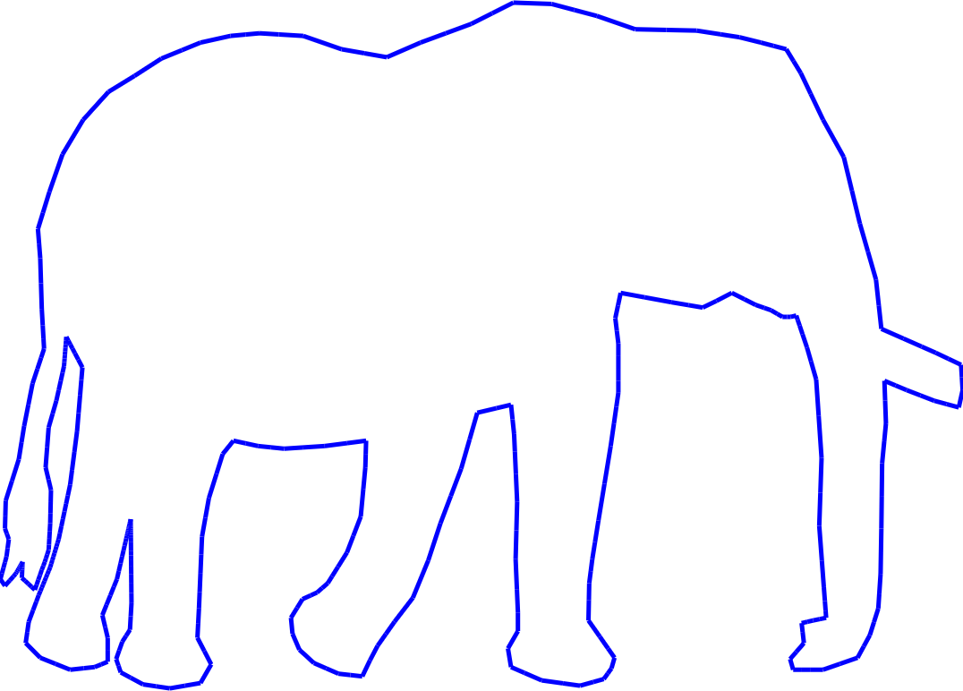
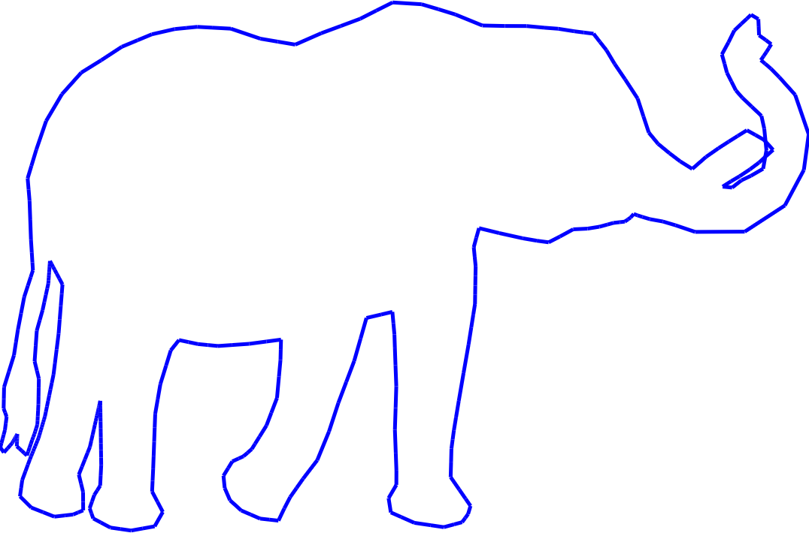
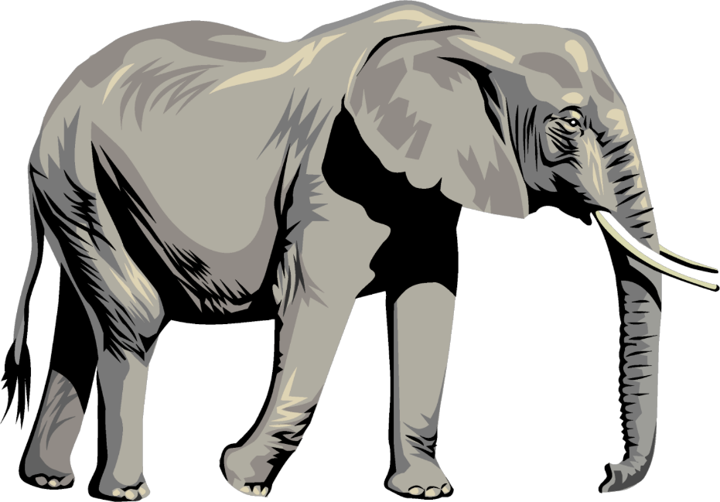
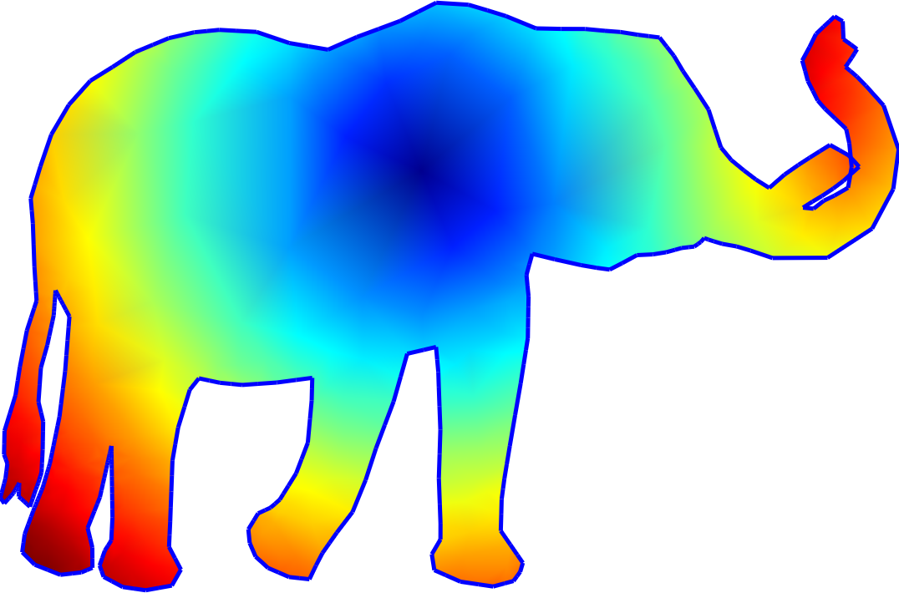
Shape interpolation - input
$$\underset{↔}{φ}$$
Source
Target
Notes:
Let’s take a more careful look at the input
In this work, we do not take the texture into account.
[CLICK] Removing the texture, we get simple planar regions bounded by closed curves.
[CLICK] We further assume that we are given a bijective map between these 2 regions, which basically tells us a point-to-point correspondence between these two shapes. Here we use colorcoding to show the correspondence, each pair of corresponding points have the same color.
Actually we don’t need the map to be globally bijective, note that for this example, the 2nd shape has slightly self overlapping, but this input is ok for our method.
[CLICK] For the interpolation problem, we usually refer to one of the shape as the source shape, and the other target.

Slide 5
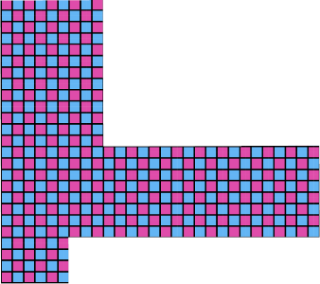
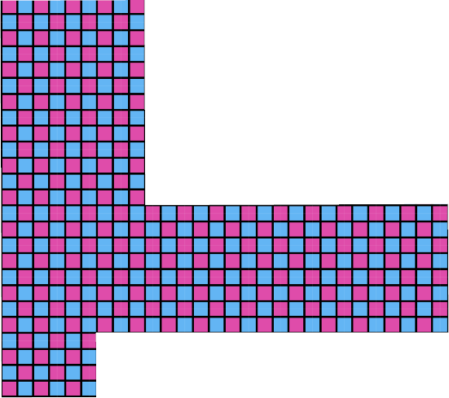
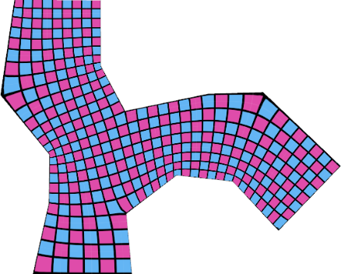
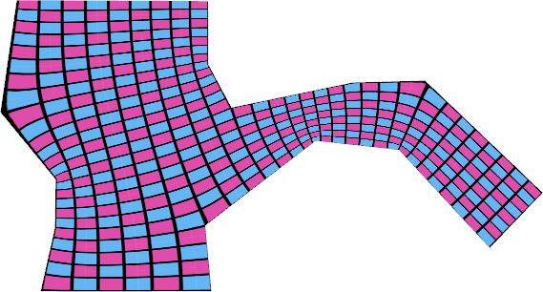
Shape interpolation – guidelines
Rotation+Scaling
(Global similarity)
Simple deformation
Rotation
Scaling
Conformal
Affine
As simple as possible
Quasi-conformal
Smooth interpolation
Similar
Conformal
(Local similarity)
Quasi-conformal
Affine
Notes:
We have several guidelines for this work
1st, if the input shows simple deformation, then the interpolation result should also be simple
By simple, [CLICK] we mean global rotation, scaling, combining them we have global similarity, and [CLICK] conformal, which basically says around each point, locally, it’s under its own rotation + scaling
The last simple deformation we consider is [CLICK] general global affine mapping
So for all these case, we want the interpolation to be of the same kind of deformation
But in practice, there’s many more deformation that do not fall in any of these, these deformation are actually quasi-conformal. [CLICK]
In such case, we want the interpolation to be as simple as possible, [CLICK] in the least, it should not be more complicated that the input. So we want around each point, the interpolation should be as similar as possible to the source.
[CLICK] So technically, the 2nd guideline is as similar as possible.
[CLICK] The last guideline is the interpolation should be smooth. Recall our motivation is to generate a continuous animation evolving the source shape to the target, so naturally we want the interpolation to be smooth, when we continuously change the time variable

Slide 6
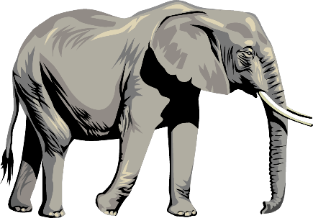
Shape interpolation – desirable properties
Source/Target reproduction
$1( )+0( )$=
$0( )+1( )$=
Notes:
Based on the guidelines, we want the interpolation to have several properties
1st, we want source and target reproduction.
Here weight 1 means we want only that shape, so if we want just the source[CLICK] , we should get the source,
likewise for the target[CLICK]

Slide 7
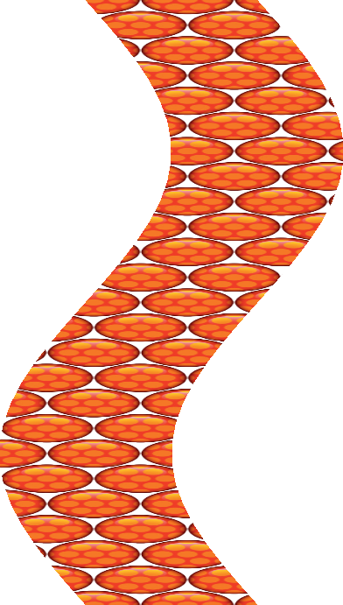
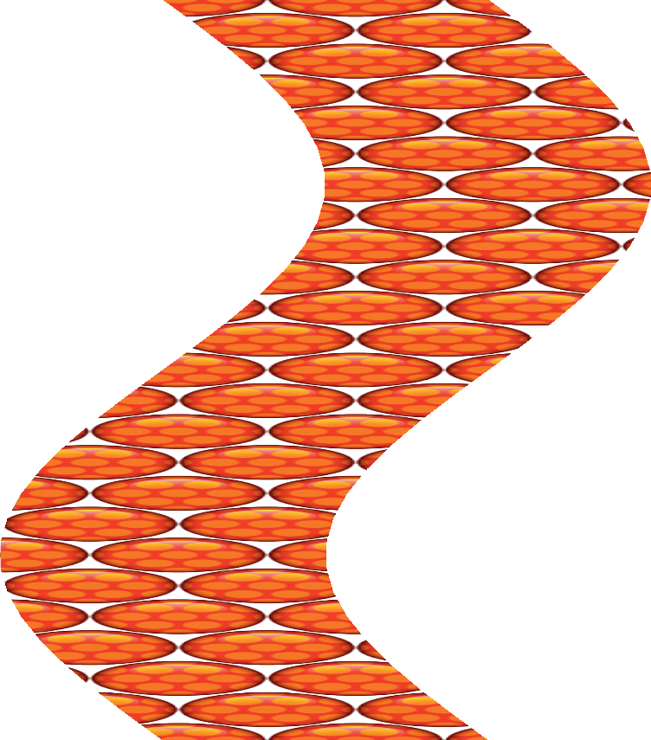
Shape interpolation – desirable properties
Affine reproduction
Source
t
Target
Notes:
The second property is affine reproduction, which we already mentioned in the guildlines.
In this case, we want the interpolation at any time t to be affine mapping version of the source[CLICK]

Slide 8
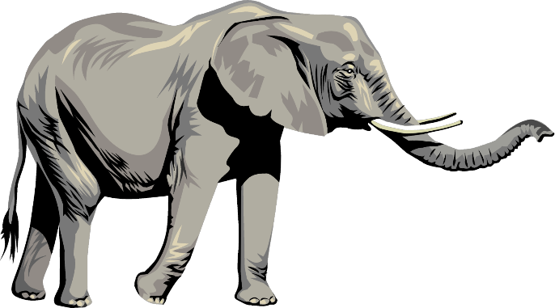
Shape interpolation – desirable properties
Symmetry
$$t$$
$$1−t$$
Notes:
The 3rd property is symmetry
Suppose we have interpolation at time t, [CLICK]
now let’s swap the source and target, [CLICK]
and interpolate at time 1-t [CLICK]
This property says these 2 interpolation should be identical [CLICK]

Slide 9
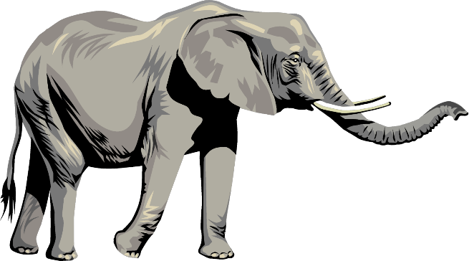
Shape interpolation – desirable properties
Smoothness
$(1−t)( )+t( )$=
$$≈$$
$$t≈s$$
$(1−s)( )+s( )$=
Notes:
The next property is smoothness, we already mentioned in the guidelines.
Basically it says, if we interpolate at closeby time variable t and s [CLICK] ,
then the interpolation results should be very similar.

Slide 10
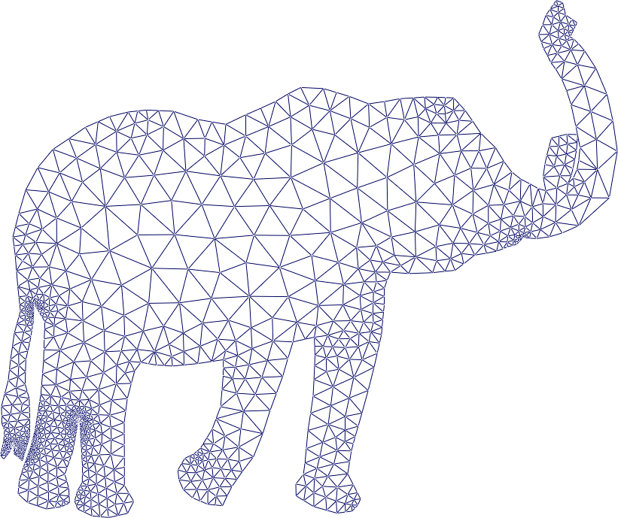
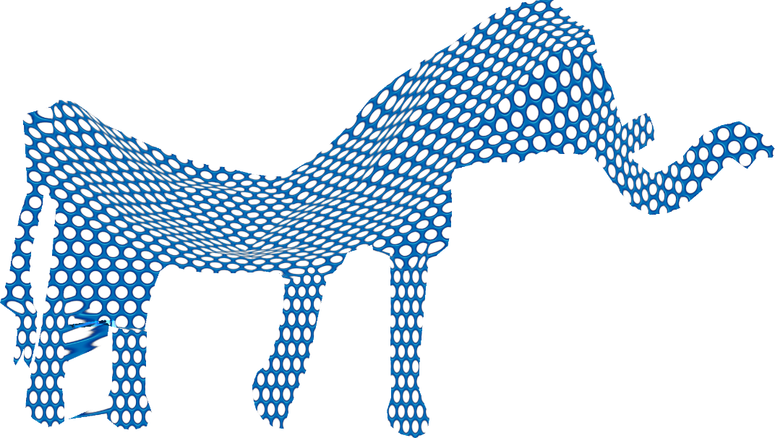
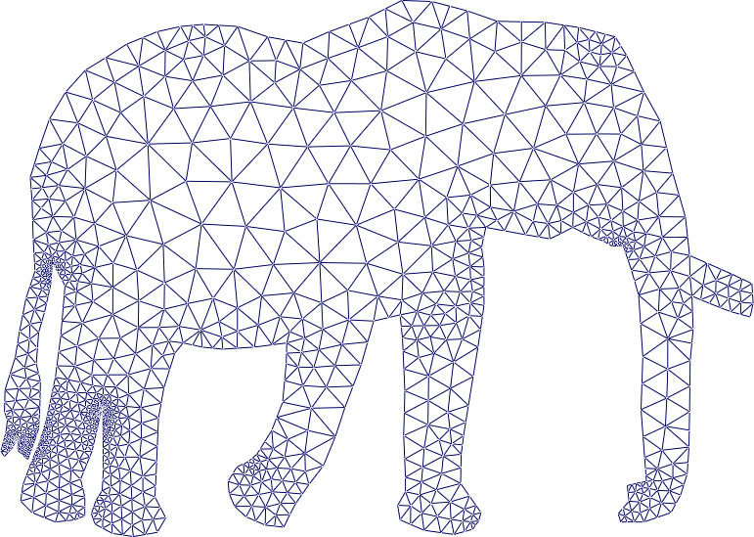
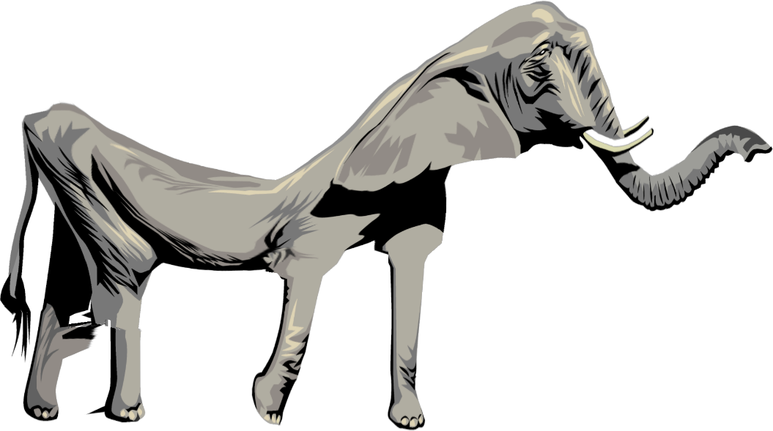
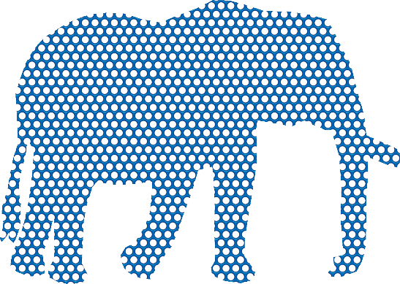
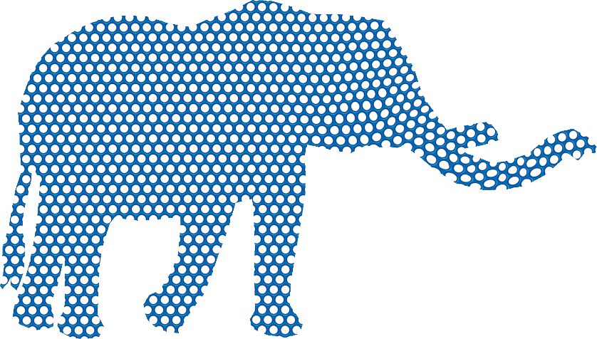
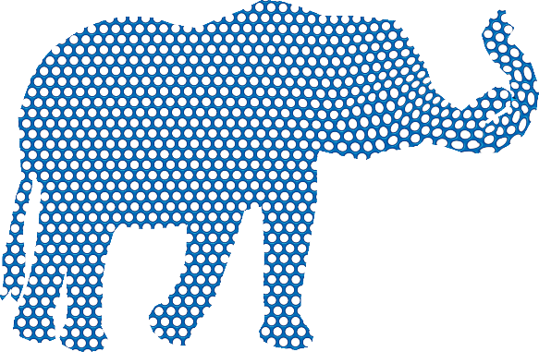
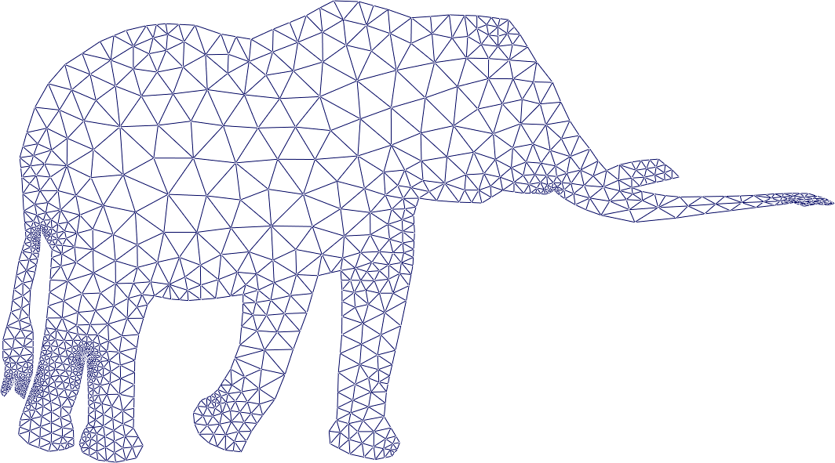
Shape interpolation – desirable properties
Pointwise bounded distortion
Conformal/angular distortion
Result with
Unbounded distortion
Result with
bounded distortion
Input
Notes:
The last but most important property we want is pointwise bounded distortion
In this work, we focus on conformal distortion, also known as angular distortion
First let’s see some result with unbounded distortion, [CLICK]
Basically it can be anything, and can be arbitrary distorted and unnatural.
In comparison, [CLICK] on the right, we show result with bounded distortion, apparently, it looks much nicer and more natural
To see pointwise bounded distortion, we replace the texture with circle patterns, [CLICK]
So in the input, the circles are mapped to quite round ellipses.
In the result with unbounded distortion, many circles become flat ellipses, and some become even more bizar shapes.
In contrast, in the bounded distortion result, the circles stay more or less like circles.
More formal definition of the conformal distortion will be explained later in our method

Slide 11
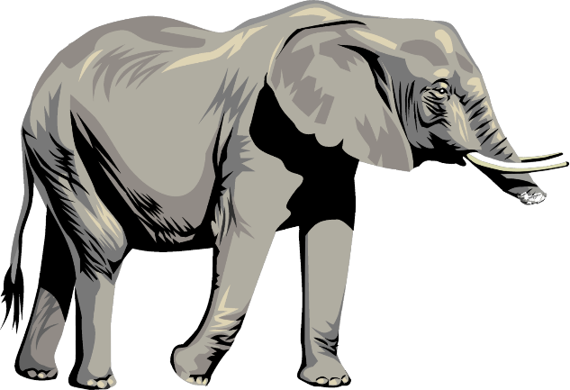
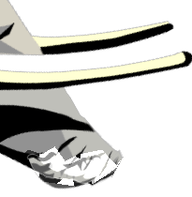
Shape interpolation – previous work
Linear coordinates interpolation
Notes:
Now let’s see some related work on this problem
The first and most naïve method one can think of is simply linearly interpolate the position of each pair of corresponding points
Here’s an example[CLICK] , apparently it has severe problem[CLICK] , in this case ,the trunk of the elephant totally collapses.

Slide 12
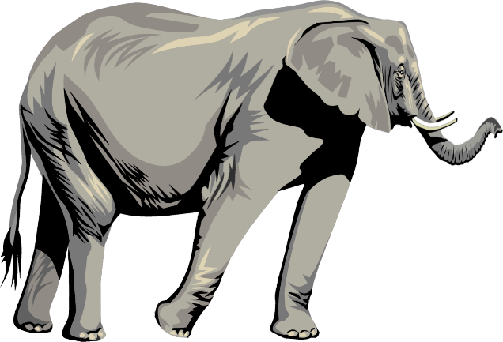
Shape interpolation – previous work
Positive barycentric coordinates
Convex boundary
Guaranteed bijectivity
Notes:
The second type of method is based on so-called positive barycentric coordinates
First the input shapes are embedded into some common convex boundary [CLICK] ,
then some positive barycentric coordinates are interpolated to get the intermediate shape, [CLICK]
after that the convex boundary is removed to get the final shape, [CLICK]
Which is guaranteed to be bijective to the source shape.
However, [CLICK] nothing more can be said beyond that, the actual conformal distortion can still be quite high, as zoom in on the right

Slide 13
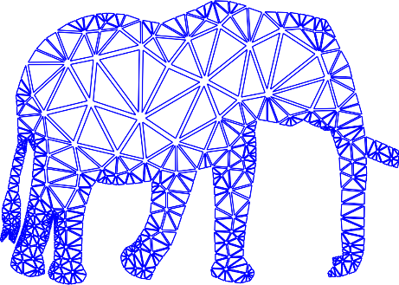
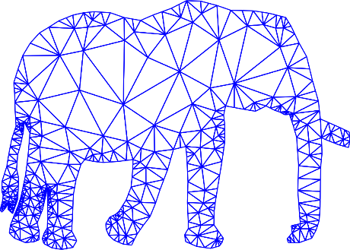
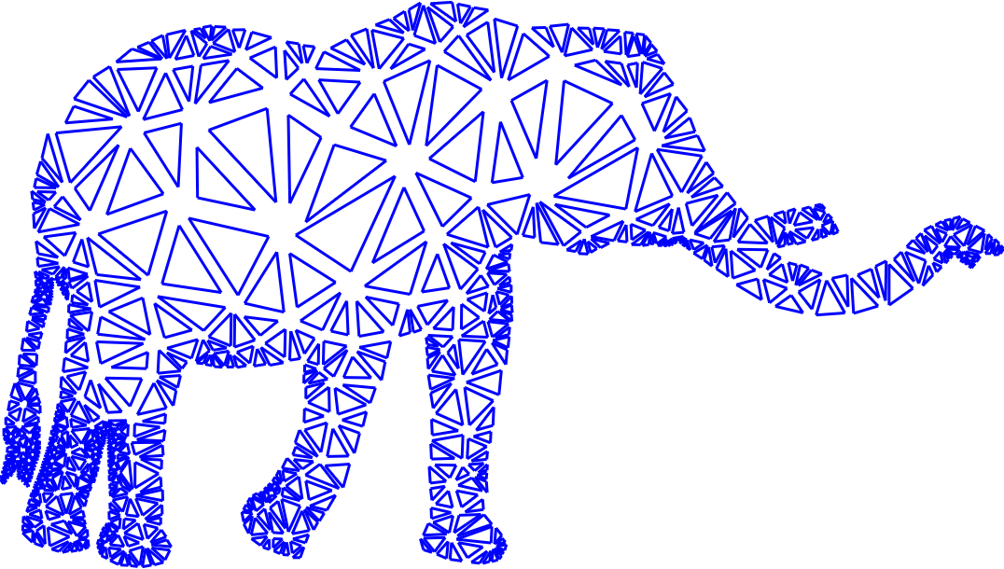
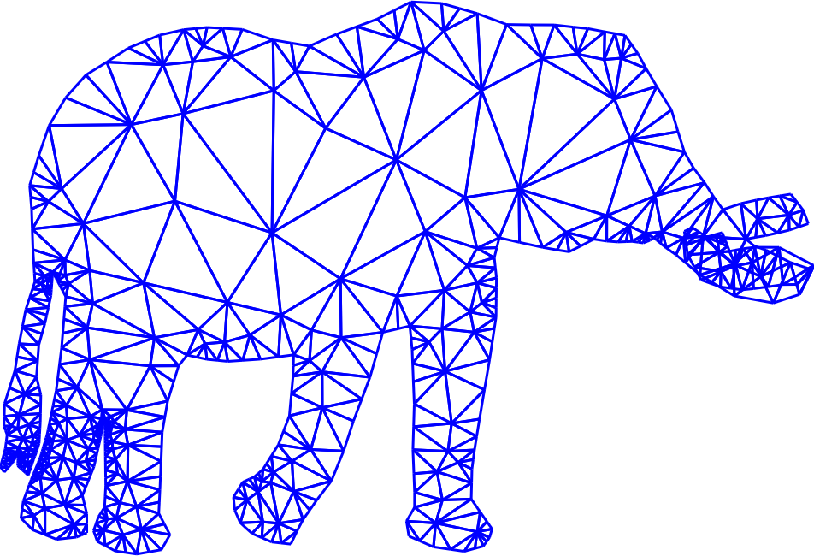
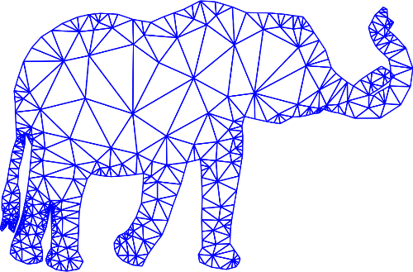
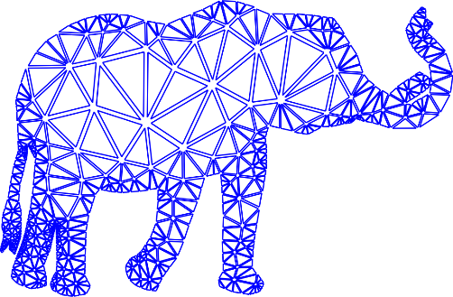
Shape interpolation – previous work
Independent per-element(edge/face/triangle pair…) interpolation + Poisson
ARAP interpolation [Alexa et. al. 2000]
ARAP local/global [Chao et. al. 2010, Liu et. al. 2008]
Free-form motion processing [Kircher and Garland 2008]
Bounded distortion mapping spaces
[Lipman 2012]
?
Poisson
Per-element Interp
Notes:
The 3rd and most popular method people use nowadays is first independent per-element interpolation, then do Poisson stitching
The element here can be edge, face, neighboring triangle pair and so on
[CLICK] There are quite many literature on this method, here we introduce the pipeline of the triangle based method
First the input shapes are partitioned into triangular meshes [CLICK]
Then each pair of triangles are interpolated such that the distortion is minimized and controlled [CLICK]
However after this step, the triangles no longer fit with each other, so something must be done to get the final result.
Almost all of these methods choose [CLICK] Poisson stitching for this task. Simply put, Poisson stitching tries to merge all the triangles together, while keeping their appearance as much as possible.
Usually it’s implemented as a least square solver, and some overall energy is minimized. In most cases, the distortion is quite low, and the result looks fine. But because it’s just a least square solver, the distortion can be concentrated in some region. For this particular example, the distortion happens around the trunk of the elephant, and makes it self overlapped. This is apparently not what we wanted.
So we ask whether we can do better than this. [CLICK]
We could try combing the bounded distortion mapping space technique [CLICK] ,
proposed by Lipman last year, into the Poisson step so that the distortion is bounded according to some hard constraints. The bounded distortion space is explained in the previous talk of this session presented by Noam.
However each convex bounded distortion space is actually a subspace of the whole bounded distortion space, and there is no obvious or easy way to find the optimal convex subspace to work with. So while it should be possible in theory, it’s not easy to find the proper distortion space, at least for our task in practice.

Slide 14
Our 2-step solution
Metric interpolation
Conformal map
Curved
No distortion
Point-wise bounded
distortion
Input
Output
Notes:
Now we present our 2-step solution, first in the continuous setting.
Given 2 planar input shapes, we propose to interpolate their metrics [CLICK],
so that a continuous intermediate shape will be produced.
Although this intermediate result is actually curved. [CLICK]
Therefore we further suggest applying a conformal map [CLICK]
on top of it to generate the final planar result.
We guarantee that the first step has the distortion bounded point-wise [CLICK] ,
while no extra distortion [CLICK] will be introduced in the second step.

Slide 15
Pullback metric
$$φ=\left(u\left(x,y\right),v\left(x,y\right)\right)$$
$$p_{2}$$
$$φ\left(p_{2}\right)$$
$$p_{1}$$
$$φ\left(p_{1}\right)$$
The Pullback metric
$$J=\left(\begin{matrix}\frac{∂u}{∂x} & \frac{∂u}{∂y} \\ \frac{∂v}{∂x} & \frac{∂v}{∂y}\end{matrix}\right)$$
$$\left\|φ\left(p_{1}\right)−φ\left(p_{2}\right)\right\|={\left(p_{1}−p_{2}\right)}^{T}M\left(p_{1}−p_{2}\right)$$
$$M=J^{T}J$$
Symmetric Positive Definite
Notes:
We have mentioned a few times that we are interpolating the metric. But what exactly do we mean by that?
So here is the actual metric that we interpolates. It’s the pullback metric.
defined as [CLICK] the Jacobian, transposed multiply by itself. The Jacobian [CLICK] is the first partial differential of the input bijective map $φ$.
The pullback metric gives us a way to move the distances computation on different domains to a common one, [CLICK]
where we can easily perform some manipulation, such as interpolation.
Note that the pullback metric is symmetric and positive definite [CLICK] . In a minute we will show a key theorem based on this property that our algorithm relies on.

Slide 16
Bounded distortion interpolation – Step 1
$$I_{d}$$
$$φ$$
$$⨁$$
Source
Curved
Target
$M_{t}$=$\left(1−t\right)I+tM(φ)$
Notes:
So in the first step, we have the input map $φ$,
and we incorporate the identity map Id [CLICK] from the source shape to itself.
Now we just interpolate the pullback metric of both maps [CLICK], and we get the metric of some continuous shape.
In the bottom right, [CLICK] we show the formula for metric interpolation. Here I denotes the identity matrix, so in the end, it boils down to matrix interpolation.
Again, the output of this step is curved [CLICK], and no longer fit into the plane.

Slide 17
Conformal distortion
$$\text{Pullback} \text{metric}:$$
$$M\left(φ\right)=J^{T}\left(φ\right)J\left(φ\right)$$
$$K\left(M\right)=\sqrt{\frac{λ_{1}\left(M\right)}{λ_{2}\left(M\right)}}$$
Conformal distortion:
Eigen values
Notes:
Next we show how we guarantee point-wise bounded distortion in this step.
First let’s see the formal definition of the conformal distortion.
For any bijective map, locally around any point, it always maps a circle to an ellipse. The more flat the ellipse is, the more distortion that the map has.
The exact formula to compute the distortion is shown here [CLICK]. Lambda 1 and lambda 2 [CLICK] are the maximum and minimum eigenvalues of the pullback metric M.

Slide 18
Key theorem
$$\text{Pullback} \text{metric}:$$
$$M\left(φ\right)=J^{T}\left(φ\right)J\left(φ\right)$$
Given SPD matrices $M_{1},M_{2}$
$$K_{t}≤\max\left(K_{1},K_{2}\right)$$
$$K_{t}=K\left(\left(1−t\right)M_{1}+tM_{2}\right)$$
Notes:
Now the key theorem of our algorithm states,
[CLICK]
Given any symmetric and positive definite matrix M1 and M2,
The interpolation of the 2 matrices, has conformal distortion that can never exceed the distortion of both input matrices.
Therefore the first step of our algorithm is guaranteed to have point-wise bounded distortion.

Slide 19
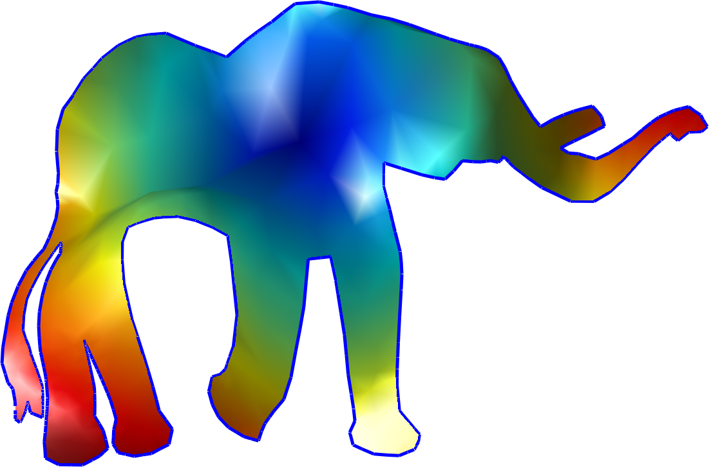
Bounded distortion interpolation – Step 2
Source
$$g$$
$$\hat{g}=e^{u}g$$
$u$: conformal scaling factor
$$Δ:Laplace−Beltrami operator$$
k$:Gaussian curvature$
Target
$$Δu=k\left(g\right)$$
Notes:
Now let’s look at the second step of our algorithm.
So the first step gives us the metric g, of the intermediate shape.
Now according to the continues conformal map theory, there exists a scalar function u [CLICK],
that turns the metric g into another, g hat, [CLICK] which is planar.
And the function u can be found by solving a partial differential equation. [CLICK]
For those curious about all the symbols here, [CLICK]
u is known as the conformal scaling factor
Delta is the Laplace-Beltrami operator
And k is the Gaussian curvature, which is determined by the metric
So in the continuous case, the problem is solved. However in practice, the partial differential equation is notorious to solve. And most of the time, we don’t care much about the continues case.
So let’s just go to the discrete case.

Slide 20
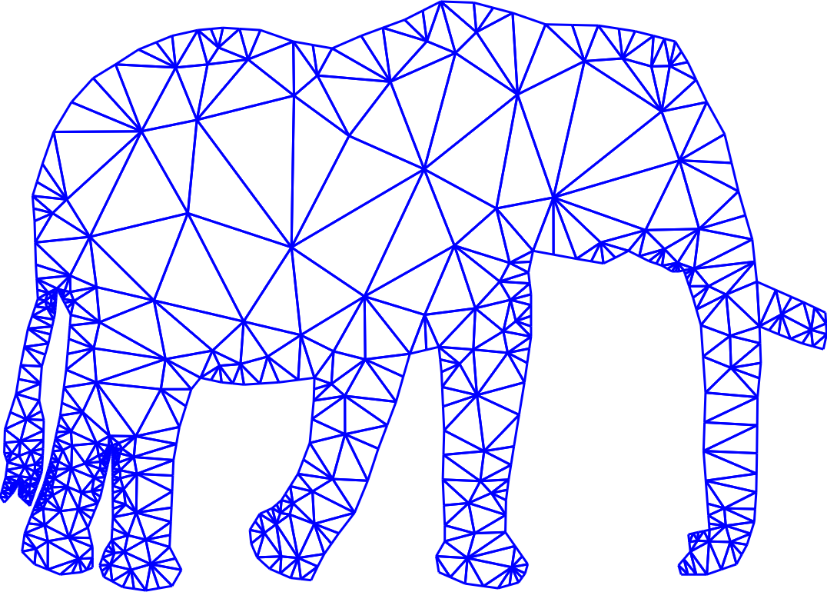
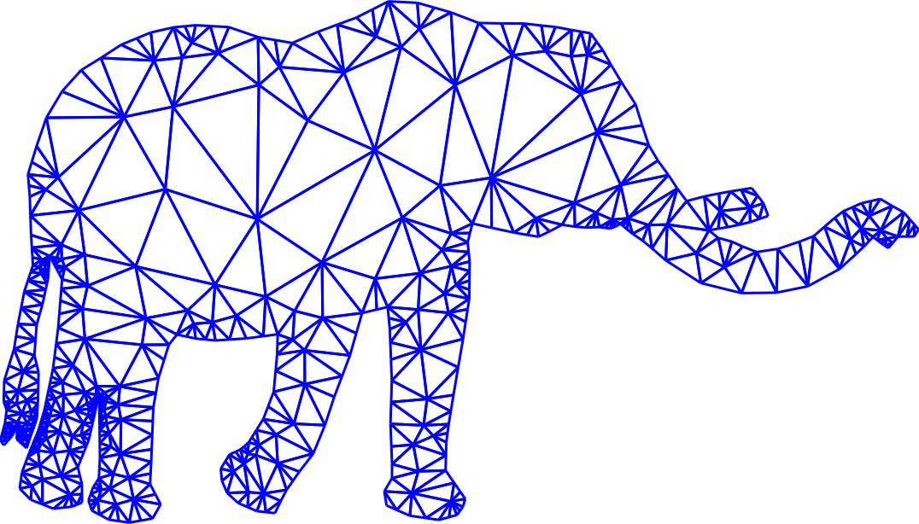
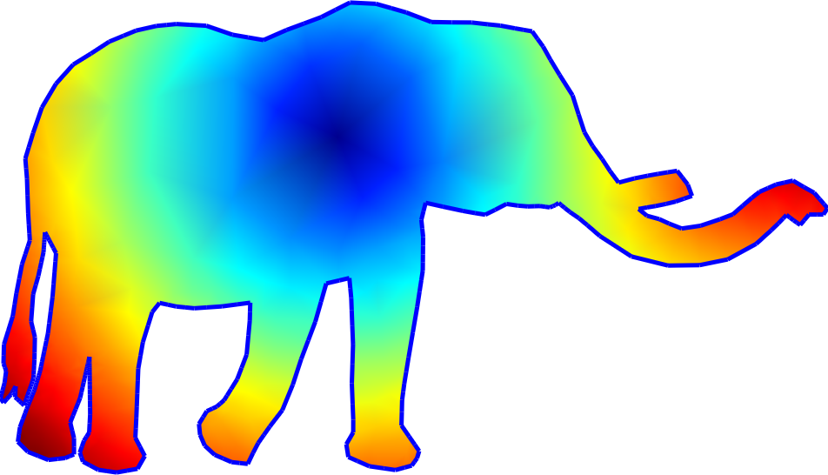
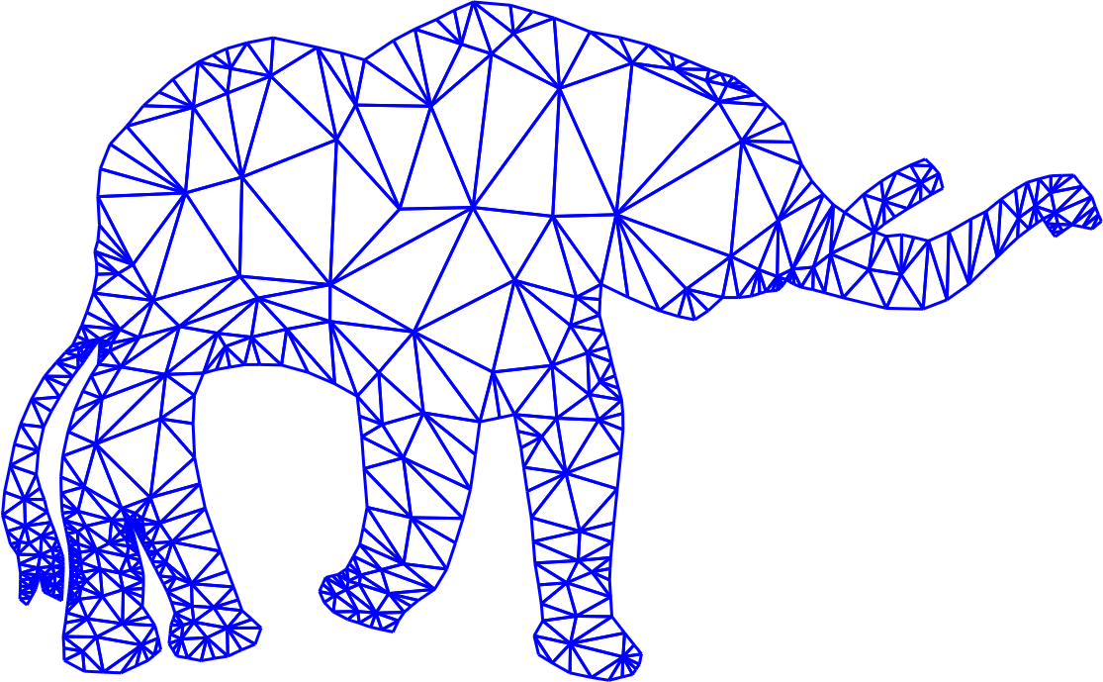
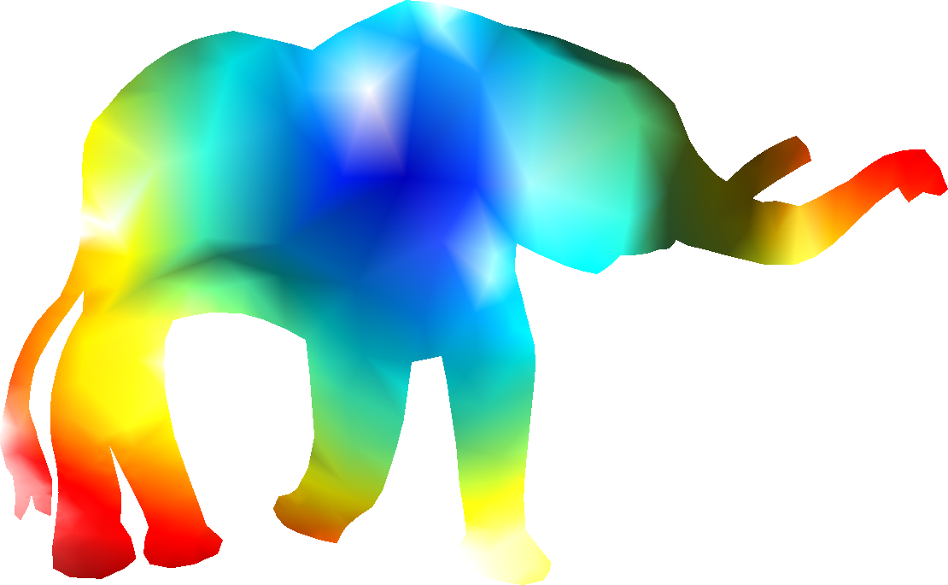
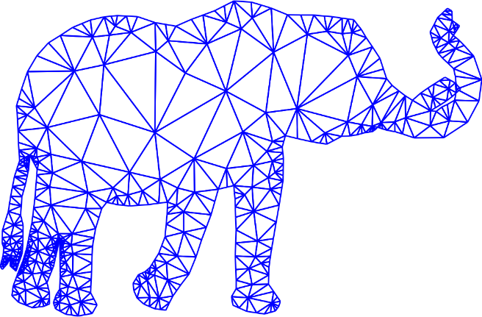
Discretization
$$φ$$
$$e_{2}$$
$$e_{1}$$
$$e_{3}$$
CETM
[Springborn et. al. 2008]
$${\left\|e_{i}\right\|}^{2}=\left(1−t\right){\left\|e_{i0}\right\|}^{2}+t{\left\|e_{i1}\right\|}^{2}$$
Input
Square edge length interpolation
Notes:
We use triangular mesh to discretize the input shapes, [CLICK]
then the input map $φ$ is discretized as a piecewise linear map and its pullback metric is piecewise constant. [CLICK]
Now, interpolating the piecewise constant pullback metric for each triangle [CLICK] is exactly the same as interpolating edge lengths squared.
Repeat the interpolation for the pullback metric of all the triangles, [CLICK]
we get the intermediate shape.
Then in the second step, [CLICK] we simply apply a discrete conformal map, proposed by Springborn and his colleagues in 2008.
[CLICK] So at the end of the day, all we need to interpolate is the edge length, only squared.

Slide 21
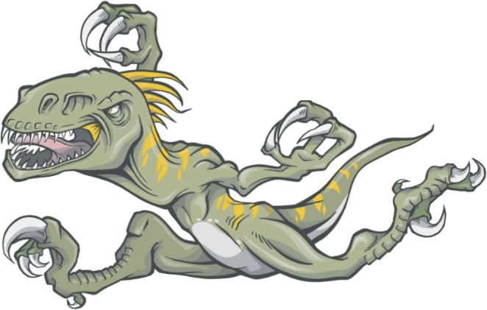
Results
Notes:
Now let’s see the results of our algorithm
On the left, is the source shape, on the right is the target shape.
In the middle we show the continuous interpolation from the source to the target. [PLAY]

Slide 22
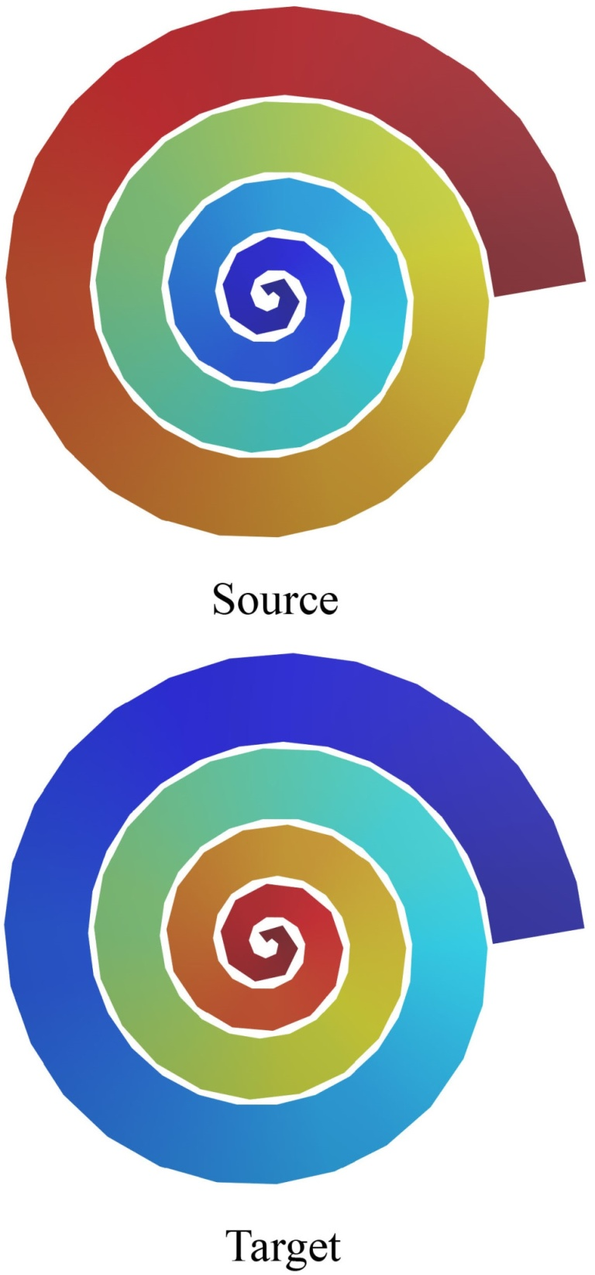
Results – comparisons
ARAP
[Alexa et. al. 2000]
FFMP
[Kircher and Garland 2008]
[Alexa et. al. 2000]
[Chao et. al. 2010
Liu et. al. 2008]
[Kircher and Garland 2008]
ARAP LG
[Chao et. al. 2010
Liu et. al. 2008]
BD Morph
Notes:
Here we compare the result of our algorithm with several state-of-the-art algorithms.
On the left, is the input. On the right is the results of other algorithm and our algorithm.
On the second row, we show the distortion of the most distorted triangles for each algorithm, from time 0 to 1.
In the graph, 0 means no distortion, 1 means the distortion of the target shape. We can see that [CLICK]
our result always has distortion between 0 and 1, while none of the other algorithm has this property, which means their distortion is not bounded locally.
As for the results themselves, the result of as-rigid-as-possible, denotes as ARAP, has some shrinking effect, while free-form motion processing, denotes as FFMP, shows some stretching effect. The result of As-rigid-as-possible local global, denotes as ARAP LG, looks ok for this particular frame, but let’s see them in animation, [CLICK]
Here bottom right is our result.
Now we can see that arap lg has some jiggling effect, this is because this method try's to do local optimization for each frame independently, the result of each frame gets trapped to its own minimum, therefore smoothness is not guaranteed

Slide 23
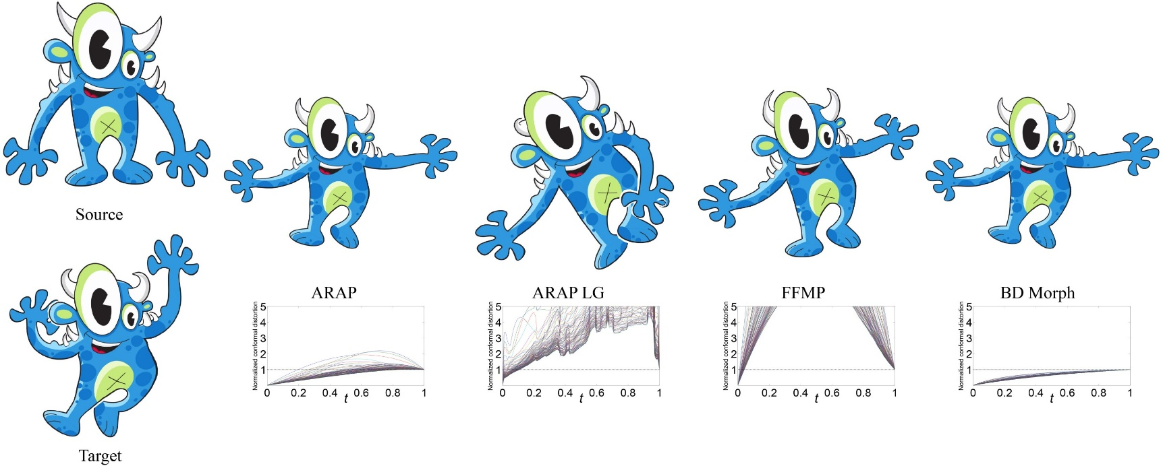
Results – comparisons
[Alexa et. al. 2000]
[Chao et. al. 2010
Liu et. al. 2008]
[Kircher and Garland 2008]
Notes:
Here’s another comparison.
Again, the distortion of our algorithm is between 0 and 1, [CLICK] thus bounded locally.

Slide 24
Results – multiple targets
Notes:
Here we show the result from fast-forwad
In the middle is the result of our algorithm applied to 6 input shapes. [PLAY]
The only difference here is now we interpolate the squared edge lengths, for more than 2 shapes.
And all the properties that we have for 2 input shapes carries over to this case.

Slide 25
Conclusions
Metric interpolation
Bounded distortion
Conformal flattening
No extra distortion
Simple, efficient, robust interpolation with high quality results
Notes:
To conclude,
For the shape interpolation problem,
we proposed to interpolate the metric, which guarantees the distortion is bounded point-wise
And we suggest to use conformal flattening to generate the final planar shape,
Because it will not introduce extra distortion
All in all, we present a simple, efficient and robust planar shape interpolation method, and we show many high quality results.

Slide 26
Thank you!
Notes:
That’s all. Thanks for your attention.
Someone might ask if our method works on non simply connected domains.

Slide 27
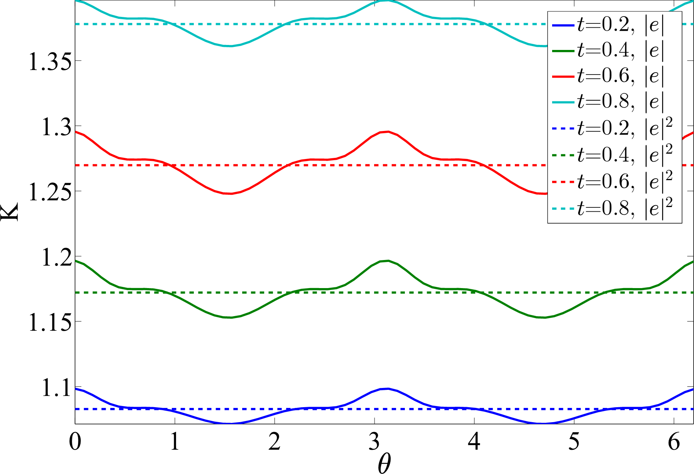
Why not interpolating edge length
$$\left\|e_{i}\right\|=\left(1−t\right)\left\|e_{i0}\right\|+t\left\|e_{i1}\right\|$$
$$Affine$$

Slide 28
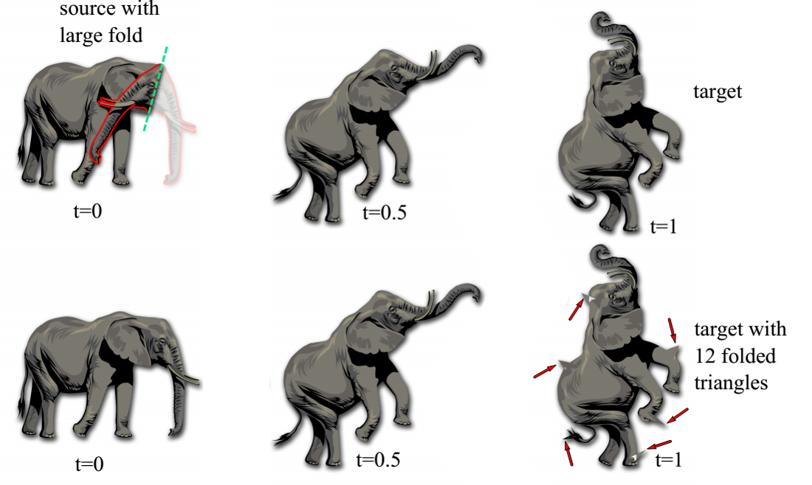
Results – robustness
Notes:
We require the input to the algorithm to be a bijective map.
This slide shows that if this condition is violated to begin with our method can still be applied and the results it produces are not very sensitive to small imperfections in the input map.
In such a case we will lose the source/target reproduction.

Slide 29
Results – comparisons
[Alexa et. al. 2000]
[Chao et. al. 2010
Liu et. al. 2008]
[Kircher and Garland 2008]

Slide 30
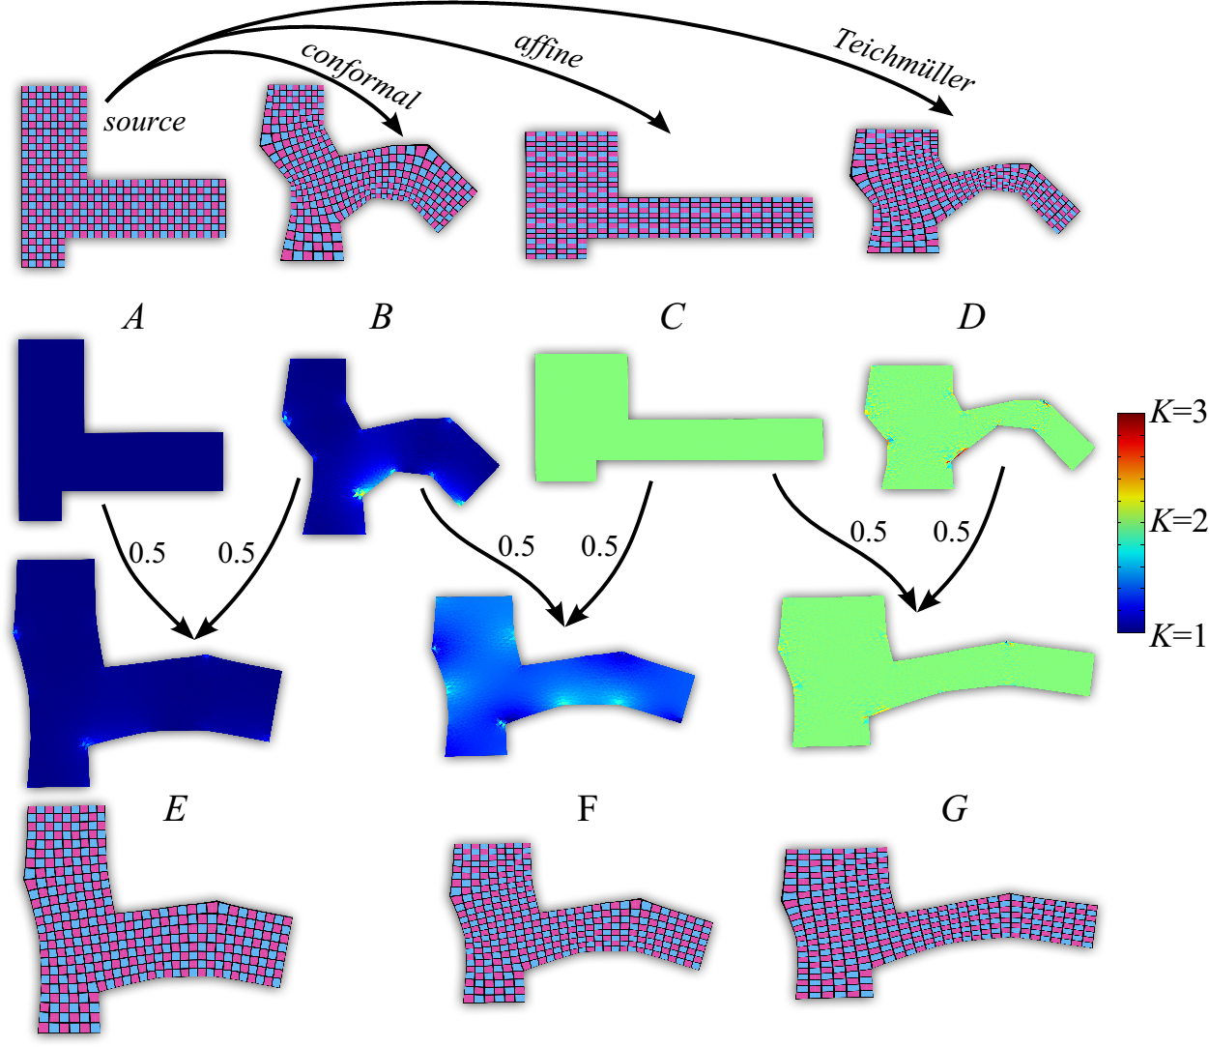
Results – conformal and Teichmüller maps

