Slide 1
CyToStruct
Augmenting the network visualization of Cytoscape with the power of molecular viewers

Slide 2
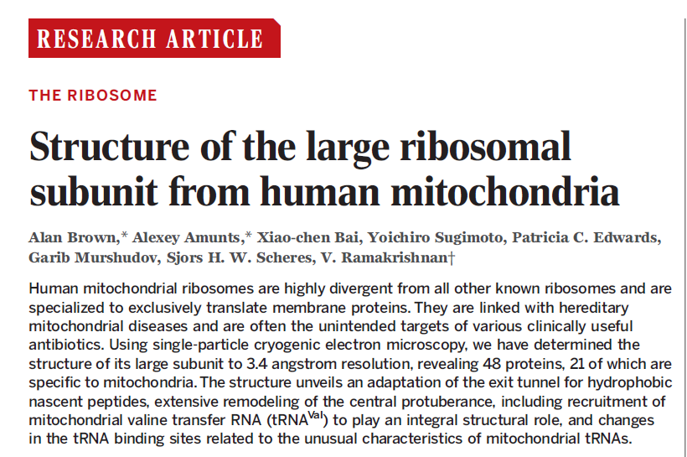
Network Demo

Slide 3
Network Demo

Slide 4
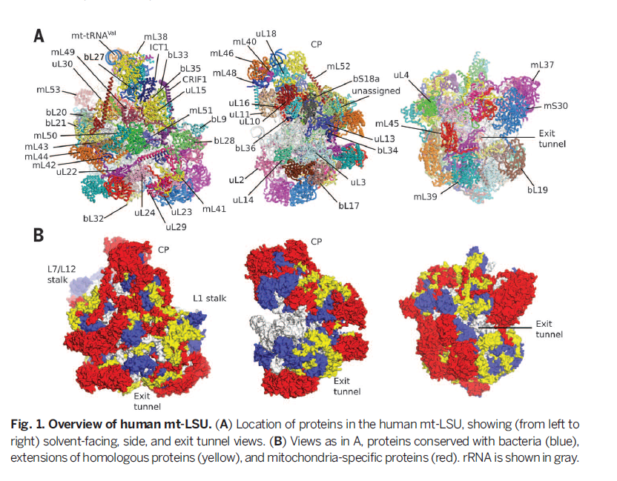
The complex for our demos

Slide 5
Demo – A Network for 3J7Y
Use http://trachel-srv.cs.haifa.ac.il/rachel/ppi/ to produce a network archive.
Unzip the downloaded zip file
Open Cytoscape
Use File->Open menu to load the 3j7y.cys file

Slide 6
3J7Y Network
Nodes:
proteins of the complex
Edges:
pairs that have an interface of more than 100A² (calculated using PISA)

Slide 7
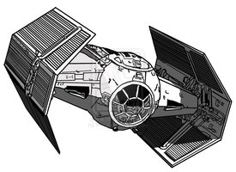
CyToStruct ties it together
PDBePISA (Proteins, Interfaces, Structures and Assemblies)

Slide 8
Agenda
Understand what CyToStruct does for this network
Modify the 3J7Y network:
Add more PyMOL viewing options
Modify viewing commands
Change to JMOL
Viewing other networks

Slide 9
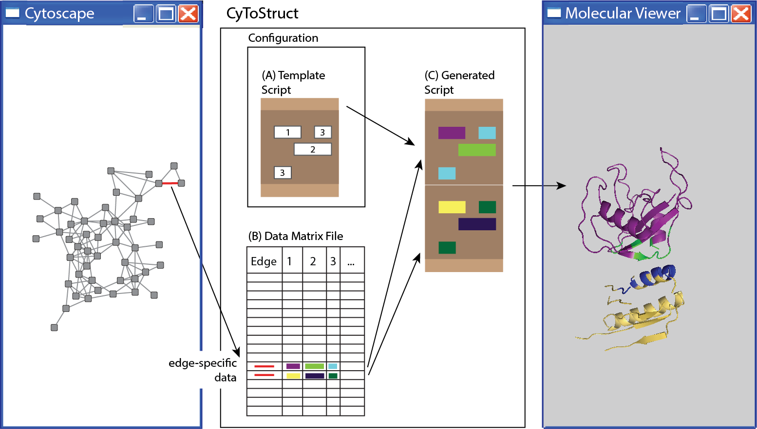
Overview

Slide 10
CyToStruct YAML configuration
---
appBinary: pymolwin
appCaption: "Open in PyMol"
appContext: edge
dataMatrixFile: network.txt
scriptLines: |
set ignore_case, 0
load protein.pdb
select %chain1%l, chain %chain1%
select ifres1, (%chain1%l and resi %H_START%%res1%,%H_END%none)
select %chain2%r, chain %chain2%
select ifres2, (%chain2%r and resi %H_START%%res2%,%H_END%none)
hide all
show cartoon, %chain1%l
color cyan, %chain1%l
show spheres, ifres1
color blue, ifres1
show cartoon, %chain2%r
color orange, %chain2%r
show spheres, ifres2
color red, ifres2
orient %chain1%l %chain2%r
select none
suffix: pml
type: script

Slide 11
Template
set ignore_case, 0
load protein.pdb
select %chain1%l, chain %chain1%
select ifres1, (%chain1%l and resi %H_START%%res1%,%H_END%none)
select %chain2%r, chain %chain2%
select ifres2, (%chain2%r and resi %H_START%%res2%,%H_END%none)
hide all
show cartoon, %chain1%l
color cyan, %chain1%l
show spheres, ifres1
color blue, ifres1
show cartoon, %chain2%r
color orange, %chain2%r
show spheres, ifres2
color red, ifres2
orient %chain1%l %chain2%r
deselect
res2 | res1 | chain2 | chain1
178,180,225,… | 56,58,59,… | k | T
Edge-Specific Script
set ignore_case, 0
load protein.pdb
select Tl, chain T
select ifres1, (Tl and resi 56,58,59,61,62,69,71,73,74,132,134,135,136,none)
select kr, chain k
select ifres2, (kr and resi 178,180,225,228,229,232,278,280,281,283,none)
hide all
show cartoon, Tl
color cyan, Tl
show spheres, ifres1
color blue, ifres1
show cartoon, kr
color orange, kr
show spheres, ifres2
color red, ifres2
orient Tl kr
deselect

Slide 12
Changing the configuration
---
appBinary: pymolwin
appCaption: "Open in PyMol"
appContext: edge
dataMatrixFile: network.txt
scriptLines: |
*** script lines showing interacting chains ***
suffix: pml
type: script
---
appBinary: pymolwin
appCaption: "Open in PyMol (Full structure)"
appContext: edge
dataMatrixFile: network.txt
scriptLines: |
*** script lines showing full structure too ***
suffix: pml
type: script

Slide 13
Add command
---
appBinary: pymolwin
appCaption: "Open in PyMol"
appContext: edge
dataMatrixFile: network.txt
scriptLines: |
*** script lines showing interacting chains ***
suffix: pml
type: script
---
appBinary: pymolwin
appCaption: "Open in PyMol (Full structure)"
appContext: edge
dataMatrixFile: network.txt
scriptLines: |
*** script lines showing full structure too ***
suffix: pml
type: script

Slide 14
Configuration beyond the Template
Configuration is in YAML*
A list of fields and their values (one or many)
If the parsing fails, there are online YAML validators: (e.g., http://www.yamllint.com/)
---
appBinary: pymolwin
appCaption: "Open in PyMol"
appContext: edge
dataMatrixFile: network.txt
scriptLines: |
** place script lines here **
suffix: pml
type: script
*YAML: YAML Ain’t Markup Language (http://www.yaml.org/)

Slide 15
Adding meaningful names
Template
set ignore_case, 0
load protein.pdb
select %chain1%l , chain %chain1%
select ifres1, (%chain1%l and resi %H_START%%res1%,%H_END%none)
select %chain2%r , chain %chain2%
select ifres2, (%chain2%r and resi %H_START%%res2%,%H_END%none)
hide all
show cartoon, %chain1%l
color cyan, %chain1%l
show spheres, ifres1
color blue, ifres1
show cartoon, %chain2%r
color orange, %chain2%r
show spheres, ifres2
color red, ifres2
orient %chain1%l %chain2%r
select none
%realname1%
%realname2%
%realname1%
%realname1%
%realname2%
%realname2%
%realname1%
%realname2%
In new file: network_with_names.txt
realname2 | realname1 | res2 | res1 | chain2 | chain1
mL45 | uL22 | 178,180,225,… | 56,58,59,… | d | T

Slide 16
Must use the correct data file!
---
appBinary: pymolwin
appCaption: "Open in PyMol"
appContext: edge
dataMatrixFile: network.txt
scriptLines: |
** place script lines here **
suffix: pml
type: script
network_with_names.txt

Slide 17
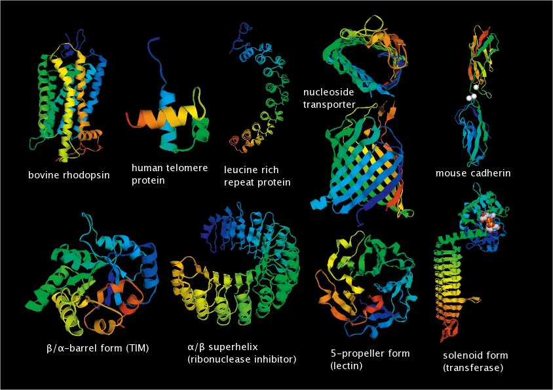
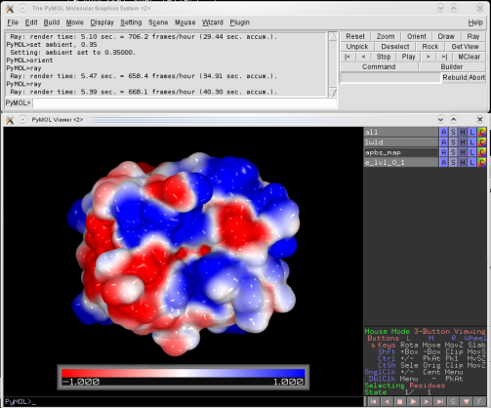
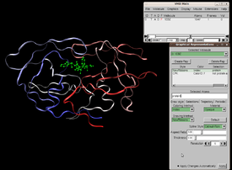
Switching a Molecular Viewer
Sophisticated software
Entire ecosystem
Support many calculations

Slide 18
Molecular Viewers
* Poled in http://rosettadesigngroup.com/ (~2000 answers)

Slide 19
Molecular Viewers
* Poled in http://rosettadesigngroup.com/ (~2000 answers)

Slide 20
CyToStruct ties it together
PDBePISA (Proteins, Interfaces, Structures and Assemblies)

Slide 21
Just Load the file in JMOL
---
appBinary: jmol -s
appCaption: "Open in JMol"
appContext: edge
dataMatrixFile: network_with_names.txt
scriptLines: |
load FILE protein.pdb
set chainCaseSensitive ON
background white
cartoon ONLY
** place more JMOL script lines here **
suffix: jml
type: script

Slide 22
Start from a working JMOL script
load FILE protein.pdb
background white
cartoon ONLY
define uL22 ( 56:T or 58:T or 59:T or 61:T or
62:T or 69:T or 71:T or 73:T or
74:T or 132:T or 134:T or
135:T or 136:T )
define mL45 ( 178:d or 180:d or 225:d or
228:d or 229:d or 232:d or
278:d or 280:d or 281:d or
283:d )
select *
color gray
select uL22
color cyan
select mL45
color magenta
%realname1%
%realname2%
%realname1%
%realname2%

Slide 23
Horizontal (In-Row) Replication
define uL22 ( 56:T or 58:T or 59:T or 61:T or
62:T or 69:T or 71:T or 73:T or
74:T or 132:T or 134:T or
135:T or 136:T )
define mL45 ( 178:d or 180:d or 225:d or
228:d or 229:d or 232:d or
278:d or 280:d or 281:d or
283:d )
or )
none)
or )
none)
realname2 | realname1 | res2 | res1 | chain2 | chain1
mL45 | uL22 | 178,180,225,… | 56,58,59,… | d | T
define uL22 ( %H_START% %res1%:%chain1% or %H_END%)
define mL45 ( %H_START% %res2%:%chain2% or %H_END%)
define uL22 ( %H_START% %res1%:%chain1% or %H_END% none)
define mL45 ( %H_START% %res2%:%chain2% or %H_END% none)

Slide 24
Horizontal (In-Row) Replication
define uL22 none
define uL22 uL22 or (56:T)
define uL22 uL22 or (58:T)
define uL22 uL22 or (59:T)
...
define mL45 none
define mL45 mL45 or (178:d)
define mL45 mL45 or (180:d)
...
realname2 | realname1 | res2 | res1 | chain2 | chain1
mL45 | uL22 | 178,180,225,… | 56,58,59,… | d | T
define uL22 ( %H_START% %res1%:%chain1% or %H_END%)
define mL45 ( %H_START% %res2%:%chain2% or %H_END%)
define %realname1% none
%H_START% define %realname1% %realname1% or (%res1%:%chain1%)
%H_END%
define %realname2% none
%H_START% define %realname2% %realname2% or (%res2%:%chain2%)
%H_END%

Slide 25
JMOL Template Script
set chainCaseSensitive ON
load FILE protein.pdb
background white
cartoon ONLY
define %realname1% none
define %realname2% none
define %realname1% (%H_START% %res1%:%chain1% or %H_END% none)
define %realname2% (%H_START% %res2%:%chain2% or %H_END% none)
select *
color gray
select %realname1%
color cyan
select %realname2%
color magenta

Slide 26
Chimera & VMD

Slide 27
Sharing & Publishing
The full configuration is stored in the *.cys file.
Additional data files can be zipped along
Local paths should work automatically

Slide 28
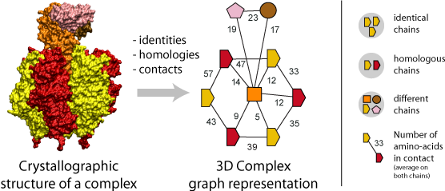
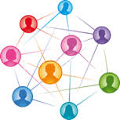
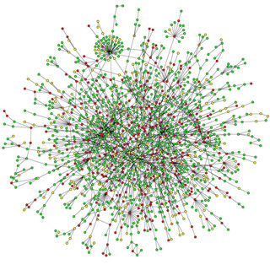
Networks = Nodes & Edges
Nodes: people
Edges: acquaintances
Nodes: proteins in a complex
Edges: common interfaces
Social network
3dcomplex.org
Relationships among
the CAs of 2VIK
protein-protein interactions in a yeast cell
Nodes: CA atoms
Edges: proximity in three-dimensional space
Nodes: yeast proteins
Edges: interactions in a yeast cell

Slide 29
Cytoscape¹ for network visualization
Network can represent anything!
People
Concepts
Diseases
Genes
….
Complexes
Proteins
Ligands
Small Molecules
Atoms
protein1 1 protein2
protein2 2 protein3
protein5 3 protein3
protein4 4 protein1
protein5 5 protein1
¹ www.cytoscape.org

Slide 30
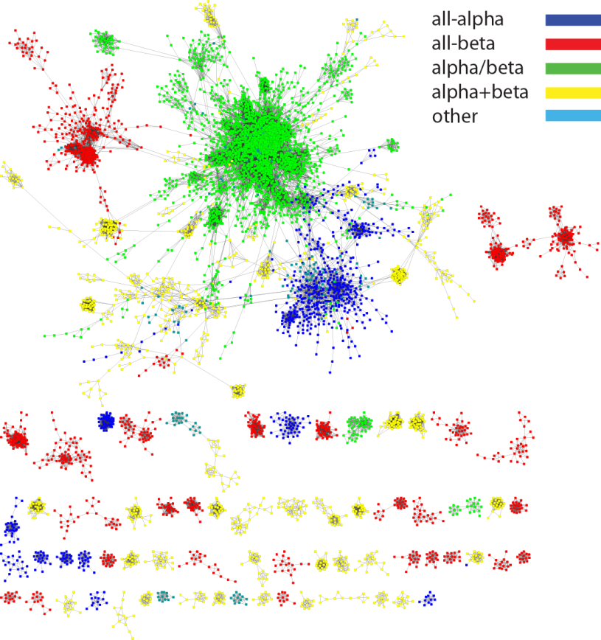
A Network view of Protein Space
Nodes:
protein domains
Edges:
shared segment s.t.
Length >75 residues
Sequence similarity > 25%
RMSD <2.5A
Nepomnyachiy, Ben-Tal, & Kolodny, PNAS (2014)

Slide 31
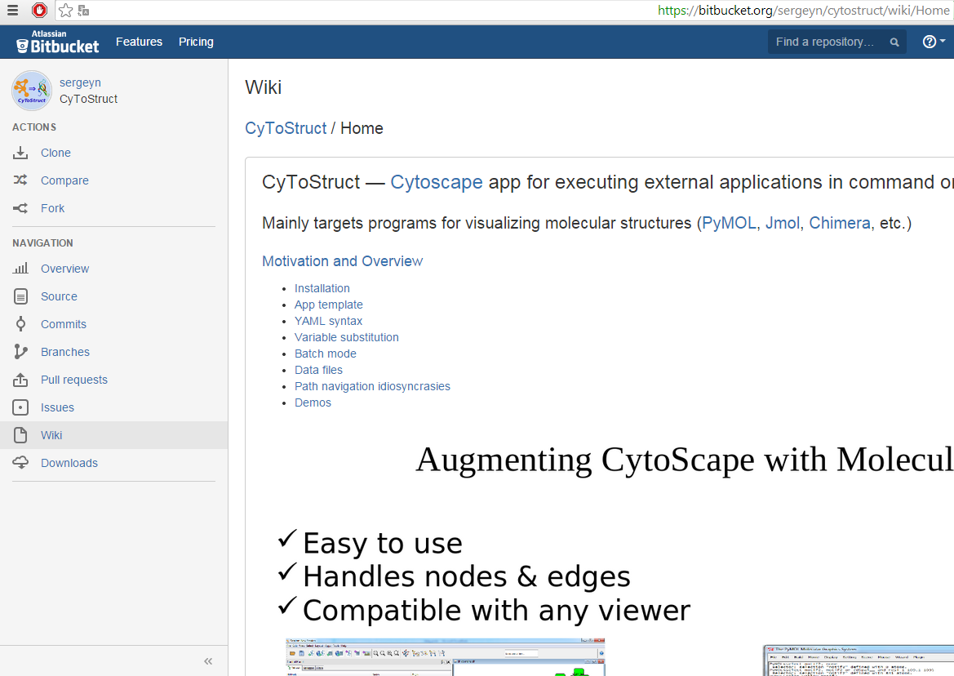
CyToStruct is Open Source

Slide 32
Linking Back
Using the scripts interface
To network tables

Slide 33
CyToStruct
Anything you can do with a molecular viewer
(a lot!) you can add to your Cytoscape network
With little effort
And share it

Slide 34
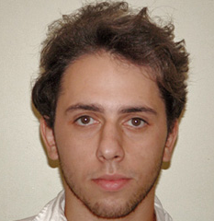
Thank You
Sergey Nepomnyachiy
nsergey82@gmail.com
Nir Ben-Tal
bental@tauex.tau.ac.il
Rachel Kolodny
trachel@cs.haifa.ac.il

